Slide 1

Pandit Deendayal Energy University
3rd Sem Project Evaluation
Prepared by :
Dev Jethva
(23MDS003)
Under the guidance of
Dr. Yogesh Kumar
Topic
Real time detection of AI generated speech for deep-Fake voice conversion

Slide 2
Table of Contents
Introduction
Literature review
Problem Statement
Objective
Dataset
Proposed Model Architecture
Conclusion & Future Direction
References

Slide 3
Introduction
With the rapid development of artificial intelligence (AI) and machine learning, voice conversion technologies have advanced significantly. DeepFake voice techniques now allow AI systems to mimic human speech with high accuracy, making it difficult to distinguish between real and AI-generated voices. While this technology has applications in entertainment, voice assistants, and language translation, it also poses serious risks, such as misuse for fraud, impersonation, or other malicious purposes. The ability to detect AI-generated voices in real time is becoming increasingly important to combat these threats and maintain trust in audio communications.

Slide 4
Literature Survey
References | Dataset | Method | Accuracy
Abdullah et al. [1] | 350 blood smear images | Classification with Proposed hybrid method | 99.5%
Bagido et al. [2] | CellaVision | MobileNetV2, VGG-16 | MobileNetV2: 79.79% VGG-16: 90.28%
Macawile et.al. [3] | ALL-IDB | Pre-trained model GoogleNet | 97.54%
Ma et al. [4] | DCGAN-generated with Matrix transformation | Pre-trained model ResNet + transfer learning | 91.68%
Almezhghwi et al. [5] | LISC | Pre-trained model VGG-16, VGG-19 | VGG-16: 90.6% VGG-19: 91.8%
Siddiques et al. [6] | BCCD | SqueezNet | 93.8%

Slide 5
Problem Statement
Current methods for detecting AI-generated or DeepFake voices are often inadequate, particularly in real-time applications. The increasing sophistication of voice conversion techniques makes it harder to distinguish between genuine and synthetic speech. This presents a significant risk to security, privacy, and the integrity of voice communications. An effective, real-time solution for detecting AI-generated speech is crucial to mitigate these risks and prevent the misuse of voice conversion technologies.

Slide 6
Objective
The main goal of this project is to develop a deep learning approach that can accurately classify different types of white blood cells in blood images.
By preparing and enhancing image data, and optimizing several deep learning models, this project aims to improve the accuracy and speed of classification, contributing to more efficient medical diagnosis.

Slide 7
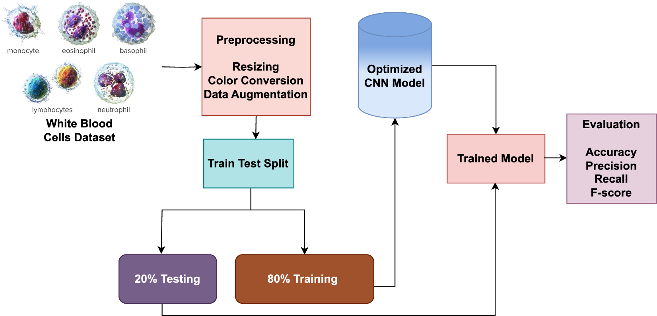
Proposed Model Architecture
Proposed Model Architecture:
credit: nature.com

Slide 8
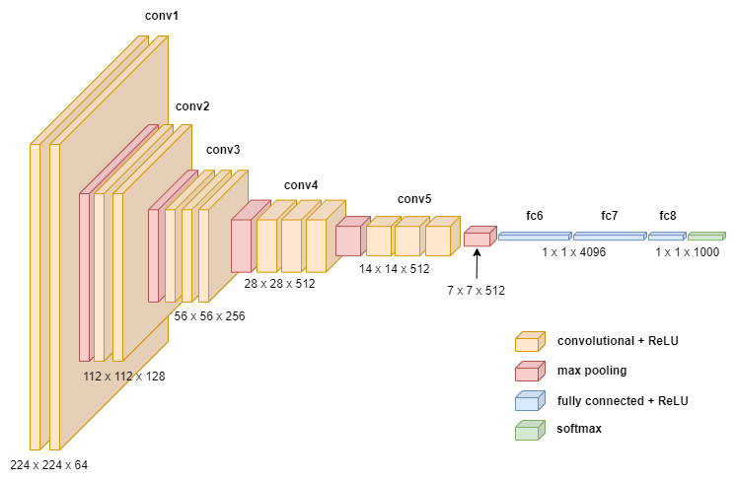
Model: Convolutional Neural Network Architecture:
credit: towardsdatascience

Slide 9
Results
Model Name | Train Accuracy | Training Loss | Validation Accuracy
DNN | 68.43% | 78.67% | 68.53%
CNN | 98.18% | 8.81% | 88.60%
VGG16 | 99.87% | 1.85% | 94.62%
VGG19 | 90.67% | 28.77% | 87.76%
ResNet50 | 37.77% | 188% | 39.37%

Slide 10
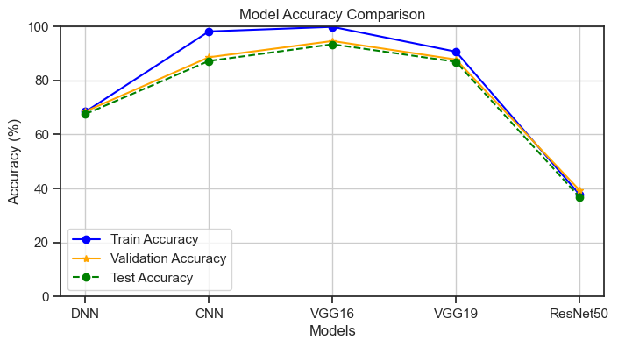
Result
Accuracy for different model generations on training, validation, and test data sets.

Slide 11
Results
Classification reports and the number of instances for each class of VGG16 model
Class Name | Precision | Recall | F1-Score | Support
Basophil | 0.91 | 0.95 | 0.93 | 237
Eosinophil | 0.95 | 0.98 | 0.97 | 596
Erythroblast | 0.91 | 0.96 | 0.94 | 294
Ig | 0.89 | 0.88 | 0.88 | 602
Lymphocyte | 0.96 | 0.88 | 0.92 | 241
Monocyte | 0.89 | 0.84 | 0.86 | 307
Neutrophil | 0.94 | 0.95 | 0.94 | 679
Platelet | 0.99 | 1.00 | 0.99 | 462
Accuracy |  |  | 0.93 | 3418
macro avg | 0.93 | 0.93 | 0.93 | 3418
weighted avg | 0.93 | 0.93 | 0.93 | 3418

Slide 12
Conclusion & Future Direction
This project showed that deep learning models, including deep neural networks (DNNs), convolutional neural networks (CNNs), and ResNet50, can accurately tell apart different types of white blood cells from images.
The high accuracy we achieved proves that using pre-trained models for medical image tasks works well and can help improve how we diagnose blood-related conditions.
In the future, additional models will be compared to determine the best one for classifying white blood cells. These findings will be submitted to a conference, contributing to advancements in medical image analysis and potentially improving clinical practices.

Slide 13
References
[1] Abdullah, E. & Turan, M. K. Classifying white blood cells using machine learning algorithms. Int. J. Eng. Res. Dev. 11, 141–152 (2019).
[2] Bagido RA, Alzahrani M, Arif M. White blood cell types classification using deep learning models. IJCSNS Int J Comp Sci Netw Secur. 2021;21:223 Available at: https://doi.org/10.22937/IJCSNS.2021. 21.9.30
[3] Macawile MJ, Quinones VV, Ballado A, Dela CJ, Caya MV. White blood cell classification and counting using convolutional neural network. 2018 3rd international conference on control and robotics engineering (ICCRE). IEEE; 2018. p. 259–263. Available at: https:// ieeexplore.ieee.org/document/8376476/
[4] Ma L, Shuai R, Ran X, Liu W, Ye C. Combining DC-GAN with ResNet for blood cell image classification. Med Biol Eng Comput. 2020;58: 1251–64. Available at: http://link.springer.com/10.1007/s11517- 020-02163-3
[5] Almezhghwi K, Serte S. Improved classification of white blood cells with the generative adversarial network and deep convolutional neural network. Comput Intell Neurosci. 2020;2020:1–12. Available at: https://www.hindawi.com/journals/cin/2020/6490479/

Slide 14
References
[6] Siddique MAI, Bin AAZ, Matin A. An improved deep learning based classification of human white blood cell images. 2020 11th international conference on electrical and computer engineering (ICECE). IEEE; 2020. p. 149–152. Available at: https://ieeexplore.ieee.org/ document/9393156/
[7] https://onlinelibrary.wiley.com/cms/asset/898be9f9-cc38-44ec-bd05-4131a252cef3/cytoa24839-fig-0002-m.jpg
[8] https://towardsdatascience.com/how-to-easily-draw-neural-network-architecture-diagrams-a6b6138ed875
[9] https://www.researchgate.net/figure/ResNet50-architecture-22_fig1_372274736

Slide 15
Thank you

