Slide 1

Pandit Deendayal Energy University
3rd Sem Project Evaluation
Prepared by :
Dev Jethva
(23MDS003)
Under the guidance of
Dr. Yogesh Kumar
Topic
Real time detection of AI generated speech for deep-Fake voice conversion

Slide 2
Table of Contents
Abstract
Introduction
Literature review
Problem Statement
Objective
Dataset
Block Diagram
Conclusion & Future Direction
References

Slide 3
Abstract
The rapid growth of AI and machine learning has enabled realistic DeepFake voice generation, posing risks like fraud and impersonation. Current detection methods, especially in real-time, are inadequate and this system that enhances real-time detection of AI-generated speech using advanced machine learning models. It improves the security of voice communications by distinguishing between real and synthetic voices. Future advancements, including better models and expanded detection of hybrid audio, can further strengthen defenses against the misuse of DeepFake voice technologies in industries like cybersecurity and telecommunications.

Slide 4
Introduction
With the rapid development of artificial intelligence (AI) and machine learning, voice conversion technologies have advanced significantly. Deep-fake voice techniques now allow AI systems to mimic human speech with high accuracy, making it difficult to distinguish between real and AI-generated voices. While this technology has applications in entertainment, voice assistants, and language translation, it also poses serious risks, such as misuse for fraud, impersonation, or other malicious purposes. The ability to detect AI-generated voices in real time is becoming increasingly important to combat these threats and maintain trust in audio communications.

Slide 5
Literature Survey
References | Dataset | Model | Accuracy
Suk-Young et al. [1] | LJSpeech | Convolutional Neural Network(CNNs) & Long-Short-Term Memory | 97 – 99%
Mcuba et al. [2] | Not Mentioned | VGG-16 CNN With Adadelta Optimizer | 85.91%
Conti et al. [3] | ASVSpoof 2019 | Speech Emotion Recognition (SER) With Transfer Learning | 78.66%
Jung et al. [4] | Their Deepfake | GAN (Generative Adversarial Network) | 87.5%
Lee et al. [5] | HFM dataset | GAN (Generative Adversarial Network) | 93.99%
Wijethunga et al. [6] | Fake or real dataset + AMI corpus dataset | CNN & RNN | 80%

Slide 6
Problem Statement
Current methods for detecting AI-generated or Deep-fake voices are often inadequate, particularly in real-time applications. The increasing sophistication of voice conversion techniques makes it harder to distinguish between genuine and synthetic speech. This presents a significant risk to security, privacy, and the integrity of voice communications. An effective, real-time solution for detecting AI-generated speech is crucial to mitigate these risks and prevent the misuse of voice conversion technologies.

Slide 7
Objective
The primary objective of "DEEP-VOICE" is to develop a real-time detection system for AI-generated speech, focusing on DeepFake voice conversion.
This system aims to improve accuracy and speed in differentiating between real and synthetic voices, enhancing the security and integrity of voice communications.
By leveraging advanced machine learning models, the project will address the growing risks posed by the misuse of AI-driven voice conversion technologies in areas like fraud and impersonation.

Slide 8
Dataset
The dataset is available in two forms:
Raw Audio Files: Found in the "AUDIO" folder, divided into "REAL" and "FAKE" directories.
Extracted Features: Found in the "DATASET-balanced.csv" file, containing features extracted from one-second audio windows. The dataset is balanced through random sampling.
The total dataset size is about 4 GB.

Slide 9
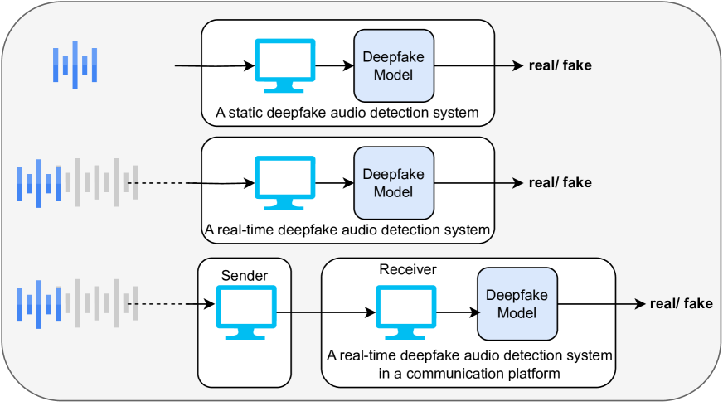
Block Diagram
Block diagram of deepfake audio detection systems:
credit: arxiv

Slide 10
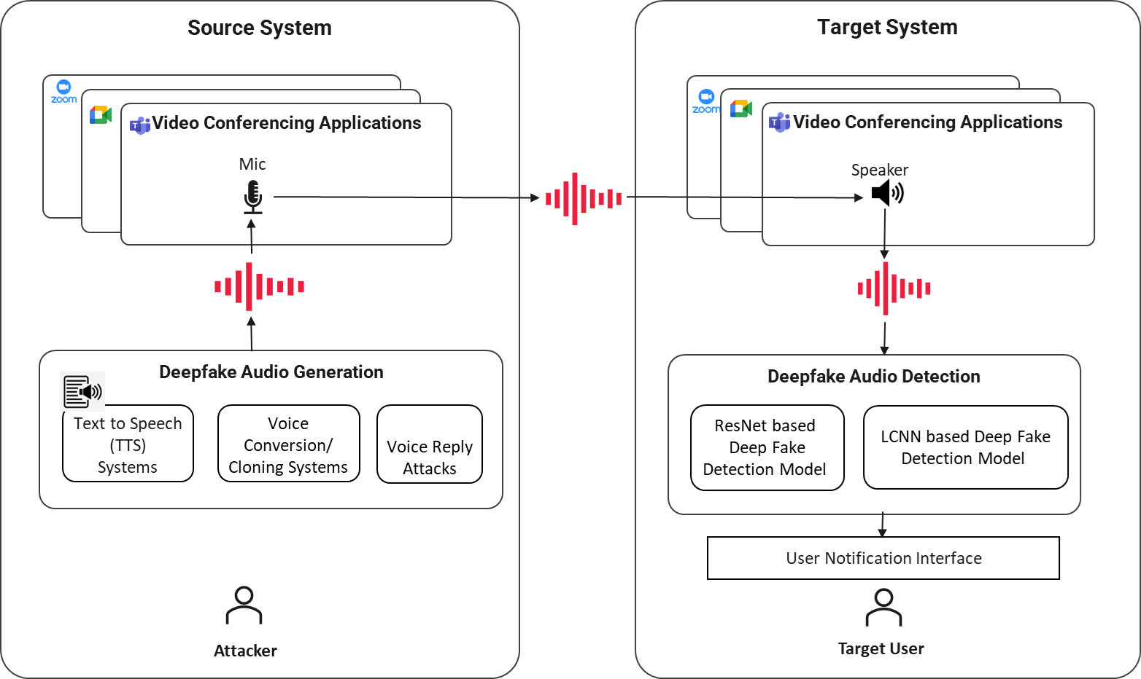
Use-case of deepfake audio detection system:
credit: arxiv

Slide 11
Conclusion & Future Direction
In conclusion, the "DEEP-VOICE" system demonstrates the potential of machine learning models to detect AI-generated speech effectively, especially in real-time scenarios.
This work contributes to safe guarding communication channels by improving the ability to identify synthetic voices and reducing the risks associated with DeepFake voice technology.
For future work, the system can be improved by using more advanced models trained on diverse real-world audio.
Expanding detection to include hybrid or partially manipulated voices will further strengthen its capabilities.

Slide 12
References
[1] S.-Y. Lim, D.-K. Chae, and S.-C. Lee, “Detecting deepfake voice using explainable deep learning techniques,” Applied Sciences, vol. 12, no. 8, p. 3926, 2022.
[2] M. Mcuba, A. Singh, R. A. Ikuesan, and H. Venter, “The effect of deep learning methods on deepfake audio detection for digital investigation,” Procedia Computer Science, vol. 219, pp. 211–219, 2023.
[3] E. Conti, D. Salvi, C. Borrelli, B. Hosler, P. Bestagini, F. Antonacci, A. Sarti, M. C. Stamm, and S. Tubaro, “Deepfake speech detection through emotion recognition: a semantic approach,” in ICASSP 2022-2022 IEEE International Conference on Acoustics, Speech and Signal Processing (ICASSP), pp. 8962–8966, IEEE, 2022.
[4] Jung, T., Kim, S., & Kim, K. (2020). Deep Vision: Deepfakes detection using human eye blinking pattern. IEEE Access, 8, 83144–83154.

Slide 13
References
[5] Lee, S., Tariq, S., Shin, Y., & Woo, S. S. (2021). Detecting handcrafted facial image manipulations and GAN-generated facial images using shallow-Fake FaceNet. Applied Soft Computing, 105, 107256.
[6] Wijethunga, R., Matheesha, D., Al Noman, A., De Silva, K., Tissera, M., & Rupasinghe, L. (2020). Deepfake audio detection: A deep learning based solution for group conversations. Paper presented at the 2020 2nd International Conference on Advancements in Computing (ICAC).

Slide 14
Thank you

