Slide 1
Customer Satisfaction Prediction
By Devkankshi Prasad
Unified Mentor – Data Science Internship

Slide 2
Problem Statement
To analyze customer feedback data and predict satisfaction levels using machine learning techniques to improve customer experience strategies.

Slide 3
Dataset Overview
The dataset includes customer attributes such as service type, wait time, issue resolution, and satisfaction ratings.
Target variable: Satisfaction (satisfied/unsatisfied)

Slide 4
EDA & Visualizations
Feature importance: Top 10 important features used to predict customer satisfaction
Heatmap : Confusion Matrix
Word Cloud : Ticket Descriptions
Count Plot : Customer Satisfaction ratings
Correlation Heatmap : Numerical features

Slide 5
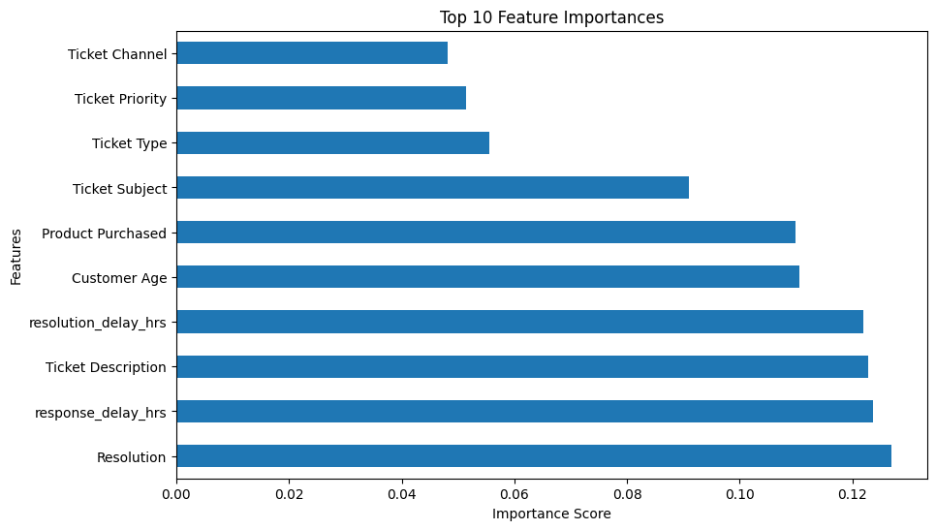
Feature importance
This bar chart visualizes the top 10 most influential features used by the model to predict customer satisfaction.

Slide 6
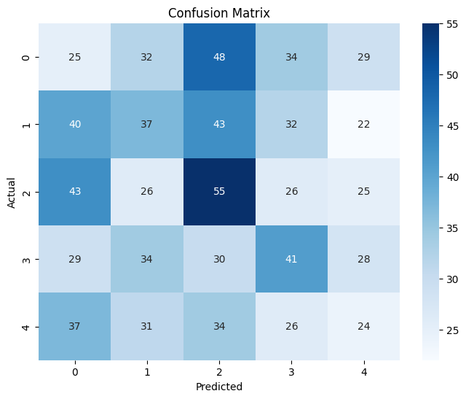
Confusion matrix - heatmap
The confusion matrix displays how often the model correctly predicted satisfaction levels versus how often it misclassified them across different classes.

Slide 7
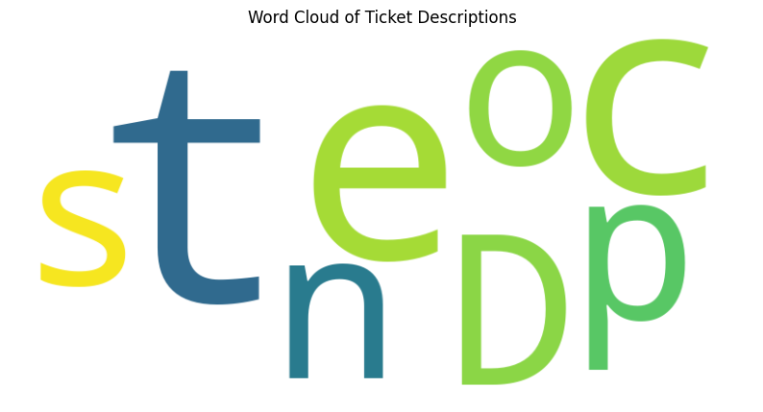
Word cloud for ticket descriptions
The word cloud highlights the most frequently occurring words in customer ticket descriptions, with larger words indicating higher frequency.

Slide 8
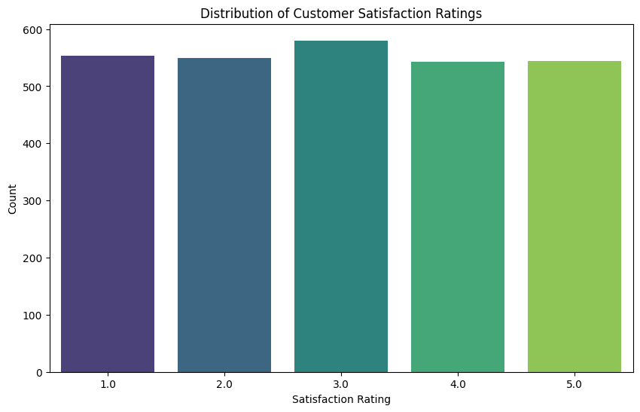
Count plot of customer satisfaction ratings
This count plot displays the frequency distribution of different customer satisfaction ratings in the dataset.

Slide 9
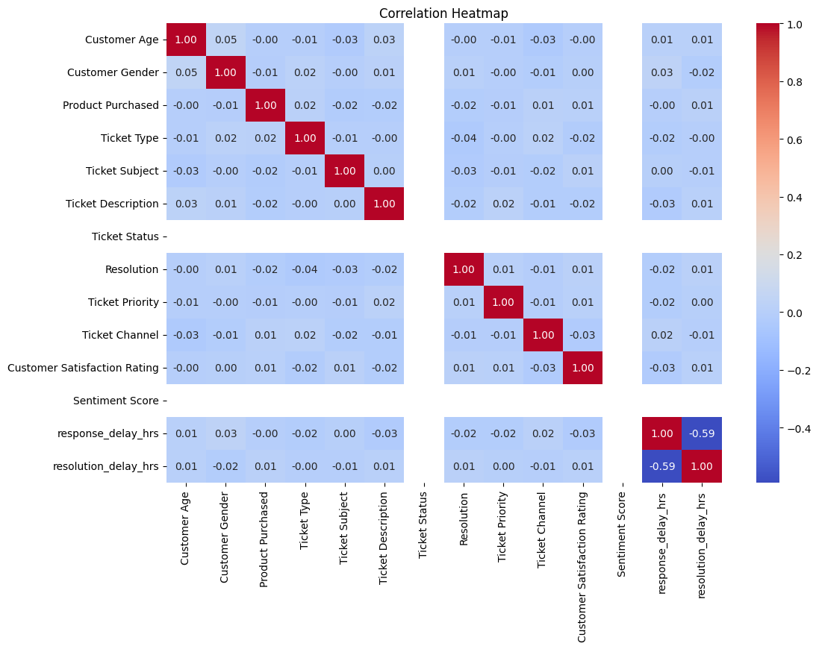
Correlation heatmap
This heatmap presents the pairwise correlation coefficients among numerical features in the dataset.

Slide 10
Feature Engineering & Preprocessing
• Handling missing values and encoding categorical variables
• Scaling numerical features
• Creating new features like service-to-wait ratio

Slide 11
Modeling & Evaluation
• Models: Logistic Regression, Random Forest, Gradient Boosting
• Evaluation: Accuracy, Precision, Recall, Confusion Matrix
• Best model: Gradient Boosting (highest F1 Score)

Slide 12
Insights & Business Value
• Long wait times strongly reduce satisfaction
• Fast issue resolution boosts satisfaction
• Targeted improvements in support centers can significantly enhance experience

Slide 13
Challenges Faced
• Class imbalance between satisfied and unsatisfied customers
• Identifying relevant features among many
• Overfitting on small customer segments

Slide 14
Conclusion & Learnings
Successfully developed a satisfaction prediction system using classification models.
Gained skills in EDA, modeling, and interpreting business impact from predictions.

Slide 15
Thank You
Looking forward to your feedback. Happy to present any part in more detail if needed.

