Slide 1
Suspicious Web Threat Interaction Analysis
By Devkankshi Prasad
Unified Mentor – Data Science Internship

Slide 2
Problem Statement
Identify and analyze suspicious web interactions to detect potential security threats using machine learning and deep learning models.

Slide 3
Dataset Overview
Web traffic logs including IP addresses, URLs, bytes transferred, protocols, and timestamps.
Target: Whether an interaction is classified as anomalous or not.

Slide 4
EDA & Visualizations
Hist plot : Bytes in/out distribution
Count plot : Number of protocols used
Scatterplot : Anomalies over time and by IP

Slide 5
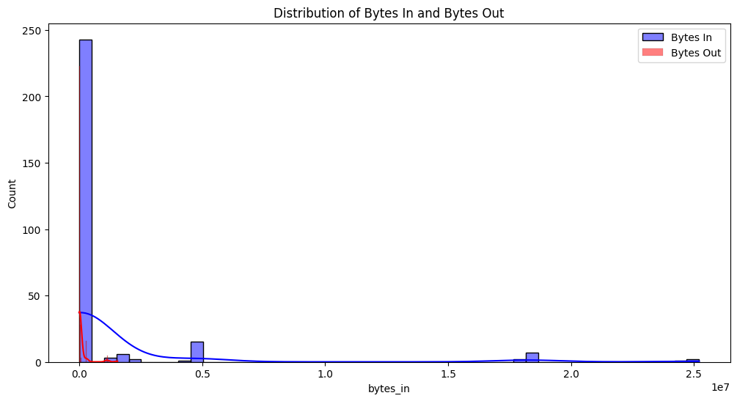
Histogram
This histogram visualizes the frequency distribution of incoming bytes in and outgoing bytes out network data across all requests.

Slide 6
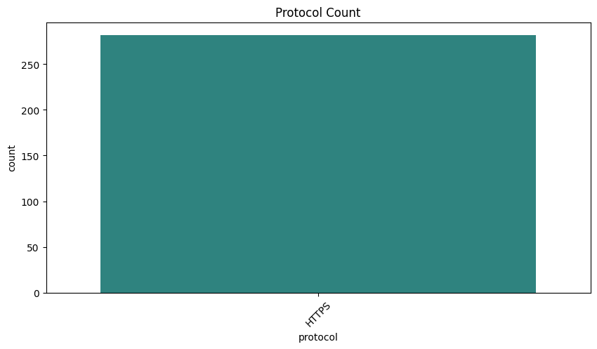
Count plot
This count plot illustrates how frequently each network protocol appears in the dataset.

Slide 7
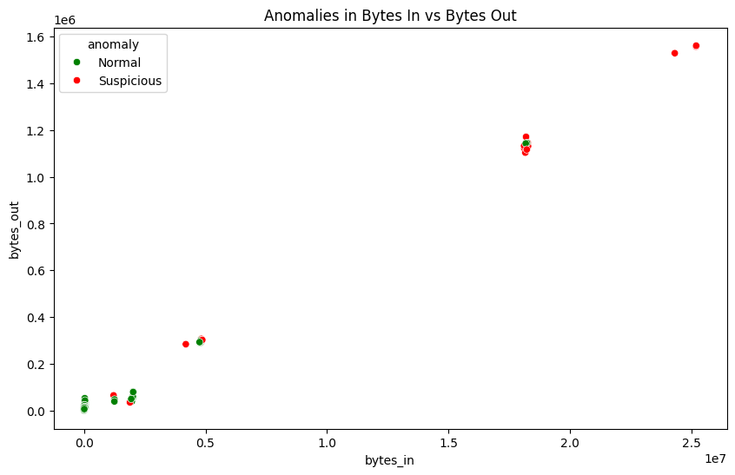
Scatter plot
This scatter plot highlights points classified as anomalous versus normal by the Isolation Forest model, plotted against selected features (e.g. bytes in vs bytes out)

Slide 8
Feature Engineering
Created temporal features from timestamps
Encoded categorical variables like protocols
Aggregated traffic behavior by user/IP

Slide 9
Modeling & Evaluation
Models: Isolation Forest, Autoencoders, MLP Classifier
Evaluation metrics: AUC, F1 Score, Precision
Best: Autoencoder with unsupervised anomaly detection

Slide 10
Insights & Value
Certain IPs show consistent high traffic spikes
Rare protocols often coincide with anomalies
Model helps preemptively block suspicious behavior

Slide 11
Challenges Faced
High class imbalance in anomaly detection
Noisy data and irrelevant interactions
Need for real-time inference capability

Slide 12
Conclusion & Learnings
Applied anomaly detection techniques on web logs.
Learned model evaluation under imbalanced data.
Gained exposure to cybersecurity data handling.

Slide 13
Thank You
Looking forward to your feedback. Happy to present any part in more detail if needed.

