Slide 1
Data Science Job Salaries Analysis
By Devkankshi Prasad
Unified Mentor – Data Science Internship

Slide 2
Problem Statement
Understanding salary trends in data science roles across regions, experience levels, and company types to guide career and hiring decisions.

Slide 3
Dataset Overview
The dataset contains job titles, experience levels, company size, location, and salary information for data science-related roles.
Key columns: job title, experience level, company size, employee residence, salary in USD.

Slide 4
EDA & Visualizations
Hist plot: Average salary by company size
• Heatmap: Correlation between numerical salary columns
• Pair plot: Number of jobs by title and experience level
• Boxplot: Salary distribution by experience level

Slide 5
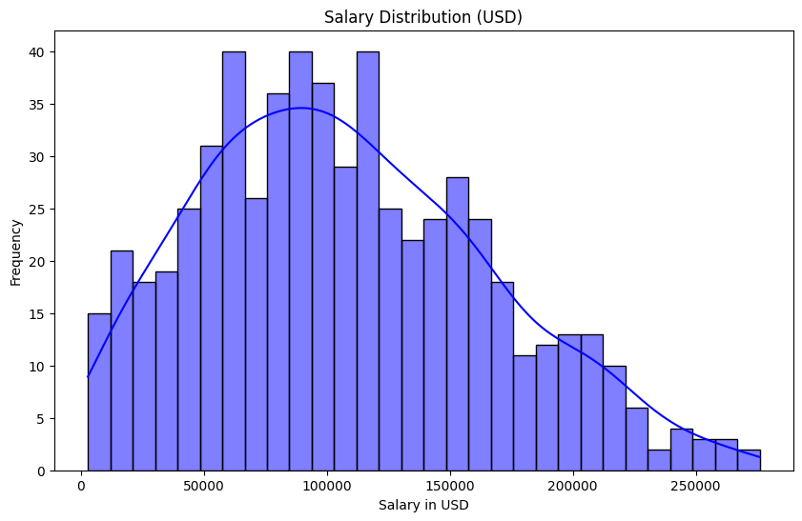
Hist Plot
This histogram represents the distribution of salaries (in USD) across all job roles in the dataset. Each bar indicates the frequency of salaries falling within a specific salary range.

Slide 6
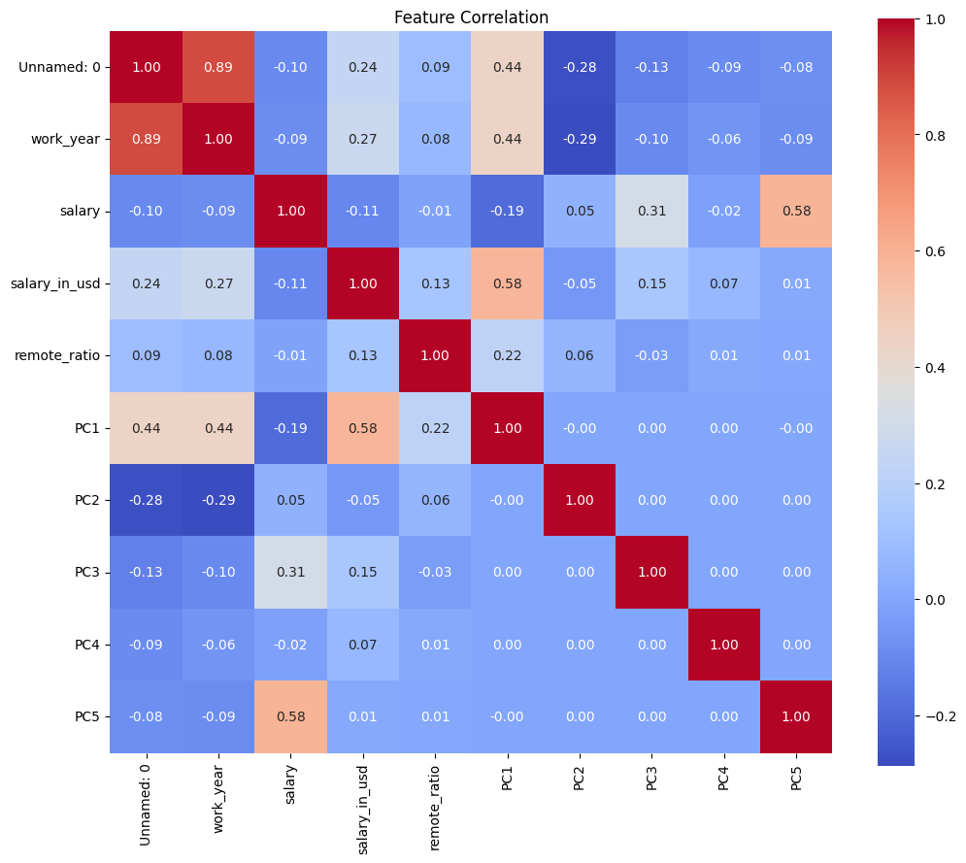
Heat Map
This heatmap shows the pairwise Pearson correlation coefficients between the numerical features in the dataset, including salary in USD, remote ratio , employee residence and other encoded fields.

Slide 7
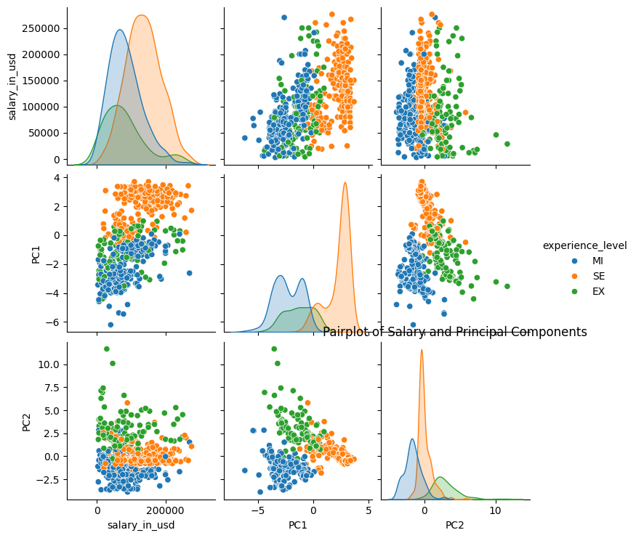
Pair Plot
This pair plot displays scatter plots and histogram for combinations of features – specifically focusing on salary in USD and experience level. Its useful for examining distribution patterns, relationships, and data clustering.

Slide 8
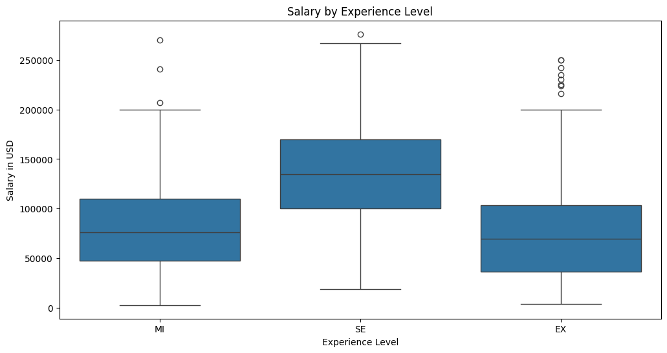
Box Plot
This boxplot compares the salary distribution across different experience levels: EN(entry), MI(Mid), SE(Senior), and EX(Executive).

Slide 9
Modeling Approach
• Target: salary in USD
• Features: job title, experience level, company size, location
• Models tried: Linear Regression, Random Forest Regressor
• Evaluation metrics: MAE, R-squared

Slide 10
Results & Insights
• Senior-level positions earn significantly higher salaries
• Larger companies generally offer higher compensation
• Location impacts salary due to cost-of-living and company HQ locations

Slide 11
Business Impact
• Helps companies benchmark competitive salaries
• Assists job seekers in targeting roles and locations with better pay
• Guides HR policies and resource allocation

Slide 12
Challenges Faced
• Handling missing or inconsistent salary entries
• Dealing with high cardinality in categorical features like job titles
• Adjusting for currency and salary normalization

Slide 13
Conclusion & Learnings
Learned how to perform comprehensive salary analysis using real-world datasets.
Practiced data preprocessing, EDA, modeling, and communication of insights.

Slide 14
Thank You
Looking forward to your feedback. Happy to present any part in more detail if needed.

