Slide 1
Electric Vehicle Sales Analysis & Prediction
By Devkankshi Prasad
Unified Mentor – Data Science Internship

Slide 2
Problem Statement
Rising adoption of EVs demands deeper market understanding.
Identify sales trends and key influencers for EV purchases.
Support business decisions with data-driven insights.

Slide 3
Dataset Overview
Sourced from EV registration and sales data across Indian states.
Key fields: State, Vehicle Category, Sales Quantity, Price, Year.
Dataset cleaned and preprocessed before analysis.

Slide 4
EDA Visualizations Summary
Line Plot: EV sales over time by state.
Correlation Heatmap: Shows relationships between numerical features.
HistPlot: Distribution of sales quantity.
Boxplot: Sales distribution by vehicle category.
Scatter Plot: Price vs EV sales quantity.

Slide 5
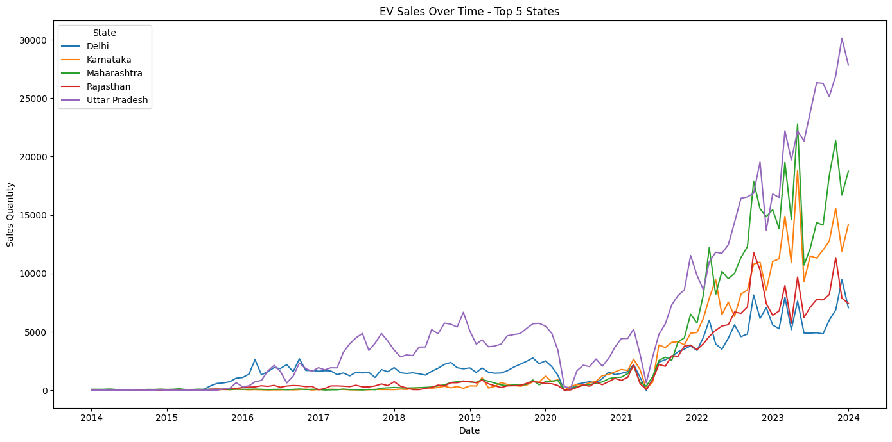
Line Plot
This line plot visualizes the trends in EV sales over time across different states. Each line represents a state’s sales pattern, showing growth, decline, or stability in adoption rates.

Slide 6
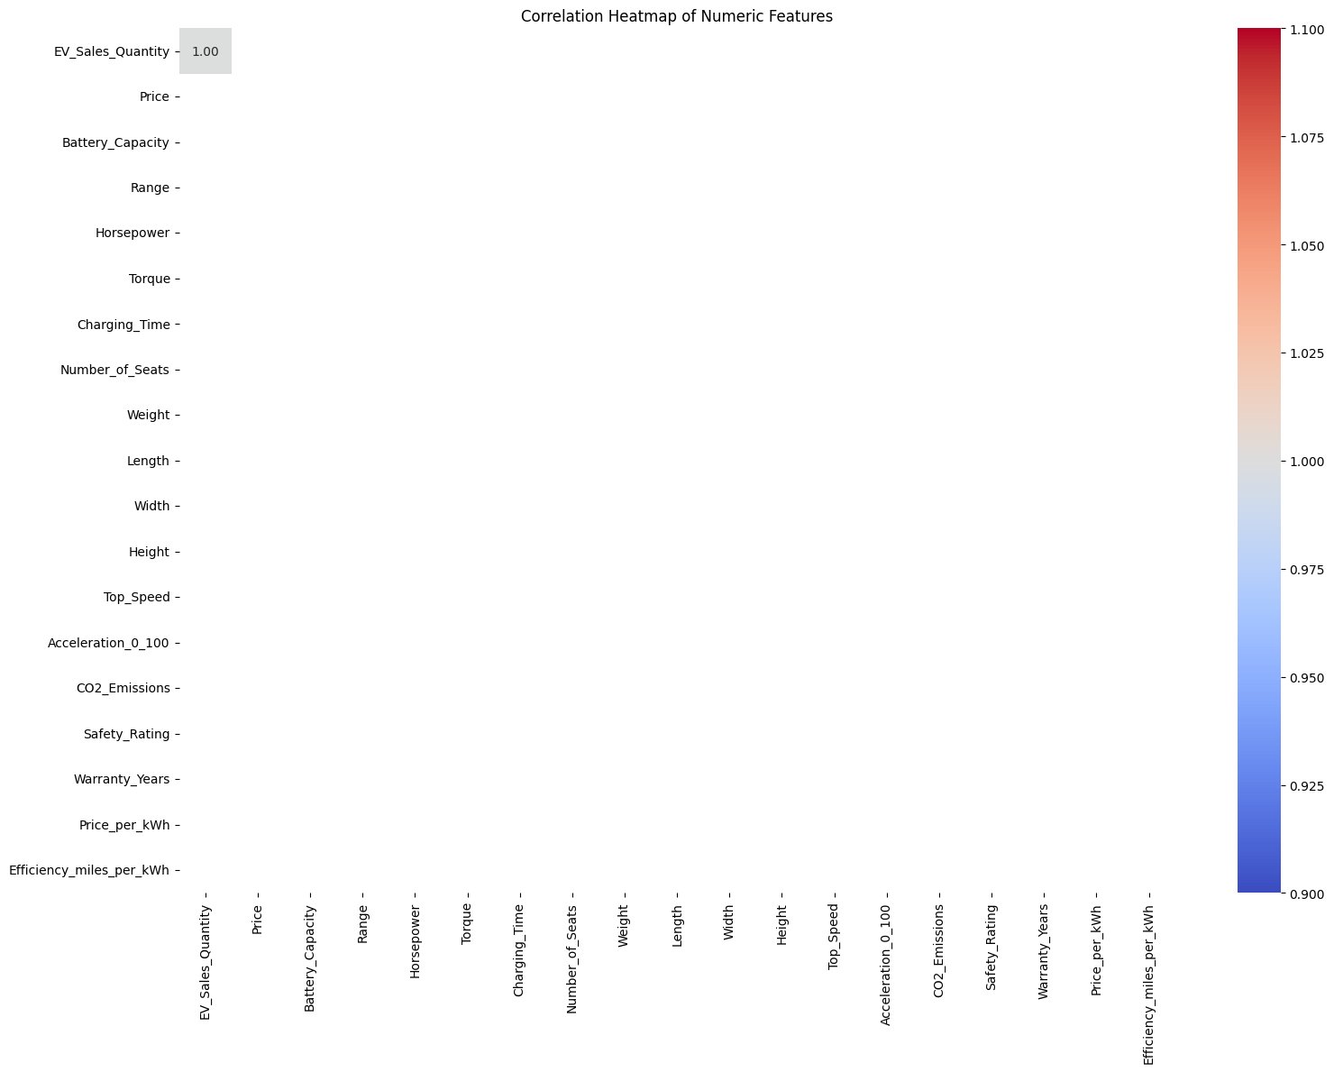
Correlation Heatmap
The heatmap displays the correlation coefficients between numerical features, showing how strongly each variable is related to the others.

Slide 7
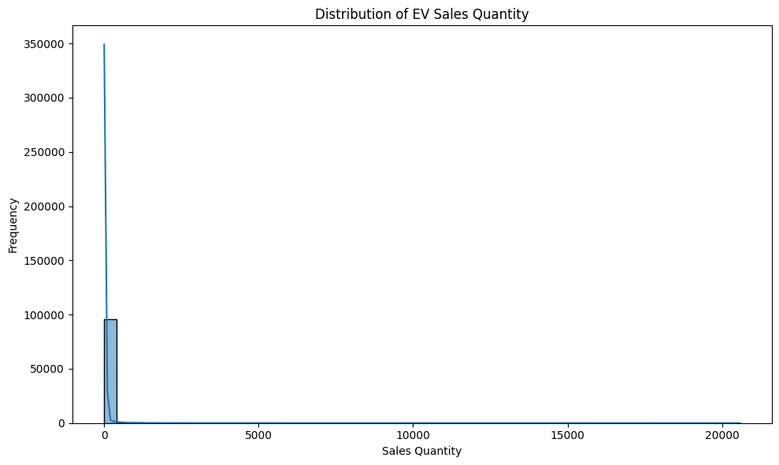
HistPlot
This histogram illustrates how often different sales quantity values occur. It highlights whether sales are uniformly distributed or skewed towards certain volumes.

Slide 8
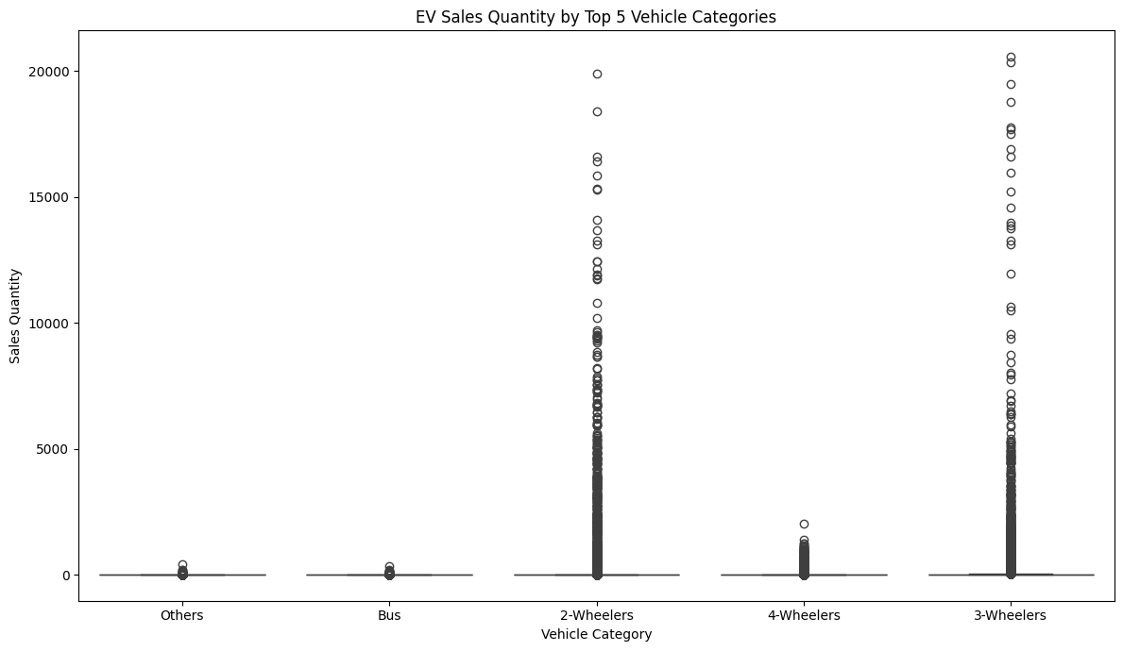
Boxplot
This boxplot compares the distribution of EV sales across different vehicle categories (e.g., SUV, Sedan, Hatchback). It displays median values, spreads, and outliers.

Slide 9
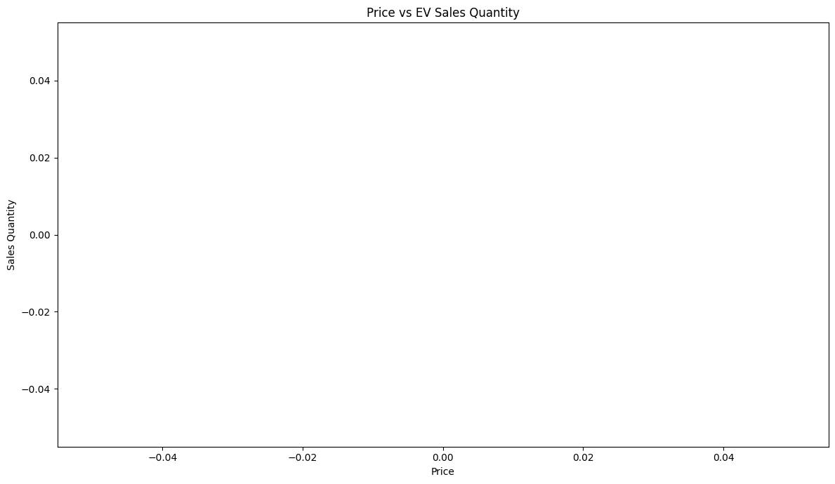
Scatter plot
This scatter plot visualizes the relationship between vehicle price and EV sales quantity. It shows whether lower or higher-priced vehicles sell more.

Slide 10
Machine Learning Model
Model used: Linear Regression.
Target variable: EV Sales Quantity.
Trained using price, vehicle category, and region as features.
Performance evaluated using R-squared and MAE.

Slide 11
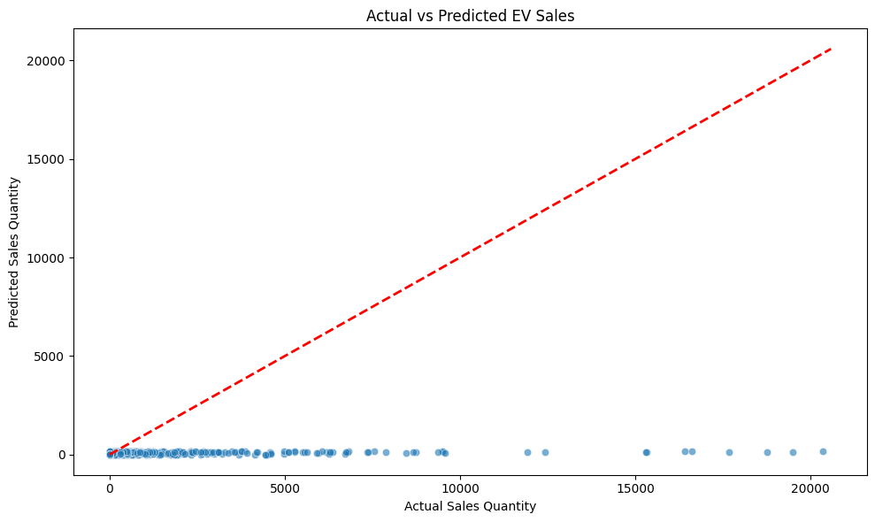
Actual vs Predicted Plot
Scatter plot comparing predicted and actual EV sales.
Most points align closely, indicating decent prediction accuracy.
Outliers highlighted for further investigation.

Slide 12
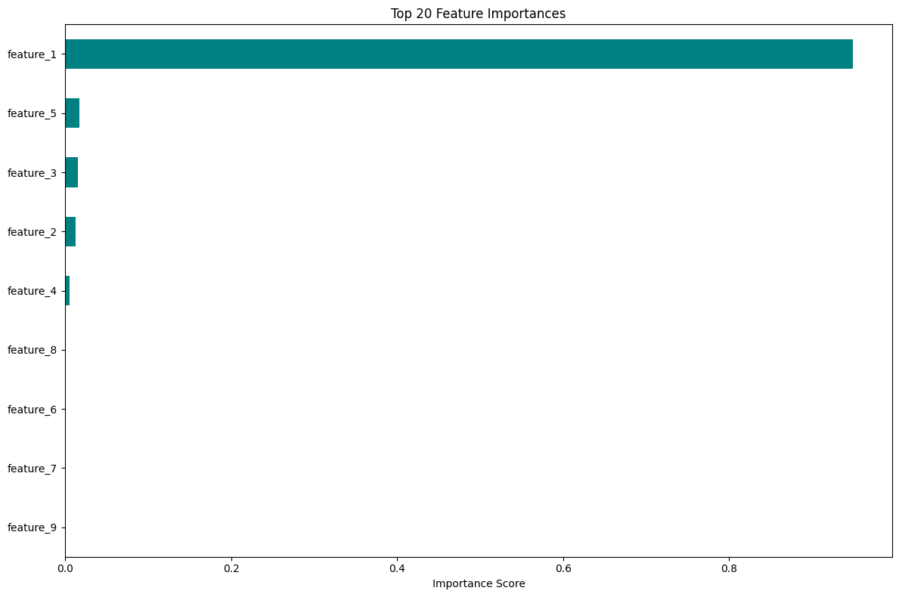
Feature Importance
Top 20 most influential features visualized using bar plot.
Price, State, and Category are key drivers of sales.
Helps prioritize business and marketing strategies.

Slide 13
Key Insights & Business Impact
States like Uttar Pradesh show the highest growth in EV adoption.
Two-wheeler and commercial categories dominate the market.
Lower-priced models have significantly higher sales volumes.

Slide 14
Challenges Faced
Missing or inconsistent values in raw dataset.
Balancing feature selection and model interpretability.
Handling categorical data and encoding.

Slide 15
Conclusion & Learnings
Learned complete EDA-to-modeling pipeline for real-world data.
Built visualizations that translate data to strategic insights.
Opportunity to extend into forecasting and classification models.

Slide 16
Thank You
Looking forward to your feedback.
Happy to present any part in more detail if needed.

