Slide 1


GYM STUDIO
SUBMITTED BY- Devkaran Singh

Slide 2
TABLE OF CONTENTS
S.NO
1
2
3
4
5
6
7
8
9
10
11
12
TOPIC
ABSTRACT
SOFTWARE REQUIREMENTS
HARDWARE REQUIREMENTS
ABOUT WORKING
GOALS OF PROIPOSED SYSTEM
GYM STUDIO CONTAINS
VARIOUS OPERATION
CHARACTERSTICS
ADVANTAGES
MODULES
SCREENSHOTS
CONCLUSIONS

Slide 3
ABSTRACT
We are developing an GYM STUDIO by taking advantage of the centralized database with a web interface. The main concept of this project is to build a website, which should be able to allow people to join gym online.
Time saving, working load reduced, information available at time and it provide security for the data. The Gym owners can use this website.

Slide 4
SOFTWARE REQUIREMENTS
Client on Internet: Web Browser, Operating System (any)
Web Server: Operating System (any), Apache 2
Database: MySQL
Scripting Language: HTML, PHPScript, JQuery

Slide 5
HARDWARE REQUIREMENTS
Processor : Intel Pentium IV or more
Ram : 512 MB or more
Cache : 1 MB
Hard Disk : 10 GB recommended

Slide 6
ABOUT THE PROJECT
This is a simple, safe and secure method that take minimum of time.
By developing website which will be solution to this problem. The Gym Owner will maintain this website.
Once the person register themselves in classes, with proper authentication the re-registration is prohibited.
This method of registration of classes online can provide security and safe for join classes in this lockdown so with lockdown a person can maintain him/herself in perfect shape or to be fit.

Slide 7
GYM STUDIO CONTAINS-
ABOUT OUR GYM
SERVICES WE PROVIDE
SCHEDULE FOR CLASSES
ZUMBA CLASSES
NEW INFLUENCERS INVITED FOR PROMOTIONS
CONNECT WITH US THROUGH ONLINE SYSTEM

Slide 8
User Characteristics
- Every User Should:
- Comfortable with Internet Browsers
- He/she should not have any serious disease.

Slide 9
ADVANTAGES
Time Saving
To store the record of the customers, the staff that has the privileges to access, modify and delete any record and finally the service, gym provides to its customers.
Information available at time.

Slide 10
MODULES
Home page
About page
Service page
Contact page

Slide 11

HOME PAGE

Slide 12
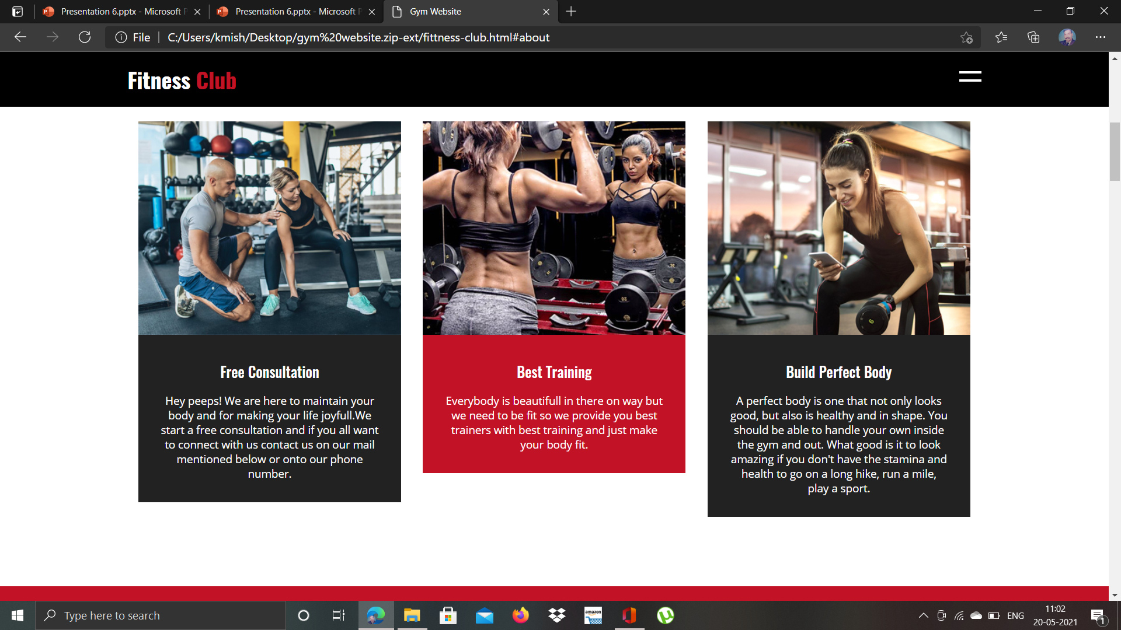
ABOUT PAGE

Slide 13
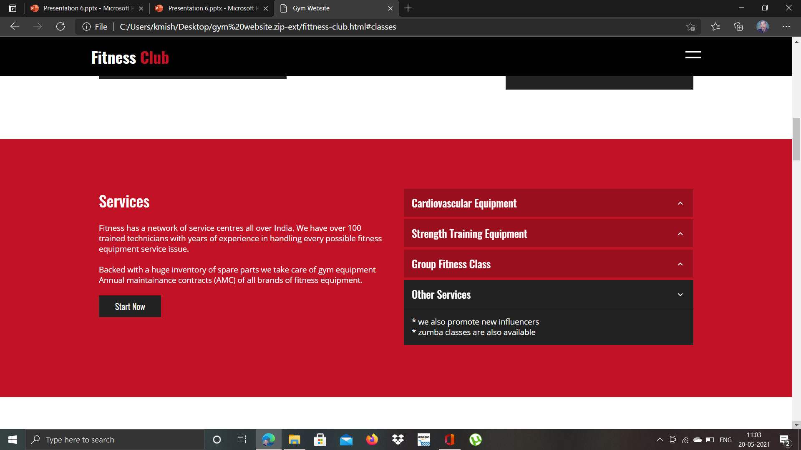
SERVICE PAGE

Slide 14
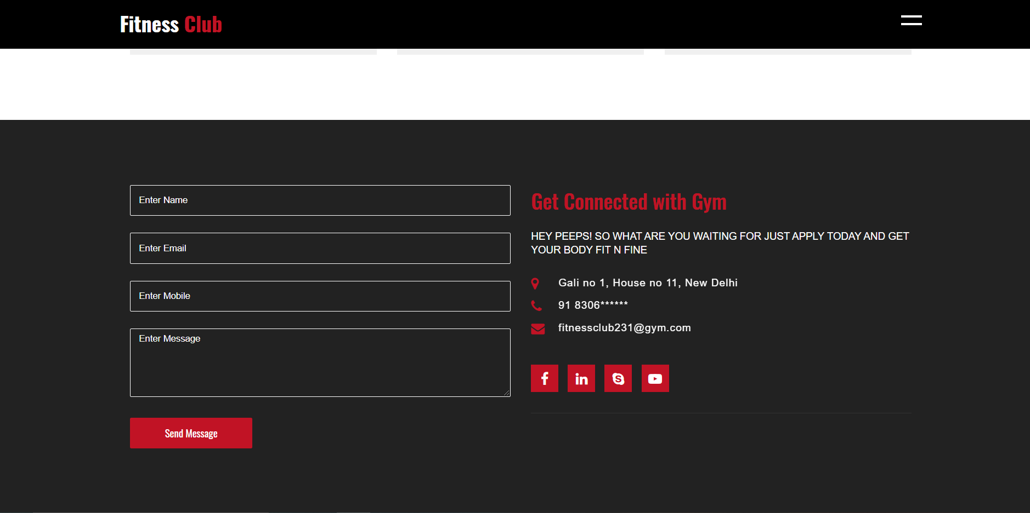
CONTACT PAGE

Slide 15
CONCLUSION
Generally people going to gym for registration with the help of this website they can register themselves online.
Therefore we make this website so during this lockdown time people can enjoy the facility of gym like Zumba classes and Online session with experts.

Slide 16
THANK YOU

