Slide 1
Welcome
To
Darjeeling

Slide 2
Top 5 places in Darjeeling
Tiger Hill
Peace Pagoda
Happy Valley Tea Estate
Kalimpong
Ghoom

Slide 3
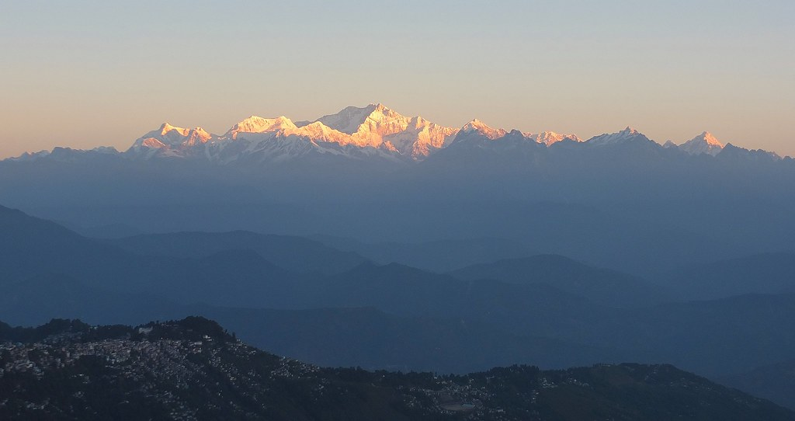
Tiger Hill
At sunrise, the peaks of Kanchenjunga are illuminated before the sun is seen at lower elevations. From Tiger Hill, Mount Everest (8848 m) is just visible. Kanchenjunga (8598 m) looks higher than Mt. Everest, as it is several miles closer than Everest. The distance in a straight line from Tiger Hill to Everest is 107 miles (172 km).^{[3][4]}
On a clear day, Kurseong is visible to the south and in the distance, along with Teesta River, Mahananda River, Balason River and Mechi River meandering down to the south.^{[5]} Chumal Rhi mountain of Tibet, 84 miles (135 km) away, is visible over the Chola range.^{[6]}
A sunrise at Tiger Hill is an impressive experience.
This Photo by Unknown Author is licensed under CC BY-SA-NC

Slide 4
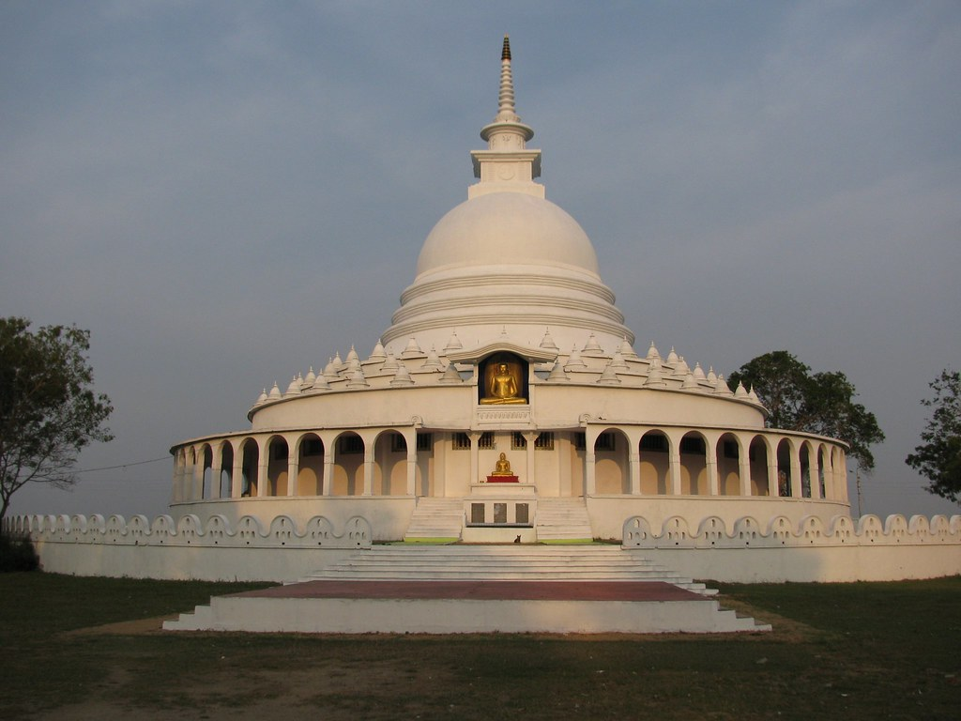
Peace Pagoda
A Peace Pagoda is a Buddhist stupa; a monument to inspire peace, designed to provide a focus for people of all races and creeds, and to help unite them in their search for world peace. Most (though not all) peace pagodas built since World War II have been built under the guidance of Nichidatsu Fujii (1885–1985), a Buddhist monk from Japan and founder of the Nipponzan-Myōhōji Buddhist Order. Fujii was greatly inspired by his meeting with Mahatma Gandhi in 1931 and decided to devote his life to promoting non-violence. In 1947, he began constructing Peace Pagodas as shrines to world peace.^{[1]} The first was inaugurated at Kumamoto in 1954.
This Photo by Unknown Author is licensed under CC BY-SA-NC

Slide 5
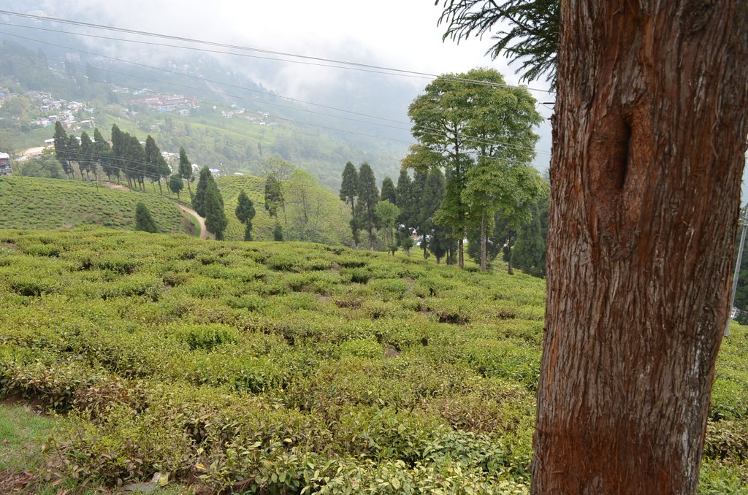
Happy Valley Tea Estate
The tea estate is spread over 177 hectares (440 acres), at a height of 2,100 metres (6,900 ft). The bushes in the garden are very old — the minimum age is 80 years, and some are 150 years old. Very little re-plantation has been done in the recent past. Situated around 3 km north of town, below Hill Cart Road, accessible via Lochnager Road from Chowk Bazaar, this tea estate is the closest tea estate to Darjeeling town, and tourists often visit the garden. The months of March to May are the busiest time here. when plucking and processing are in progress. It is open Tuesday to Saturday from 8 a.m. to 4:30 p.m.^{[6][7]}
This Photo by Unknown Author is licensed under CC BY

Slide 6
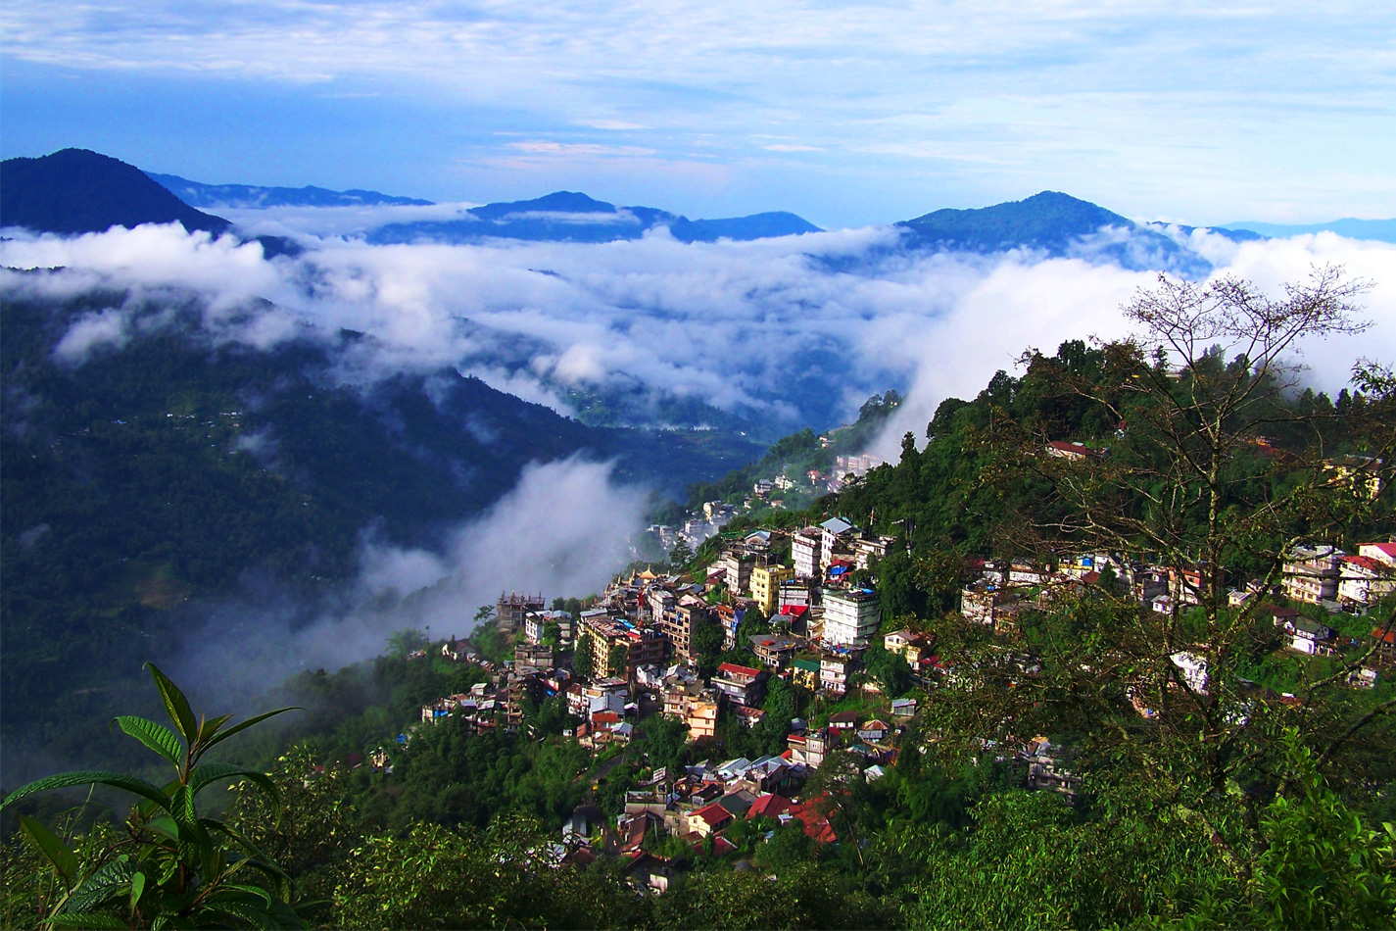
Kalimpong
Kalimpong is a town and a municipality in the Indian state of West Bengal. It is located at an average elevation of 1,250 metres (4,101 ft).^{[4]} The town is the headquarters of the Kalimpong district.^{[5]} The region comes under Gorkhaland Territorial Administration which is an autonomous governing body within the state of West Bengal. The Indian Army's 27 Mountain Division is located on the outskirts of the city.^{[6]}
This Photo by Unknown Author is licensed under CC BY-NC

Slide 7
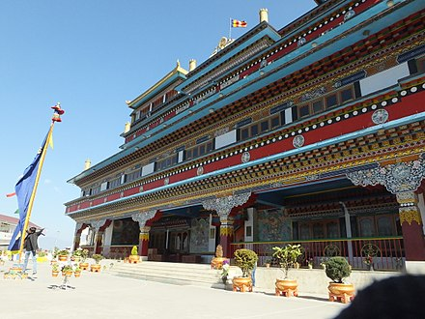
Ghoom
Ghum (also spelt Ghoom) is a small hilly neighbourhood in the Darjeeling Himalayan hill region of West Bengal, India. It comes under ward number one of the Darjeeling Municipality. Ghum railway station of the Darjeeling Himalayan Railway is the highest railway station in India. It is situated at an altitude of 2,258 metres (7,407 ft).^{[1]} The place is the home of the Ghum Monastery and the Batasia Loop, a bend of the Darjeeling Himalayan Railway.
This Photo by Unknown Author is licensed under CC BY-SA

Slide 8
Thank You

