Slide 1
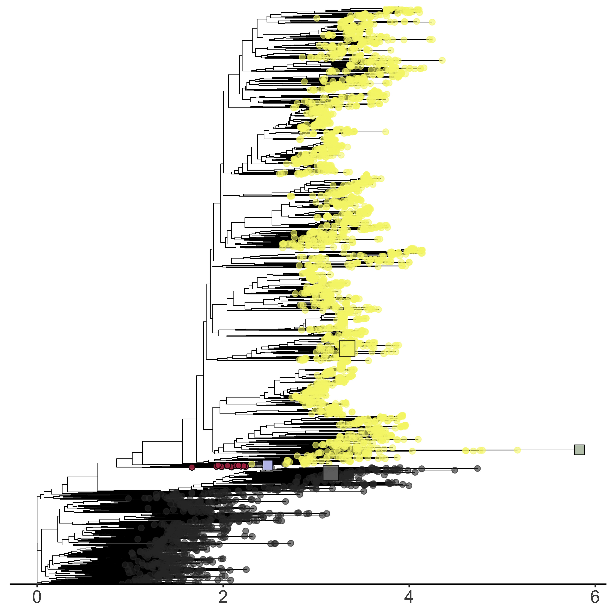
Bridge Sequences
HTH₄ + ins
Winged Helix
wH + wings_{gapped}
KdpE_{PDB}
Helix-Turn -Helix
FixJ_{PDB}

