Slide 1
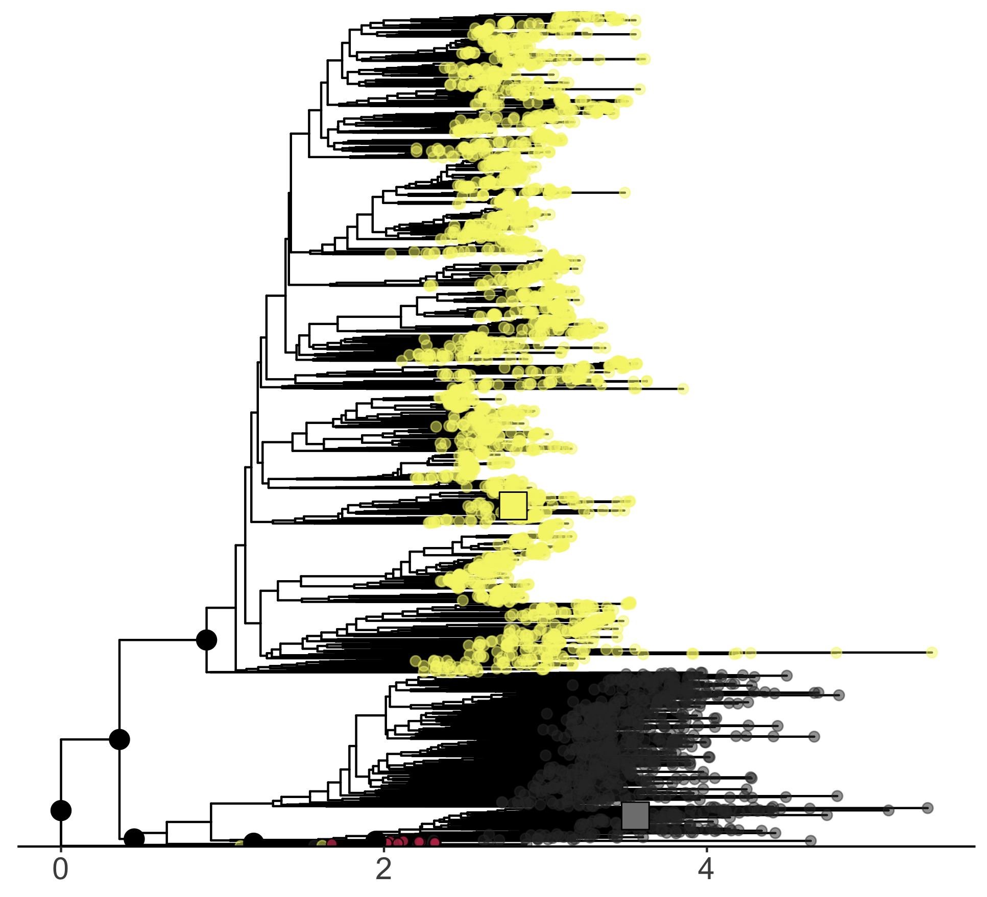
FixJ_{PDB}
KdpE_{PDB}
Bridge Sequences
Winged Helix
Anc.3
Anc.1
Helix-Turn -Helix
Anc.0
Anc.5
Anc.2
Anc.4
Distance

