Slide 1
INVESTMENT ASSIGNMENT SUBMISSION
Name: Devmallya Karar

Slide 2
Abstract
Spark Funds wants to make investments in a few companies. The CEO of Spark Funds wants to understand the global trends in investments so that she can take the investment decisions effectively. Where it wants to invest between 5 to 15 million USD per round of investment to invest only in English-speaking countries because of the ease of communication with the companies. Spark Funds wants to invest where most other investors are investing. This pattern is often observed among early stage startup investors.
The objective is to identify the best sectors, countries, and a suitable investment type for making investments. The overall strategy is to invest where others are investing, implying that the 'best' sectors and countries are the ones 'where most investors are investing'.

Slide 3
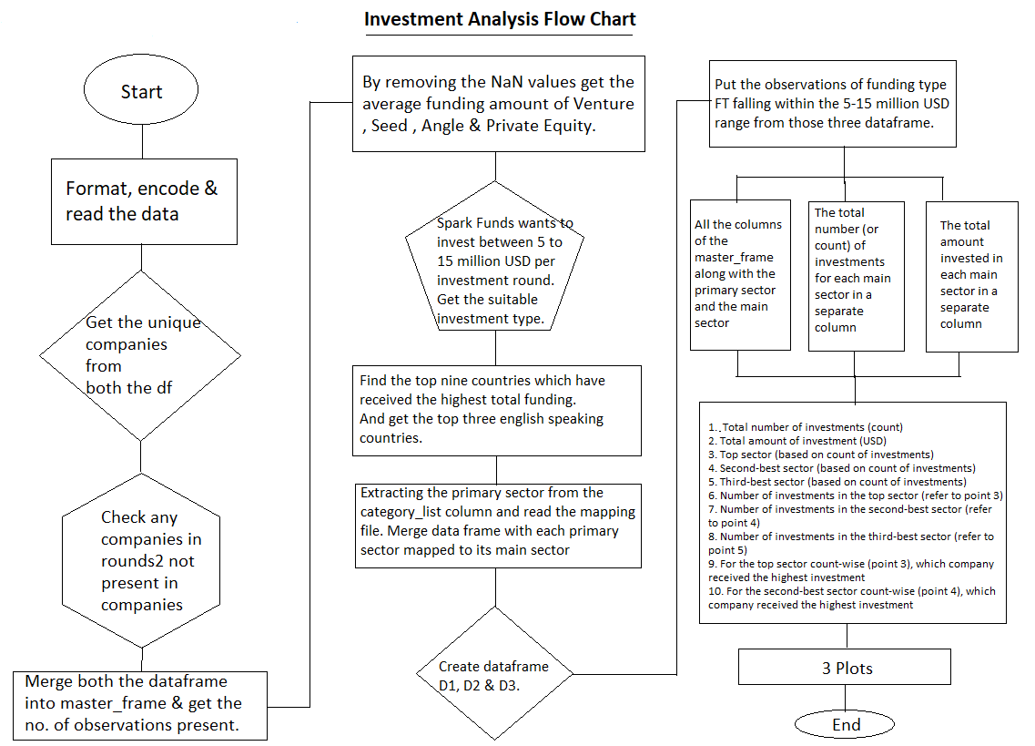
Flow Chart :

Slide 4
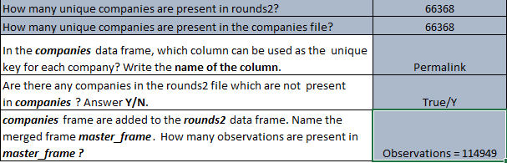
Understand the Data Set

Slide 5
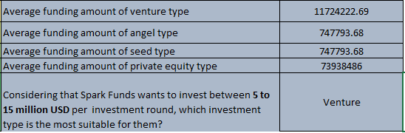

Funding Type Analysis & Country Analysis

Slide 6
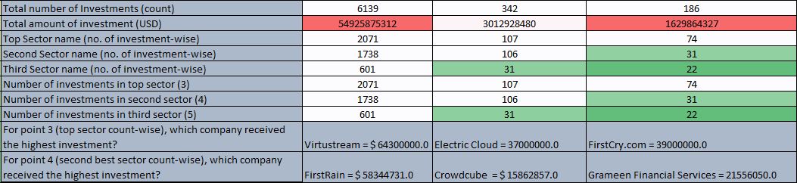
Sector-wise Investment Analysis

Slide 7
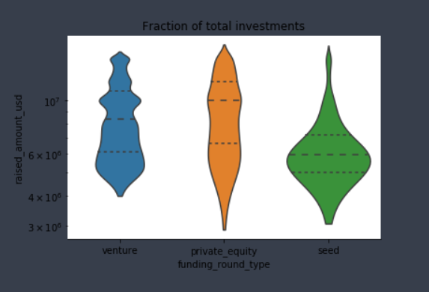
Results

Slide 8
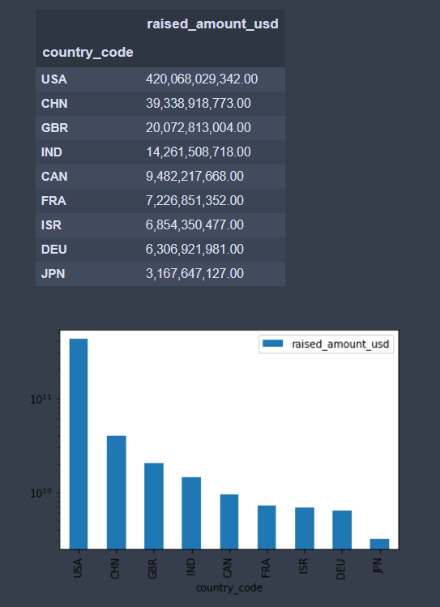
Results

Slide 9
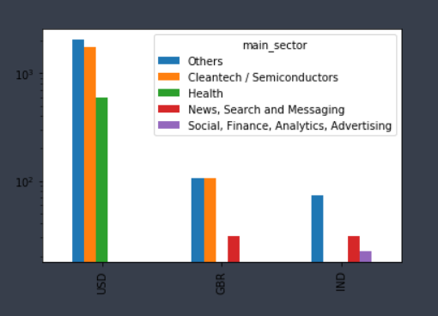
Results

Slide 10
Conclusions
The spark funds can invest on top three English speaking countries. Those top English speaking countries are USA, Great Britain and India. They can invest in three different top sectors in this three different countries. Where in venture investors are investing more than the private equity, angle & seeds. USA is the top most countries against the total amount of investments of funding type.
After multiple rounds of analysis we got that it is better to invest in English speaking countries where people easily can approach on the products where most people can invest.

