Slide 1
AZURE FUNCTIONS VERSION 3
Dev Gandhi
Nischal Khadka
Sri Vibhu Paruchuri

Slide 2
INTRODUCTION
What are Azure Functions?
Serverless FaaS computing platform
Event driven - an event driven architecture where the function is driven by the trigger
Pay as you go scalable model

Slide 3
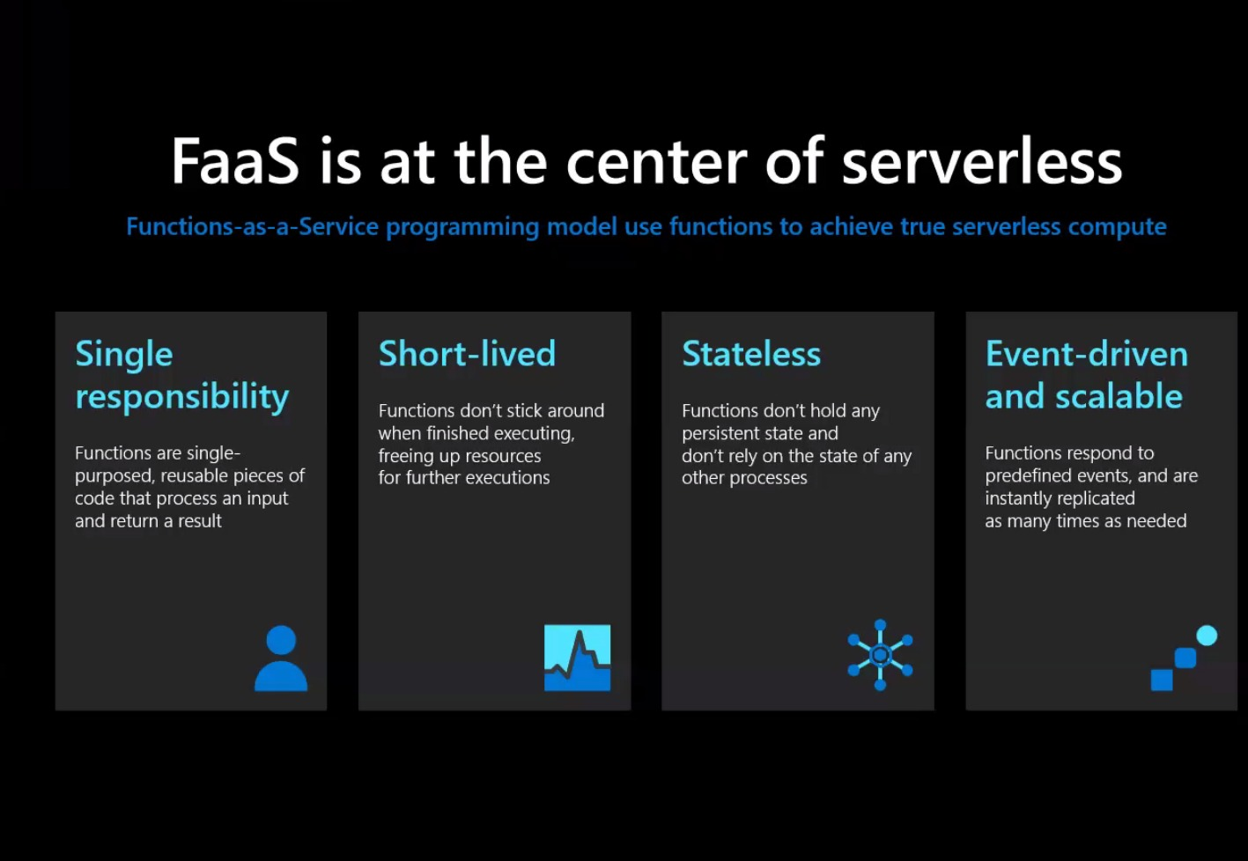
INTRODUCTION

Slide 4
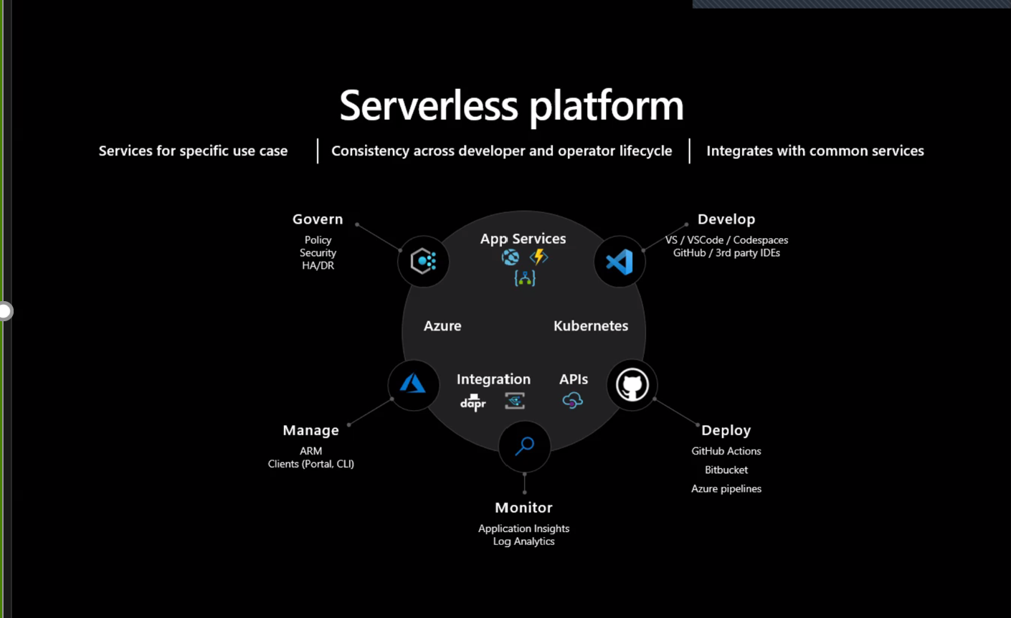
INTRODUCTION

Slide 5
HISTORY
Started in preview in March 2016.
General Availability started in November 2016.
Competitors:
AWS Lambda
Google Cloud Functions
IBM OpenWhisk
Auth0 Webtask

Slide 6
Azure Function
Azure is a serverless solution that enables writing less code, maintain less infrastructure and saves on cost.
Enable developer to connect to data sources making it easy to process and react to events
Also, allows to build HTTP-based APIs.

Slide 7
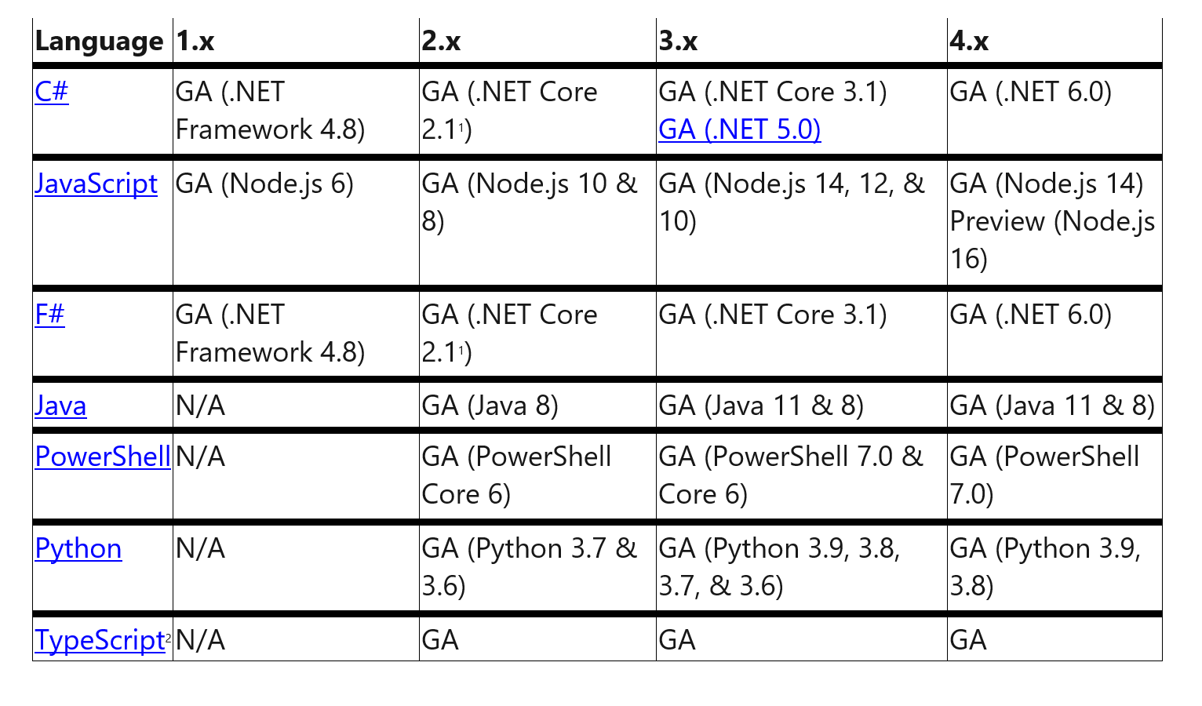
History

Slide 8
Features Summary
Key Feature of Azure function 3:
– Supports .NET Core 3.1 and Node 12
– Deploy and scale containers on managed Kubernetes.
– Add cognitive capabilities to apps with APIs and AI services.
– Azure PlayFab.
– Execute event-driven serverless code with an end-to-end development experience.

Slide 9
Use Cases
> Example Use Case Scenarios:
– Big data Processing
– File Processing Validation
– Game data visualization
– IoT reliable edge relay
> Companies using Azure Function at large scale:
– American Red Cross
– Lorven Technology
Notes:
Scheduled Tasks
Reminders and Notifications
Lightweight Web API
Sending background emails
Running background backup tasks
Doing backend calculations

Slide 10
AZURE FUNCTION
ADVANTAGES
More enterprise focused than the FaaS offerings from AWS and Google Cloud.
The pricing model is same as in AWS Lambda or GCD
F# and Typescript, .NET (6.0)
enables open binding extensions
Different plan option
Notes:
Scheduled Tasks
Reminders and Notifications
Lightweight Web API
Sending background emails
Running background backup tasks
Doing backend calculations

Slide 11
AZURE FUNCTION
DISADVANTAGES
Doesn't have ease of access
limitations on scaling
upper bound of 100 on the number of App Functions
The pricing model is complex
premium plan and Dedicated plans are targeted towards enterprise customers
low end consumption plan has some pretty severe limitations
pricing associated with storage is not clear

Slide 12
AZURE FUNCTION
EASE OF USE
Doesn’t have that ease of deployment compared to AWS
Relatively new version so it needs technical support
Azure can host python only on Linux based hosting plan so it does not have Azure portal support

Slide 13
AZURE FUNCTION
COST
CONSUMPTION PLAN
Pay-per-call
Pay-per-GB*seconds
PREMIUM PLAN
no cold start, enhanced performance and VNET access.
$0.20 per million executions | FREE 1 million executions
$0.000016/GB-s | FREE 400,000 GB-s
vCPU duration | vCPU: $0.16 vCPU/hour
Memory duration | Memory: $0.0114 GB/hour

Slide 14
AZURE FUNCTION
COST USAGE
Resource Consumption in
1 second:- 3 million executions / sec=3m sec
GB/s:- 512 MB / 1,024 MB *3 million sec = 1.5 m GB/sec
Monthly free grant
1.5 m GB/sec - 0.4 Gb/sec= 1.1 GB/sec
3 m executions – 1 m executions = 2 m executions
Cost after free usage
1.1 GB/sec *$0.000016/GB/s = $17.60
2 million executions *$0.20 = $0.40
TOTAL= $18

Slide 15
AZURE f
BEST PRACTICES
Choose the correct hosting plan
Configure storage correctly
Organize your functions
WRITE ROBUST FUNCTIONS
Avoid long running functions
Plan cross function communication

Slide 16
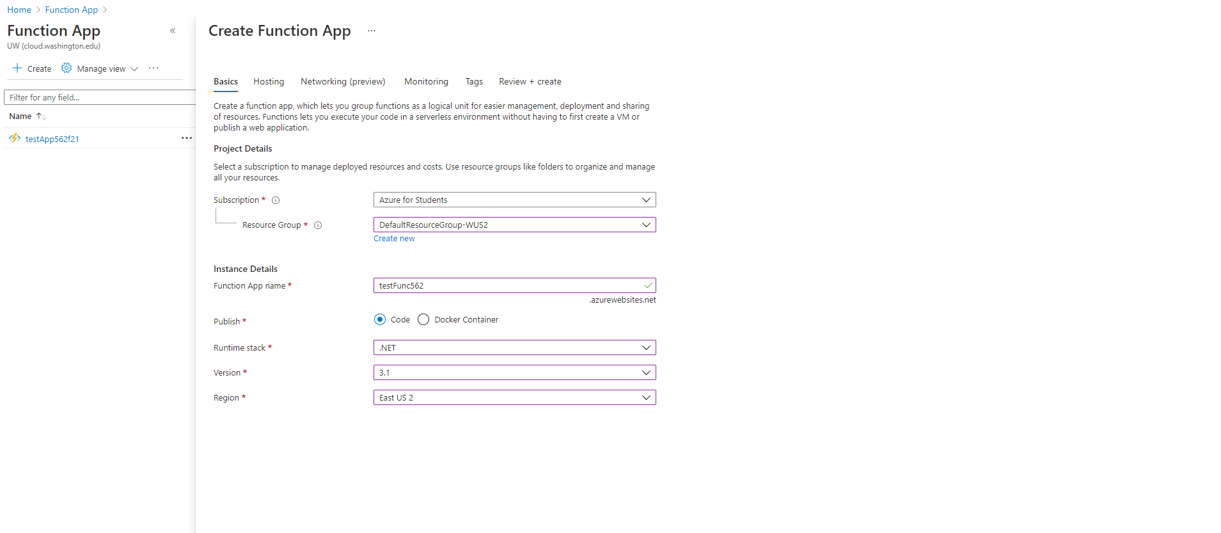
Demo

Slide 17
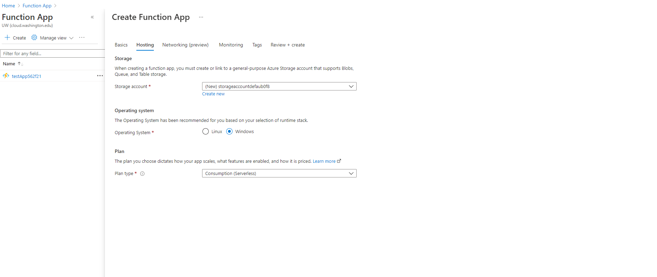
Demo

Slide 18
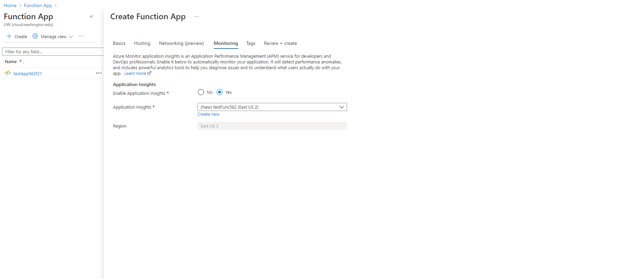
Demo

Slide 19
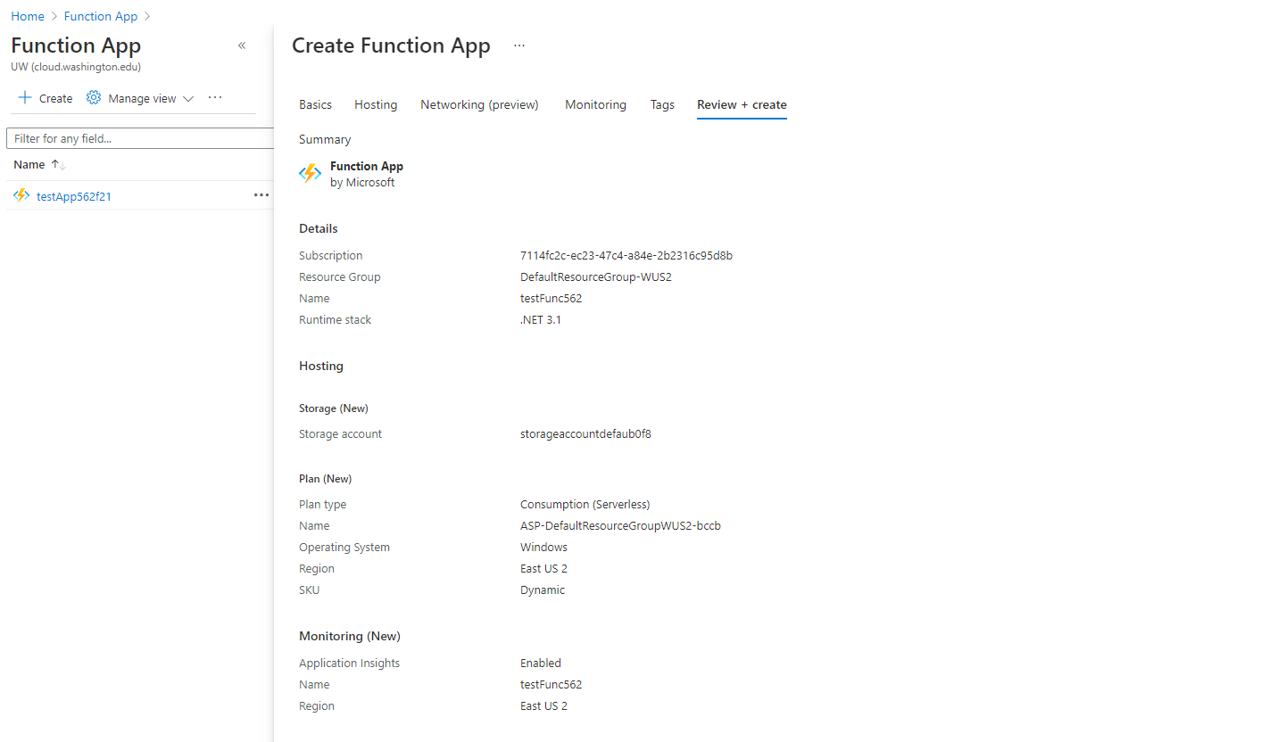
Demo

Slide 20

Demo
Output

Slide 21
REFERENCES
Docs.microsoft.com. 2021. Create your first function in the Azure portal. [online] Available at: <https://docs.microsoft.com/en-us/azure/azure-functions/functions-create-function-app-portal> [Accessed 8 December 2021].
Docs.microsoft.com. 2021. Create serverless APIs in Visual Studio using Azure Functions and API Management. [online] Available at: <https://docs.microsoft.com/en-us/azure/azure-functions/openapi-apim-integrate-visual-studio> [Accessed 8 December 2021].
Docs.microsoft.com. 2021. Create your first function in the Azure portal. [online] Available at: <https://docs.microsoft.com/en-us/azure/azure-functions/functions-create-function-app-portal> [Accessed 8 December 2021].
Talking Serverless. 2021. The Pros and Cons of Azure Functions - Talking Serverless. [online] Available at: <https://talkingserverless.com/2020/11/24/the-pros-and-cons-of-azure-functions/> [Accessed 8 December 2021].
Docs.microsoft.com. 2021. Azure Functions Overview. [online] Available at: <https://docs.microsoft.com/en-us/azure/azure-functions/functions-overview> [Accessed 8 December 2021].
Docs.microsoft.com. 2021. Azure Functions Overview. [online] Available at: <https://docs.microsoft.com/en-us/azure/azure-functions/functions-overview> [Accessed 8 December 2021].
Azure.microsoft.com. 2021. Pricing - Functions | Microsoft Azure. [online] Available at: <https://azure.microsoft.com/en-us/pricing/details/functions/> [Accessed 8 December 2021].
Shilkov, b., 2021. AWS Lambda vs. Azure Functions: 10 Major Differences - IOD. [online] IOD. Available at: <https://iamondemand.com/blog/aws-lambda-vs-azure-functions-ten-major-differences/> [Accessed 8 December 2021].
Medium. 2021. AWS Lambda Vs Azure Functions. [online] Available at: <https://fintelics.medium.com/aws-lambda-vs-azure-functions-e26c8f2ec2bc> [Accessed 8 December 2021].
https://docs.microsoft.com/en-us/azure/azure-functions/create-first-function-cli-python?tabs=azure-powershell%2Cpowershell%2Ccurl
https://docs.microsoft.com/en-us/dotnet/architecture/serverless/serverless-business-scenarios

