Slide 1
Low Power Processor Designs & Performance
Cassie Priddy, Devon Wilkening, Daria Casey, Kelcee Gabbard

Slide 2
Project Overview
This project aims to evaluate the performance of low-power processors versus high-power processors. We conducted five performance tests on both a Raspberry Pi 4B and a Linux desktop computer, compared the results, drew conclusions, and compared our findings to those in our sourced related works.

Slide 3
Low Power vs High Power Processor
Low Power
High Power
Smaller chip sizes
Multiple cores, but not as many
Integrated graphics
Small cache sizes
Generates very little heat
Good for portable devices
Larger chip sizes
Higher number of cores
Larger cache sizes
Generates more heat
Found in larger desktops
Notes:
Low power processor: All of physical qualities (all but last 2 bullet points) make it easy for the processor to focus on balancing performance with energy efficiency. All of the high power physical qualities make it easy for the processor to do demanding tasks like gaming

Slide 4
Performance Tests
Amount of power used by CPU specifically during a given test
CPU Usage
Memory
Percentage of memory used to complete a task
Disk I/O
Amount of time taken to read and write data to the disk during a given task
Total amount of time taken for device to complete given task
Power*
Response Time
Percentage of CPU capability used to complete a task
1
2
3
4
5

Slide 5
Hardware Details
 | Desktop | Raspberry Pi 4B
CPU | Intel Core i9 10900k | Quad Core Cortex-A72 (ARM v8)
RAM | 16 Gigabytes | 2 Gigabytes
Storage | Hard Drive | SD Card
Operating System | Linux Ubuntu 20.04 | Linux Ubuntu Server 20.04

Slide 6
CPU Usage Test
Importance:
Steps:
Tests efficiency while completing tasks with varying workloads
Tests how effectively the processor utilizes its power
Helps identify bottlenecks in the system
Helps gauge the responsiveness and smoothness of the system
Start Nginx web server on desktop and Raspberry Pi
Install Apache Bench tool. Use it to send varying number of generated HTTP requests to each server individually
Use command line utility "htop" to display live CPU usage percentage on desktop and Raspberry Pi
Monitor CPU usage percentage while requests are being sent to the servers. Record number of requests and peak CPU percentage while requests are being processed on both individual machines

Slide 7
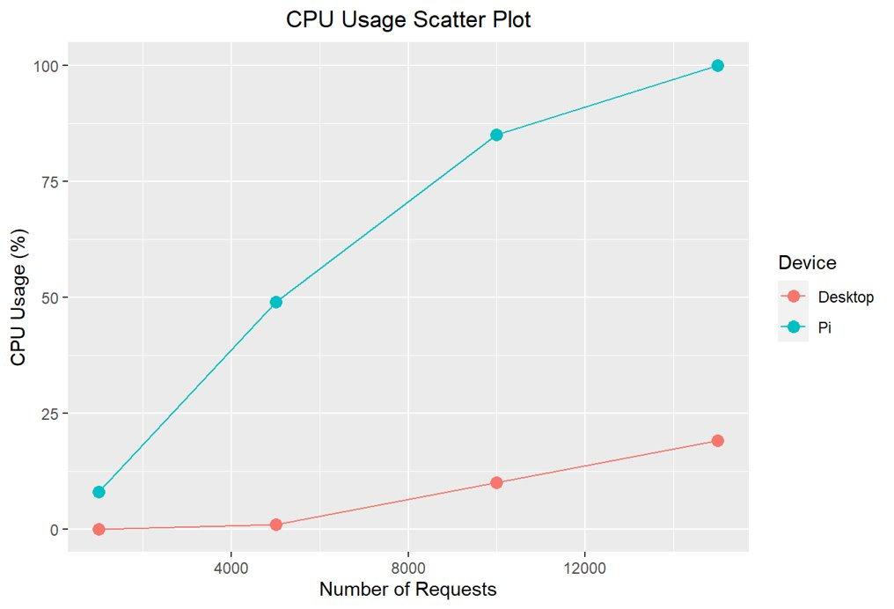
CPU Usage Test Results
As seen in the graph, the desktop CPU usage is significantly lower than that of the Raspberry Pi's CPU usage across the varying tests. The Raspberry Pi's CPU maxes out while processing 15,000 requests compared to the desktop's 19% CPU usage.

Slide 8
Memory Usage Test
Importance:
Steps:
Helps evaluate how each processor handles multiple simultaneous tasks
Handling memory intensive tasks poorly causes freezes and instability in the system
Can help assess scalability
Start Nginx server on Pi & desktop
Send varying number of requests with set number of connections(1,000) to server with Apache Bench Tool on both machines
View metrics on machine using the command line utility "htop" on both machines
Monitor percentage of memory used during the processing of the requests. Record peak percentage while processing each set of requests for each machine individually

Slide 9
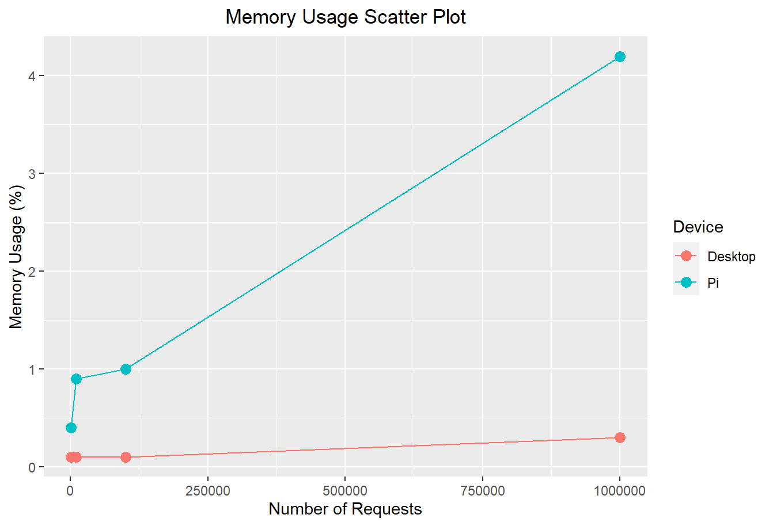
Memory Usage Test Results
On average, the Pi's memory usage for the same number of requests is 9.25 times higher than the memory usage of the desktop device. When calculating the amount of memory used (by multiplying percentage used and amount available), we still found that the pi used significantly more memory than the desktop. This contrast makes the Pi slower and more unstable in comparison to the desktop when handling multiple tasks.

Slide 10
Response Time Test
Importance:
Steps:
Faster response times result in a quicker system and seamless user experience
Tests how quickly the processor can execute a given task
Tests how quickly the processor can respond to requests
Start Nginx server on Pi & desktop
Use Apache Bench tool to send varying number of requests and set number of connections to server on both machines
In the output from running the Apache Bench tool, monitor the listed response time for each set of requests
Record the number of requests and listed response time for each machine
Notes:
Response time is the next performance test we ran. Faster response times result in a quicker system and more seamless user experience. It also tests how quickly the processor can execute a given tasks as well as respond to requests. To run this test, we started the web server on both machines. We then sent a varying number of requests with a set number of connections to the server on both the Pi and desktop. The test actually outputs response time so we didn’t have to use any other tools to monitor it. We recorded the response time with the correlating number of requests sent to the server and then analyzed the data.

Slide 11
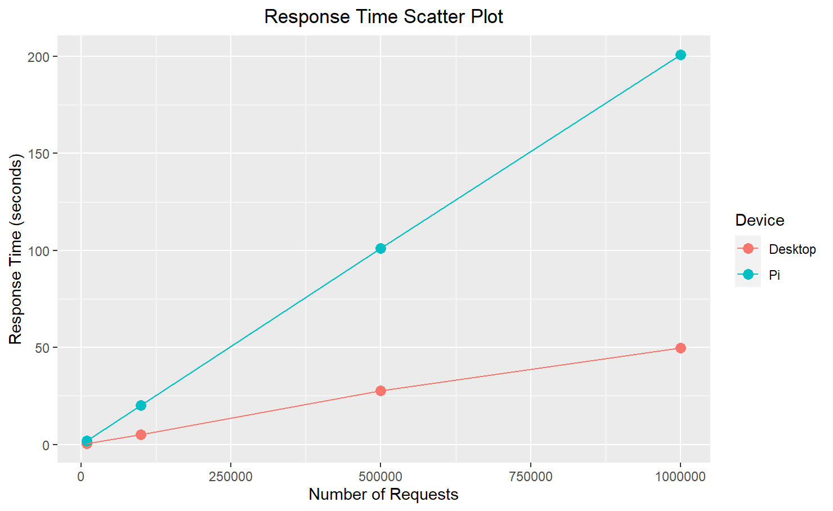
Response Time Test Results
The desktop response times are significantly lower than the Raspberry Pi's. Overall, the Pi's response times are 3.92 times higher than the desktop's. The desktop provides a much faster and smoother experience for the user, while it is likely the user will experience delays running the same tasks on the Pi.
Notes:
These are our results. As you can see, the slopes on the graph are positive and stay consistent. the desktop's response times are consistently faster than the Pis by a large margin. Overall, the raspberry pi's response times are 3.92 times slower than the desktops. This tells us the desktop provides a much faster and smoother experience for the, while the user will likely experience delays running the same tasks on the raspberry pi.

Slide 12
Power Test
Importance:
Complications:
Power consumption should justify the rest of the Raspberry Pi's data underperforming
It is designed to balance power consumption with performance capability. This is metric is what makes sacrificing performance worth it.
Could not accurately record wattage consumption on the desktop without a power meter.
We tried software tools like PowerStat. They output wildly inaccurate results
We were able to output voltage on the Pi and convert it to watts
Notes:
The next test we tried to run was the power test. This is where the Pi should be superior. Its power consumption should be low enough to justify the rest of its underperformance compared to the desktop because it is designed to balance power consumption with performance capability. We ran into quite a few complications with the test. We couldn't accurately record the wattage consumption on the desktop without a power meter. We tried software tools like PowerStat as well as PowerTop but they output wildly inaccurate results. It told us the desktop was idling at like 1.8 watts which is impossible. We also had to install older versions of the software to even get an estimate and I think they took the feature out of newer versions because it just did not work. That being said, we were able to get a voltage output on the Pi and convert it to watts.

Slide 13
Power Tests Results
Results:
Conclusion:
The most power that the Pi consumed while we ran heavy task loads was 7.6 watts.
The average desktop idles at 50-100 watts.
The Pi consumes at least 6.6 times less power than the Pi
The Raspberry Pi excels at what it is designed for, which is low power consumption. Low power consumptions results in the following advantages:
Longer battery life in portable devices
Generates much less heat, so there is no need for a cooling solution
More environmentally friendly
Notes:
These are our results and estimates. Like a said we were able to get a wattage read on the pi and even when running a really heavy task load it output 7.6 watts. The average desktop is estimated to idle at 50-100 watts. So, the pi's highest power consumption is still at least 6.6 times lower than a desktop's lowest. From these results, we can conclude the pi excels at what it is designed for, which is low power consumption. Low power consumption results in longer battery life in portable devices. It also generates a lot less heat so theres no need for a cooling solution. Lastly its also a lot more environmentally friendly.

Slide 14
Disk I/O Test
Importance:
Steps:
Another way to measure the responsiveness of a system
Helps access how quickly the processor can retrieve and write data to/from storage
Influences the times it takes to load applications
Tests how effectively the processor uses its available storage technology
Start the Nginx server on both the Pi & desktop
Install and utilize the command line tool "iotop" to view live disk I/O rates on both machines
Use Apache Bench tool to send varying number of requests to both servers
Monitor disk read rate. Record highest number output while processing each set of requests on both machines

Slide 15
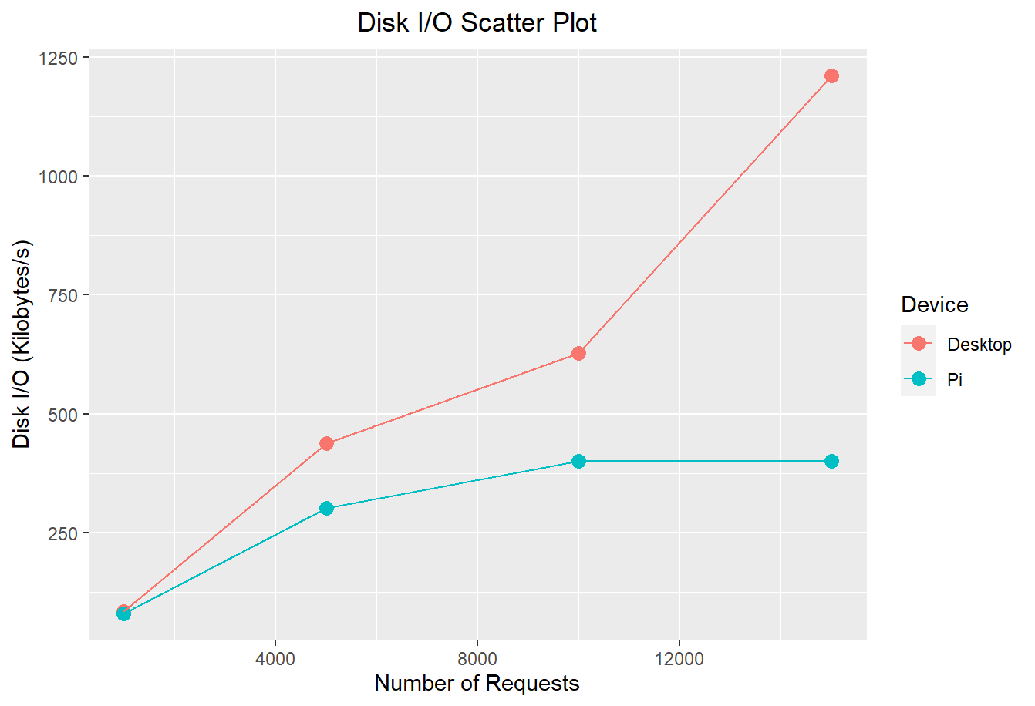
Disk I/O Test Results
While the task load increases, both machines have higher rates. It is important to note that the Raspberry Pi capped at the last data point, 400.93 Kilobytes per second. The desktop tripled the Pi's fastest rate with the rate of 1,212 Kilobytes per seconds and was able to perform faster. The desktop retrieves data 1.775 times faster than the Pi overall. This results in the Pi having longer boot times and an overall sluggish system in comparison to the desktop.

Slide 16
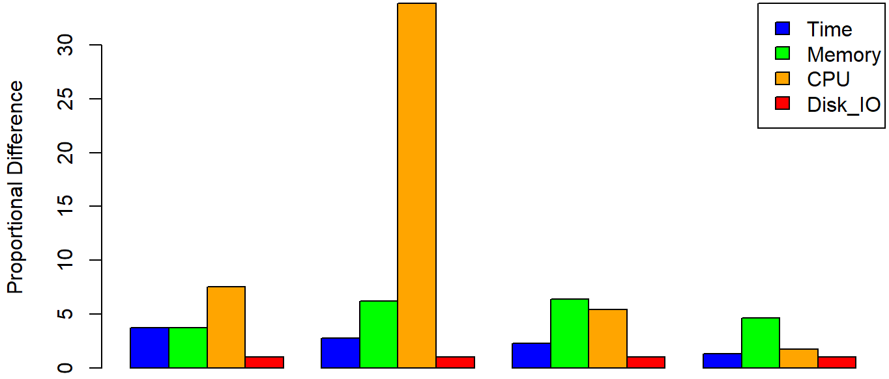
General Comparison
A value of 1 in the table to the right would indicate that the Pi and the Desktop measured the same performance in a test, the higher the value in all columns except Disk I/O the worse the Pi performed in comparison to the Desktop. As is demonstrated by the table and graph, the pi routinely tested poorly compared to the desktop many times over, with the most significant difference in performance being measured during the CPU tests. However, while not graphed due to technical constraints, the Raspberry Pi is drastically more efficient with regards to power consumption at the expense of overall performance parameters.
Proportional Difference in Test Results (Pi/Desktop Result)
 | Time | Memory | CPU | *Disk I/O
test 1 | 3.978431 | 4 | 8 | 0.942618
test 2 | 4.039671 | 9 | 49 | 0.691076
test 3 | 3.633268 | 10 | 8.5 | 0.637959
test 4 | 4.029078 | 14 | 5.263158 | 0.3308
Overall Diff. | 3.920112 | 9.25 | 17.69079 | 0.650613
*In the case of Disk I/O a worse performance is indicated by a lower value

Slide 17
Overall Findings
Overall, our findings correspond to those of other studies comparing the low-power processor design of Raspberry Pi's and other low-power devices to traditional desktops. The low-power processor design of the Raspberry Pi's CPU has a significant impact on CPU usage and other associated components. However, while the Raspberry Pi has much less to offer in terms of general performance, it also consumes significantly less power than a traditional desktop PC while completing the same task.

Slide 18
Sources & Related Works
Brennan, J. P., Dean, A., Kenyon, S., & Ventrone, S. (1998). Low Power Methodology and Design Techniques for Processor Design. Essex Junction; IBM Microelectronics.
Gonzalez, R. E. (1997, June). Low-Power Processor Design. Stanford; Stanford University.
Jadeja, S., Mathuria, P., & Popat, J. (n.d.). A Review on Low Power Testing Techniques. https://ijana.in/Special%20Issue/12.pdf
Kaiser, S., Materic, I., & Saade, R. (2010, November 1). ESL solutions for Low Power Design: Proceedings of the International Conference on Computer-Aided Design. ACM Digital Library. https://dl.acm.org/doi/abs/10.5555/2133429.2133501
Puri, R., Acar, E., Cho, M., Choudhury, M., Qian, H., & Ziegler, M. (n.d.). Bridging High Performance and Low Power in the era of Big Data and Heterogenous Computing . Yorktown Heights; International Symposium on Low Power Electronics and Design.
Segars, S. (2001, February 4). Low Power Design Techniques for Microprocessors. ARM Inc.
Shah, M. A., & Anwaar, W. (2015, January). Energy efficient computing: A comparison of Raspberry Pi with modern ... Research Gate. https://www.researchgate.net/publication/298790432_Energy_Efficient_Computing_A_Comparison_of_Raspberry_PI_with_Modern_Devices

Slide 19
Questions?

