Slide 1
Spider
CS-GY 9223: Cloud Computing
Anil Poonai, Sakshat Katyarmal, Jay Patyal

Slide 2
Goal and Why?
Bus ticketing system
Scalable
Quick
Access
Entertainment

Slide 3
Flow
Register/Login
Add Payment/Update Account
Book bus and grab reward points
Refund if needed
Stream entertainment on trip

Slide 4
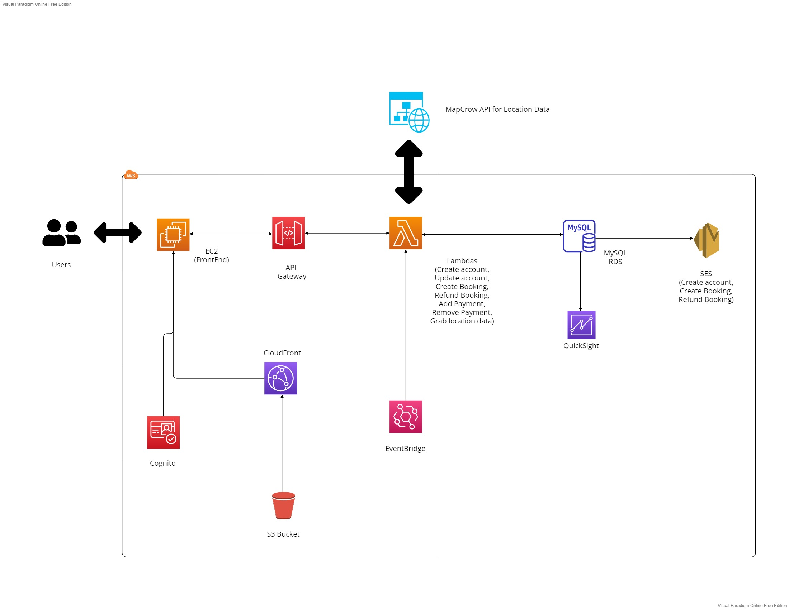
Architecture

Slide 5
API List
Resource | Method | Input | Output
addpayment | POST | Email, card: type, number, date, csv | Creates payment in database
bookingid | GET | Booking ID | Information regarding that booking
createbooking | POST | Email, card number, price, booking ID | Creates booking in database
get-price | GET | Destination and Departure location | Price of trip
get-values | GET | Email and password | Finds if credentials are authorized
pasttrips | POST | Email | Grabs past trips of user
payment | GET | Email | Grabs payment options of user
payments | GET | Email | Grabs payment options for removal

Slide 6
API List part 2
Resource | Method | Input | Output
removecard | POST | Email and Card number | Removes card from database
post-data | POST | First name, last name, Email, Contact, and Password | Adds a new profile to the database
profile | GET | Email | Grabs user information
profileupdate | POST | Email, First name, Last name, Contact, password | Updates user information
refund | POST | Email and Booking ID | Refunds booking
trip | GET | Departure, Arrival, and Date | Finds upcoming trips for planned locations
upcoming | GET | Email | Grabs user’s upcoming trips

Slide 7
Results
Successful booking and refunding of trips
Successful streaming on entertainment content
Successful registration, profile updates, and payment updates

Slide 8
Future Changes
Add more online rewards to obtain
Add more locations to choose from
More content than just streaming videos for entertainment
Implement Elasticsearch for faster searches
Better UI and UX
Possibly add an API key for security

Slide 9
Thank you!

