Slide 1
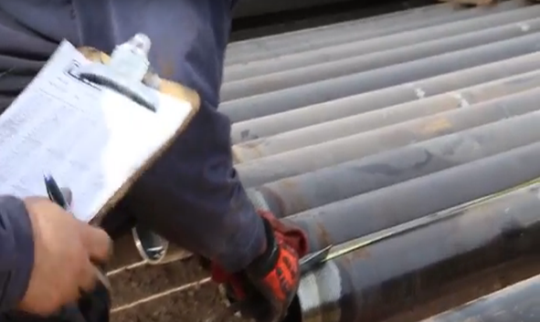
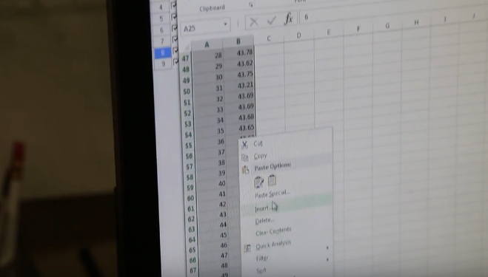
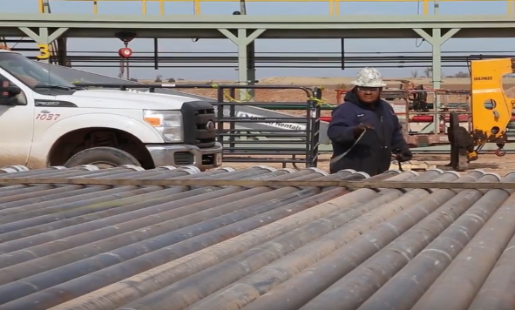
Problem
Three people, verbal to paper
Paper emailed to groups
Transpose paper to excel
Copy/paste into Well View

Slide 2
Design
Cheaper
Pipe Data: Two person job (one less than current)
Faster
No paper
One Time Collection, no transposing
Better
Accuracy
Data available for import/export, reports in near real time

Slide 3
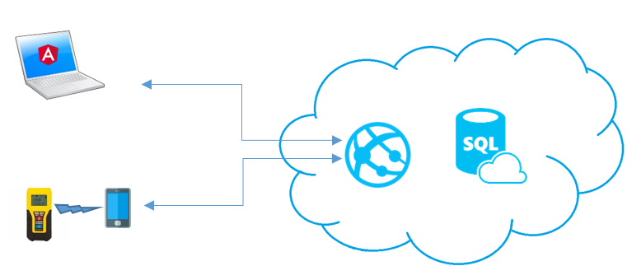
Solution
Web API (OData): to collect and expose data WellView, PowerBI, etc
Mobile App: paired with rugged, Bluetooth enabled Laser Measuring device (used on location)
Web App: manual entry of non-pipe related equipment, re-order run, export, in CSV
Notes:
Architecture (PaaS: host API, Web app, Db)
Mobile App. Xamarin IOS / Android: SQLite
Collect data via Bluetooth enabled Laser
Online or Off (Auto Sync)
Web API 2 (OData): Azure
Web App: Angular 4: Azure
SQL Server: Azure

Slide 4
Laser Measurement: onsite Workflow
Recorder: positions laser to outside pipe and places a backer board at thread end and records measurement
Fill In repeat data
Gather Thread Length
Gather Pipe Length
Mobile App saves data
Backer board placed flush to female end of a joint
Recorder aims laser to ‘shoot’ inside pipe (leaser flush to male end)
App records max measurement returned from laser
Notes:
Mobile App: (Pipe Measurement)
Enter initial data collection run; Metadata (well, pad, OD, Grade)
Team of two:. One with laser (recorder), one with backer board)
Each team member aligns at each end of a single joint
Measure Pipe Length:
Backer board placed flush to female end of a joint
Recorder aims laser to ‘shoot’ inside pipe (leaser flush to male end)
App records max measurement returned from laser
Measure thread length
Recorder: positions laser to outside pipe and places a backer board at thread end and records measurement
Mobile App saves and resets for next entry
Repeat step 1.2 – 2.4

Slide 5
Future
Uniquely identifying pipe on the rack:
Add disposable RFID tag to pipe when measuring: used for order, Adding an RFID scanner below the Rig Floor: (Above BOP) to track order in the hole, (also will help id and track pipe with anomalies that would not be ran in.
CBA:
one less person to collect onsite data.
no manual entry (can if needed): save time both onsite and in office.
reduce data latency, improve quality.
Architecture is extensible and scalable

