Slide 1

Exploratory Data Analysis of the Hobbies Dataset
By Devon Van Tussenbrook
CS 5580 – Data Science
Instructor: [Dr. Robert Ball]
Date: [11/2/2025]

Slide 2
Why This Dataset?
• Selected for its interesting insight into hobbies across various demographics.
• Comes from the FactoMineR package (8,403 individuals, 23 columns).
• Combines binary hobby indicators with demographic data.
• Offers practical experience applying EDA techniques.
• Interesting due to its blend of hobbies and multivalued hobby index.

Slide 3
Data Structure Overview
• 23 columns, 8,403 rows.
• 17 binary (0/1) hobby variables.
• 1 ordinal variable (TV 0–4).
• 4 categorical variables (Sex, Age, Marital Status, Profession).
• 1 numeric variable (nb.activitees).
• ~1,500 missing Profession values handled as NaN.

Slide 4
Data Science Questions
1. What are the most popular hobbies overall?
2. How do hobbies correlate with one another?
3. Does gender influence the number of hobbies?
4. How frequently do people watch TV?

Slide 5
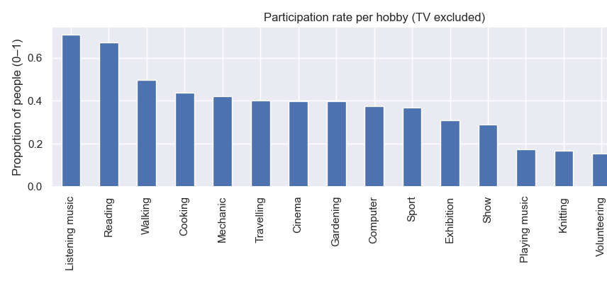
Popularity of Hobbies
• Listening to music and Reading are most common.
• Fishing and Collecting are least common.

Slide 6
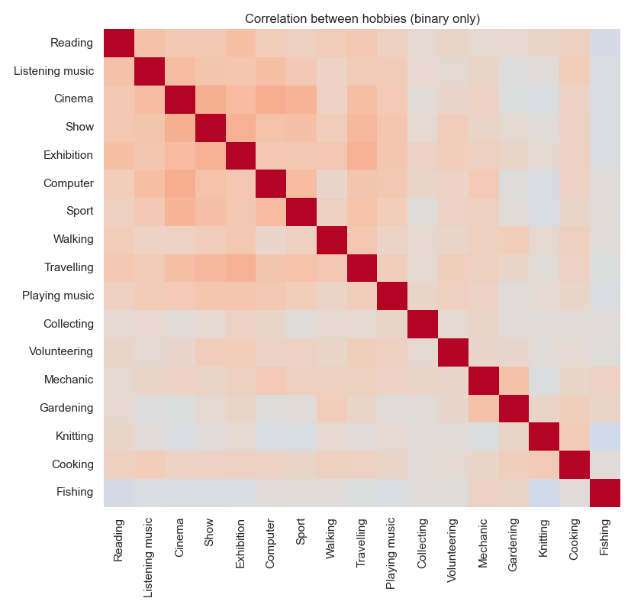
Hobby Correlations
• Reading correlates with Cinema and Show.
• Cinema ↔ Show show strong co-occurrence.
• Some unexpected relationships (e.g., Computer ↔ Sport).

Slide 7
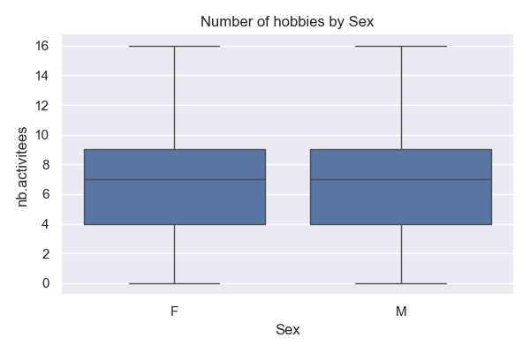
Gender vs Number of Hobbies
• Both genders report similar number of hobbies (~7 average).
• No significant gender bias detected.

Slide 8
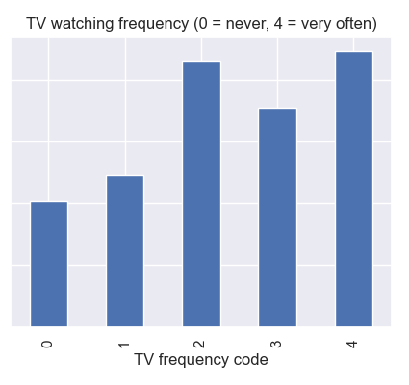
TV Frequency
• TV measured 0–4 (never → very often).
• Majority watch frequently.
• Represents screen-time intensity.

Slide 9
Interesting Anomalies or Patterns
• Balanced gender ratio suggests curated data.
• Profession missing for ~18% of responses.
• No modern digital hobbies included (e.g., gaming, social media).
• Limits generalization but strong educational use.

Slide 10
Future Work
• Incorporate newer hobbies for modern trends.
• Analyze clustering by hobby similarity.
• Compare results to real-world survey datasets.
• Extend to predictive modeling applications.

Slide 11
Conclusions
• Clear popularity and correlation patterns found.
• Gender shows minimal effect.
• Demonstrates meaningful analysis even with incomplete data.
• Reinforces value of EDA as a storytelling tool.

Slide 12
References / Appendix
Dataset Source:
Husson, F. (FactoMineR package) – Hobbies Dataset.
CRAN – The Comprehensive R Archive Network.
https://r-packages.io/datasets/hobbies
Tools: pandas, seaborn, matplotlib

