Slide 1
The SOLID Principles of Good object-oriented design
Developed by Devon Dalrymple

Slide 2

The five solid principles listed
S – Single Responsibility
O – Open Closed
L – Liskov Substitution
I – Interface Segregation
D – Dependency Inversion
This Photo by Unknown Author is licensed under CC BY-NC

Slide 3

What are the principles meant to achieve
Maintainability of the code
Code flexibility to extension
Ease of testing
Less code coupling
Reduced complexity of code chunks

Slide 4

Single Responsibility
“
A class should have one and only one reason to change, meaning that a class should have only one job. – [1]
While it is possible to multitask, the quality of the effort put into the tasks decreases
More responsibilities also tends to mean a greater number of collaborators
Handler of functionality becomes harder to decipher between larger classes
As reliance on other classes decreases, testing becomes harder
More responsibilities requires a larger file to read through
Fix this by separating unrelated responsibilities into separate types
This Photo by Unknown Author is licensed under CC BY-SA-NC

Slide 5

Open closed principle
Once the current functionality is tested and implemented, it should not be changed
Changing code that is already there is likely to cause bugs
Try creating subclasses or using new methods that make use of the old without using them
Following dependency inversion can reduce the need for modification
“
Objects or entities should be open for extension but closed for modification. – [1]
This Photo by Unknown Author is licensed under CC BY-SA

Slide 6
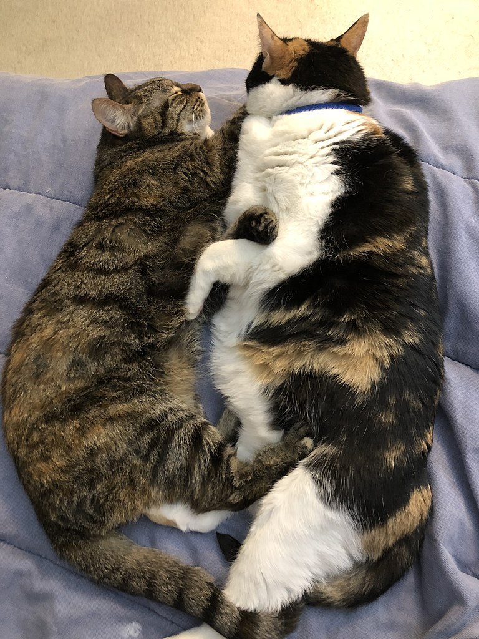
Liskov substitution
“
Let q(x) be a property provable about objects of x of type T. Then q(y) should be provable for objects y of type S where S is a subtype of T. – [1]
A subclass should be usable in any case that a superclass is
Any overridden methods that are derived should follow expected returns and general behaviors
Fix this by making inherited types more general or follow the inherited type more closely
This Photo by Unknown Author is licensed under CC BY-SA

Slide 7

Interface Segregation
Nothing should be contracted to do things that it shouldn’t
Snakes do not fly
Planets do not go supernova
Most war hammers do not cut
Fix this by breaking interfaces that include too much into smaller ones
“
A client should never be forced to implement an interface that it doesn’t use, or clients shouldn’t be forced to depend on methods they do not use. – [1]
This Photo by Unknown Author is licensed under CC BY-SA
An interface for animals should not include a contract for flying

Slide 8

Dependency inversion
Reusable code is aided using abstracted versions of types
Helps to decouple code
Helps the open-closed principle to be followed to greater lengths
Whenever a relevant and correct abstraction exists to an implementation, use it instead
“
Entities must depend on abstractions, not on concretions. It states that the high-level module must not depend on the low-level module, but they should depend on abstractions. – [1]

Slide 9
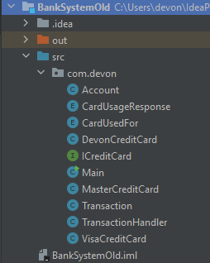
Current project structure for example project

Slide 10
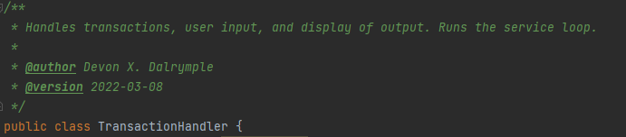
An area not following the single responsibility principle
Why:
It has four responsibilities
Handling transactions
User input
Display of output
Running the service’s loop

Slide 11

Suggestions for fixing this issue
Use two classes:
Transaction Handler
Display
Or four classes:
Display
Input parser
Transaction handler
Service controller
This Photo by Unknown Author is licensed under CC BY-SA-NC

Slide 12
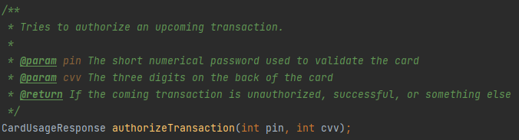
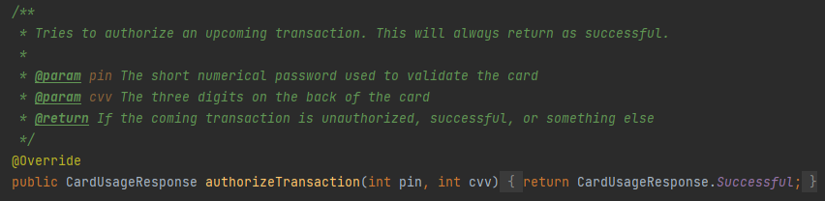
Next biggest area for improvement (Interface segregation)
ICreditCard has:
But this is not used for the DevonCreditCard class:

Slide 13
What’s wrong with this?
The DevonCreditCard does not use a PIN or CVV number
01
It is being forced to implement something it does not need
02
No class should be given a contract for something it is not supposed to do
03

Slide 14
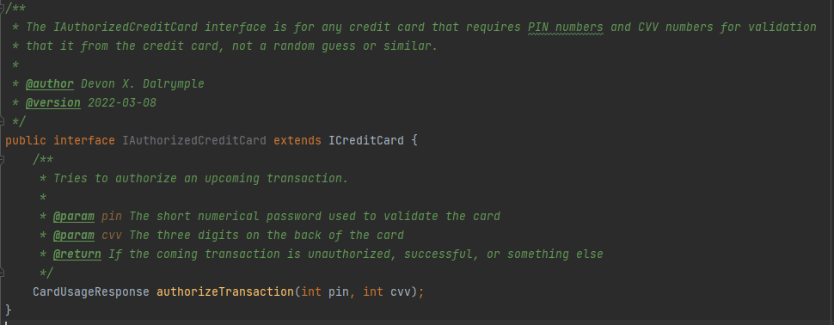
A simple solution
Separate the authorization method from the original interface into its own

Slide 15
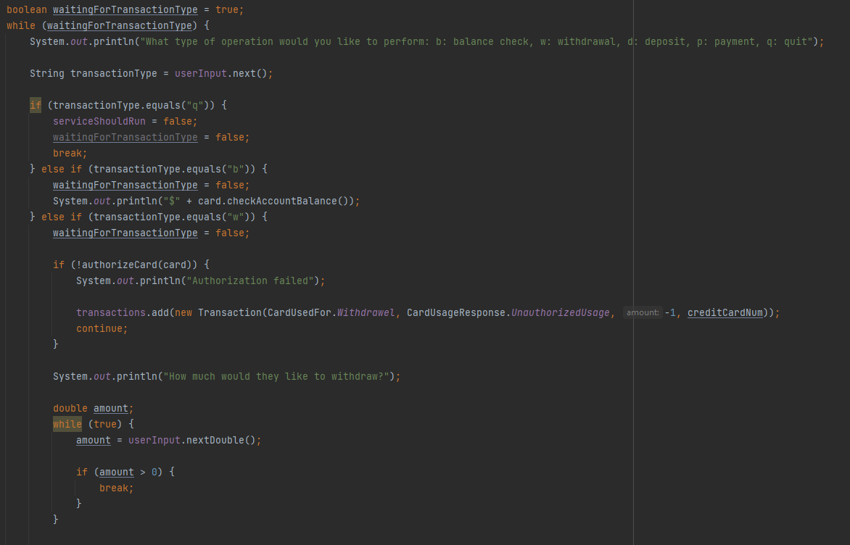
Open closed issues
The code will have to be changed whenever a new feature is added

Slide 16
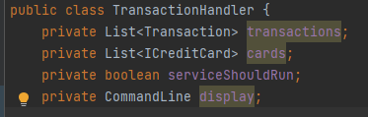
Dependency inversion issue from trying to use the single responsibility principle
The simple solution of using a command line display to separate some responsibilities from the TransactionHandler class has its own problem
What if the banking system was upgraded to use a GUI to take input and give out output?

Slide 17
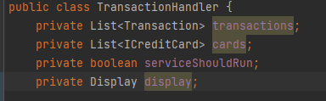
Solution to this new dependency inversion issue
Use a Display interface or abstract class

Slide 18

Questions

Slide 19
Sources for information
[1] | https://www.digitalocean.com/community/conceptual_articles/s-o-l-i-d-the-first-five-principles-of-object-oriented-design
[2] | https://www.baeldung.com/solid-principles

