Slide 1
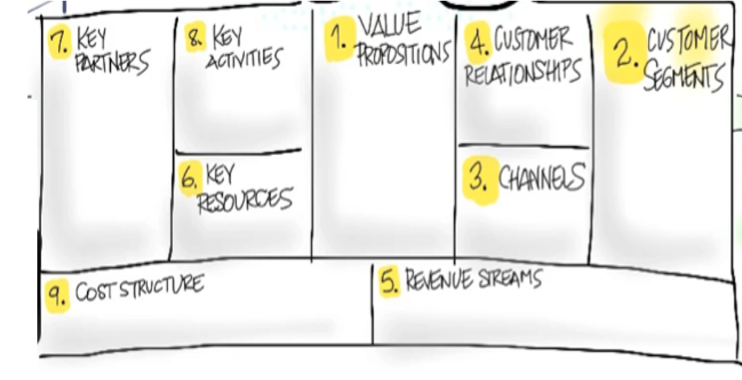
Ordering food at restaurants or online for pickup
App on smart phones and computers for ordering food called QuickEats
Restaurants we work with/potential clients
self-service/
automated service
Convenient
Stress-free
Ease-of-use
Cheaper than delivery
financial, physical, human
Smartphones, tableside tablets
Transaction based/recurring payments
After a free trial period, annual fees in addition to a percentage of client’s profit

