Slide 1
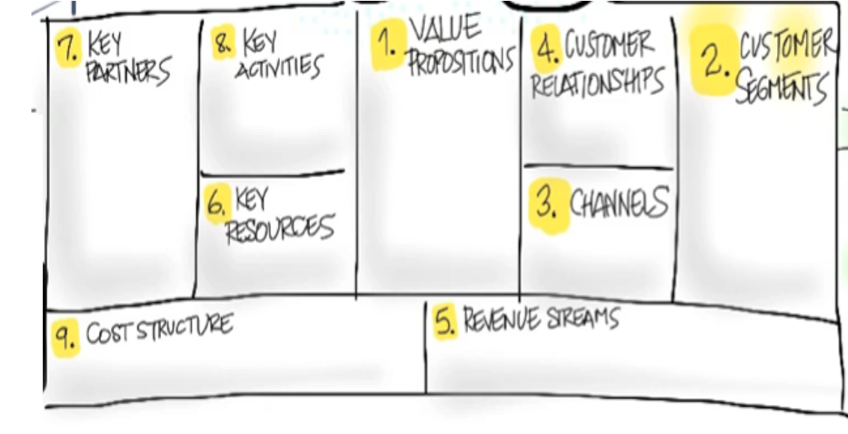
Nathan Vedros, Janusz Wojcik, Stephen Hoorman, Devonte Whitely
Ordering food at restaurants or online for pickup
App on smart phones and computers for ordering food called QuickEats
Restaurants we work with/potential clients
self-service/
automated service
Convenient
Stress-free
Ease-of-use
Cheaper than delivery
financial, physical, human
Smartphones, tableside tablets
Transaction based/recurring payments
After a free trial period, annual fees in addition to a percentage of client’s profit

