Slide 1
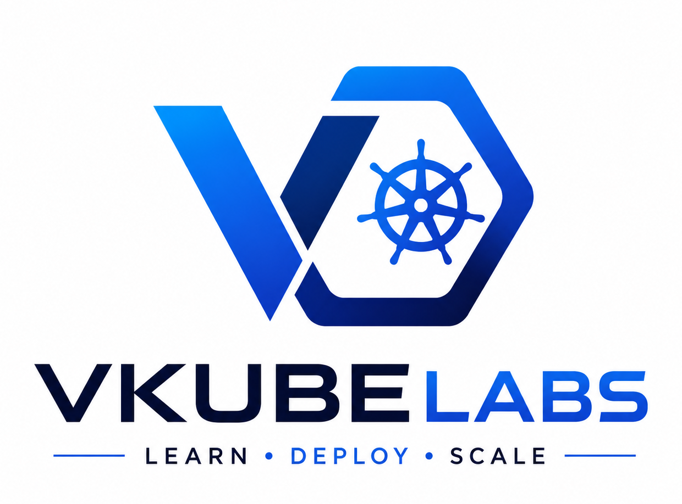
DevOps · Cloud · Platform Engineering
3-Month Comprehensive Training Program for Freshers/Professionals
Mobile : +91 6303128414 , +91 7989459504 Email : vkubelabs@gmail.com

Slide 2
Program Overview Training Details : https://github.com/Devops-Platform-Cloud-learnings/Training-Plan
12 Weeks
3 Phases
30+ Tools
3 Projects
Full Program Duration
Structured Learning Path
Hands-On Exposure
Real-World Practice
CI/CD pipeline design & automation
Cloud infrastructure management
Container orchestration (K8s)
Platform engineering practices
Fresh graduates (CS/IT/ECE)
Career switchers to tech ops
Developers moving to DevOps
Aspiring cloud engineers
Who Is This For?
Learning Outcomes

Slide 3
3-Month Curriculum Roadmap
Phase 1 — Month 1
Phase 2 — Month 2
Phase 3 — Month 3
Foundations
Core DevOps & Cloud
Platform Engineering
Linux & Bash Scripting
Git & Version Control
Networking Basics
Python for DevOps
Docker Fundamentals
CI/CD (GitHub Actions)
AWS / Azure Fundamentals
Terraform & IaC
Kubernetes Basics
Monitoring & Logging
Internal Developer Platforms
GitOps & ArgoCD
Observability Stack
Security & DevSecOps
Capstone Project

Slide 4
Phase 1 — Foundations

Slide 5
Phase 1 · Month 1 — Foundations & Core Skills
Week 1: Linux & Bash
Week 2: Git & Python
Week 3: Docker
Continuous Integration, Delivery & Deployment
Trunk-based development
Shift-left testing approach
blue-green and canary releases
Week 4: CICD
Linux filesystem & commands
Shell scripting & cron jobs
Process & permissions ,
Networking
Git branching & workflows
Pull requests, code reviews
Python scripting for DevOps
Containerisation concepts
Dockerfile & image building
Docker Compose multi-service
Hands-On Lab: Build a containerised Python web app and push to Docker Hub

Slide 6
Phase 2 — DevOps & Cloud

Slide 7
Phase 2 · Week 5–8 — Cloud Platforms & IaC
AWS Core Services
Terraform (IaC)
EC2, S3, RDS, VPC
IAM roles & policies
ELB & Auto Scaling
route53 ,cloudfront & WAF
HCL syntax & providers
State management
Modules & workspaces
Ansible
Playbooks & roles
Inventory management
Configuration automation

Slide 8
Phase 2 · Week 9 — Kubernetes & Container Orchestration
K8s Architecture
Core Objects
Master node components
Worker nodes & kubelet
API Server, etcd, Scheduler
Controller Manager
Pods, Deployments
Services & Ingress
ConfigMaps & Secrets
Operations
kubectl commands
Namespaces & RBAC
Helmcharts & packaging
Scaling & HA
HPA & VPA
Rolling updates
Drain & cordon nodes

Slide 9
Phase 3 — Platform Engineering

Slide 10
Phase 3 · Week 10–11 — Platform Engineering Concepts
Internal Developer Platform (IDP)
A self-service layer built on top of infrastructure tools — enabling dev teams to deploy without needing ops expertise.
Backstage / Port
GitOps & ArgoCD
Observability Stack
DevSecOps
Developer portals
Service catalogues
Self-service templates
Git as source of truth
Sync & drift detection
App-of-apps pattern
Prometheus & Grafana
EFK / Loki log stack
Jaeger distributed tracing
SAST & DAST scanning
Container image scanning
Secret management (Vault)

Slide 11
Phase 3 · Week 12 — Capstone Project
Build a production-ready DevOps platform from scratch
01
02
03
04
Infrastructure
Containerise App
Deploy on K8s
CI/CD + GitOps
Provision cloud infra with Terraform
Setup VPC, subnets, security groups
Dockerise a 3-tier application
Push to container registry
Create K8s manifests & Helm charts
Deploy to managed K8s cluster
GitHub Actions pipeline
ArgoCD for GitOps deployment
Deliverable: A fully documented GitHub repo with live demo and architecture diagram

Slide 12
Tools & Technologies Covered
Source Control
CI/CD
Git · GitHub · GitLab · Bitbucket
GitHub Actions
Containers
Orchestration
Docker ·
Kubernetes · Helm · Kustomize · k3s
Cloud
IaC
AWS (EC2/S3/EKS)
Terraform · Ansible · CloudFormation · Pulumi
Observability
GitOps/Platform
Prometheus · Grafana · EFK · Jaeger · Datadog
ArgoCD · Flux · Backstage · Vault · OPA

Slide 13
Assessment & Certification Criteria
Component
Description
Weightage
Weekly Quizzes
End-of-week MCQ & short answers
15%
Lab Assignments
Hands-on tasks per module
25%
Mini Projects (×2)
Phase 1 & Phase 2 deliverables
30%
Capstone Project
Full-stack DevOps platform
30%
Passing Score: 70% · Certificate of Completion awarded on successful capstone submission

Slide 14
Daily Training Schedule & Format
08:00–9:30
Concept Session
Theory, slides & whiteboard explanation
10:45–12:30
Hands-On Labs
Guided practical exercises on live environments
13:30–15:00
Tool Deep Dive
Focused tool walkthroughs & demos
15:15–16:30
Project Work
Self-paced project building with mentor support
20:30–21:00
Daily Standup
Progress review, doubts & next-day preview

Slide 15
Ready to Build the Next Generation
of DevOps & Cloud Engineers
12 Weeks · Hands-On Learning · Real Projects · Industry Tools
Let's Get Started!

