Slide 1
Kubernetes Workloads & Scheduling
Cloud Native Bootcamp - Karachi

Slide 2


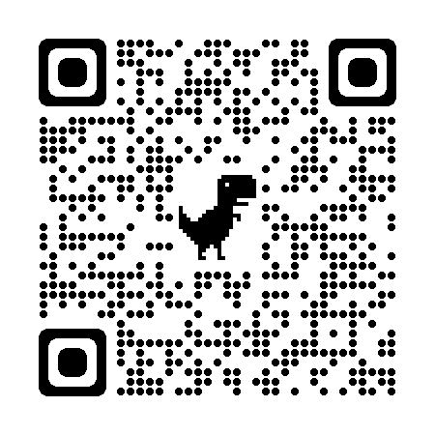
Hello .. It’s me 👋
Bashir Ahmed Zeeshan
\bashirahmedzeeshan

Slide 3
Road Map
Kubernetes
Workloads & Scheduling
Hands on & Project
Q/A and Discussion

Slide 4
Kubernetes

Slide 5
Google is running
Two Billion (2 000 000 000)
Containers per week !!!

Slide 6
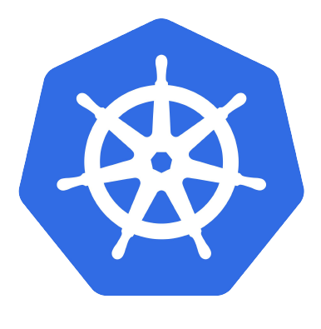
Kubernetes
K8s is an open-source container management system for automating deployment, operations, scaling of containerized applications and creating clusters of containers.
Production-Grade Container Orchestration System

Slide 7
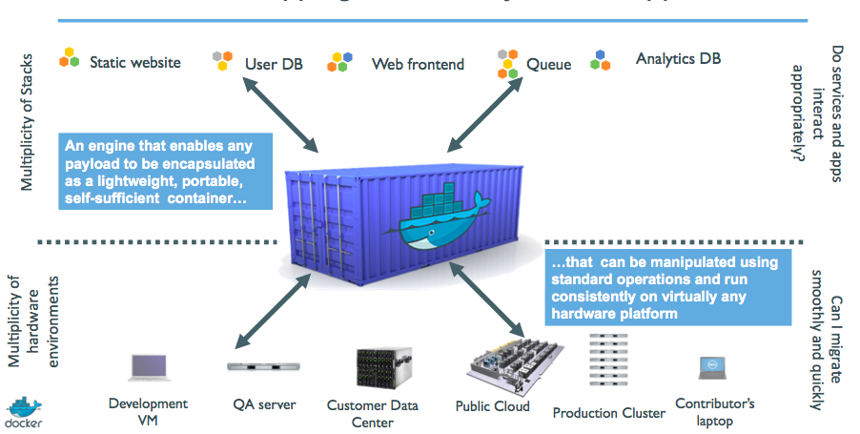
K8’s Big Picture

Slide 8
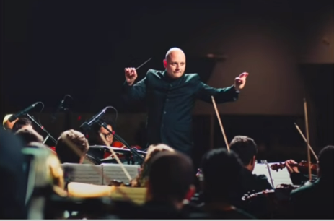
What really Kubernetes is?

Slide 9
How its all done!

Slide 10
Worker
Master

Slide 11
Workloads
Some common workloads

Slide 12
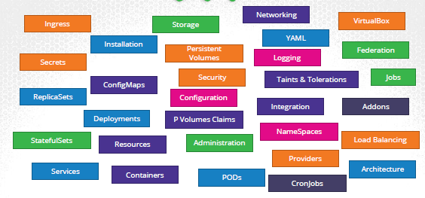
Intro of Workload
an application running on Kubernetes
Can be a single component or several that work together,
A lonely Pod
Grouped ones
defined lifecycle
Ensure reliability
Notes:
A workload is an application running on Kubernetes
Whether your workload is a single component or several that work together, on Kubernetes you run it inside a set of pods In Kubernetes, a Pod represents a set of running containers on your cluster
Kubernetes pods have a defined lifecycle For example, once a pod is running in your cluster then a critical
fault on the node where that pod is running means that all the pods on that node fail Kubernetes treats
that level of failure as final you would need to create a new Pod to recover, even if the node later becomes
Healthy
However, to make life considerably easier, you don't need to manage each Pod directly Instead, you can
use workload resources that manage a set of pods on your behalf These resources configure controllers
that make sure the right number of the right kind of pod are running, to match the state you specified

Slide 13
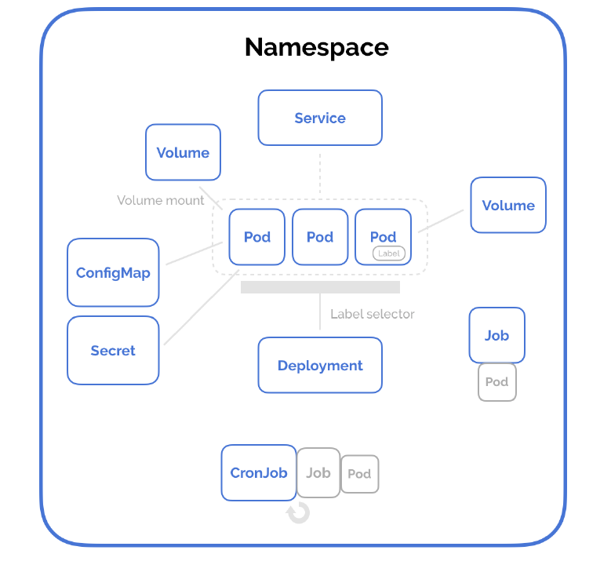
Resources
Pod
NS
Deployment
Services
Volumes
Job/CJ
CM /Secrets
…

Slide 14
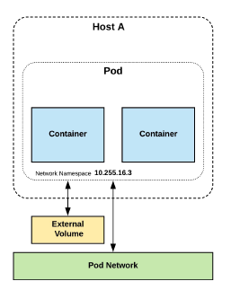
Containers:
like a virtual machine that shares its Operating System (OS) among several applications. It has its own filesystem, CPU, memory, & process space.
Containers are always created in Pods, and multiple containers can be created in one Pod.
pod
Atomic unit or smallest “unit of work”of Kubernetes.
group of containers running together on a node)
Pods are one or MORE containers that share volumes, a network namespace, and are a part of a single context.
Node
a machine (physical or virtual in our cluster)

Slide 15
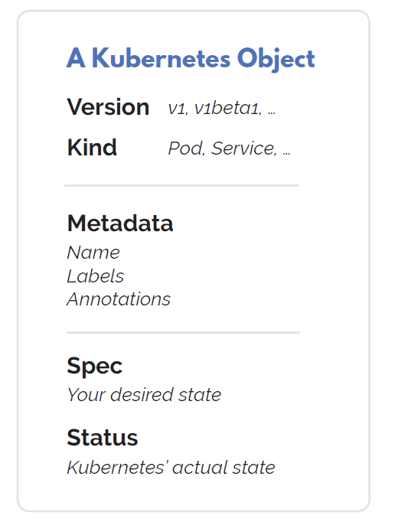
Service
Unified method of accessing the exposed workloads of Pods.
stable network endpoint to connect to one or multiple containers
Namespace
more-or-less isolated group of things
Namespaces are a logical cluster or environment, and are the primary method of partitioning a cluster or scoping access.
Secret
bundle of sensitive data to be passed to a container

Slide 16
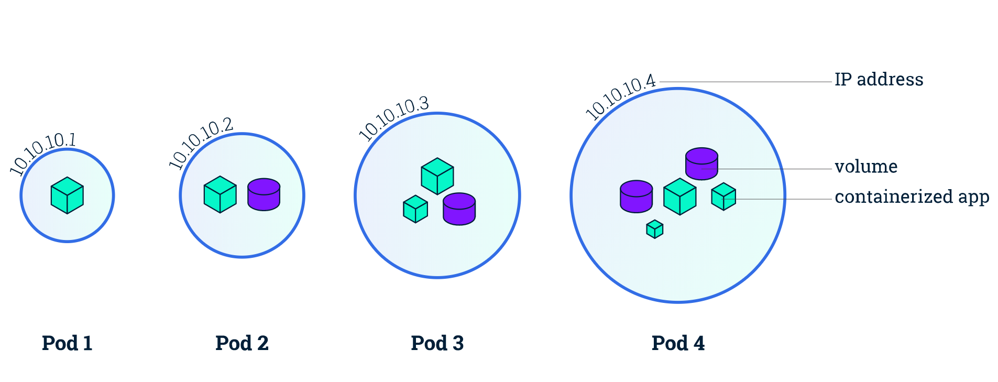
Pod
Smallest deployable units
Pods are usually not created directly. Instead, create them using workload resources such as Deployment or Job or StatefulSets
$ kubectl run nginx --image nginx
apiVersion: v1
kind: Pod
metadata:
name: simple-webapp
labels:
app: App1
spec:
containers:
- name: nginx
image: nginx
ports:
- containerPort: 8080
Notes:
Pods are the smallest deployable units of computing that you can create and manage in Kubernetes. The whole point of Kubernetes is to orchestrate the lifecycle of a container.
Share context:
Linux Namespaces
Cgroups

Slide 17
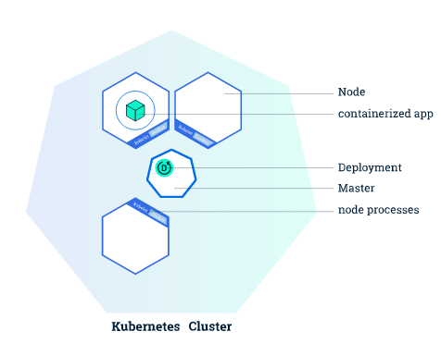
Deployment
Provides declarative updates for Pods & RS
Describe the desired state and the deployment Controller will match the actual state to the desired state
apiVersion: apps/v1
kind: Deployment
metadata:
name: nginx-deployment
labels:
app: nginx
spec:
replicas: 3
selector:
matchLabels:
app: nginx
template:
metadata:
labels:
app: nginx
spec:
containers:
- name: nginx
image: nginx:1.14.2
ports:
- containerPort: 80
Imperative
$ kubectl create deployment nginx-deploy ---image=nginx
Declarative
$ kubectl apply -f deployment-def.yaml
Notes:
Create a Deployment to rollout a ReplicaSet
Declare the new state of the Pods
Rollback to an earlier Deployment revision
Scale up the Deployment to facilitate more load
Pause the Deployment

Slide 18
Pod / Replicatset / Deployment Structure
apiVersion: v1
kind: Pod
metadata:
spec:
apiVersion: apps/v1
kind: Deployment
metadata:
spec:
template:
pod-structure
replicas:
selector:
matchLabels:
apiVersion: apps/v1
kind: ReplicaSet
metadata:
spec:
template:
pod-structure
replicas:
selector:
matchLabels:

Slide 19
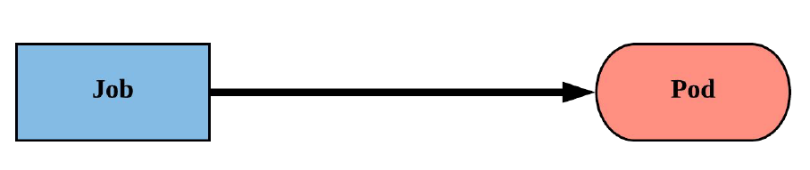
Job
Job controller ensures one or more pods are executed
and successfully terminate.
Will continue to try and execute the job until it satisfies the completion
Pods are NOT cleaned up until the job itself is deleted.*
apiVersion : batch/v1
kind: Job
metadata :
name: whalesay
spec:
template :
spec:
containers :
- name: whalesay
image: docker/whalesay
command: ["cowsay" , “k8S!"]
restartPolicy : Never
backoffLimit : 4
activeDeadlineSeconds : 60
Notes:
backoffLimit specify the number of retries before considering a Job as failed
○ 6 is default retries set back-off limit by kubernetes
○ Failed Pods associated with the Job are recreated by the Job controller with an
exponential back-off delay (10s, 20s, 40s …) capped at six minutes
○ The back-off count is reset if no new failed Pods appear before the Job’s next
status check
● activeDeadlineSeconds applies to the duration of the job, once a Job reaches
activeDeadlineSeconds, all of its Pods are terminated and the Job status will become
type: Failed with reason: DeadlineExceeded

Slide 20
CronJobs
similar to Kubernetes Job resource
Only difference is Job resource create Pod to perform instantly and do not reinitiates the job once completed successfully
CronJob resource is used to schedule Job at later time and can be set to initiate the Job again on provided time gap
CronJob always creates only a single Job resource for each execution
configured in the schedule
minute [0,59]
hour [0,23]
day of the month [1,31]
month of the year [1,12]
day of the week ([0,6] with 0=Sunday)

Slide 21
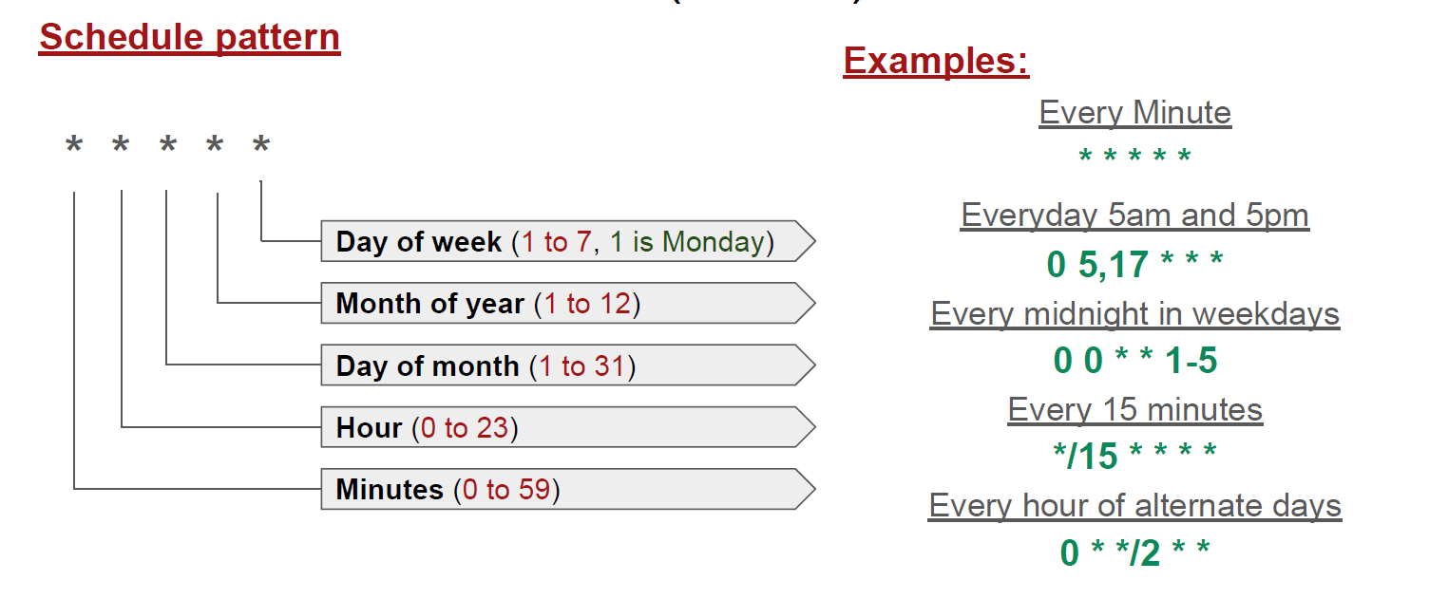
Cron Jobs

Slide 22
ConfigMaps
an API object used to store non-confidential data in key-value pairs.
Pods can consume ConfigMaps as environment variables, command-line arguments, or as configuration files in a volume.
Has a data field rather than spec in the definition
Declarative
cm-definition.yaml
apiVersion: v1
kind: ConfigMap
metadata:
name: game-config-env-file
data:
allowed: '"true"'
enemies: aliens
lives: "3"
$ kubectl apply -f cm-definition.yaml

Slide 23
Secret:
Secrets provides a way to distribute credentials, keys, passwords or “secret” data to the pods
Kubernetes itself uses this Secrets mechanism to provide the credentials to access the internal API
Kubernetes Secrets let you store and manage sensitive information, such as passwords, OAuth tokens, and ssh keys.
pod-secret.yaml
apiVersion: v1
kind: Pod
metadata:
name: env-single-secret
spec:
containers:
- name: envars-test-container
image: nginx
env:
- name: SECRET_USERNAME
valueFrom:
secretKeyRef:
name: backend-user
key: backend-username
$ kubectl create secret generic backend-user --from-literal=backend-username='backend-admin'

Slide 24
Let’s Hands On

Slide 25
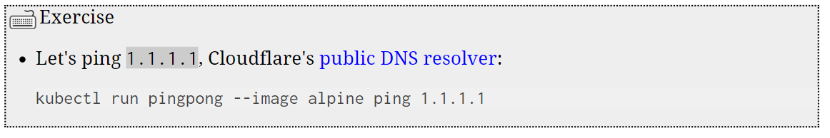
Running our first containers on Kubernetes
Starting a simple pod with kubectl run
$ kubectl run webpage01 –-image devopsdockerhub123/bootcamp:2022
Notes:
kubectl run pingpong --image alpine ping 1.1.1.1
kubectl get all

Slide 26
Hands On
$ Pod
$ Deployments
$ Scaling
$ kubectl explain --recursive
$ kubectl <command> --help
Notes:
kubectl run myweb --image devopsdockerhub123/bootcamp:2022
kubectl expose pod myweb --port=80 --type NodePort

Slide 27
Must Know!
$ kubectl api-resources
$ kubectl api-versions
$ kubectl explain
$ kubectl explain --recursive
$ kubectl cluster-info
$ kubectl <command> --help

Slide 28
Lab – Kubernetes Control
Give us more info about the nodes:
kubectl get nodes -o wide
Let's have some YAML:
kubectl get no -o yaml
See that kind: List at the end? It's the type of our result!

Slide 29
Exploring types and definitions
We can list all available resource types by running
kubectl api-resources
We can view the definition for a resource type with:
kubectl explain <type>
We can view the definition of a field in a resource, for instance:
kubectl explain node.spec
Or get the full definition of all fields and sub-fields:
kubectl explain node --recursive

Slide 30
Exploring types and definitions
We can use kubectl get -o yaml to see all available details
For instance, kubectl get node node1 -o yaml has too much information
For a comprehensive overview, we can use kubectl describe instead

Slide 31
Multi Tier Application
It is an application distributed among more than one layer.
It logically separates the operational layers. In this, application divided into 3 layers backend, middle and frontend layer.
Database
Rest API
Web
Frontend
middle
Backend
Notes:
A multi-tier application is an application distributed among more than one layer. It logically separates the operational layers. The number of layers varies with business and application requirements. In this, application divided into 2 layers, backend and frontend layer. We will use MongoDB as a backend to store data and Python Flask as a frontend Webserver. We will deploy these two applications using deployments in Kubernetes and have services to forward requests to them.

Slide 32
Workloads
db
Go Web app
Service
Deployment
Postgres db
Deployment
Service
words
Java Rest API
Deployment
Service
web

Slide 33
Task Explained
Wordsmith is the demo project shown at DockerCon EU 2017 and 2018.
The demo app runs across three containers:
**db** - a Postgres database which stores words
**words** - a Java REST API which serves words read from the database
**web** - a Go web application which calls the API and builds words into sentences:

Slide 34
Database
apiVersion: v1
kind: Service
metadata:
name: words
labels:
app: words-api
spec:
ports:
- port: 8080
targetPort: 8080
name: api
selector:
app: words-api
clusterIP: None
apiVersion: v1
kind: Service
metadata:
name: db
labels:
app: words-db
spec:
ports:
- port: 5432
targetPort: 5432
name: db
selector:
app: words-db
clusterIP: None
---
API
apiVersion: apps/v1
kind: Deployment
metadata:
name: db
labels:
app: words-db
spec:
selector:
matchLabels:
app: words-db
template:
metadata:
labels:
app: words-db
spec:
containers:
- name: db
image: dockersamples/k8s-wordsmith-db
ports:
- containerPort: 5432
name: db
apiVersion: apps/v1
kind: Deployment
metadata:
name: words
labels:
app: words-api
spec:
replicas: 5
selector:
matchLabels:
app: words-api
template:
metadata:
labels:
app: words-api
spec:
containers:
- name: words
image: dockersamples/k8s-wordsmith-api
ports:
- containerPort: 8080
name: api

Slide 35
apiVersion: v1
kind: Service
metadata:
name: web
labels:
app: words-web
spec:
ports:
- port: 8081
targetPort: 80
name: web
selector:
app: words-web
type: LoadBalancer
Web App
apiVersion: apps/v1
kind: Deployment
metadata:
name: web
labels:
app: words-web
spec:
selector:
matchLabels:
app: words-web
template:
metadata:
labels:
app: words-web
spec:
containers:
- name: web
image: dockersamples/k8s-wordsmith-web
ports:
- containerPort: 80
name: words-web

Slide 36
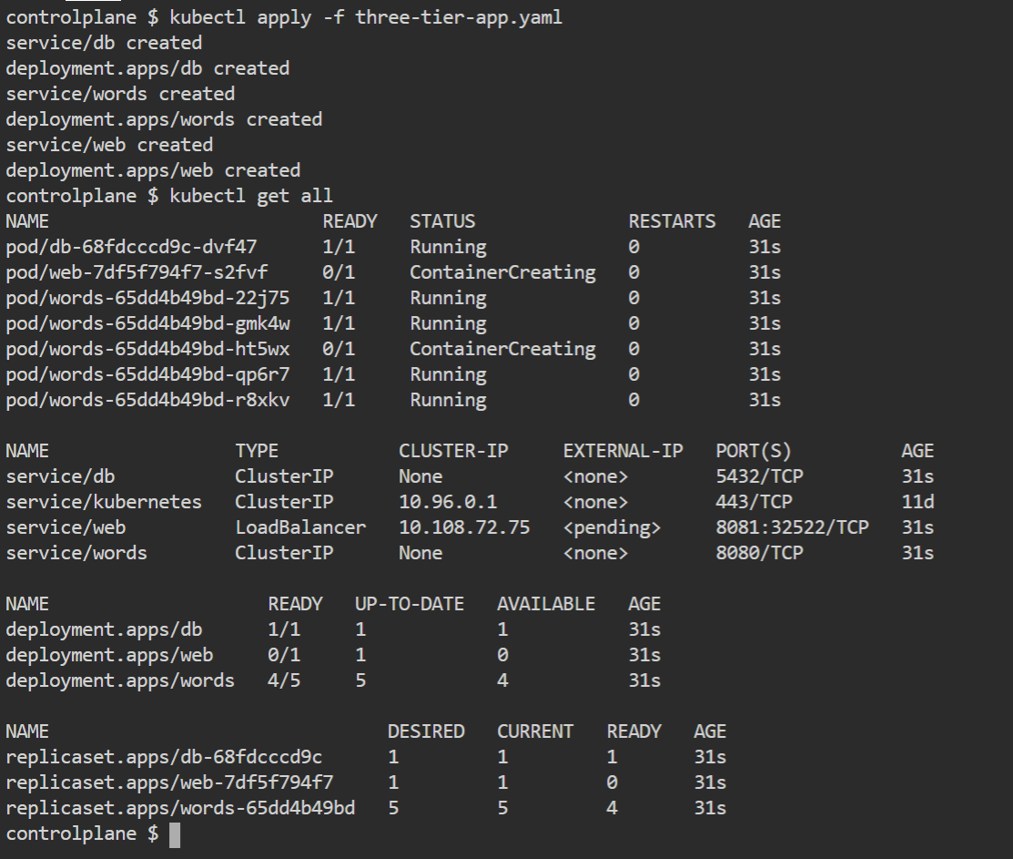
Deployment Steps

Slide 37
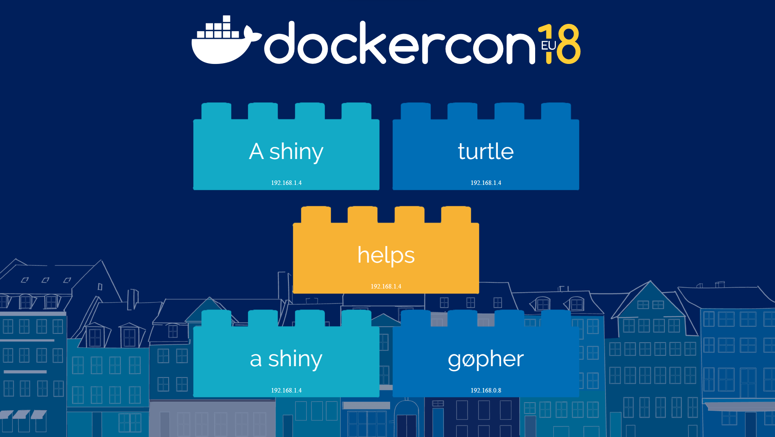
Project

Slide 38
In this task, we created a deployment of the Postgres DB as backend database and service to access the database and for the frontend, we created GO-based Web application deployment and service to access this frontend. We also saw the data getting stored in the backend database.

Slide 39


Slide 40
SlidesCarnival icons are editable shapes.
This means that you can:
Resize them without losing quality.
Change line color, width and style.
Isn’t that nice? :)
Examples:

Slide 41
Diagrams and infographics

