Slide 1
Jenkins
CI & CD

Slide 2
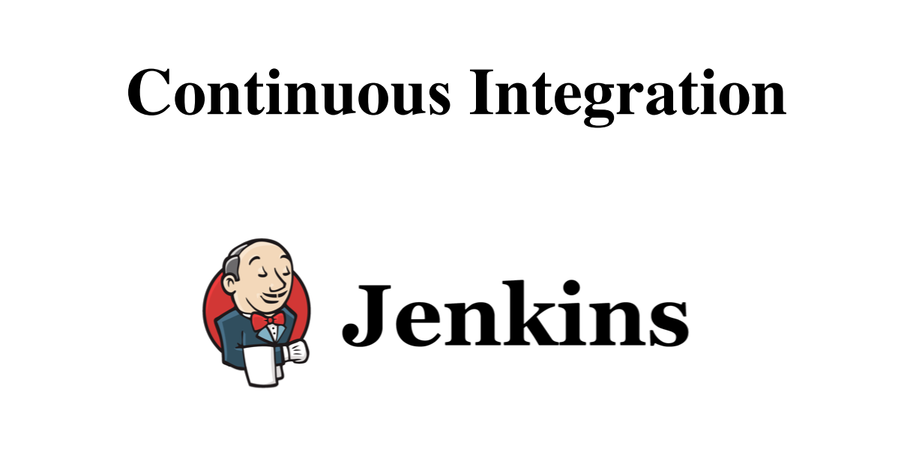

Slide 3
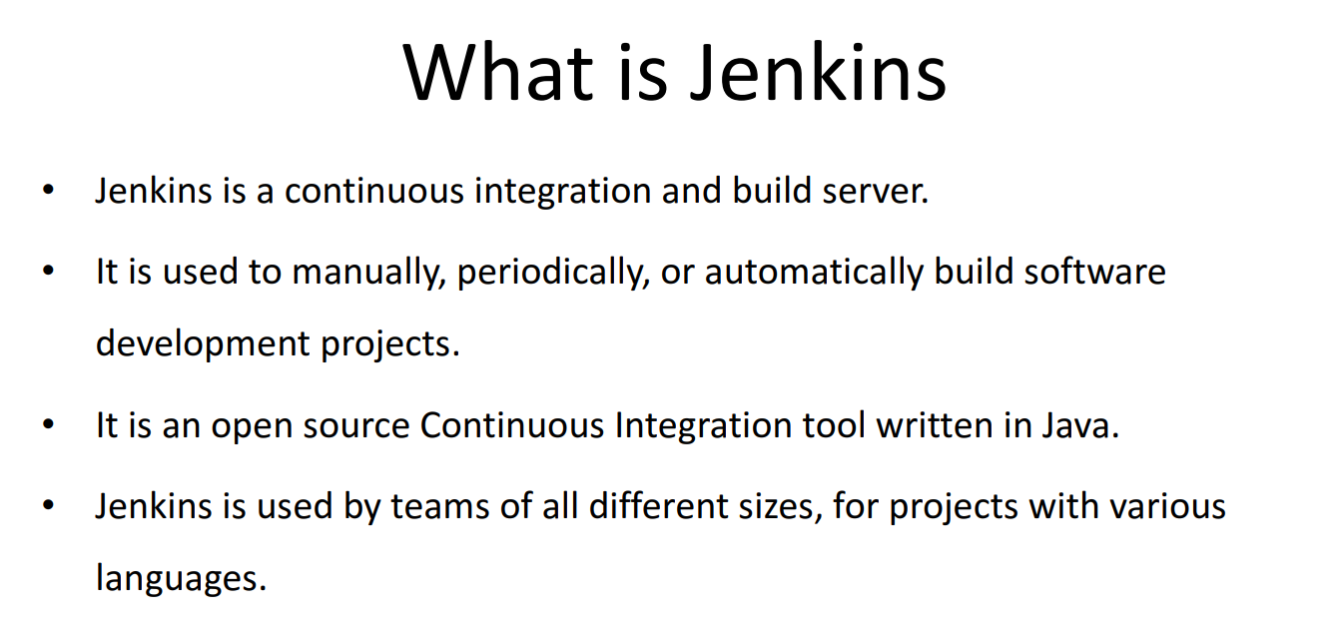

Slide 4
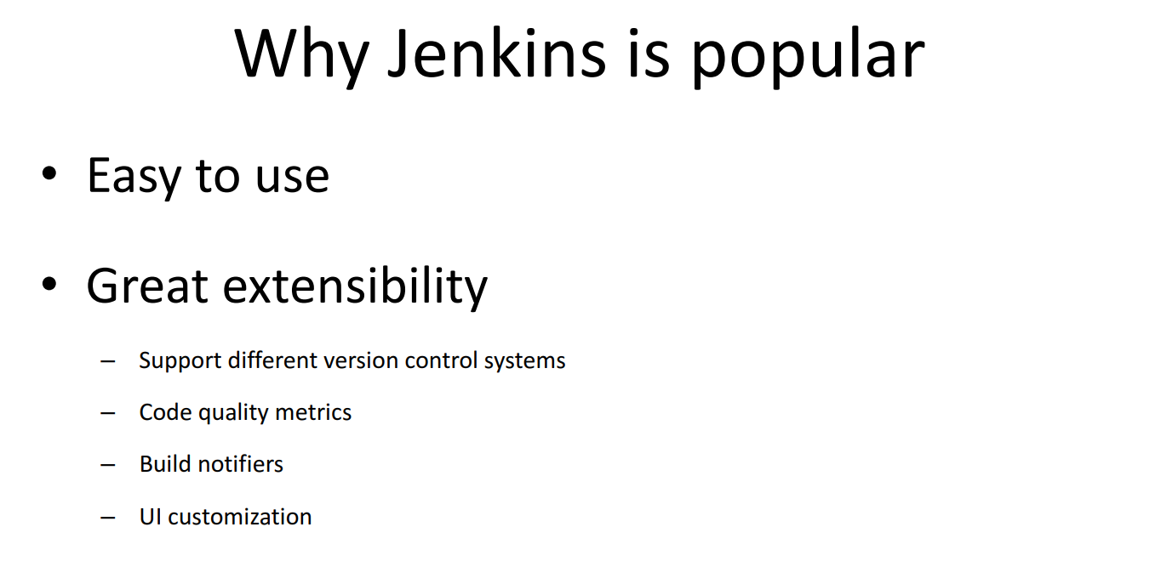

Slide 5
Jenkins Installation..
--> Jenkins needs Java for running
$ sudo apt update
$ sudo apt install openjdk-8-jdk
$ wget -q -O - https://pkg.jenkins.io/debian-stable/jenkins.io.key | sudo apt-key add
$ sudo sh -c 'echo deb http://pkg.jenkins.io/debian-stable binary/ > /etc/apt/sources.list.d/jenkins.list'
$ sudo apt update
--> Install Jenkins
$ sudo apt install jenkins
$ sudo systemctl start jenkins
$ sudo systemctl status jenkins

Slide 6
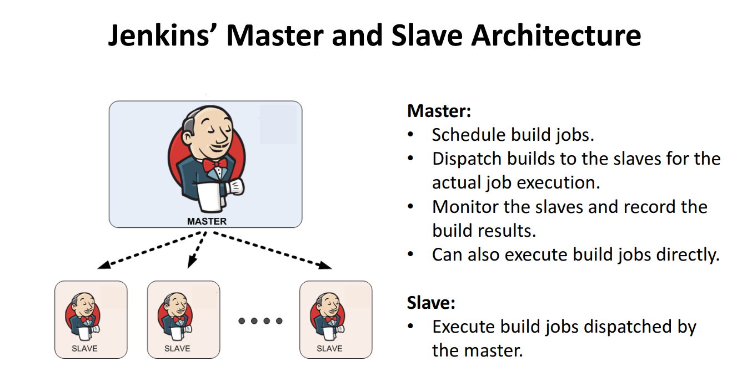

Slide 7
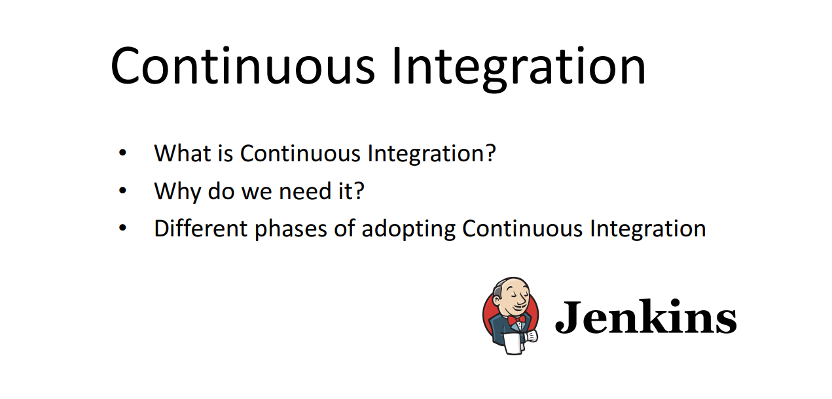

Slide 8
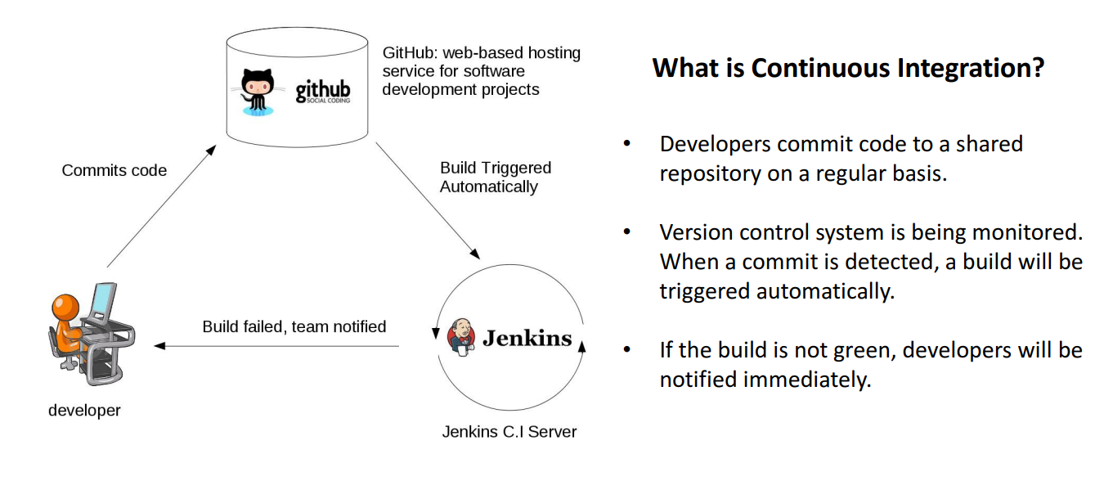

Slide 9
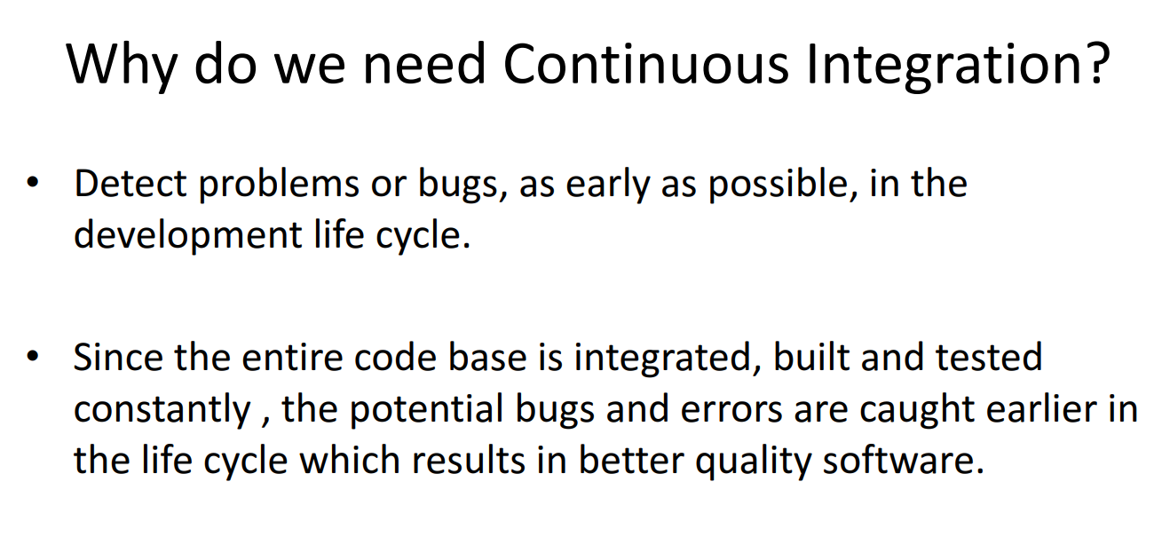

Slide 10
