Slide 1
Jenkins
CI & CD

Slide 2
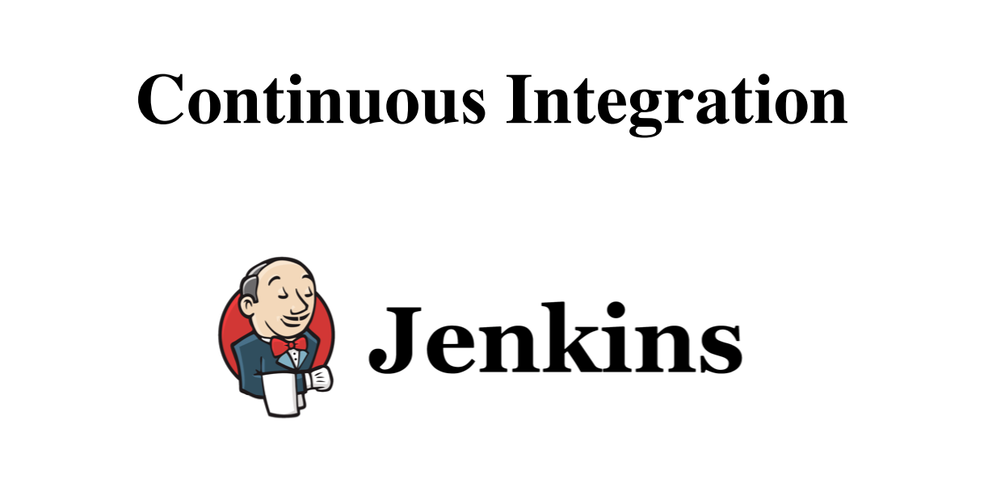

Slide 3
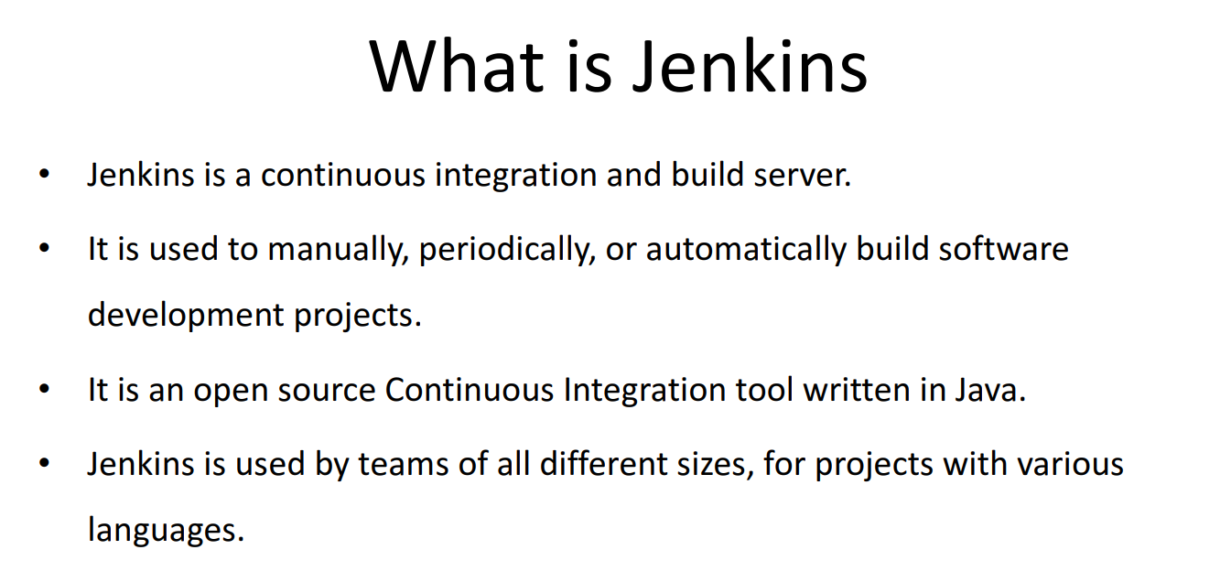

Slide 4
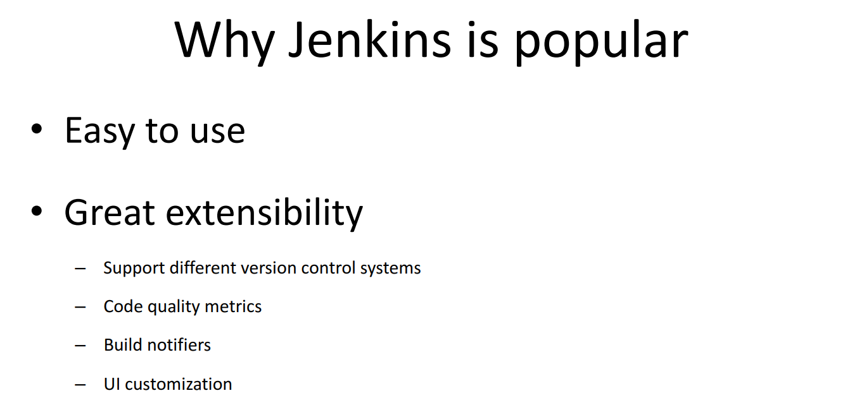

Slide 5
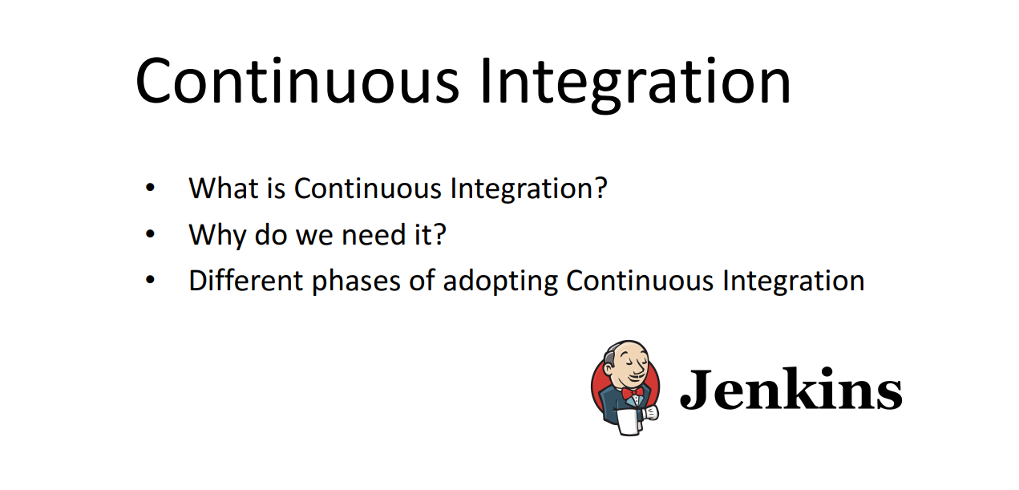

Slide 6
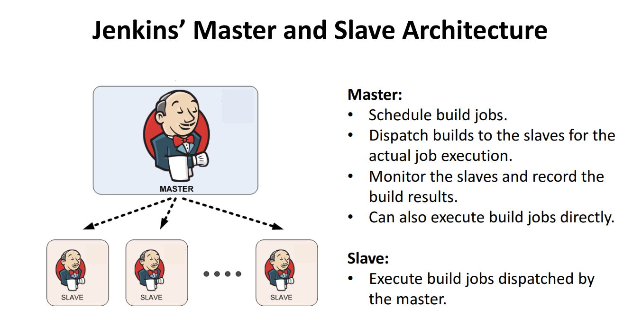

Slide 7
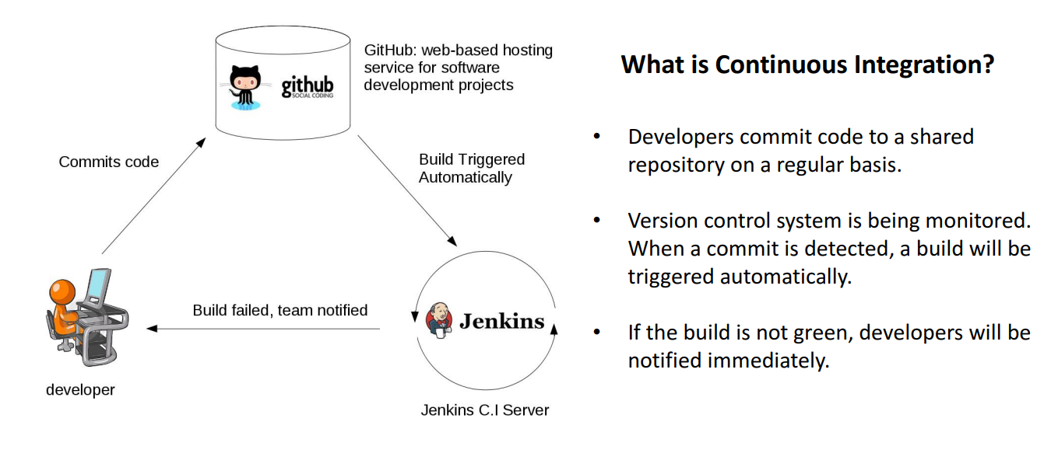

Slide 8
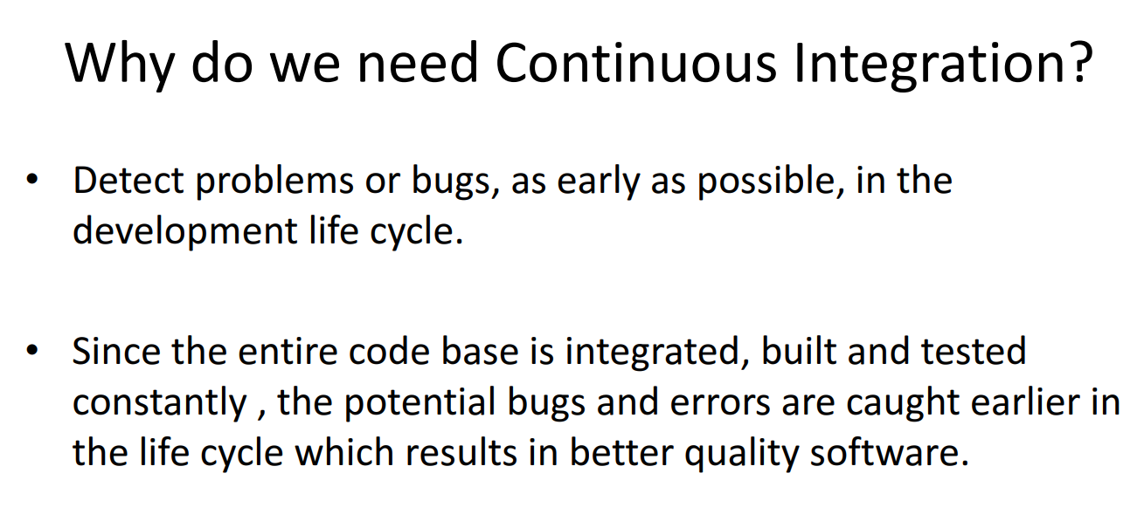

Slide 9
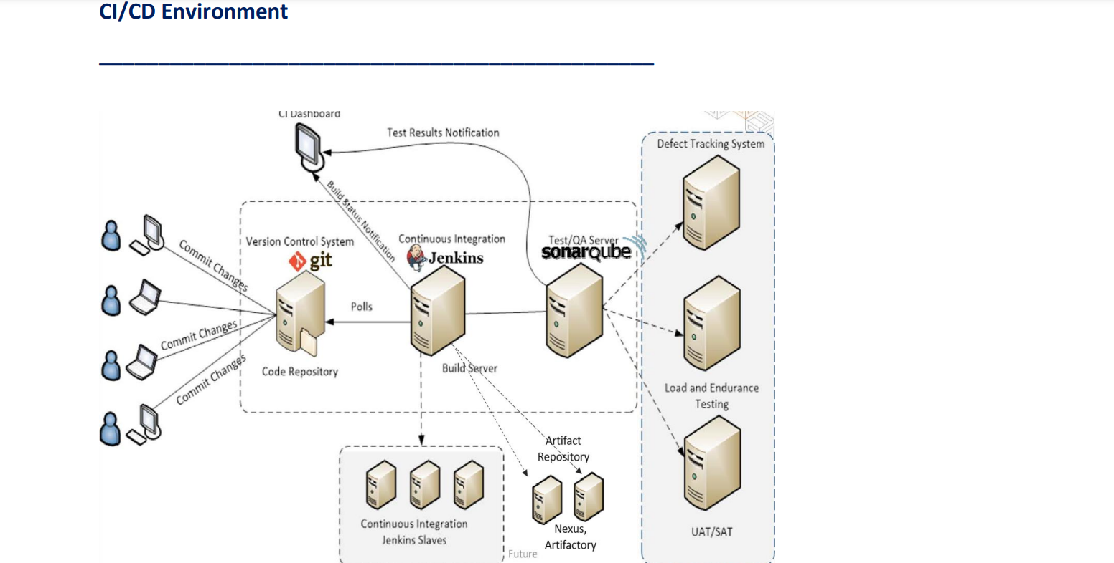

Slide 10
Jenkins Installation..
--> Jenkins needs Java for running
$ sudo apt update
$ sudo apt install openjdk-8-jdk
$ wget -q -O - https://pkg.jenkins.io/debian-stable/jenkins.io.key | sudo apt-key add
$ sudo sh -c 'echo deb http://pkg.jenkins.io/debian-stable binary/ > /etc/apt/sources.list.d/jenkins.list'
$ sudo apt update
--> Install Jenkins
$ sudo apt install jenkins
$ sudo systemctl start jenkins
$ sudo systemctl status jenkins

Slide 11
Access Jenkins homepage using the public IP of the instance
IP-address:8080
Jenkins runs on port 8080 by default.Make sure your all traffic is open on your security group for testing purposes

Slide 12
Copy the path to get the "IntialAdminPassword" showing in above screenshot
$ sudo cat /var/lib/jenkins/secrets/initialAdminPassword
The above command show the password copy N paste it there
--> Click on Install Suggested Plugins
--> Create First admin user The first user which we create here is the admin user of the jenkins.
--> Click on save and continue. Click on save and finish

