Slide 1
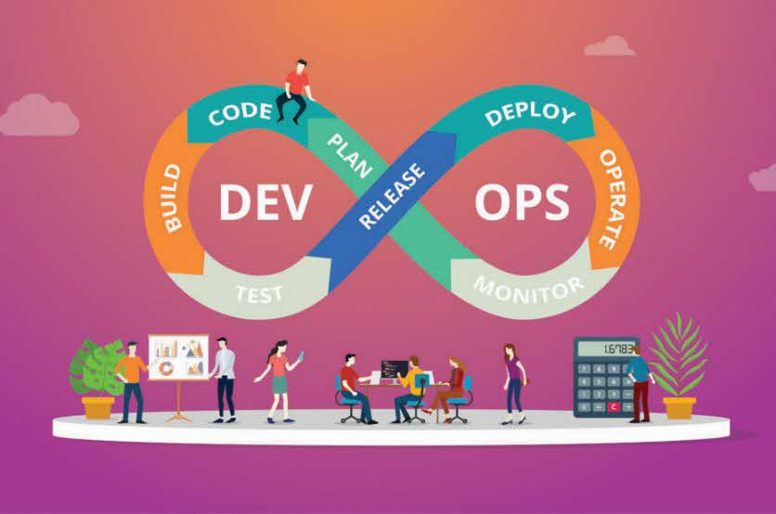
Ninjas
Squad - 6
Members
Dipanjana (381452)
Mathanagopal (391820)
Prakash Kumar (183563)
Aldrin (497952)
ObuliRajDina (206899)

Slide 2
What was done as part of case Study​
Ninjas team used Declarative Pipeline (Groovy script )
Created VM’s (Deploy/Sonarqube/Test/Prod) with all required ​packages (Jenkins, Tomcat-8, JDK8, Postgres, Sonarqube)
Integrated GIT, Slack and Jira​
Containerize the app – Build => Push => Run​

Slide 3
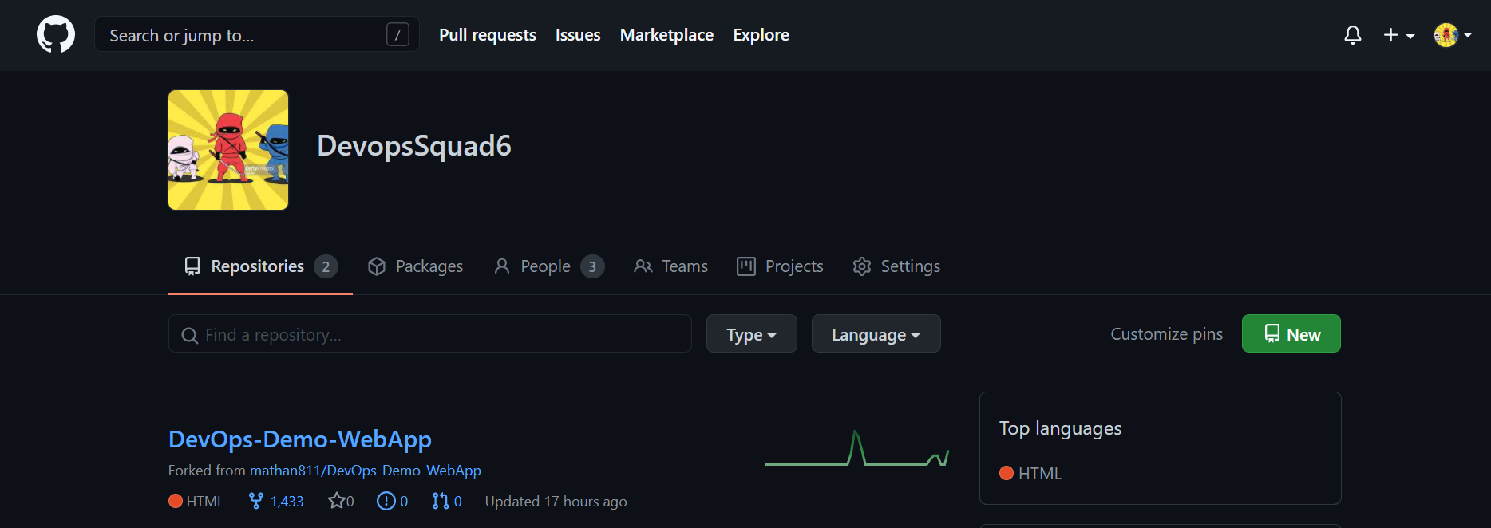
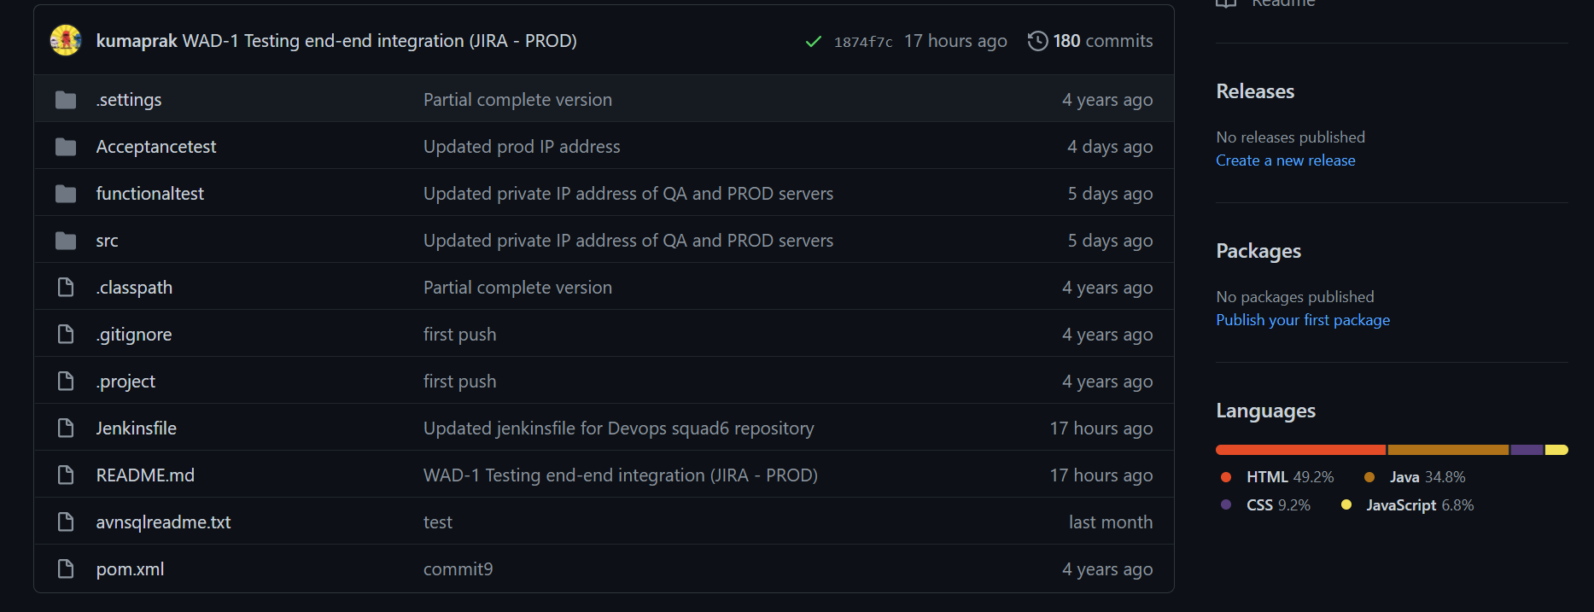
GitHub Repositories

Slide 4
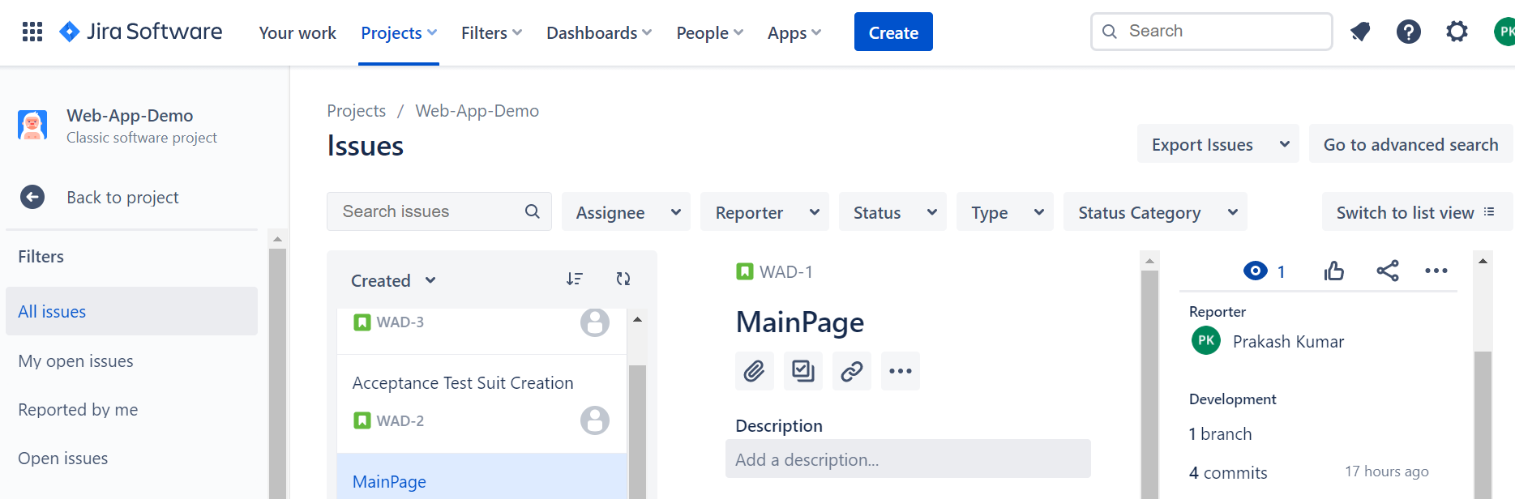
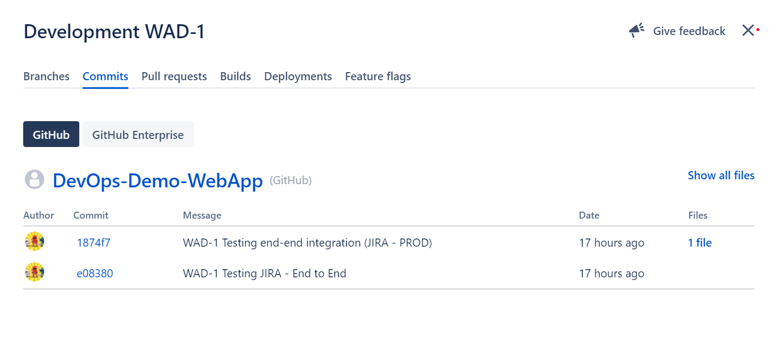
Integration of JIRA - GitHub

Slide 5
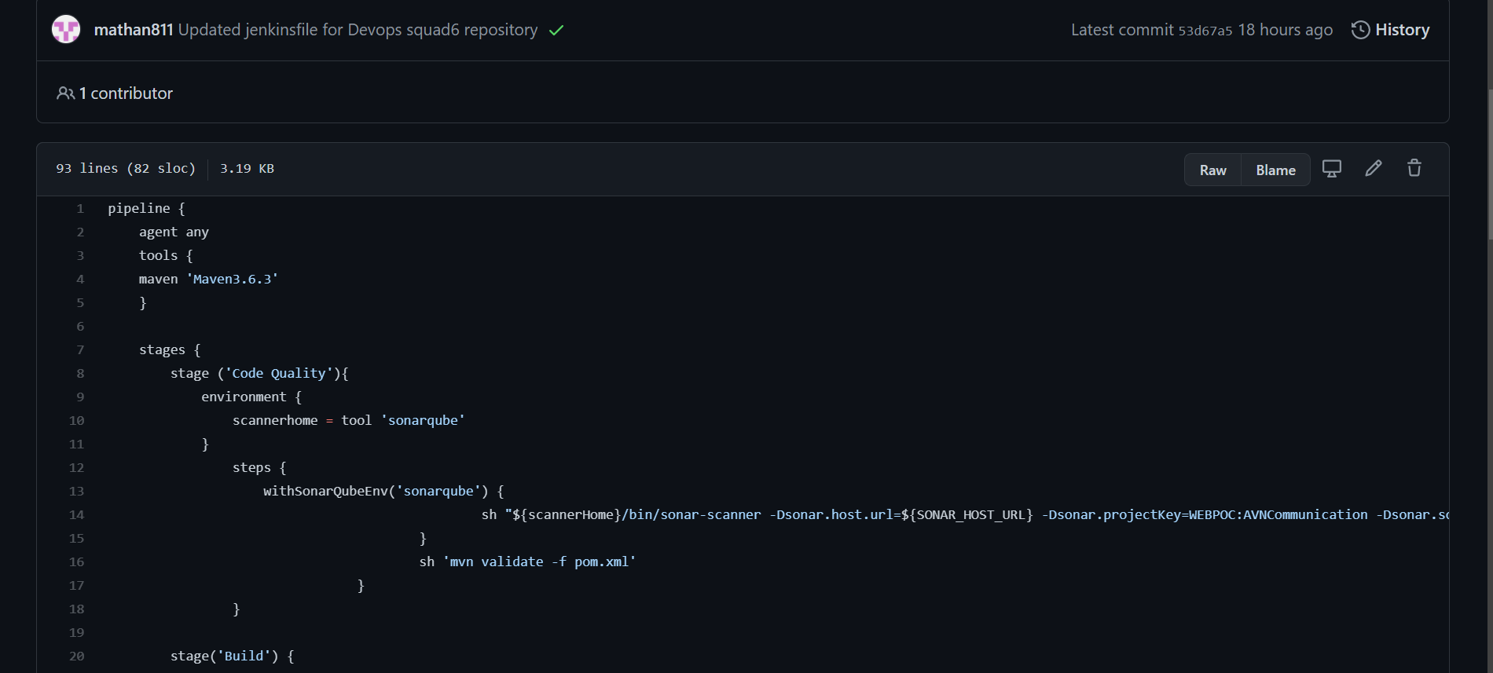
Jenkinsfile – Declarative Pipeline

Slide 6
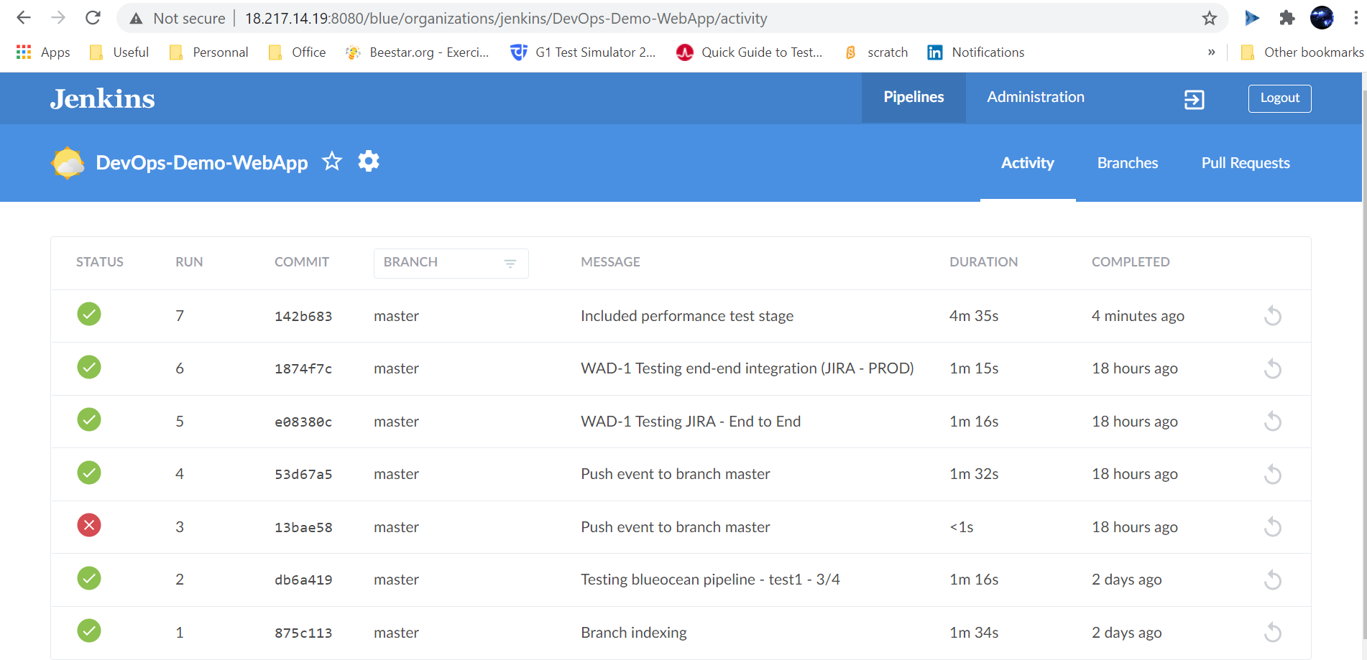
CI /CD Pipeline – Build Execution (Trigger via Webhook)

Slide 7
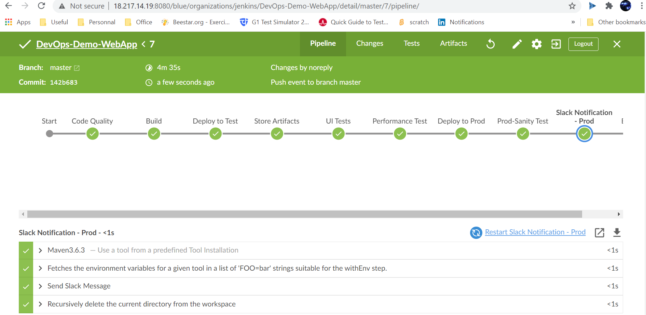
CI /CD Pipeline – Blue Ocean View

Slide 8
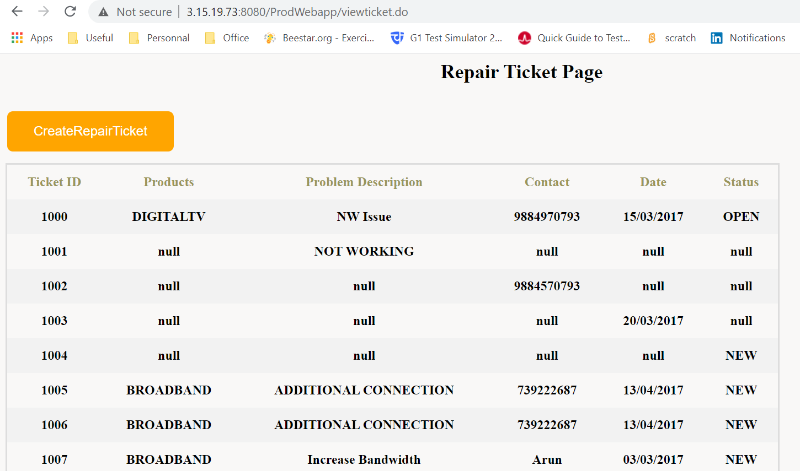
Deployment – WebApp on PROD Environment

Slide 9








Links
Jira https://devopsbc.atlassian.net/
GitHub https://github.com/DevopsSquad6/DevOps-Demo-WebApp/blob/master/Jenkinsfile
Jenkins http://34.68.44.171:8080/manage (User: Jenkins | Pass: Jenkins)
SonarQube http://35.224.54.238/projects (User: sonar | Pass: sonar)
Slack https://app.slack.com/client/T01M968QZSM/C01MWUCLMLM
Jfrog https://mathanjfrog.jfrog.io/ui/login/
Blazemeter https://a.blazemeter.com/app/#/accounts/748457/workspaces/756606/dashboard
Test Server http://18.217.15.48:8080/QAWebapp/ (User: tomcat| Pass: tomcat)
Prod Server http://3.14.10.76:8080/ProdWebapp/ (User: tomcat| Pass: tomcat)

Slide 10
