Slide 1

Soil Pollution and Conservation of Nature

Slide 2

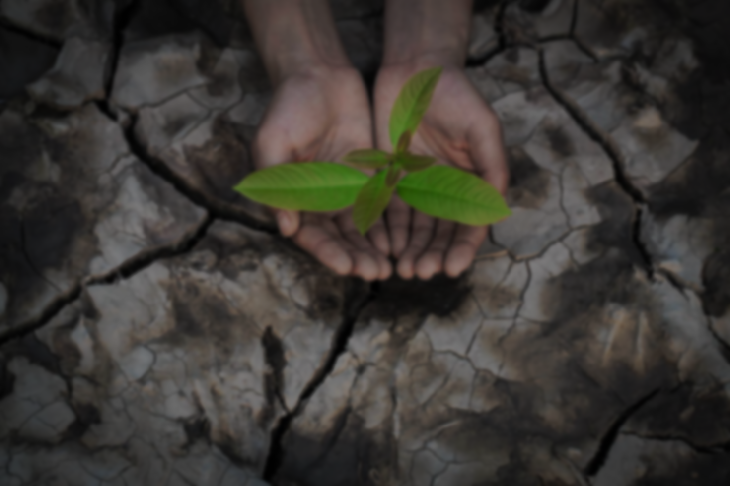
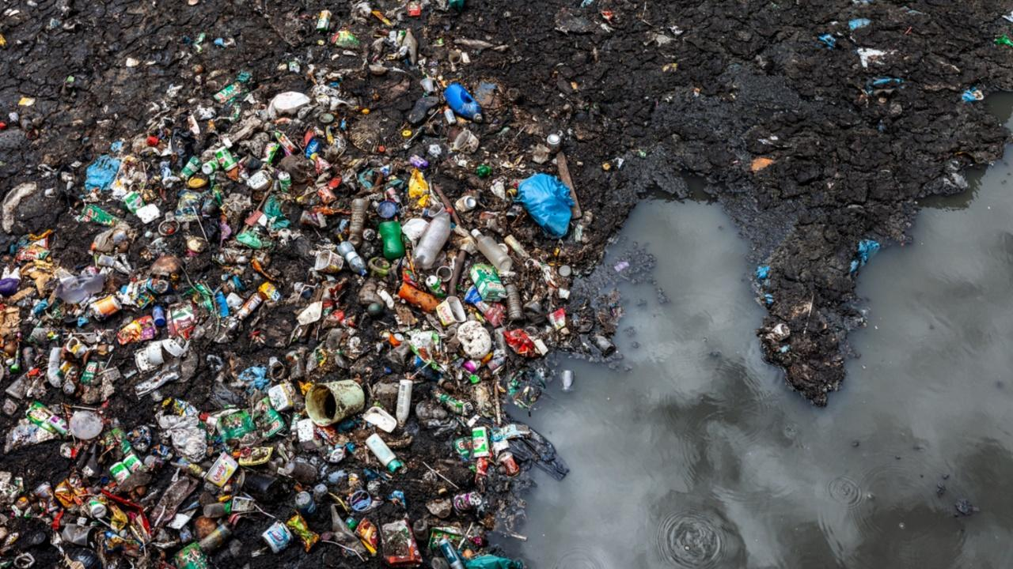
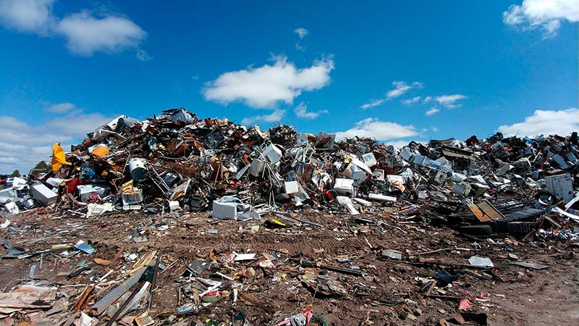
Soil Pollution
Definition: Degradation or destruction of earth‘s surface and soil directly or indirectly as a result of human activities.

Slide 3

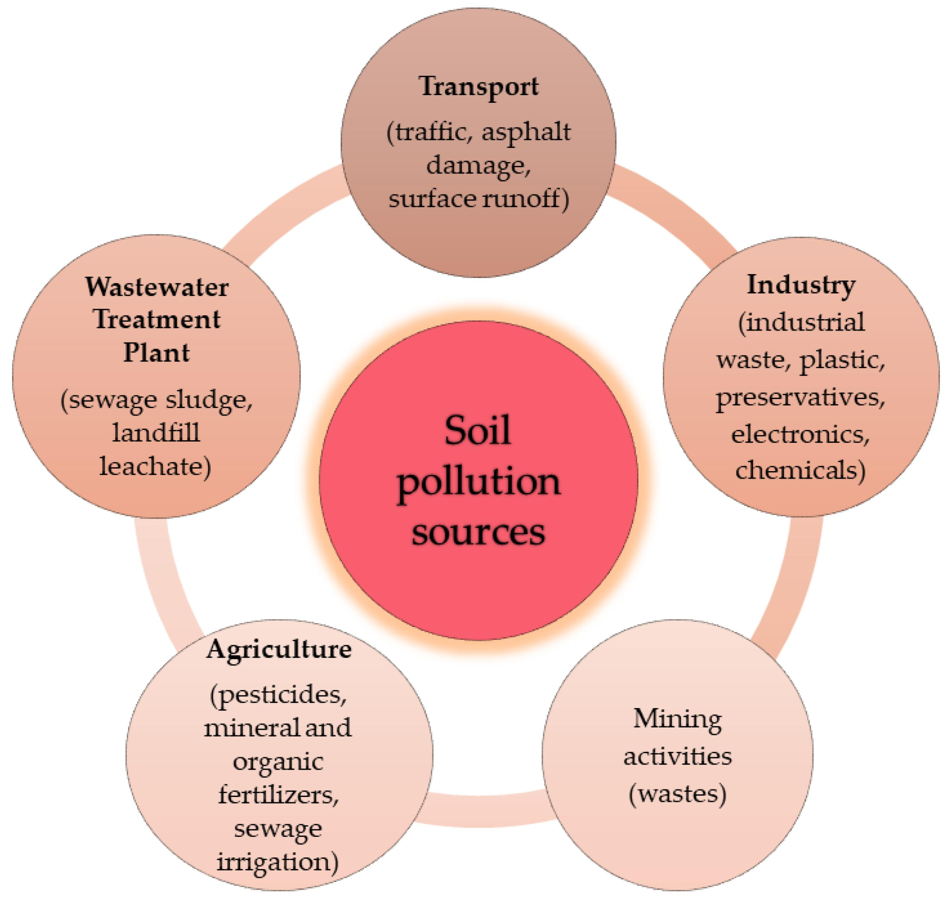
Causes of Soil Pollution
Following are the causes of soil pollution:
Agricultural waste
Acid rain
Mining wastes
Industrial wastes
Garbage
Contamination caused by war
Deforestation

Slide 4

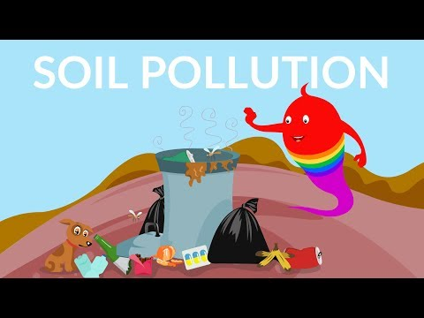
Effects of Soil Pollution
Following are the effects of soil pollution:
Land becomes unsuitable for cultivation.
Leads to health problems.
Effects plants and animals life.
Decrease the water holding capacity of soil.

Slide 5
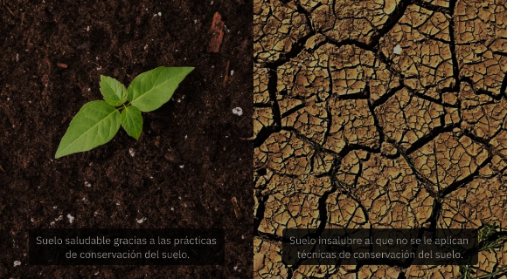
Control of Soil Pollution
Following steps should be adopted to control soil pollution:
Aware people about the concept of 3R’s.
Reduction in use of pesticides and fertilizers.
Avoid buying packages items.
Biodegradable materials should be converted to compost.
Ensure use of biodegradable products.
Grow food without use of pesticides.
Avoid single use items.
Municipal corporations should handle the waste disposal efficiently and in a sustainable manner.

Slide 6

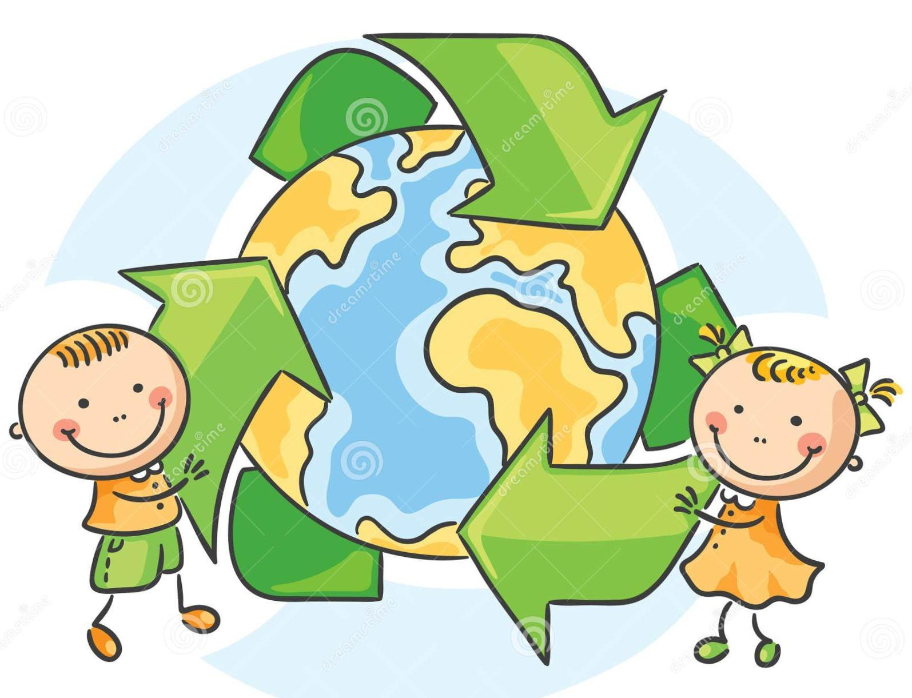
Conservation of Nature
Conservation: The balanced and planned use of natural resources is called conservation.

Slide 7
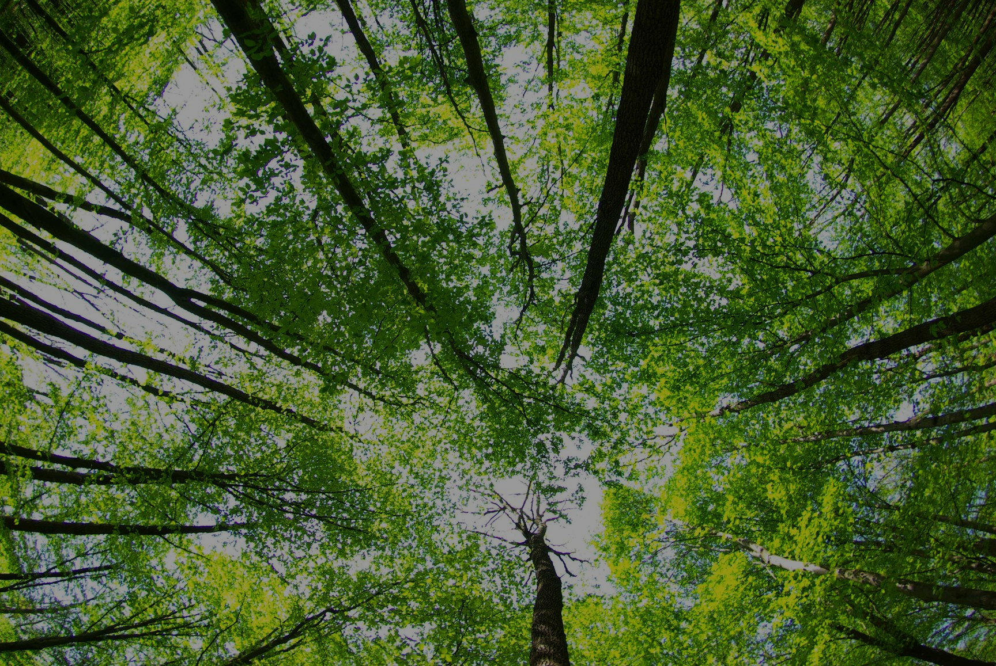
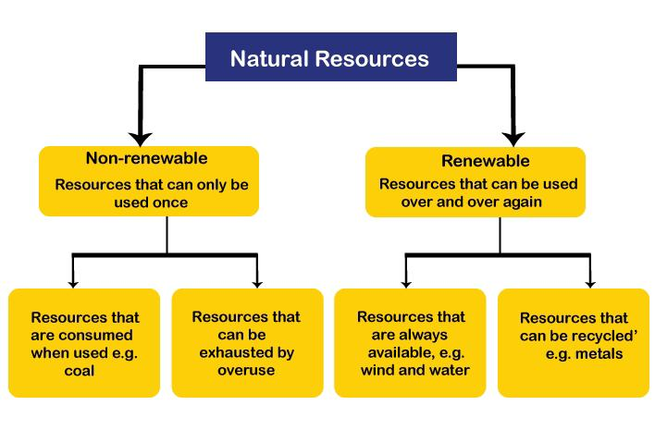
Natural Resources:

Slide 8
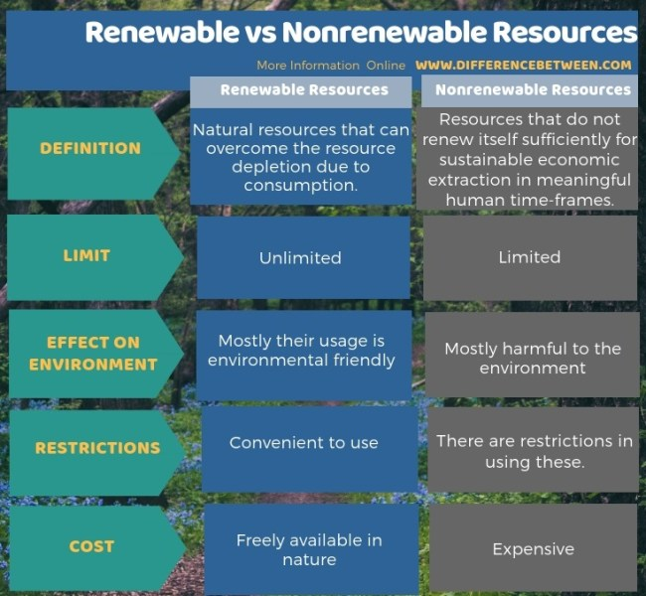
Renewable and Non-Renewable resources:

Slide 9
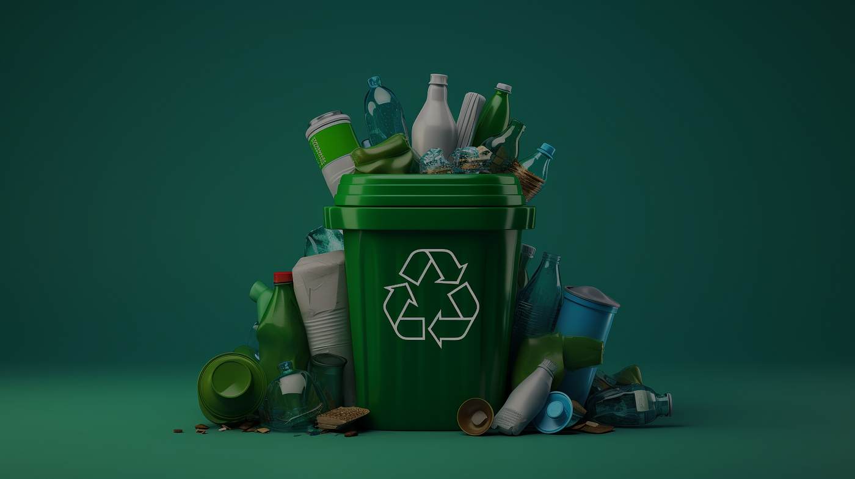
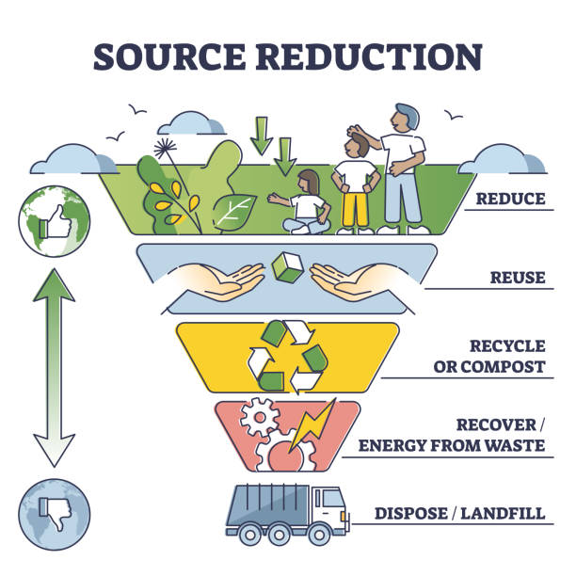
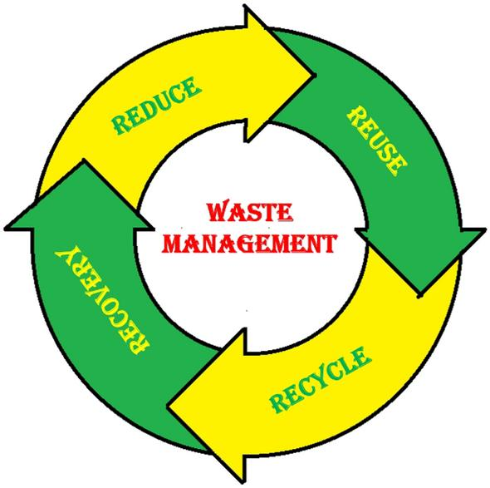
4R’s of Waste Management

Slide 10
4R’s of Waste Management
Reduce: Minimize the amount of waste we create.
Reuse: Promote the use of non-biodegradable materials.
Recycle: Process waste into a state from which new useful items can be produced.
Recover: Convert waste into useful resources.
4R’s of waste management has lots of diversity. It can be Recover, Replace, Rethink,
Repair, Renew, Reimagine, Rediscover, Reforest and so on.

Slide 11
Summary
Soil pollution is the contamination of earth’s surface.
Agricultural waste matter, acid rain, mining wastes, industrial wastes etc are the causes of soil pollution.
Soil pollution has adverse effect on environment as well as on humans.
Soil pollution can be controlled by the concept of 4R’s.
Reduce use of single use items, pesticides and fertilizers etc to control soil pollution.
Conservation of nature means the conservation of natural resources.
Natural resources may be renewable or non-renewable resources.
Renewable resources are replaced by natural cycles.
The natural resources that are found in Earth in fixed quantity are called non-renewable resources.
Non-renewable resources if consumed once will be no more available in future.
The 4R’s of waste management are Reduce, Reuse, Recycle and Recover.

Slide 12


