Slide 1
Minecraft Modding
Workshop

Slide 2
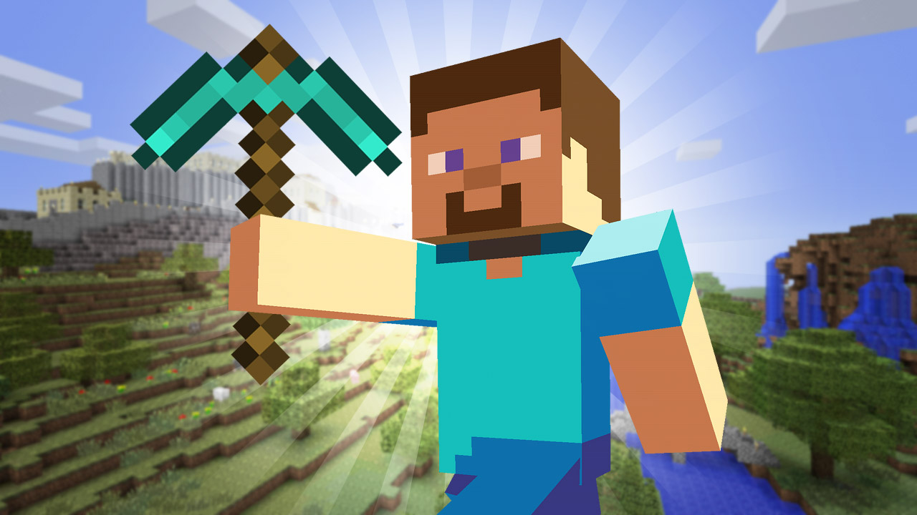
Minecraft

Slide 3
What are we doing today?
modding
  Change game experience of Minecraft and create new game goals
Extend Minecraft to create a new game
  Create a hide and seek game
  We do this with a self created program

Slide 4
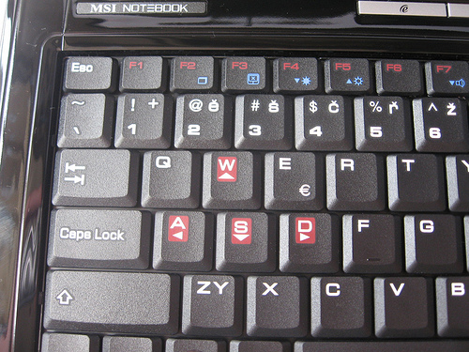
Controls
WASD for moving
Space → jumping
Notes:
Im Flugmodus:
aufsteigen → Leertaste gedrückt halten
Sinken → Umschalttaste gedrückt halten
Modus verlassen → Leertaste erneut doppelt

Slide 5
Commands
minecraft.Minecraft.create() | Create connection to Minecraft
mc.postToChat(„text“) | Post a text message to the game chat
mc.player.getPos() | Get the player's position in the world (x,y,z)
mc.setBlock(x,y,z,block-id) | Set block with block-id to the given position (x,y,z, block-id)
time.sleep(seconds) | Stop the game for some seconds
random.randrange(from,to) | Return a randomly created number in an area from → to
Notes:
Wie alles funktioniert macht der Betreuer mit seiner Gruppe

Slide 6
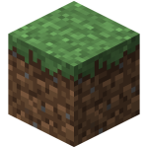

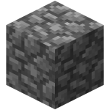
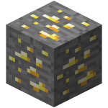

Block-id
GRASS
WOOD
COBBLESTONE
GOLD_ORE
GLOWING_OBSIDIAN

Slide 7
Useful links
API:
http://www.stuffaboutcode.com/p/minecraft-api-reference.html
Getting-Started:
https://www.raspberrypi.org/learning/getting-started-with-minecraft-pi/
Examples:
http://www.stuffaboutcode.com/p/minecraft.html

