Slide 1
MES
~PIP INSTALL ERROR

Slide 2
Mineral Exploration System:
An AI/ML - powered solution to streamline mineral exploration using the Geological Survey of India's BHUKOSH portal data, aiming to identify economically viable mineral reserves efficiently .

Slide 3
AGENDA
Introduction
Role of Technology
SWOT Analysis
Analysis

Slide 4
INTRODUCTION
Mineral exploration traditionally relies on labor-intensive data integration and interpretation, often leading to inefficiencies and inaccuracies. The BHUKOSH portal offers extensive geological datasets, yet they remain underutilized. This project aims to harness AI and ML techniques to streamline exploration processes, enhance resource allocation, and improve the accuracy of identifying viable mineral reserves. By integrating and analyzing geological data, and providing advanced visualization, the goal is to create a scalable, user-friendly solution that revolutionizes mineral exploration.

Slide 5
ROLE OF TECH.
The role of technology is to make user friendly mineral exploration using the Geological Survey of India’s BHUKOSH portal data by preprocessing, cleaning, and analyzing data with the various ML models like:
XGBoost,
Random Forest
Providing accuracy round 80 to 90% which shows economically viable mineral reserves efficiently.

Slide 6
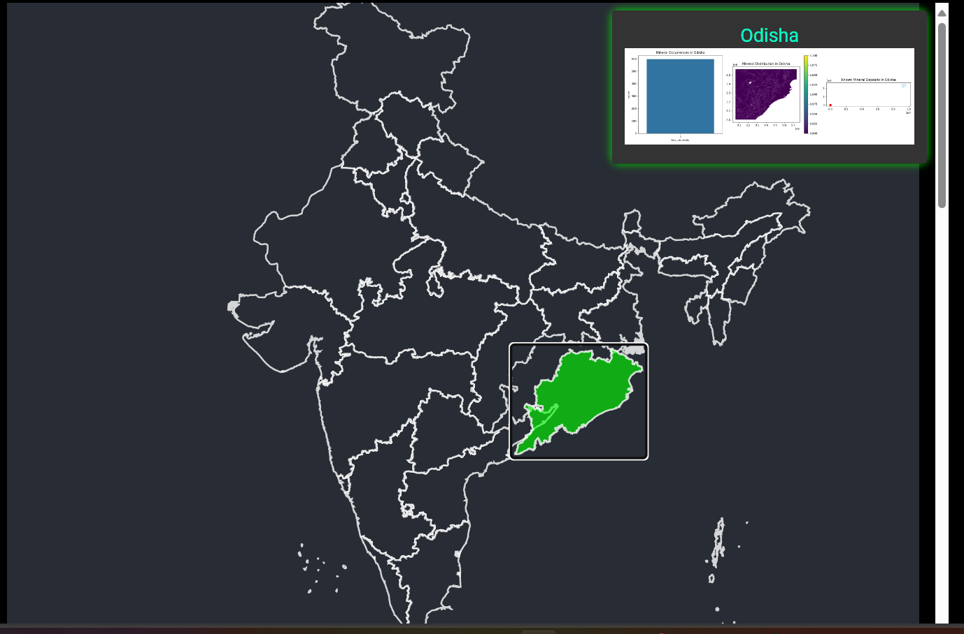

Slide 7
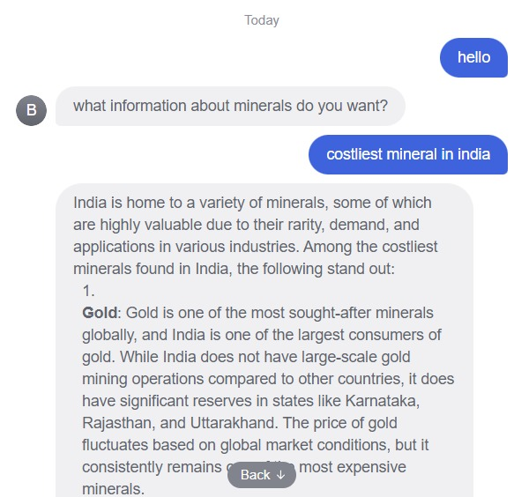
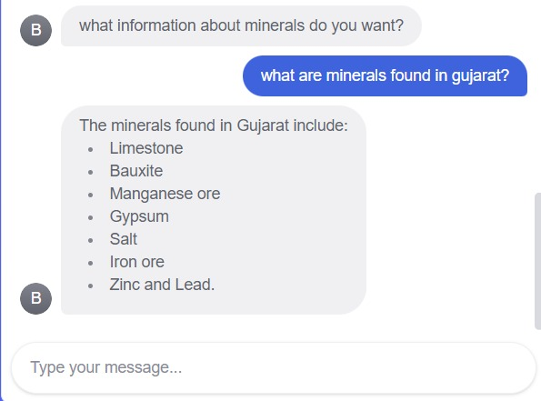
CHAT BOT

Slide 8
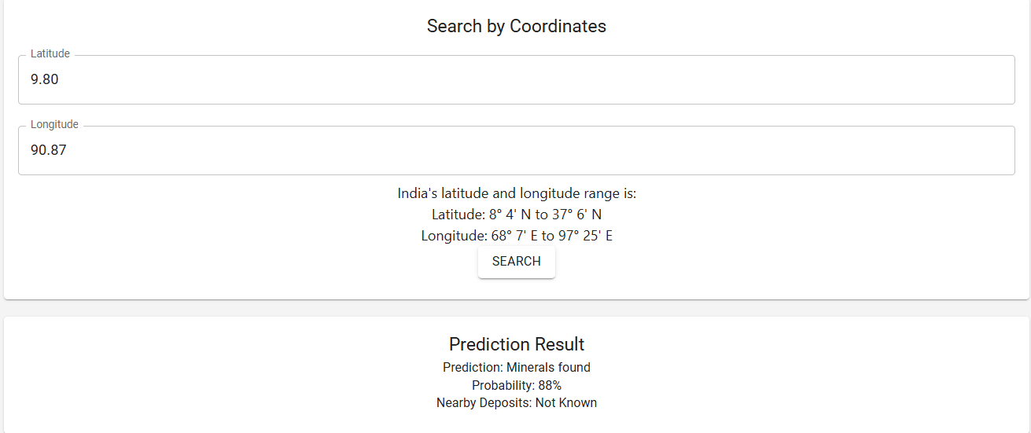
RECOMMENDATION SYSTEM

Slide 9
ANALYSIS
XGBOOST Results:
Best parameters: {'learning_rate': 0.01, 'max_depth': 3, 'n_estimators': 100}
Accuracy: 0.8664
Precision: 0.8664
Recall: 1.0000
F1 Score: 0.9284
RANDOM_FOREST Results:
Best parameters: {'max_depth': 5, 'min_samples_split': 10, 'n_estimators': 100}
Accuracy: 0.8664
Precision: 0.8664
Recall: 1.0000
F1 Score: 0.9284

Slide 10
SWOT ANALYSIS
STRENGTH Advanced Technology Integration Improved Accuracy Scalability | WEAKNESS Data Complexity Resource Intensive User Adoption
OPPORTUNITIES Innovation in Exploration Industry Adoption Partnerships | THREATS Technical Challenges Competition Data Limitations

Slide 11
FUTURE SCOPE
Enhance UI for more feasibility
Building more accurate models for more accuracy
Processing through images

