Slide 1
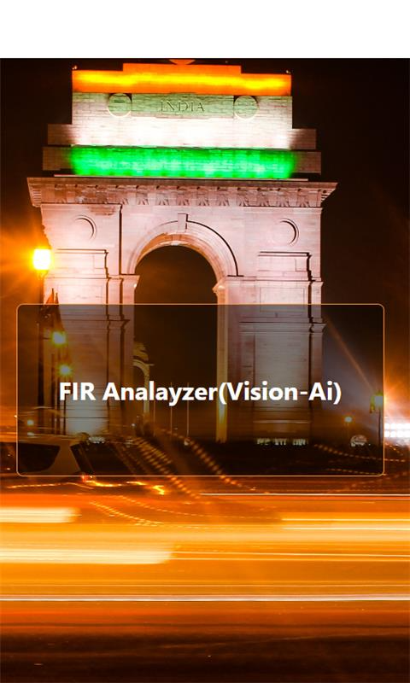


Introduction to Legal-Angel AI-Project

Slide 2
Main Functionality of Legal-Angel Project
1
Fir Analysis using Tesseract OCR + LLMs
Users can easily upload PDF or image files and then Tesseract OCR extract data from that file and then send it to LLM(Google-Flan) for predicting IPC section.
2
Fir Analysis using vision-pro by Google
Instead of using OCR for PDFs or images, streamline the process by sending the data directly to Vision-Pro. It reads the information and suggests the relevant IPC section accordingly.
3
Legal-Assistant : Chat-Bot
legal chat-bot! Fueled by Gemini-Pro model and supported by Google Generative AI, it provides personalized legal advice. Just share your legal query with it, and receive intelligent responses crafted by Gemini-Pro to guide you through legal complexities.

Slide 3
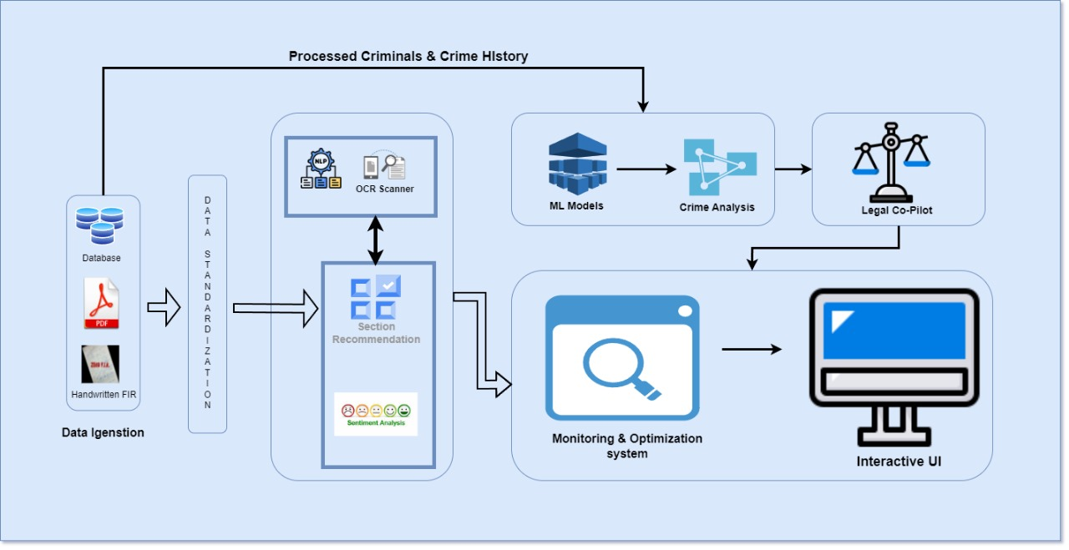
System Architecture Overview

Slide 4
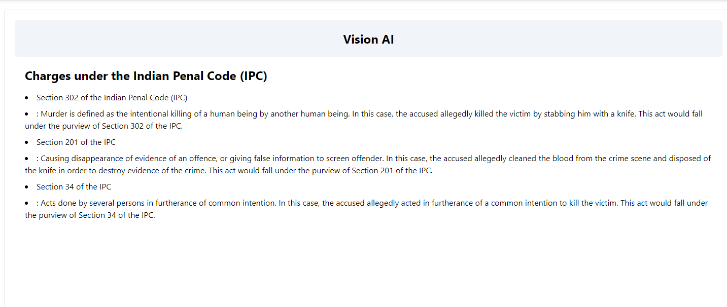
Gemini Vision Pro: Automated IPC Suggestions

Slide 5
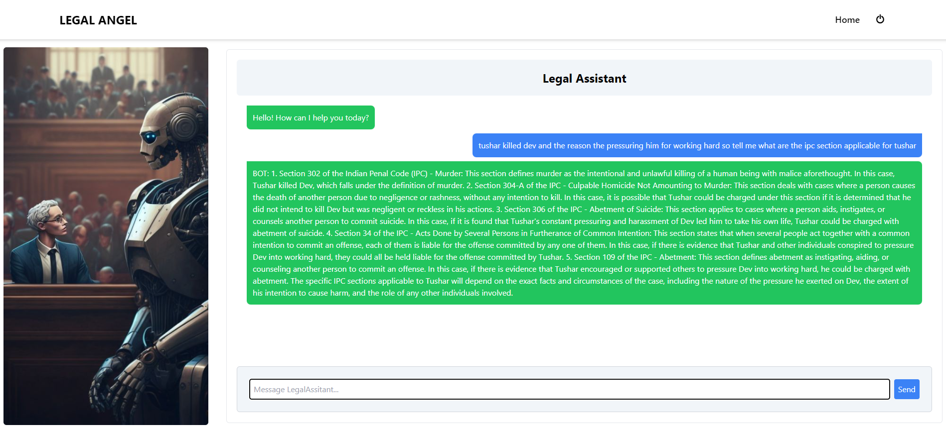
Legal-Assistant : Chat-Bot

Slide 6

Conclusion and Next Steps
Future Development
Feedback and Integration
Legal-Angel is committed to continuous improvement and expansion of its capabilities.
Feedback mechanisms will be integrated to enhance user experience and satisfaction.

Slide 7
Thank You!

