Slide 1
MAS-RELIAB
Measured offline simulation pilot
Failure propagation · attribution · mitigation · reliability–cost trade-offs
Dev Parth
16 August 2026 · v0.2.0
Synthetic-agent evidence — not LLM or deployment evidence

Slide 2
Evidence boundary
The most important interpretation rule
0
150
16,560
82,800
LLM/API calls
generated tasks
episodes
trace events
• Validates implementation, causal bookkeeping, and configured simulator mechanisms.
• Does not establish real-agent reliability, safety, or topology superiority.
• All cost and latency values are simulated; tokens are not applicable.
MAS-RELIAB · Dev Parth · Offline simulation pilot
2

Slide 3
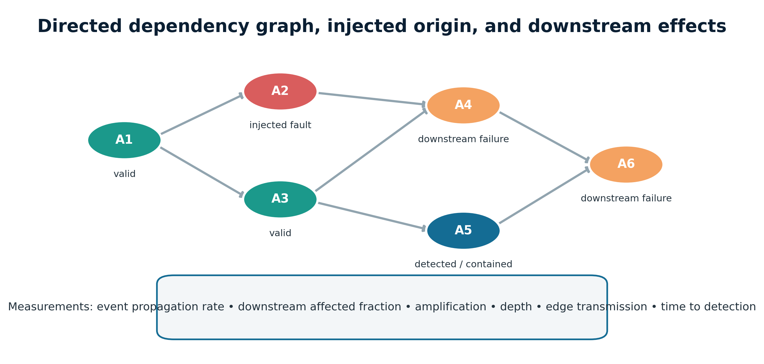
Problem: success alone is diagnostically weak
• Was an injected fault applied and consumed?
• Where did it originate and how far did it spread?
• Could available evidence attribute it?
• Did verification or recovery stop it?
• What reliability cost was paid?
MAS-RELIAB · Dev Parth · Offline simulation pilot
3

Slide 4
Contribution and positioning
What MAS-RELIAB contributes
What it does not claim
• One auditable methodology linking controlled faults, lineage, attribution, mitigation, and cost.
• Exact-state tasks and explicit intervention denominators.
• Executable repository, raw traces, paired inference, and negative findings.
• Not the first multi-agent reliability framework.
• Not a replacement for MAST, MultiAgentBench, ReliabilityBench, TraceElephant, RiskLab, or cascade benchmarks.
• Not evidence about any model, vendor, or production system.
MAS-RELIAB · Dev Parth · Offline simulation pilot
4

Slide 5
Research questions and hypotheses
RQ1/H6
Multidimensional reliability
RQ2/H1
Fault type, severity, position
RQ3/H2
Observability and attribution
RQ4/H3
Local verification
RQ5/H4
Recovery–cost trade-off
RQ6/H5
Topology × location
Hypotheses were decisions, not promises: mixed and null results were retained.
MAS-RELIAB · Dev Parth · Offline simulation pilot
5

Slide 6
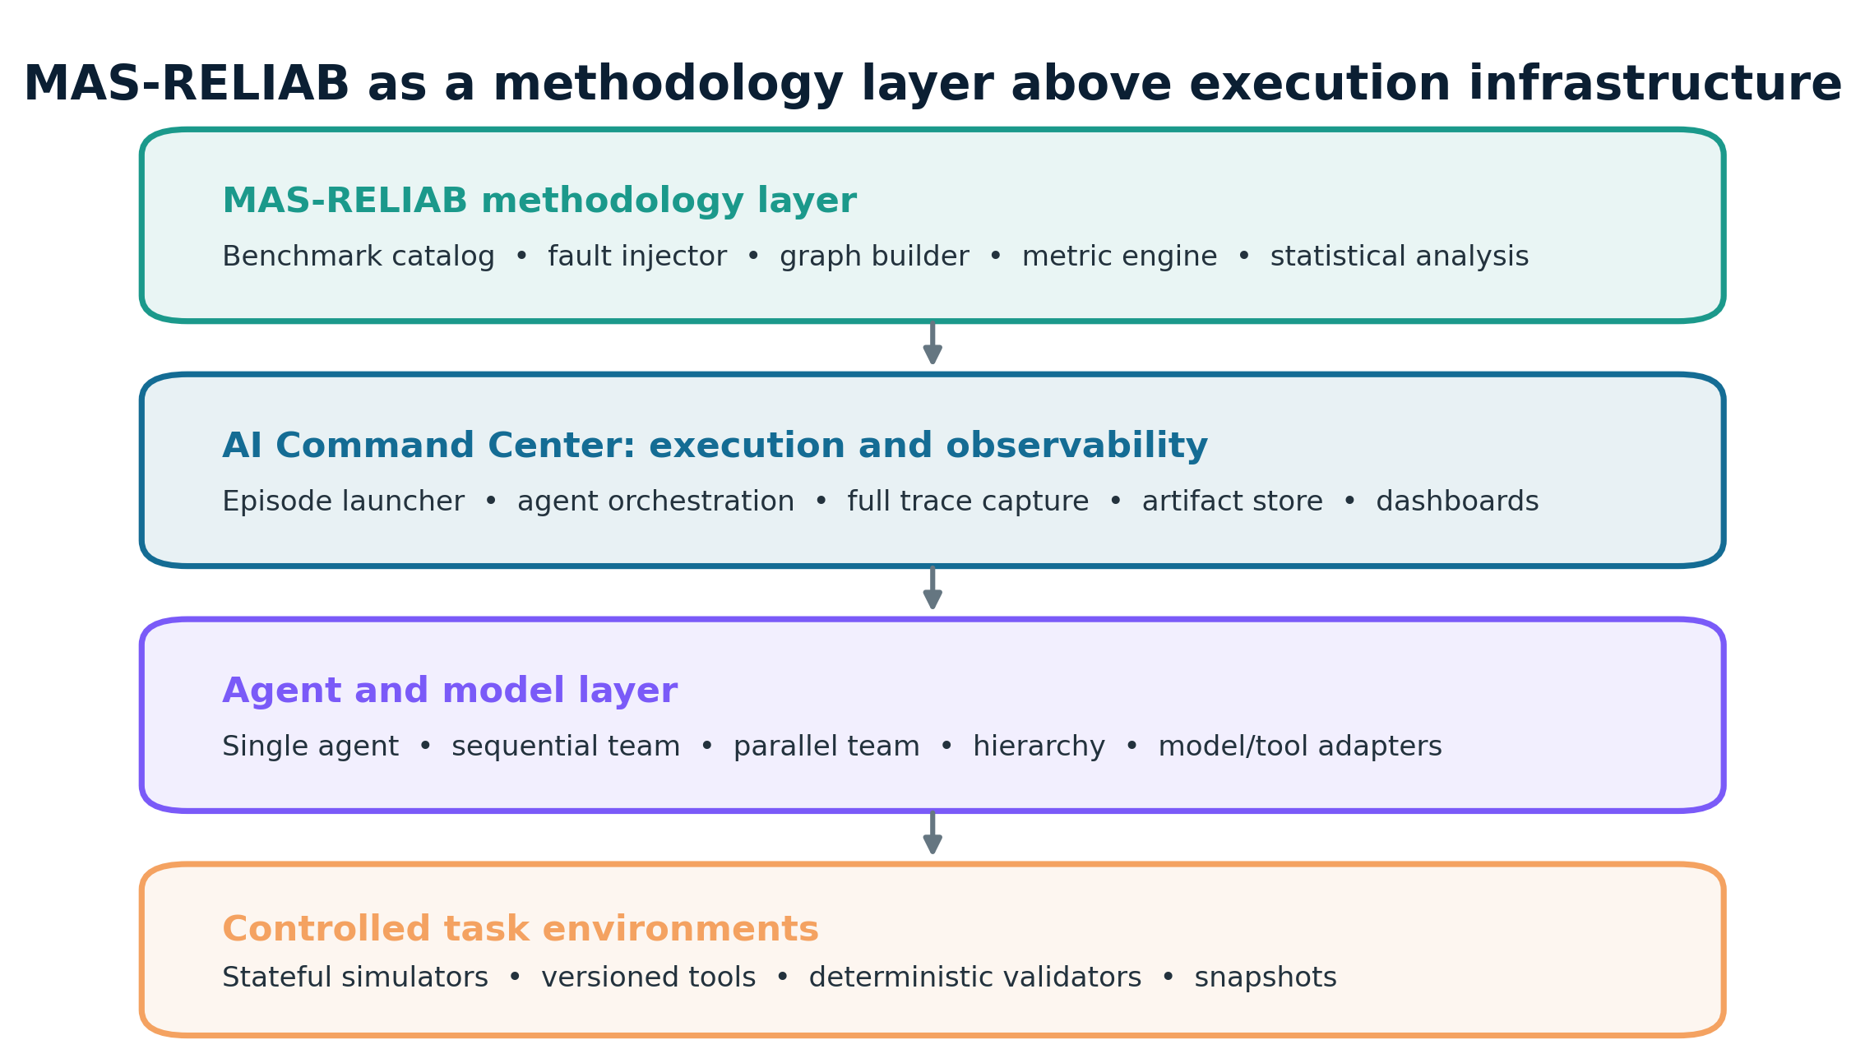
Simulator and exact-state tasks
• Five task families; associative exact-state gold labels.
• Four topology plans with stochastic intrinsic errors.
• Unique fault lineage follows corrupted state through the DAG.
• Lineage stops on correction or algebraic masking.
• No subjective judge or text similarity.
MAS-RELIAB · Dev Parth · Offline simulation pilot
6

Slide 7
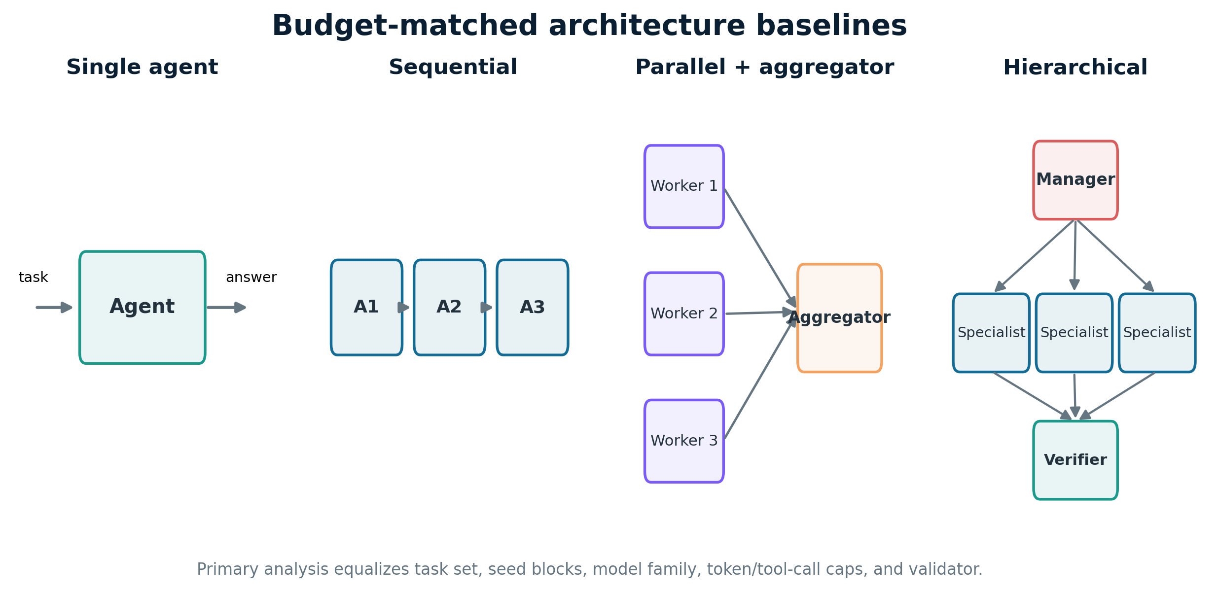
Four execution topologies
• Single: one identity across four stages
• Sequential: four-agent handoff chain
• Parallel: four workers + aggregator
• Hierarchical: workers + managers + root
• Graph size and critical path are not equal — cost is reported
MAS-RELIAB · Dev Parth · Offline simulation pilot
7

Slide 8
Controlled fault protocol
Wrong value
Truncation
Referential drift
Timeout
state perturbation
component loss
bit/field displacement
missing state
• Severity: 1–2 · Position: early / middle / late
• Scheduled ≠ applied ≠ consumed — each is logged
• 11,520 E2 faults; 96.84% applied; 94.97% consumed
• Propagation analyses condition on consumed faults
MAS-RELIAB · Dev Parth · Offline simulation pilot
8

Slide 9
Six experiments and component analysis
E1
Baseline reliability
E2
Fault propagation
E3
Attribution views
1,200 eps
11,520 eps
1,800 records
E4
Verification ablation
E5
Recovery
E6
Cost/topology synthesis
1,920 eps
1,920 eps
derived
Inference: task-clustered bootstrap CIs · paired exact/Wilcoxon tests · effect sizes · Holm adjustment
MAS-RELIAB · Dev Parth · Offline simulation pilot
9

Slide 10
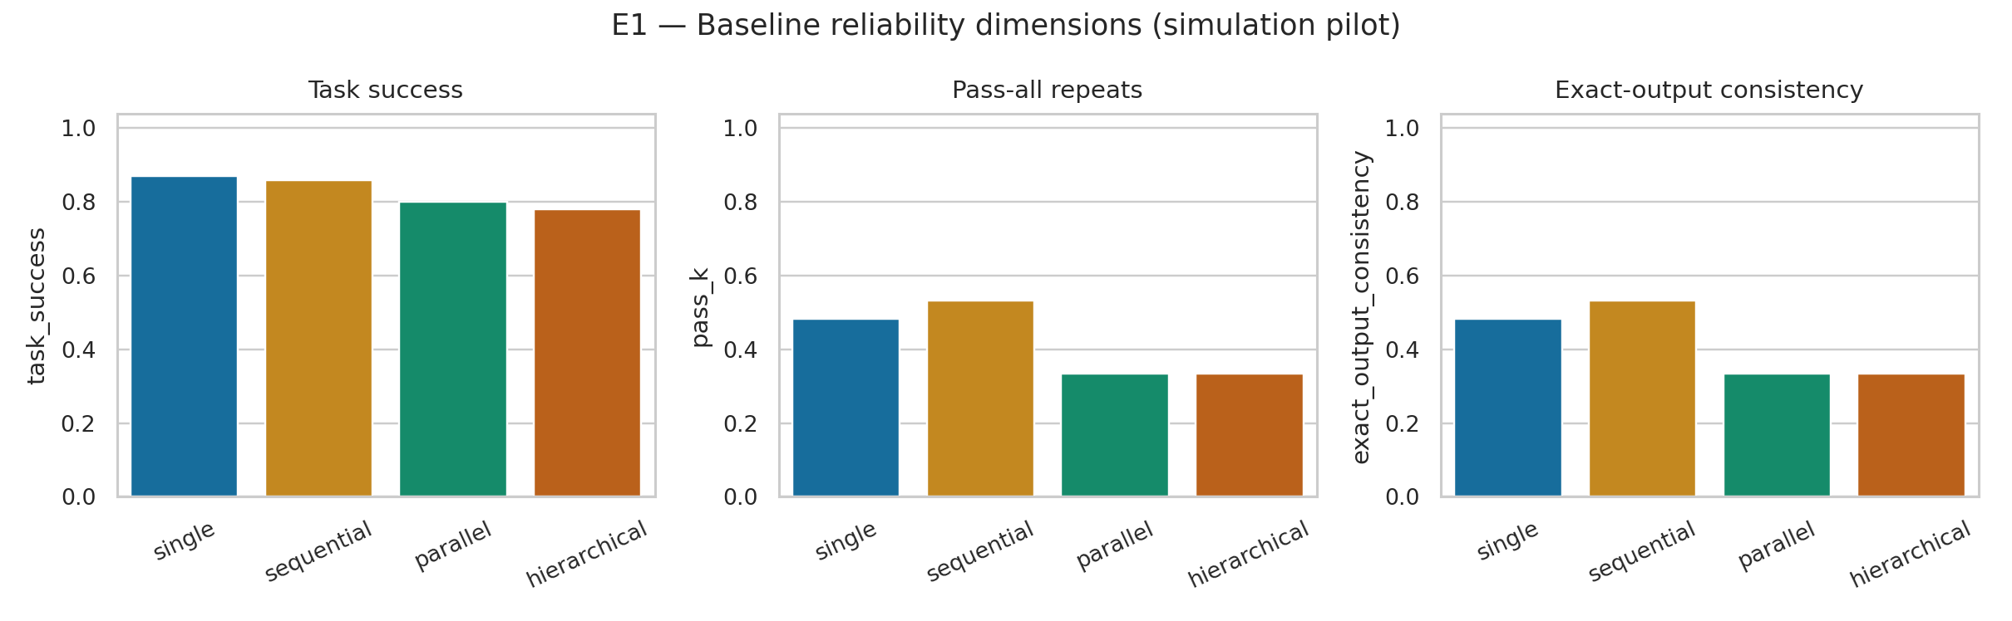
E1 result: reliability is multidimensional
0.870
highest TSR: single
0.533
highest pass-all: sequential
25.75 ms
shortest sim. latency: parallel
H6 not supported by the direct paired DAF contrast.
MAS-RELIAB · Dev Parth · Offline simulation pilot
10

Slide 11
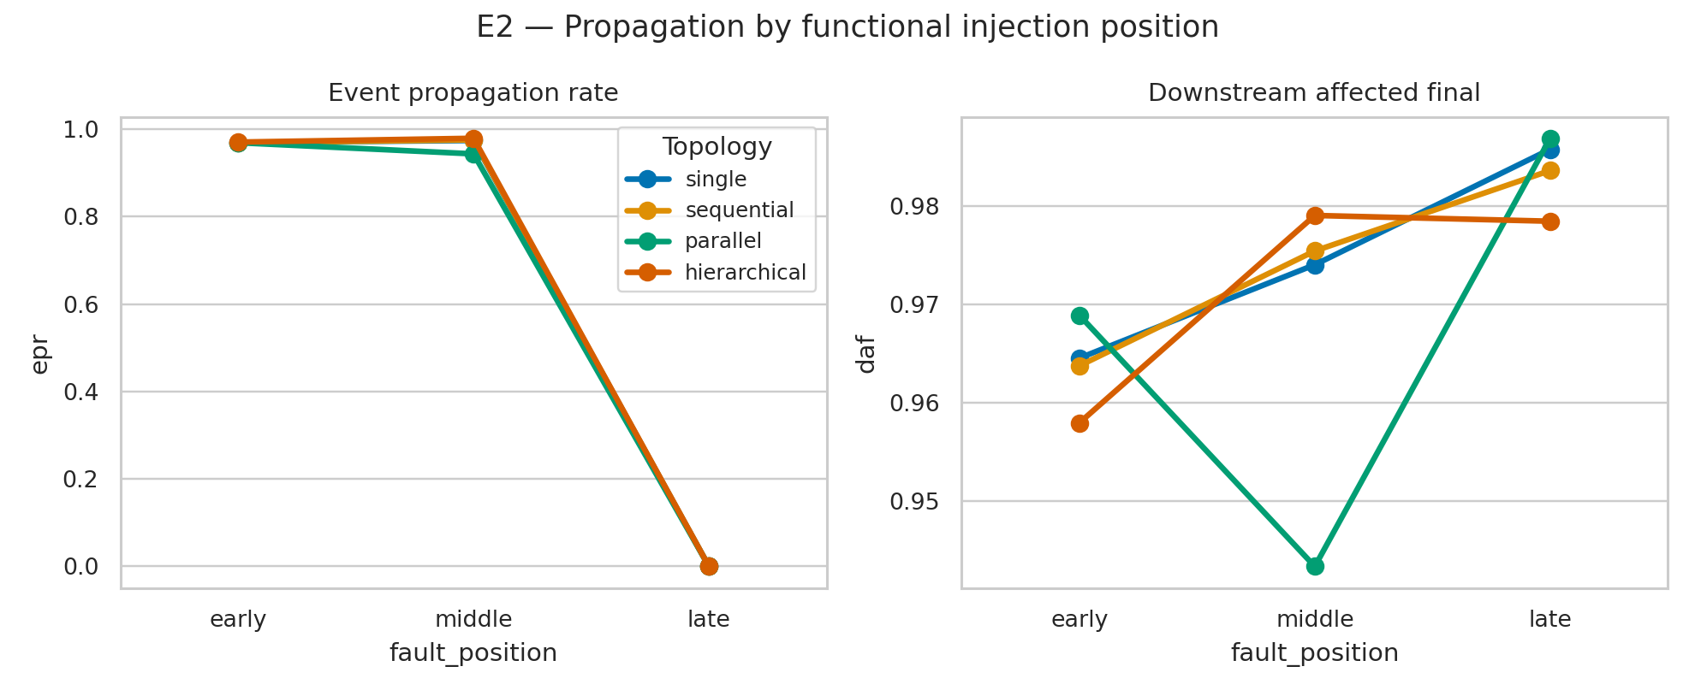
E2 result: position changes opportunity and final impact differently
+0.969
early − late EPR
+2.181
early − late depth
−0.020
early − late DAF
H1: MIXED SUPPORT
MAS-RELIAB · Dev Parth · Offline simulation pilot
11

Slide 12
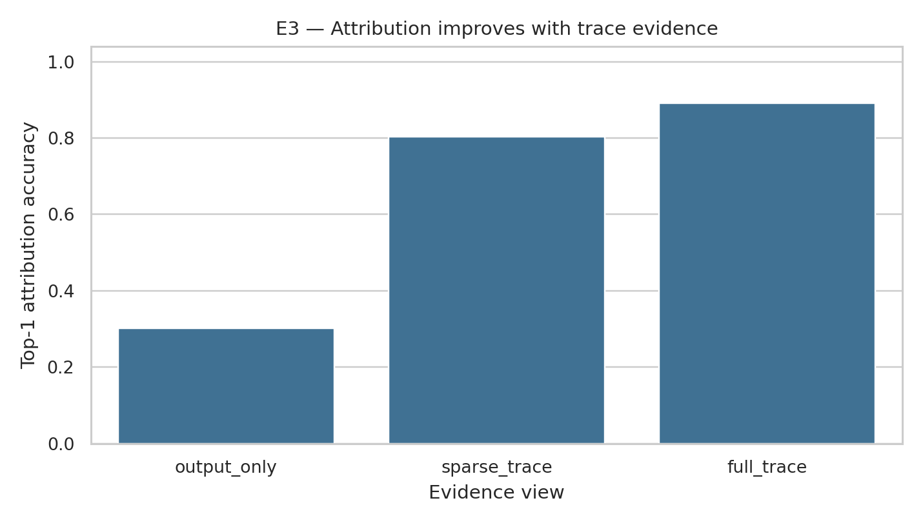
E3 result: trace evidence improves attribution
0.302
0.803
output only
sparse trace
0.892
full trace
Paired full − output: +0.590 95% CI [0.543, 0.637] Holm p < 0.001 · effect 0.839
H2 SUPPORTED — but full trace contains oracle validity
MAS-RELIAB · Dev Parth · Offline simulation pilot
12

Slide 13
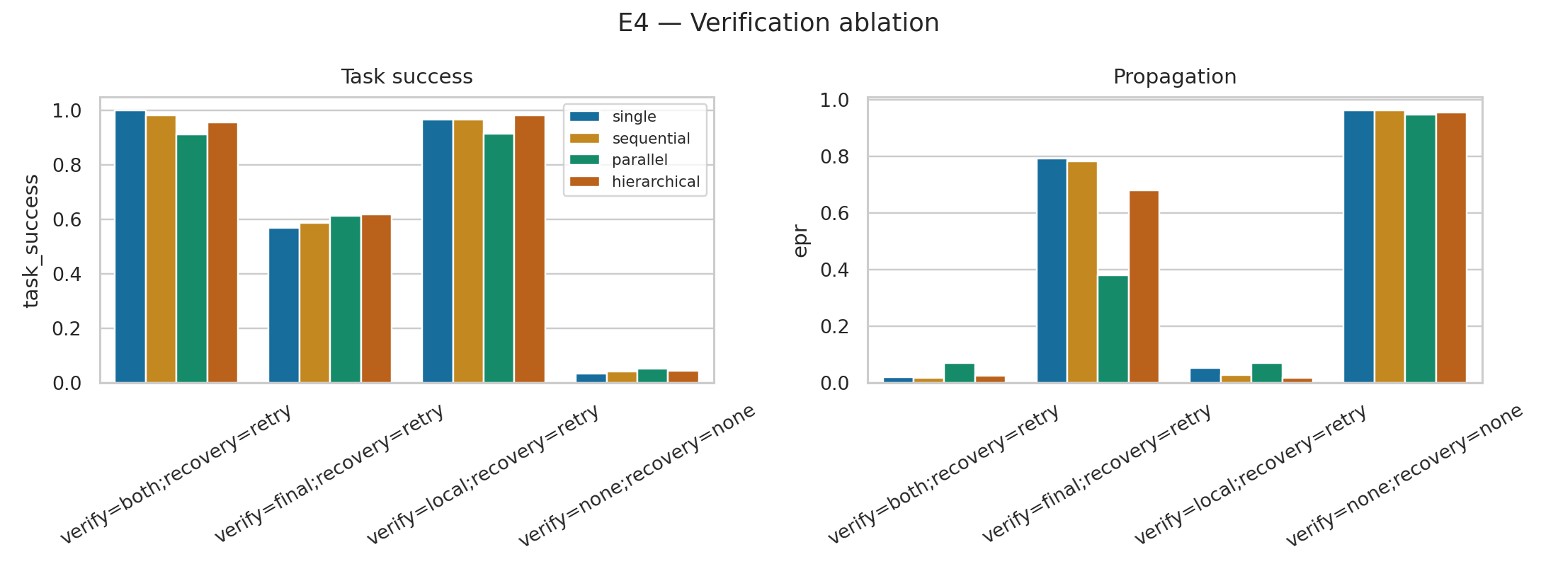
E4 result: local oracle verification contains cascades
−0.619
local − final EPR
+0.505
work units
Both Holm p < 0.001
H3 SUPPORTED Upper-bound result under privileged exact-state checking
MAS-RELIAB · Dev Parth · Offline simulation pilot
13

Slide 14
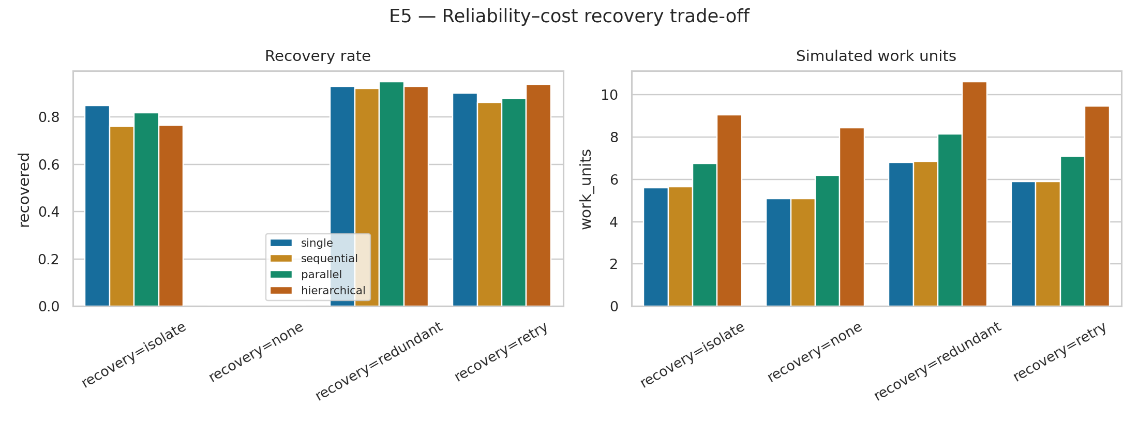
E5 result: no universal recovery winner
+0.036
redundant − retry recovery
+1.013
redundant − retry work
Recovery gain failed Holm correction (p = 0.356). Isolation was cheaper but recovered fewer faults.
H4 NOT SUPPORTED
MAS-RELIAB · Dev Parth · Offline simulation pilot
14

Slide 15
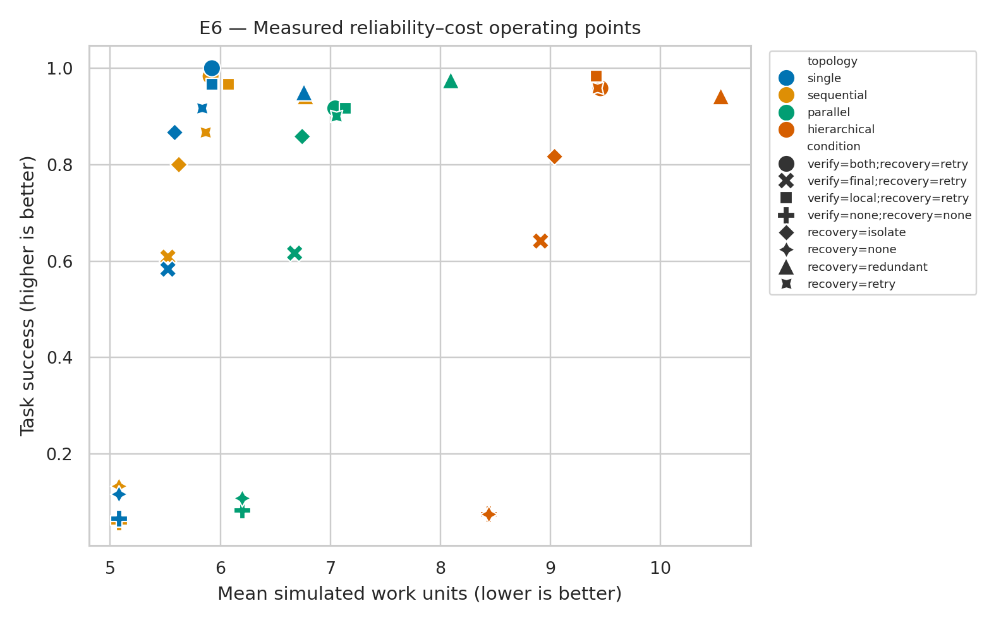
E6 result: reliability–cost operating points
• Redundancy moves upward and right: more success, more work.
• Parallel plans shorten simulated critical path but use more work.
• No scalar composite — weights would encode stakeholder utility.
• H5 and H6 were not supported.
MAS-RELIAB · Dev Parth · Offline simulation pilot
15

Slide 16
Hypothesis decisions: report what happened
H1
MIXED SUPPORT
Early injections increased EPR and depth, but their DAF contrast was lower than late injections; the directional evidence was mixed.
H2
SUPPORTED
Paired full-trace versus output-only top-1 attribution.
H3
SUPPORTED
Paired local-verification reduction in EPR/DAF versus final-only/no verification.
H4
NOT SUPPORTED
Recovery gain and work-unit cost of isolate/redundant versus retry.
H5
NOT SUPPORTED
Hierarchy manager-versus-leaf and parallel-versus-hierarchical worker contrasts.
H6
NOT SUPPORTED
TSR rank=['single', 'sequential', 'parallel', 'hierarchical']; cost rank=['single', 'sequential', 'parallel', 'hierarchical']; DAF-containment rank=['parallel', 'hierarchical', 'sequential', 'single'].
Negative and contradictory outcomes were not converted into confirmations.
MAS-RELIAB · Dev Parth · Offline simulation pilot
16

Slide 17
Methodological weaknesses — research-quality review
• No external validity: synthetic state transformers, not LLM agents.
• Oracle intermediate states make verification and attribution optimistic.
• Researcher-set rates can determine rankings — sensitivity analysis is required.
• Functional positions are not graph-equivalent; late EPR is structurally zero.
• 60 measured tasks and five algebraic families limit generalization.
• Work and latency are simulated, not observed cost.
Verdict
Fit for
implementation pilot method validation hypothesis refinement
Not fit for
deployment claims model rankings safety certification
MAS-RELIAB · Dev Parth · Offline simulation pilot
17

Slide 18
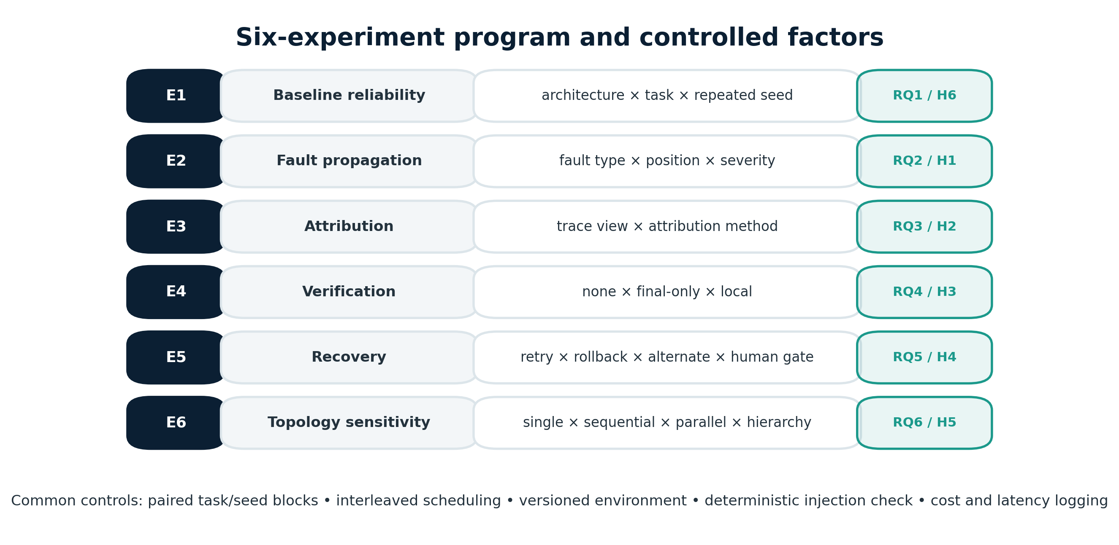
Reproducible artifact
• `bash scripts/run_pilot.sh` regenerates data and results.
• Raw episodes, 82,800 events, seeds, config, source/data hashes.
• Eight measured CSV tables + six empirical figures.
• 18 tests pass; GitHub Actions workflow included.
• Data card, fault protocol, experiment registry, methodology review.
• Release weakness: manifest has no Git commit; tag before publication.
MAS-RELIAB · Dev Parth · Offline simulation pilot
18

Slide 19
What the pilot establishes — and what comes next
Established inside simulator
Required external replication
• Auditable intervention and lineage mechanics
• Trace evidence changes attribution
• Local oracle verification contains cascades
• Recovery has measurable reliability–cost trade-offs
• Hypotheses can be rejected transparently
• Multiple real model families and frozen prompts
• Sandboxed tools and broader task domains
• Fallible verifiers and realistic logs
• Independent synchronized RNG/counterfactual streams
• Observed tokens, latency, cost, hardware
• Preregistered parameter sensitivity
MAS-RELIAB · Dev Parth · Offline simulation pilot
19

Slide 20
Conclusion
MAS-RELIAB is now executable, measured, and auditable.
• 16,560 episodes across four topologies and six experiments.
• H2 and H3 supported; H1 mixed; H4–H6 not supported.
• Report EPR with DAF and reachability — no single score is sufficient.
• The honest contribution is the integrated experimental methodology.
• The honest limitation is equally clear: this is simulation-pilot evidence only.
Questions?
MAS-RELIAB · Dev Parth · Offline simulation pilot
20

Slide 21
Viva backup: likely questions
• Why simulate instead of use LLMs?
• Why is H1 mixed rather than supported?
• Why is late EPR zero but DAF high?
• Does full-trace attribution leak the answer?
• Why not publish a composite reliability score?
• How would you establish external validity?
• What would falsify the methodology’s usefulness?
Answer pattern: result → limitation → next validation step
MAS-RELIAB · Dev Parth · Offline simulation pilot
21

