Slide 1
A Framework for Evaluating Reliability and Failure Propagation in Multi-Agent AI Systems
MAS-RELIAB
Research Paper and Viva Defence
Dev Parth
Pre-experimental, results-ready protocol • 16 August 2026
DEFENCE DECK

Slide 2
Scientific status
2
What this defence does—and does not—claim
Complete now
Pending empirical execution
Formal framework • task schema • fault operators • metrics • six experiments • statistical plan • results shell • viva defence
No run traces • no estimates • no confidence intervals • no p-values • no hypothesis outcomes
Every Results value remains “—” until populated from the frozen analysis pipeline.
NO EMPIRICAL RESULT YET
MAS-RELIAB • Dev Parth • Viva Defence

Slide 3
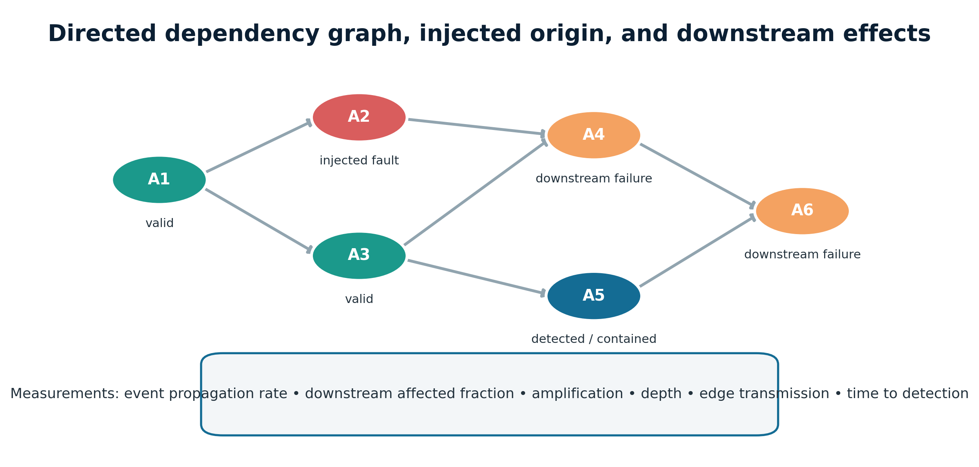
A local error can become a system failure
3
Multi-agent collaboration creates dependency paths
1. Origin
A wrong fact, truncated handoff, stale tool result, or manager decision.
2. Transmission
Downstream agents consume and reuse the altered state.
3. Outcome
The team may converge on a coherent but invalid end state.
Question: where did it start, how far did it travel, and what contained it?
MAS-RELIAB • Dev Parth • Viva Defence

Slide 4
Why final task success is insufficient
4
A binary score collapses operationally different failures
Repeatability
Robustness
Propagation
Passed once; does it pass across k repeats?
What happens under paraphrase, tool faults, or stale state?
Did one fault spread to one node or the whole team?
Attribution
Mitigation
Resources
Can we find the responsible agent and decisive step?
Did verification or recovery actually contain the lineage?
How many tokens, calls, seconds, and currency units?
MAS-RELIAB • Dev Parth • Viva Defence

Slide 5
Related work covers major components
5
MAS-RELIAB must be positioned as integration, not priority
MAST
τ-bench
ReliabilityBench
TraceElephant
failure taxonomy
state + pass^k
repeats + tool faults
full-trace attribution
AgenTracer / ErrorProbe
AgentAsk
RiskLab / TAMAS
MultiAgentBench / SILO
origin diagnosis
handoff containment
controlled risk
topology + coordination
Closest overlap
From Spark to Fire already uses directed dependency graphs, atomic error seeds, cascade analysis, topology sensitivity, and mitigation.
Therefore: no claim that graph-based propagation or cascade mitigation is novel.
MAS-RELIAB • Dev Parth • Viva Defence
[1–15] in manuscript

Slide 6
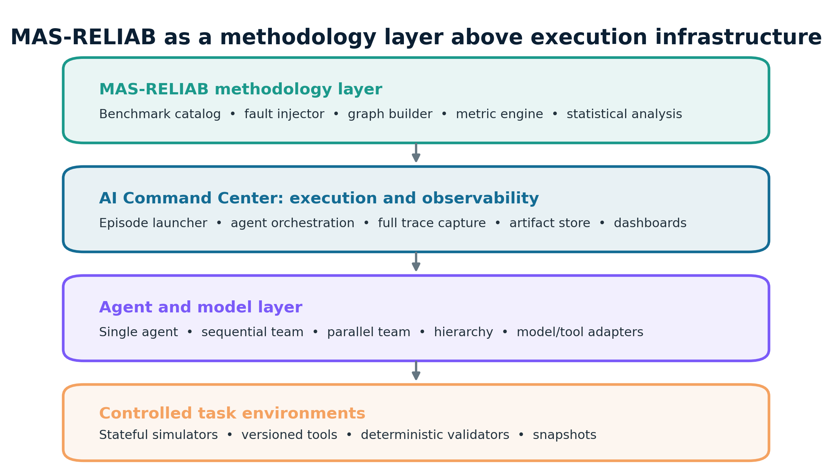
Defensible novelty boundary
6
The contribution is the controlled linkage of dimensions
MAS-RELIAB contribution
One paired protocol connects: • multidimensional reliability • verified fault injection • graph-normalized propagation • evidence-view attribution • verification and recovery • budget-matched topology • tokens, latency, and cost
Methodology claim ≠ empirical superiority
MAS-RELIAB • Dev Parth • Viva Defence

Slide 7
Aim and objectives
7
Turn “reliable” into reproducible measurements and decisions
Aim: design and empirically validate MAS-RELIAB as a reproducible method for measuring reliability and failure propagation in multi-agent AI systems.
● Represent agents, events, tools, and state as time-aware dependencies.
● Inject documented faults with applied and consumed checks.
● Measure outcome, repeatability, robustness, propagation, attribution, recovery, and resources.
● Compare single, sequential, parallel, and hierarchical architectures under controls.
● Release schemas, manifests, analysis rules, and results-ready artifacts.
MAS-RELIAB • Dev Parth • Viva Defence

Slide 8
Research questions RQ1–RQ6
8
Each question maps to one confirmatory experiment
RQ1
Reliability
RQ2
Propagation
RQ3
Attribution
Beyond one success score
Fault type, severity, position
Effect of observability
RQ4
Verification
RQ5
Recovery
RQ6
Topology
Local vs final-only
Reliability–cost trade-off
Architecture × fault location
MAS-RELIAB • Dev Parth • Viva Defence

Slide 9
Preregistered hypotheses H1–H6
9
Falsifiable claims—not expected results
H1
H2
Earlier faults → greater normalized impact/depth
Full traces → better agent + step attribution
H3
H4
Local verification → lower EPR and DAF
Rollback / alternate agent → more recovery, more cost
H5
H6
Topology interacts with fault location
Multidimensional profile reveals masked weaknesses
Null, mixed, or contradictory findings will be reported without reframing.
NO EMPIRICAL RESULT YET
MAS-RELIAB • Dev Parth • Viva Defence

Slide 10
Separation of concerns
10
AI Command Center executes; MAS-RELIAB defines the science
MAS-RELIAB • Dev Parth • Viva Defence

Slide 11
Formal episode model
11
One immutable record links configuration, intervention, trace, outcome, and cost
𝓔 = ⟨ τ, G, Π, Ω, I, X, Y, C ⟩
τ
versioned task
G
dependency graph
Π
model / roles / policy
Ω
environment snapshot
I
fault or null intervention
X
ordered trace
Y
validated outcome
C
resource record
Valid injection = applied as specified AND consumed by the intended component.
MAS-RELIAB • Dev Parth • Viva Defence

Slide 12
Propagation is measured on reachable dependencies
12
Temporal succession alone is not causal evidence
EPR
Fraction of valid injections causing any downstream failure.
DAF
Affected downstream nodes / reachable downstream nodes.
Depth + amplification
How far and how broadly the lineage spreads.
Primary evidence: instrumented consumption + lineage + task-relevant error.
MAS-RELIAB • Dev Parth • Viva Defence

Slide 13
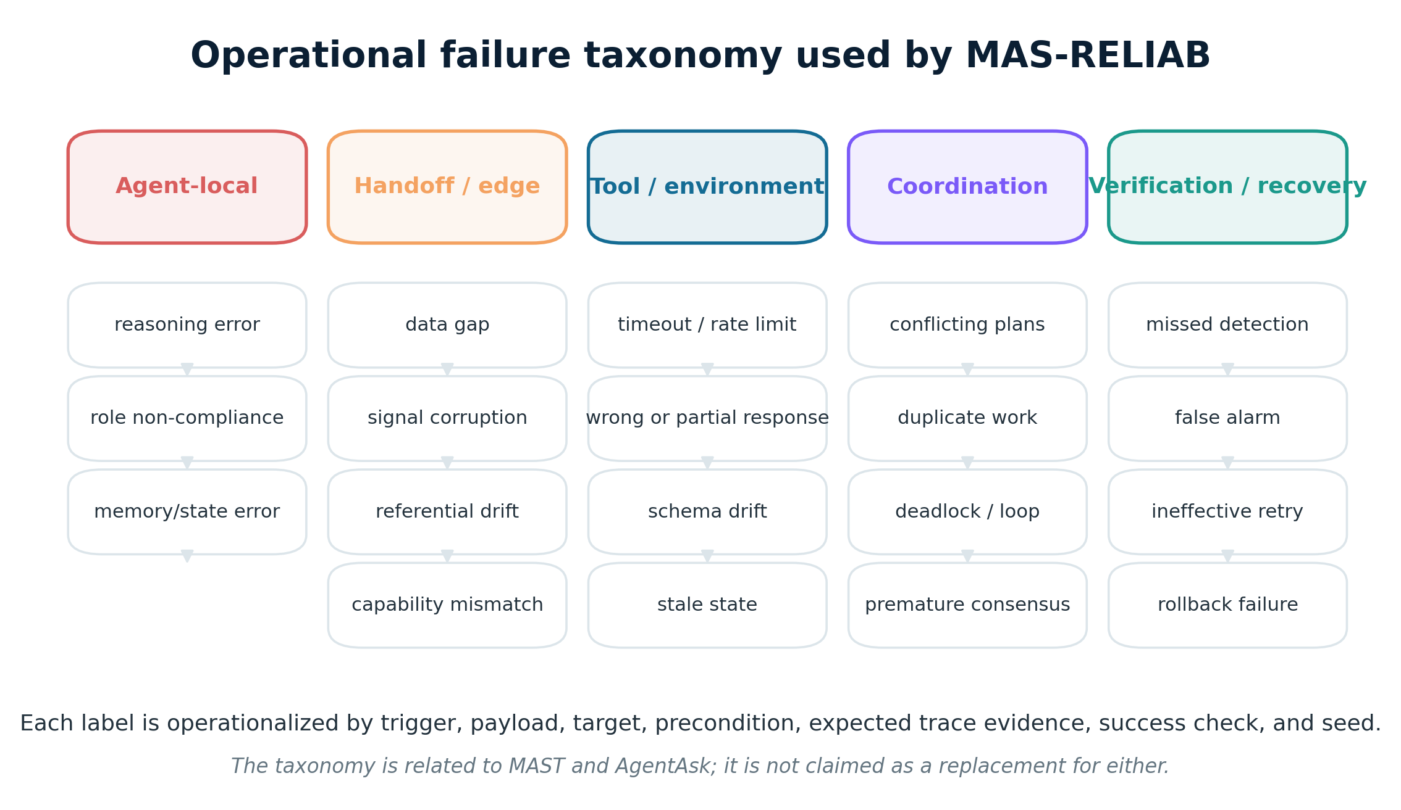
Operational fault taxonomy
13
Category names organize analysis; operator definitions create reproducibility
MAS-RELIAB • Dev Parth • Viva Defence
Related to MAST and AgentAsk

Slide 14
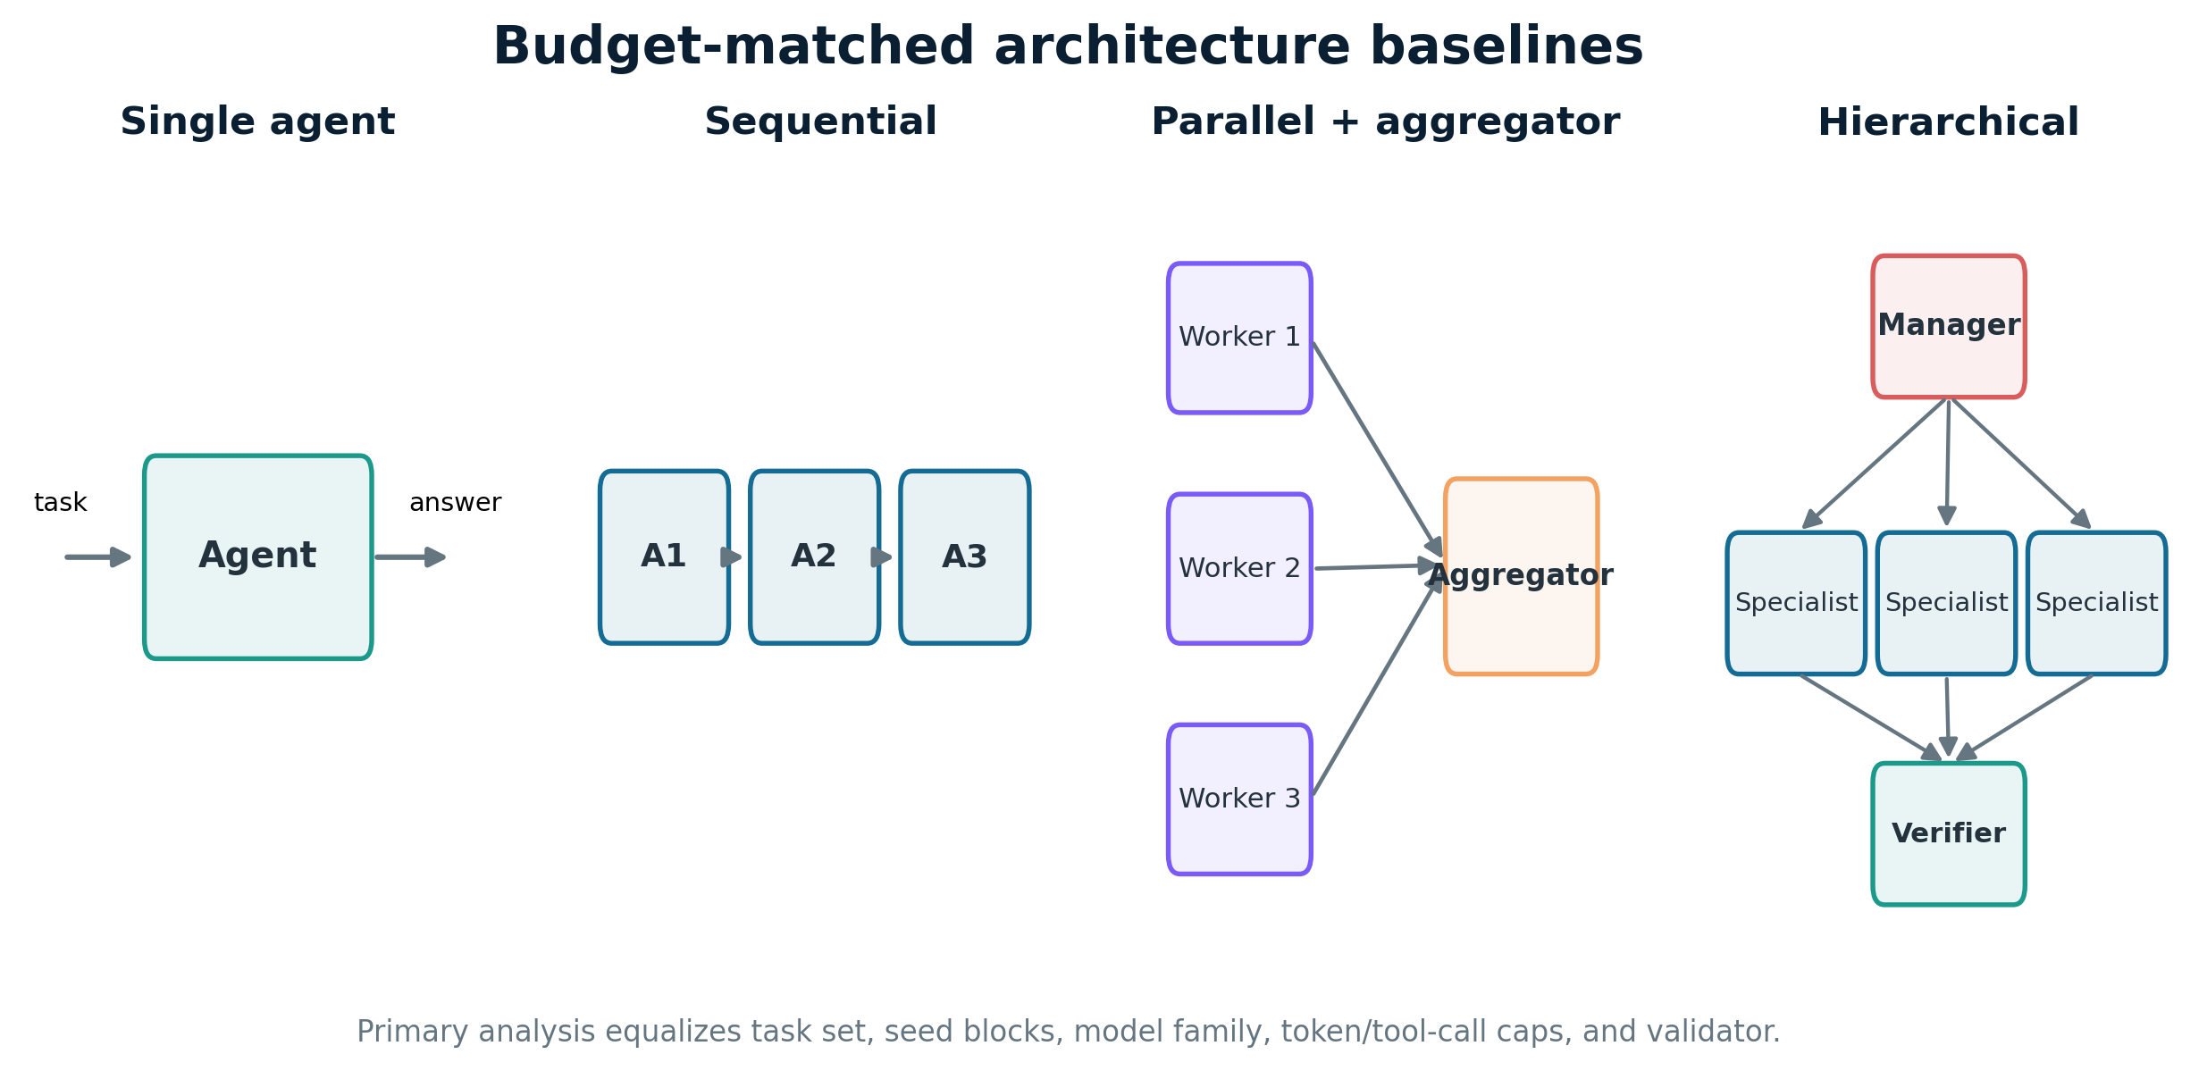
Architecture baselines
14
Primary analysis isolates topology with matched budgets
Same tasks • seed blocks • model family • information • validator • token/tool/timeout caps
MAS-RELIAB • Dev Parth • Viva Defence

Slide 15
Benchmark tasks and ground truth
15
Objectively checkable end states are the primary standard
Research synthesis
Data analysis
Software debugging
Decision support
Stateful tool workflow
Closed corpus + fact/evidence keys
Reference computation + tolerances
Hidden/public executable tests
Constraint solver + feasibility
Database end-state equivalence
LLM-as-a-judge may be a secondary diagnostic; it is not the sole ground truth for the core benchmark.
MAS-RELIAB • Dev Parth • Viva Defence

Slide 16
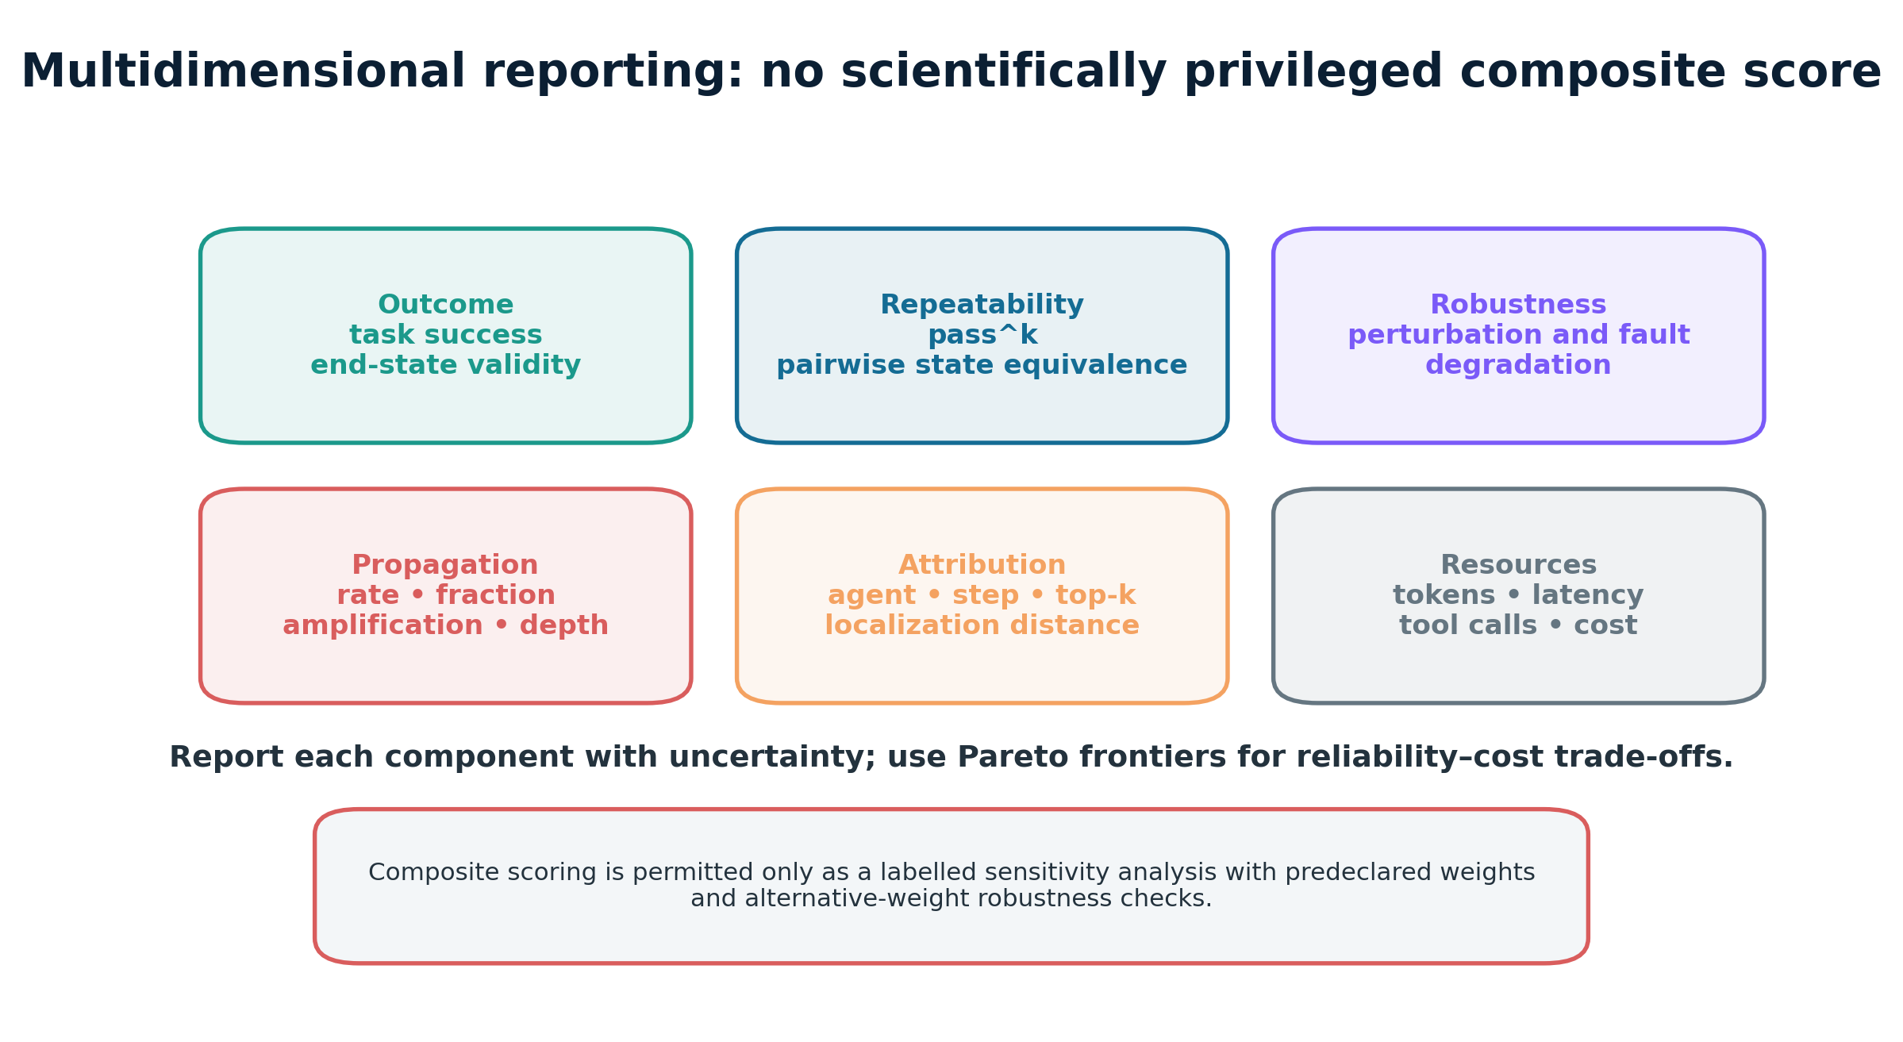
Multidimensional reliability vector
16
Report components first; use Pareto trade-offs—not hidden weights
MAS-RELIAB • Dev Parth • Viva Defence

Slide 17
Core propagation and reliability metrics
17
Explicit denominators prevent misleading claims
TSR
passᵏ
N successful / N eligible episodes
Tasks whose k prespecified repeats all pass
EPR
DAF
Episodes with any downstream effect / valid consumed injections
Affected reachable nodes / reachable downstream nodes
Recovery
Attribution
Correct end state after recovery / valid consumed faults
Agent exact • step exact • joint • top-k • distance
For one serial path: traversal ≈ product of edge probabilities; multi-path independence is not assumed in primary evidence.
MAS-RELIAB • Dev Parth • Viva Defence

Slide 18
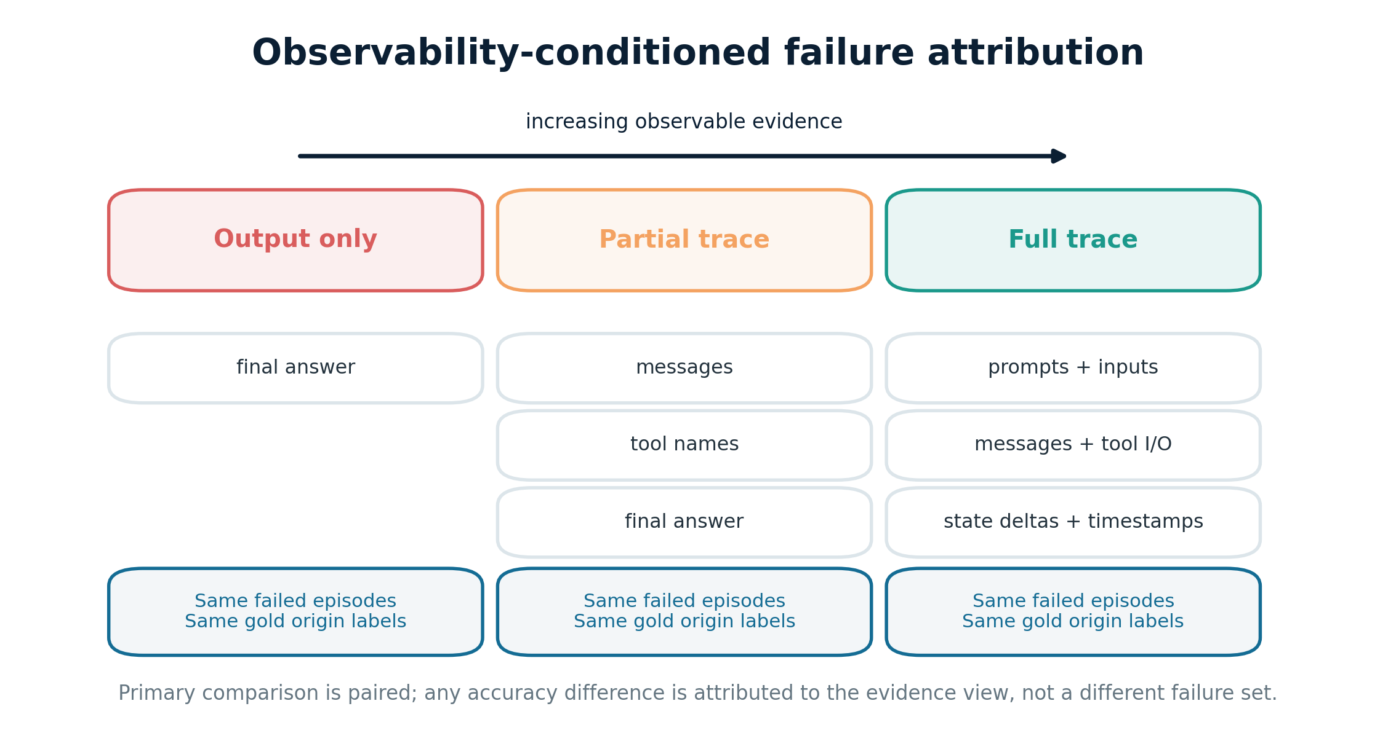
Attribution is conditioned on available evidence
18
Same failed episodes, three paired trace views
MAS-RELIAB • Dev Parth • Viva Defence
TraceElephant and AgenTracer motivate explicit evidence conditions

Slide 19
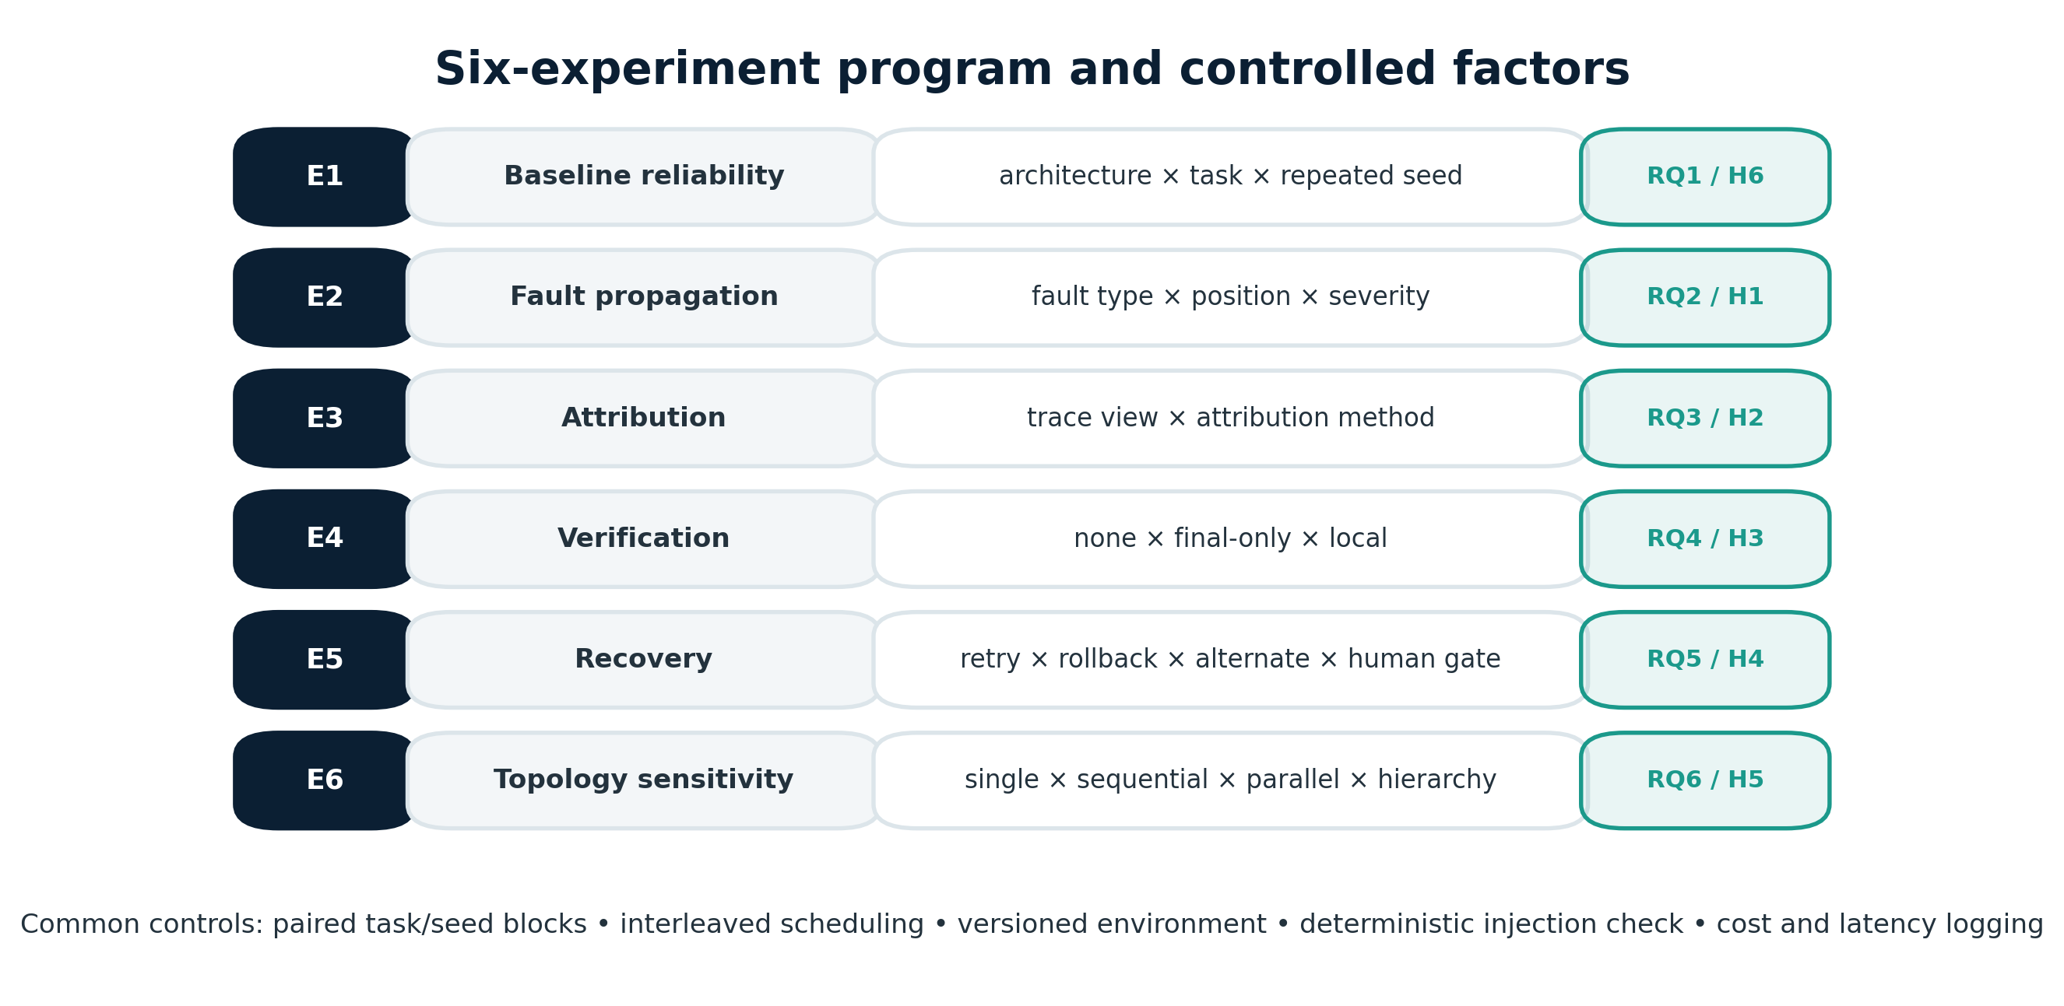
Six-experiment program
19
Every experiment maps to one RQ and hypothesis
MAS-RELIAB • Dev Parth • Viva Defence

Slide 20
Experiments 1–2
20
Baseline profile and controlled fault propagation
E1 • Baseline reliability
E2 • Fault type and position
Four architectures × locked tasks × repeated seeds Primary: TSR, pass^k, state consistency Secondary: constraint success, tokens, tools, latency, cost H6: test preregistered ranking discordance / masked weakness
Operator × severity × early/middle/late depth Primary: EPR, DAF, depth, Δ task success Controls: same task/seed/snapshot; reachable-set size H1: early vs late after normalization
MAS-RELIAB • Dev Parth • Viva Defence

Slide 21
Experiments 3–4
21
Observability for diagnosis; placement for containment
E3 • Attribution
E4 • Verification
Output-only vs partial vs full trace Same failures + same gold origins Primary: joint agent/step accuracy, localization distance Secondary: top-k, MRR, abstention, diagnostic cost H2: evidence-view effect
None vs final-only vs local-before-handoff Primary: EPR, DAF Secondary: TSR, false accept/reject, tokens, latency No privileged gold answers H3: local containment
MAS-RELIAB • Dev Parth • Viva Defence

Slide 22
Experiments 5–6
22
Recovery trade-offs and topology sensitivity
E5 • Recovery
E6 • Topology
None • same-context retry • error signal • rollback • alternate agent • human gate Primary: recovery rate + residual DAF Secondary: repeated-error similarity + resources Decision artifact: Pareto frontier H4: recovery gain with added cost
Single • sequential • parallel • hierarchical Compare worker vs aggregator and leaf vs manager faults Primary: topology × functional-location interaction Budget-matched primary; natural-budget secondary H5: location-dependent topology effect
MAS-RELIAB • Dev Parth • Viva Defence

Slide 23
Statistical analysis plan
23
Task-level inference, pairing, uncertainty, and effect size
● Unit of inference: task instance; repeats and faults are nested.
● Pairing: same task, seed block, environment, and fault where meaningful.
● Tests: exact McNemar; paired permutation/Wilcoxon; mixed models.
● Uncertainty: task-clustered 95% confidence intervals.
● Multiplicity: Holm correction within each RQ family.
● Magnitude: risk difference, matched odds ratio, median shift, Cliff’s delta.
● Power: pilot simulation; 100 paired IDs is a floor, not a guarantee.
MAS-RELIAB • Dev Parth • Viva Defence

Slide 24
Results section is intentionally locked
24
No values are shown because no executions were supplied
Architecture
TSR
passᵏ
DAF
Attribution
Cost
Single
—
—
—
—
—
Sequential
—
—
—
—
—
Parallel
—
—
—
—
—
Hierarchy
—
—
—
—
—
Populate only from signed manifests and frozen analysis outputs. Rewrite the abstract, discussion, and conclusion after validation.
NO EMPIRICAL RESULT YET
MAS-RELIAB • Dev Parth • Viva Defence

Slide 25
Reproducibility by design
25
Every run must be reconstructable—or its limits stated
Configuration
Environment
Intervention
model/version • prompts • topology • budgets • seeds
snapshot • tools • container • region • hardware
operator • target • dose • patch • applied/consumed checks
Evidence
Resources
Analysis
trace • state deltas • graph • validators • hashes
tokens • calls • latency • cost • pricing date
manifest • lockfile • code hash • CIs • deviations
MAS-RELIAB • Dev Parth • Viva Defence

Slide 26
Limitations and threats to validity
26
The protocol reduces uncertainty; it does not remove it
Fault realism
Graph completeness
Injected faults may not match natural failure distributions.
Latent dependencies and semantic edges remain uncertain.
Counterfactual replay
Provider drift
Stochastic trajectories can change after a repair.
Hosted models, policies, load, and prices can change.
Observability
Generalization
Privacy and proprietary constraints may limit traces.
Selected tasks/topologies cannot represent every deployment.
MAS-RELIAB • Dev Parth • Viva Defence

Slide 27
Conclusion
27
What is defensible today—and what remains to be done
Defensible today
Not yet defensible
MAS-RELIAB is a complete, auditable, results-ready protocol connecting reliability, verified faults, propagation, attribution, mitigation, topology, and cost.
No claim that H1–H6 are supported; no superiority claim; no priority claim for graph-based cascades or mitigation.
Next step: pilot → preregistration lock → interleaved execution → validation → populated paper.
NO EMPIRICAL RESULT YET
MAS-RELIAB • Dev Parth • Viva Defence

Slide 28
Questions
MAS-RELIAB
A unified experimental methodology for failure propagation, attribution, mitigation, topology, and reliability–cost trade-offs.
Dev Parth

Slide 29
Appendix • Metric definitions
29
Quick reference for examiner questions
TSR
passᵏ
Consistency
eligible successes / eligible episodes
all k repeats pass for a task
pairwise end-state equivalence
Δfault
EPR
DAF
TSR clean − TSR fault
any downstream effect / valid injections
affected / reachable downstream
AF
Depth
Recovery
affected / initially corrupted nodes
max shortest-path distance
correct after recovery / consumed faults
Attribution
FCS
Resources
agent + step exact/top-k/distance
1 − DAF
tokens, calls, latency, storage, cost
MAS-RELIAB • Dev Parth • Viva Defence

Slide 30
Appendix • Hypothesis decision matrix
30
Primary metrics and contrasts are frozen before unblinding
H1
DAF + depth
early vs late
H2
joint attribution
full vs partial/output
H3
EPR + DAF
local vs final/none
H4
recovery + cost
rollback/alternate vs retry
H5
interaction
topology × location
H6
rank discordance
TSR vs reliability profile
MAS-RELIAB • Dev Parth • Viva Defence

Slide 31
Appendix • Three high-risk viva questions
31
Concise answers to protect the scientific boundary
“Is this novel?”
“Where are the results?”
“What if H1–H6 fail?”
Not as a claim for graph cascades, attribution, fault injection, or mitigation individually. The contribution is the paired integration of reliability, propagation, evidence-conditioned attribution, verification/recovery, topology, and cost.
No experimental artifacts were supplied. I use a locked shell with em dashes rather than fabricate findings. This is a complete pre-experimental protocol; empirical completion follows execution and validation.
I report the observed direction, confidence interval, effect size, and uncertainty. Unsupported hypotheses are rejected or left inconclusive. The discussion and conclusion are rewritten accordingly.
NO EMPIRICAL RESULT YET
MAS-RELIAB • Dev Parth • Viva Defence

