Slide 1
Covid-19 Image Classification Deep learning with Pytorch
Prepared by: Dev Patel
Student Id: 1211076
Guided by: Dr. Mohammed Yousefhussien

Slide 2
Table of contents
01
02
03
04
05
06
Introduction
Dataset Description
Model selection and Architecture
Outcome
Challenges handled
Lesson learned

Slide 3

01
Introduction
Develop a deep learning model using PyTorch to detect COVID-19 from chest X-ray images.
Dataset: Approximately 400 chest X-ray images labeled as COVID-19 positive or negative by medical professionals.
Model architecture: Utilization of convolutional neural network (CNN) layers for feature extraction and classification.
Leveraging machine learning techniques to support medical diagnosis and decision-making processes.

Slide 4



Dataset Description
02
Dataset Source
Kaggle Dataset
Dataset has around 400
Total Images
Each class has around 198 images.
Dataset size: 184 MB

Slide 5
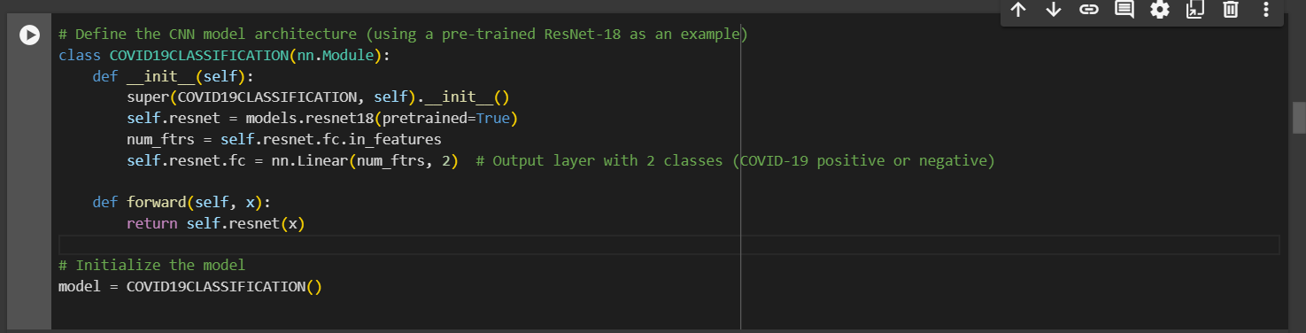
Model selection and Architecture
03
This study utilizes a pre-trained ResNet-18 model as the foundational architecture for a program aimed at classifying chest X-ray images into COVID-19 positive and negative cases. By fine-tuning the ResNet-18 model with a specific dataset, the study seeks to optimize its performance for accurate diagnosis. Leveraging the existing knowledge within the ResNet-18 model, acquired from a diverse dataset, contributes to improving the model's accuracy and effectiveness in detecting COVID-19 from X-ray images.

Slide 6
Outcome(Result)
04
In the training process after 5 epochs my selected ResNet-18 model achieved a training accuracy of 99.32 % and at the same time validation accuracy losses 0.9655 %. Moreover, in the confusion matrix for precision, recall, and F1 score the model gain 97.00 %, 96.57 %, 96.99 respectively. By looking on to these evaluation result metrics gives us a proper understanding of the model output with total 5 number of epochs.

Slide 7
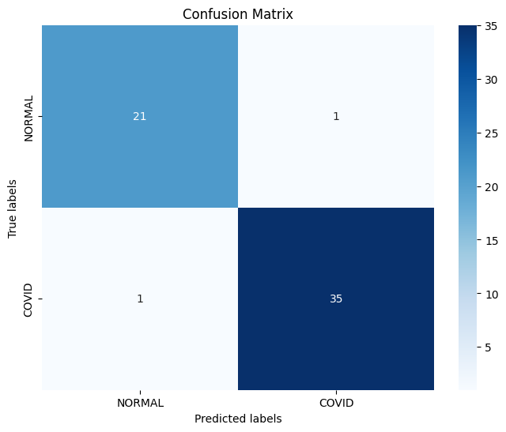
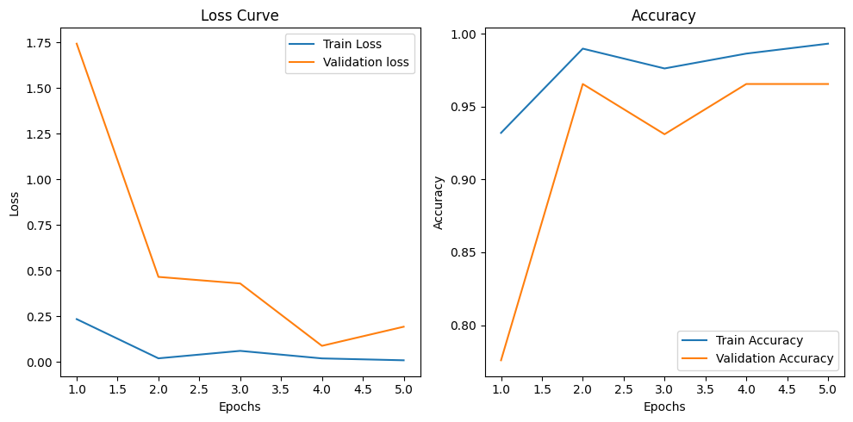

Slide 8
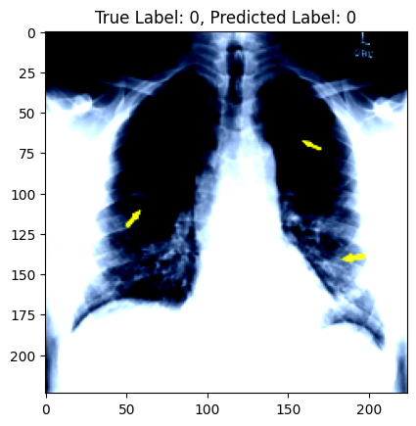
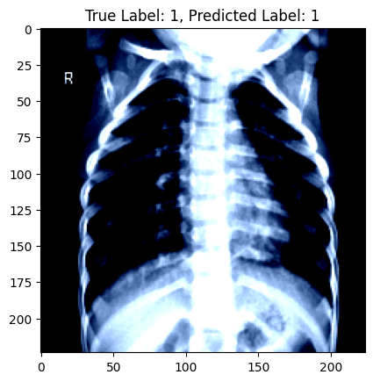
Visuals Of Covid-19 Symptoms In Chest X-Ray

Slide 9
Challenges handled
Image Transformation
Overfitting Issue with data
Loss calculation
Accuracy measurement

Slide 10
Conclusion
In summary, I have developed a strong AI model to detect COVID-19 from chest X-ray images.
It's quite good at distinguishing between positive and negative cases. However, there's still chance for improvement, especially in handling imbalances between different types of cases. I will also fine-tune the model further to better to detect cases. By adjusting the model and training it more, I can aim to make it even better at helping in the fight against COVID-19 situation in future also.

Slide 11
Any Doubts

Slide 12


