Slide 1
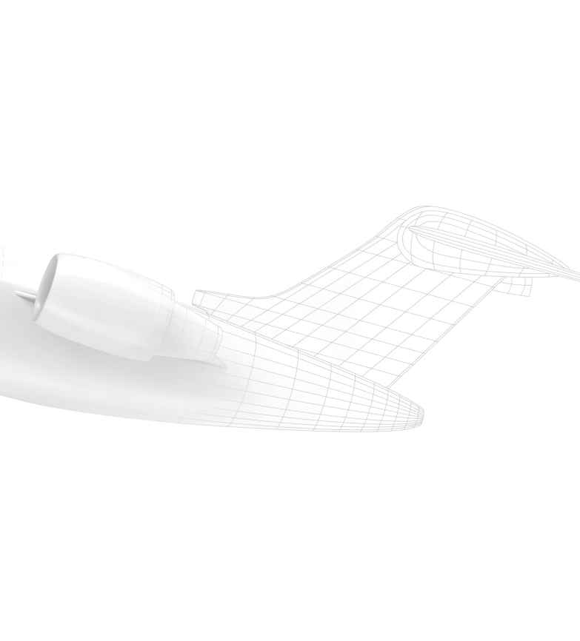
Abbreviations meaning & where to find them
By BA Integration
June 2018

Slide 2
Abbreviations
Abbrev. | Meaning | Where to Find
ECS | Engineering Configuration Statement | These are released in ERD, & Are populated in BDI. These are the different RALs associated to each project.
CCL | Customer Configuration List | Uploaded to Inputs Database & also Released in BDI; different configuration for every tail ; Ex. CCL-BD700-SXXXX
IDL | Indented Drawing List | Released in BDI;
RPC | Not an abbreviation, This is an options list | The different RPCs are in the inputs database, but can also be found in BDI or in ERD
WA | Work Authorization | Uploaded to Inputs Database & also Released in BDI; different configuration for every tail ; Ex. WA-G7000-XXXX
P&O | Price & Offerability | P&Os are attached to the WA, but they can also be found in BDI directly. Ex. PO-XXXX-YYY
RFQ | Request For Quotation | RFQs are deviations from the WA, after the official A/C Kick-Off; They can be found in BDI.
PCR | Product Change Request | PCRs are major changes to the program and have wide range of complexity. They are found in ICMS.
RFC | Request For Change | RFCs are minor changes that can also vary in complexity, they are found in ICMS.
ESSD | Electrical System Schematic Diagram | Released in BDI;
SDD | System Defintion Dataset | Released in BDI;
CCD | Completion Control Drawing | The CCD has all the information needed for the detailed design. This is now being released in BDI, but previously in ERD.
ICD | Interface Control Drawing | The ICD defines the monument enveloppe & interface points. This is now being released in BDI, but previously in ERD.
BAPS | Bombardier Aerospace Process Specification | Can be found in BA Intranet & in BDI
BAMS | Bombardier Aerospace Material Specification | Can be found in BA Intranet & in BDI
BM | Bombardier Manual | These are found in Bombardier Intranet.
CCS | Customer Completion Specification | Uploaded to Inputs Database & also Released in BDI; different configuration for every tail ; Ex. CCS-G7000-XXXX
FML | Finish Material List | Uploaded to Inputs Database & also Released in BDI; different configuration for every tail
FTER | Functionnal Test Engineering Requirement | Released in BDI;
BAERD | Bombardier Aerospace Engineering Requirements Document | Can be found in BA Intranet & in BDI

