Slide 1
Employee Retention Prediction
By – Devendra Singh Rathore

Slide 2
Agenda
1.Key Sections: Business Context
2.Dataset Overview
3.Exploratory Data Analysis (EDA)
4.Preprocessing and Feature Engineering
5.Model Training and Evaluation
6.Insights
7.Conclusion

Slide 3
Business Context
Why This Matters
High attrition disrupts workflows and team stability.
Recruiting replacements is costly and time-consuming.
Retaining talent boosts productivity and morale.
Objective
Predict employees likely to leave using machine learning.
Enable HR teams to optimize resource allocation.
Provides actionable insights for retention strategies.

Slide 4
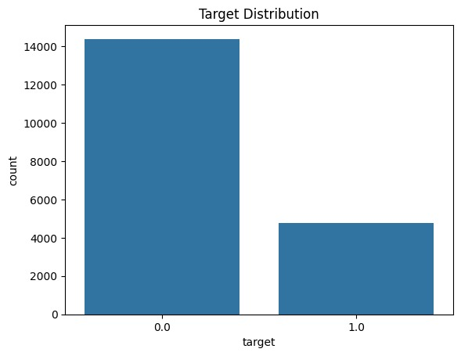
Dataset Overview
DATASET | ROWS | COLUMNS | PURPOSE
Train | 19158 | 14 | Model Training
Test | 2129 | 13 | Model Evaluation
Features
Identification : enrollee_id, city.
Demographics : gender, education, major_discipline.
Professional info : experience, lat_new_job, company_type company_size.
Job-Seeking Indicator : target (0 = Not looking, 1 = Looking.)

Slide 5
Exploratory Data Analysis (EDA)
City Index: Lower city development index links to higher attrition.
Training Hours: Fewer training hours increase attrition risk.
Demographics: Younger employees show higher attrition rates.

Slide 6
Preprocessing and Feature Engineering
Data Standardization: Applied manual replacement and string manipulation.
Handling Missing Data: Used statistical imputation (mode and mean).
Text Clearing: Used string operations (replace) for cleaning text columns.
Categorical Encoding: Used Label Encoding.
Features Transformation: Converted ranges into numeric features using split and pd.to_numeric.
New features: Created a new feature named ‘experience_level’.

Slide 7
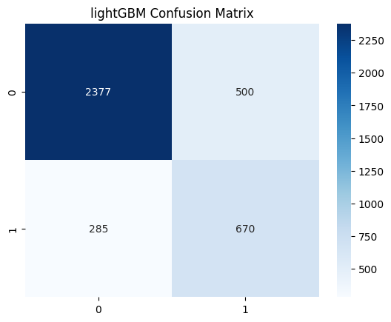
Model training and Evaluation
MODEL TRAINING
Logistic Regression.
Random Forest.
XGBoost.
LightGBM
MODEL EVALUATION
Best Performing Model:
Model: LightGBM
Accuracy: 0.795146
ROC-AUC: 0.814989
Precision: 0.795146
Recall: 0.630588
F1-Score: 0.630588
Accuracy
ROC-AUC
Precision
Recall
F1-Score
Confusion Matrix

Slide 8
Insights…
Training Hours: Employees with fewer training hours are more likely to leave.
City Development Index: Attrition is higher among employees in cities with a lower development index (e.g., ≤0.5).
Relevant Experience: Employees with relevant experience show a higher likelihood of attrition.
Company Size: Smaller companies (e.g., company size ≤10 employees) tend to have higher attrition rates.
Enrolled University: Employees not pursuing higher education may feel less engaged and are at greater risk of leaving.

Slide 9
Conclusion
The predictive analysis has revealed key drivers of employee attrition, such as training hours, city development index, and relevant experience.
These insights empower organizations to adopt targeted strategies for retaining talent, including enhanced programs and city-specific initiatives.
This data-driven approach underscores the value of machine learning in strategic decision-making.

Slide 10
Questions ?

Slide 11
Thank You!

