Slide 1





SKILLUP HACKATHON · IBM SKILLSBUILD
Multi-Agent
Research & Content System
An AI pipeline that plans, researches, writes and reviews — automatically.
Planner
Researcher
Writer
Reviewer
Python · Anthropic Claude · Mock mode · Markdown output
Notes:
Title slide. Introduce the project as a four-agent AI pipeline that turns a topic into a reviewed Markdown report.

Slide 2


THE PROBLEM
Research is a manual relay race
Turning a raw topic into a polished, reviewed document means repeating the same four steps by hand — every single time.
Doing it by hand
With the pipeline
Slow, inconsistent, easy to skip a step
One command, four specialised agents
Break the topic down yourself
Planner splits it into sub-tasks
Search and summarise each part
Researcher gathers each one
Stitch the notes into a draft
Writer produces the draft
Re-read and rewrite it again
Reviewer approves or sends it back
Notes:
Explain the manual effort involved in research and content creation, and how this system removes that friction.

Slide 3






ARCHITECTURE
One orchestrator, four agents
Orchestrator
controls every hand-off
Planner
Researcher
Writer
Reviewer
topic → sub-tasks
sub-task → notes
notes → draft
draft → verdict
revision loop · max 2
No agent ever calls another directly — swapping or adding an agent touches one file.
Notes:
Highlight that the Orchestrator is the single coordinator and agents are fully decoupled. Point out the dashed feedback loop from Reviewer back to Writer.

Slide 4
THE AGENTS
What each agent is responsible for
Planner
01
Researcher
02
Breaks the topic into 2–4 focused, non-overlapping sub-tasks so nothing is researched twice.
Runs once per sub-task and returns a short, self-contained summary of that slice.
input topic string
output list of sub-tasks
input one sub-task
output summary text
Writer
03
Reviewer
04
Merges every summary into one coherent Markdown draft, and rewrites it on request.
Judges the draft for completeness and either approves it or returns specific feedback.
input all summaries
output Markdown draft
input draft
output approve / revise
Notes:
Walk through each agent's single responsibility. Stress that each one does exactly one job — that is what makes them swappable.

Slide 5

THE INTERESTING PART
The revision loop — and its brakes
1
Writer produces a draft
2
All research summaries are merged into one document.
maximum revision rounds
2
Reviewer inspects it
Checks coverage, structure and whether anything is missing.
Without a cap, two agents can argue with each other indefinitely.
3
Feedback goes back
If rejected, the specific critique is handed to the Writer.
Failure is handled, not ignored
4
Hard stop at 2 rounds
Empty topic, malformed agent output and API errors each raise a named exception instead of crashing the run.
The loop cannot run forever — the best draft is returned.
Notes:
This is the most interesting technical decision in the project — the loop that improves quality, plus the cap that stops it running away.

Slide 6
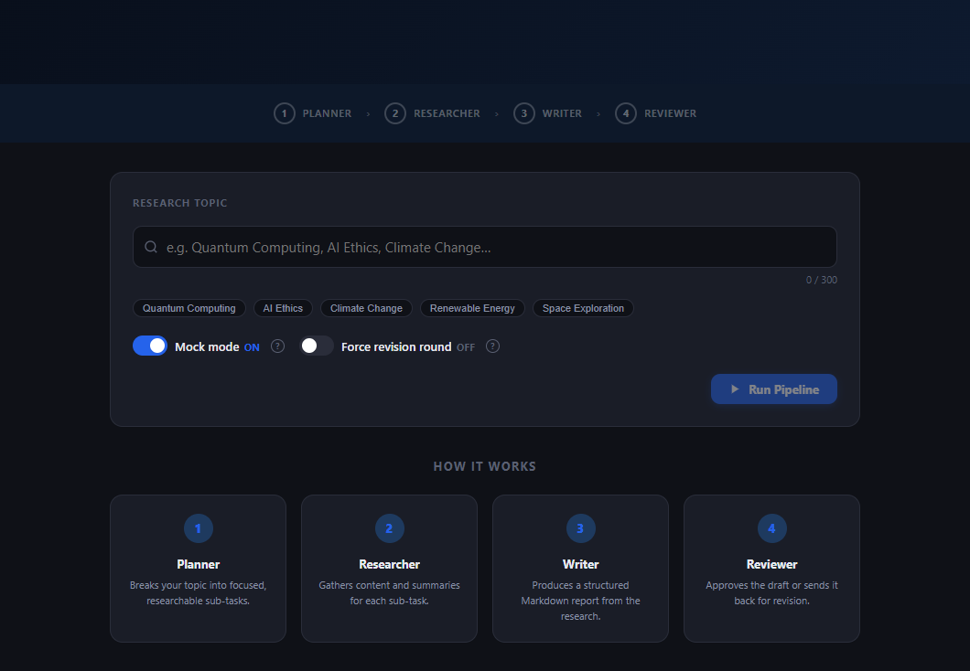



LIVE DEMO · 1 OF 2
Enter a topic, run the pipeline
Mock mode
Runs the full four-agent pipeline with zero API cost
One input
A single topic, live-counted and capped at 300 characters
Live stepper
The header shows which agent is working right now
The app in mock mode — topic input, example chips and both toggles
Notes:
Demo slide 1 — the interface before running. Point out mock mode being ON and the example topic chips.

Slide 7
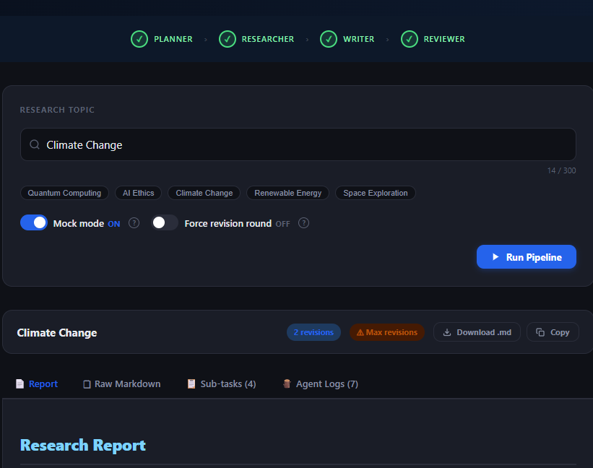
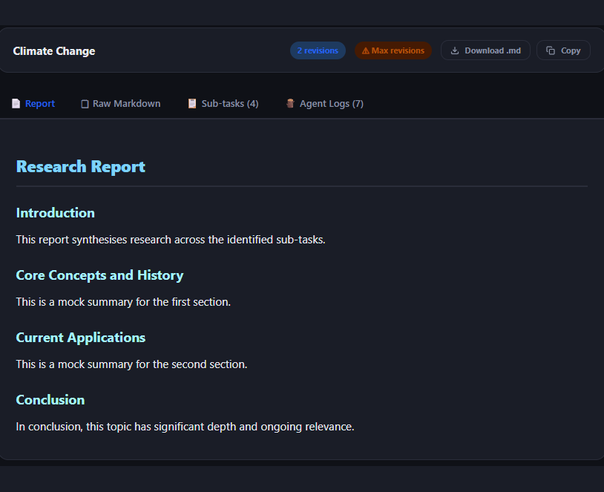
LIVE DEMO · 2 OF 2
Four agents, one finished report
All four stages complete — 2 revision rounds, max reached
The generated Markdown report, ready to copy or download
Notes:
Demo slide 2 — the completed run on the left, the finished report on the right. Mention the Sub-tasks and Agent Logs tabs as the transparency feature.

Slide 8

HOW TO RUN
Two commands, no setup friction
MOCK MODE
REAL MODE
$ python -m multi_agent_system.main \
--topic "Quantum Computing" --mock
$ set ANTHROPIC_API_KEY=your-key
$ python -m multi_agent_system.main \
--topic "Quantum Computing"
No API key. Hardcoded responses. Free.
Calls Anthropic Claude for every agent.
Output is written to output/<topic>.md and printed to the terminal — every agent’s intermediate result is logged along the way.
Notes:
Show both modes. Mock mode is the one to use when demoing — it is instant and free.

Slide 9



KEY FEATURES
Why the design holds up
Mock mode
Revision loop
Demo or test the whole pipeline with no API key and no cost.
The Writer improves the draft until the Reviewer signs off — capped at 2.
Decoupled agents
Structured output
Every agent shares one base interface, so any of them can be swapped.
A clean Markdown report saved to disk, not throwaway terminal text.
Named exceptions
Dual interface
Each failure mode has its own exception and a readable message.
A --topic flag for scripted runs, an interactive prompt when omitted.
Notes:
Mock mode and the revision loop are the two most interesting technical choices — lead with those if time is short.

Slide 10

Thank you
A small, readable codebase that demonstrates a real multi-agent pattern — planning, delegation, synthesis and critique.
github.com/Devreeeeee/Multi-Agent-System
Built with Python · Anthropic Claude · Clean agent architecture
Notes:
Closing slide with the repo link. Invite questions.

