Slide 1
OrigoDB Workshop
Module 6 – Immutability
Notes:
Considerations when hosting the in-process engine and model.
Lifecycle

Slide 2
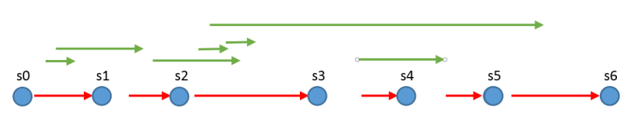
Immutability and blocking
Notes:
Explain each briefly

Slide 3
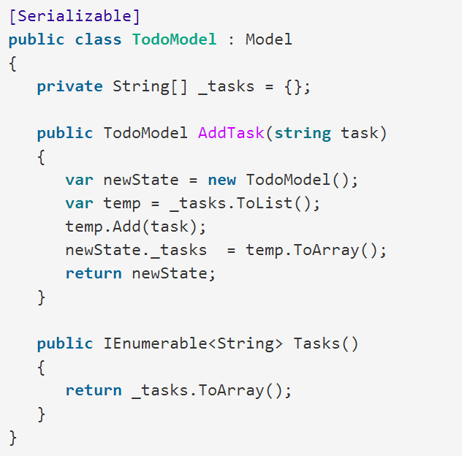
Example immutable model

Slide 4
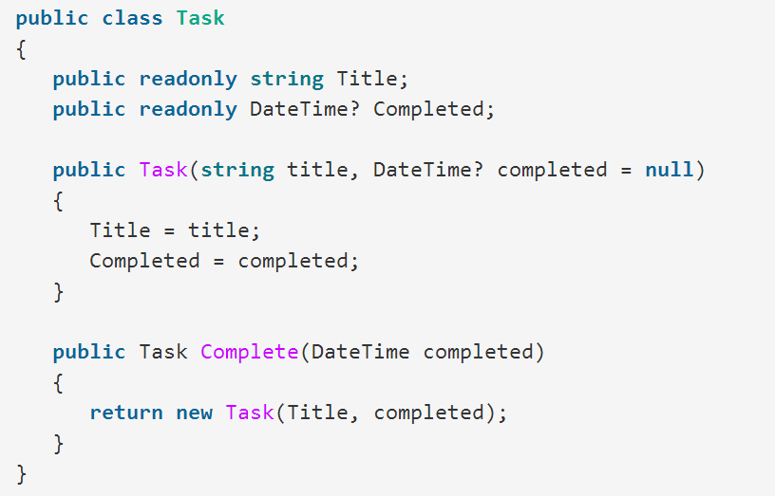
Example immutable entity

Slide 5
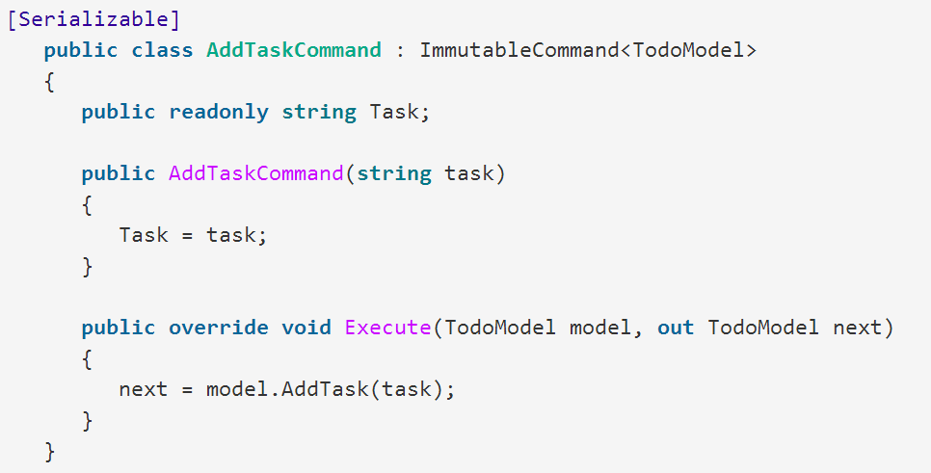
Immutable command example
Notes:
Notice base class and out parameter on execute

Slide 6
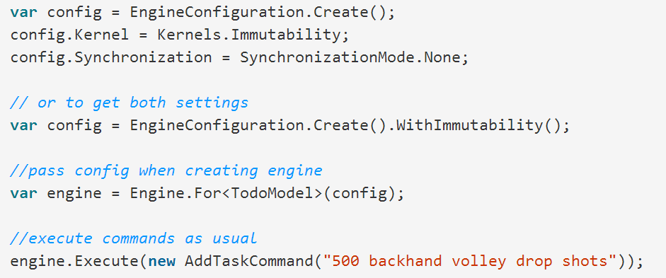
Configuration

Slide 7
Lab
Try out the example from the slides

