Slide 1
The visitor design pattern
Notes:
Hi, my name is Simona and today I am going to talk about the visitor design pattern. More explicitly, we are going to look into what it is, what problem it solves, and its implementation.

Slide 2
What is it?
A behavioural design pattern that allows the addition of new operations to existing object structures without having to modify the objects themselves.
Notes:
The visitor design pattern is a behavioural design pattern that allows the addition of new operations to existing object structures without having to modify the objects themselves.

Slide 3



The credit card problem
Established bank offers 3 types of credit cards: Bronze, Silver, and Gold.
Notes:
In order to better understand it, we are going to look at a hypothetical scenario.
Let’s imagine that we work for a multinational bank which offers 3 types of credit cards: Bronze, Silver, and Gold. These credit card options have been introduced a long time ago and the codebase that handles operations for them is already in place and used throughout the banking system.

Slide 4
The credit card problem
The bank signs new contracts with 3 companies: a hotel, an airline, and a gas station based on which they will offer cashbacks to customers that use their credit cards.
Notes:
We have been tasked to develop these new pieces of functionality. The question now is: how would we go around to implementing these new features? Let’s first take a look at the most simple, yet not so efficient way.

Slide 5
CreditCard Interface
BronzeCard implements CreditCard
SilverCard implements CreditCard
GoldCard implements CreditCard
Notes:
We have discovered that each type of card is represented by its own class and they all implement the CreditCard Interface.

Slide 6
CreditCard Interface
gasOffer();
hotelOffer();
airlineOffer();
...
BronzeCard
implements CreditCard
gasOffer() {
//get gas offer for bronze card;
}
hotelOffer {
//get gas offer for bronze card;
}
airlineOffer() {
//get airline offer for bronze card;
}
BronzeCard
implements CreditCard
gasOffer() {
//get gas offer for silver card;
}
hotelOffer {
//get gas offer for silver card;
}
airlineOffer() {
//get airline offer for silver card;
}
BronzeCard
implements CreditCard
gasOffer() {
//get gas offer for gold card;
}
hotelOffer {
//get gas offer for gold card;
}
airlineOffer() {
//get airline offer for gold card;
}
Notes:
The first idea that comes into our minds would be to add the methods in the CreditCard interface and then implement them in the corresponding classes. This way, we will compute each type of offer inside the CreditCard implementations.

Slide 7
CreditCard Interface
gasOffer();
hotelOffer();
airlineOffer();
...
BronzeCard
implements CreditCard
gasOffer() {
//get gas offer for bronze card;
}
hotelOffer {
//get gas offer for bronze card;
}
airlineOffer() {
//get airline offer for bronze card;
}
BronzeCard
implements CreditCard
gasOffer() {
//get gas offer for silver card;
}
hotelOffer {
//get gas offer for silver card;
}
airlineOffer() {
//get airline offer for silver card;
}
BronzeCard
implements CreditCard
gasOffer() {
//get gas offer for gold card;
}
hotelOffer {
//get gas offer for gold card;
}
airlineOffer() {
//get airline offer for gold card;
}
Notes:
The problem that we will encounter is that as we add more operations in the interface class, we also need to add them in all classes that implement the interface as well. This causes a lot of unnecessary disruption and can be quite dangerous.

Slide 8
Simple, but ineffective
We are tightly coupling 2 concepts: the credit cards and external offers.
We are violating the Open/Closed principle: we should keep our objects open for extensibility, but closed for modification.
Makes the codebase difficult to maintain.
Easy to introduce bugs.
Notes:
Although this method is the simpler one, we need to consider how it affects us. By handling logic focused around external offers, we are tightly coupling 2 different concepts: the credit card, and the offers, reducing our flexibility and reusability of the code.
Moreover, we are also violating the Open/Closed principle that says that we should keep our objects open for extensibility, but closed for modification. We also need to keep in mind that the credit card classes are used by downstream components which can be affected by the changes.
Overall, this change could make the codebase difficult to maintain and test.

Slide 9
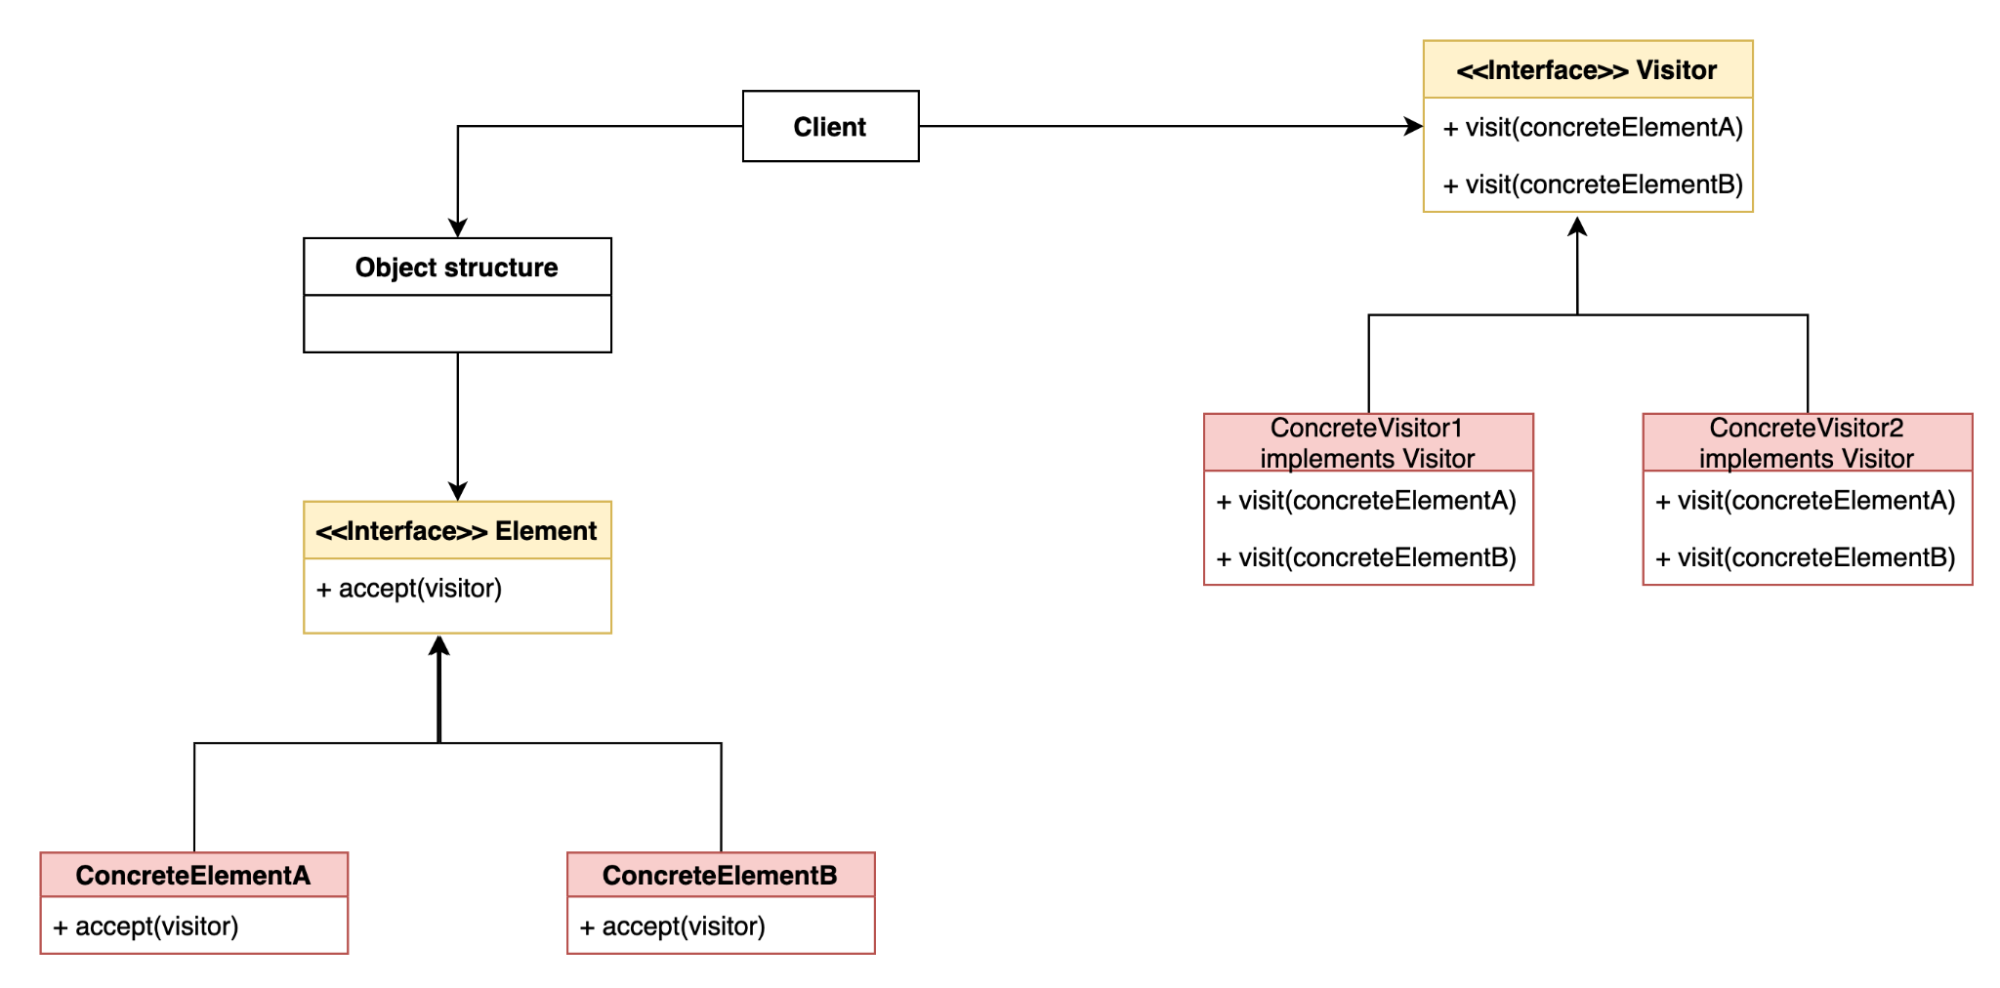
Visitor pattern general design
Notes:
This is when the visitor design pattern becomes useful. For simplicity purposes we are going to look at a general design first.
Looking in the right hand side of the diagram, the Visitor interface defines visit methods which take as parameters the concrete element classes. The visit methods are then implemented in the Concrete visitor classes which will contain the pieces of functionality that the elements require. So, instead of having these pieces of logic coupled with element classes directly, they will be isolated inside the appropriate concreteVisitor classes.
Looking at the left hand side, we have the Element interface and the classes that implement it and require the new functionality. The only change we need to make here is to add an accept method. The accept method takes in a visitor object and from there on it’s the visitor’s responsibility to make sure the correct method is used based on the element type. Inside the accept method, we are going to call the visit method and pass in a reference to the current object.

Slide 10
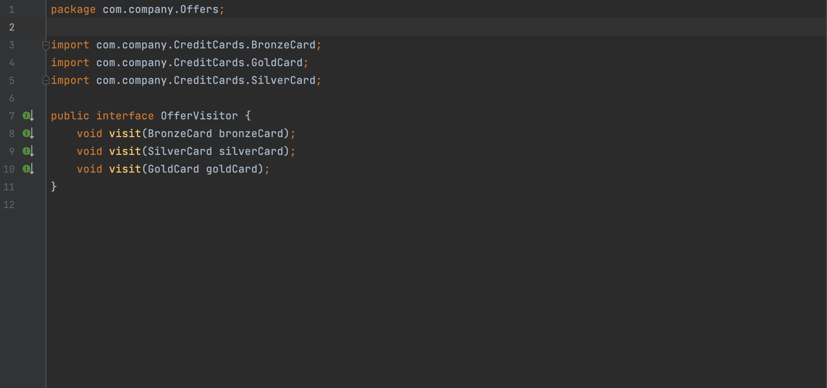
The OfferVisitor interface
Notes:
Let’s now dive into the implementation of our credit card problem in code. For demo purposes, the classes don’t contain any logic besides printing some strings to the console.
First, let’s analyse the OfferVisitor interface. This contains visit method definitions for each type of credit card(Bronze Silver, and Gold) which will be implemented accordingly in our concrete visitor classes. We’re abstracting operations for each type of credit card here and then implementing them based on types of offers. Remember that we have 3 types of offers(The Gas offer, the hotel offer, and the airline offer) which based on the type of credit card should output a different result.
Let’s now take a look at one of the implementations of this interface, the GasOfferVisitor.

Slide 11
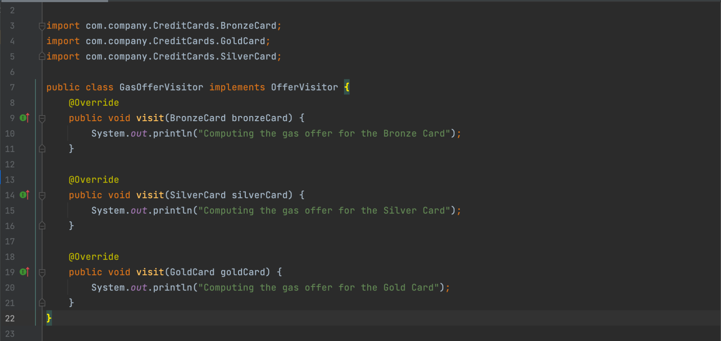
The GasOfferVisitor
Notes:
The GasOfferVisitor implements the OfferVisitor interface and defines logic for handling gas offers on credit cards. Each visit method takes a bronze, silver, or gold card and outputs the offer.

Slide 12
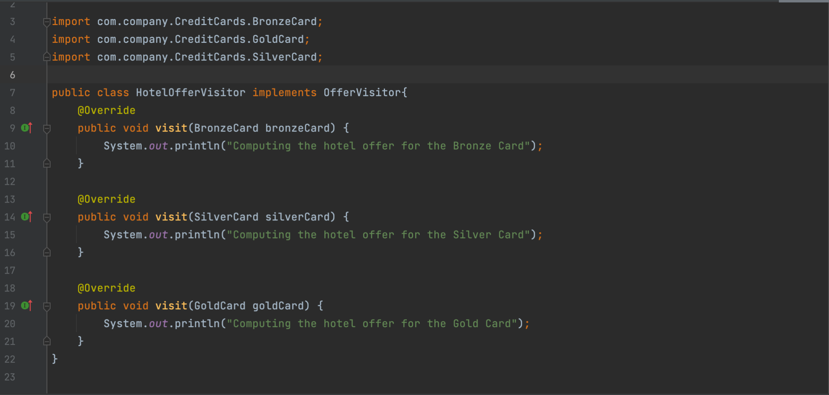
The HotelOfferVisitor
Notes:
Similarly, the HotelOfferVisitor handles how hotel offers are being outputted for the different credit cards. This plug and play power that the pattern offers us leads to great flexibility in terms of what functionality gets added and what functionality can get removed without actually modifying any of the Credit Card classes.

Slide 13
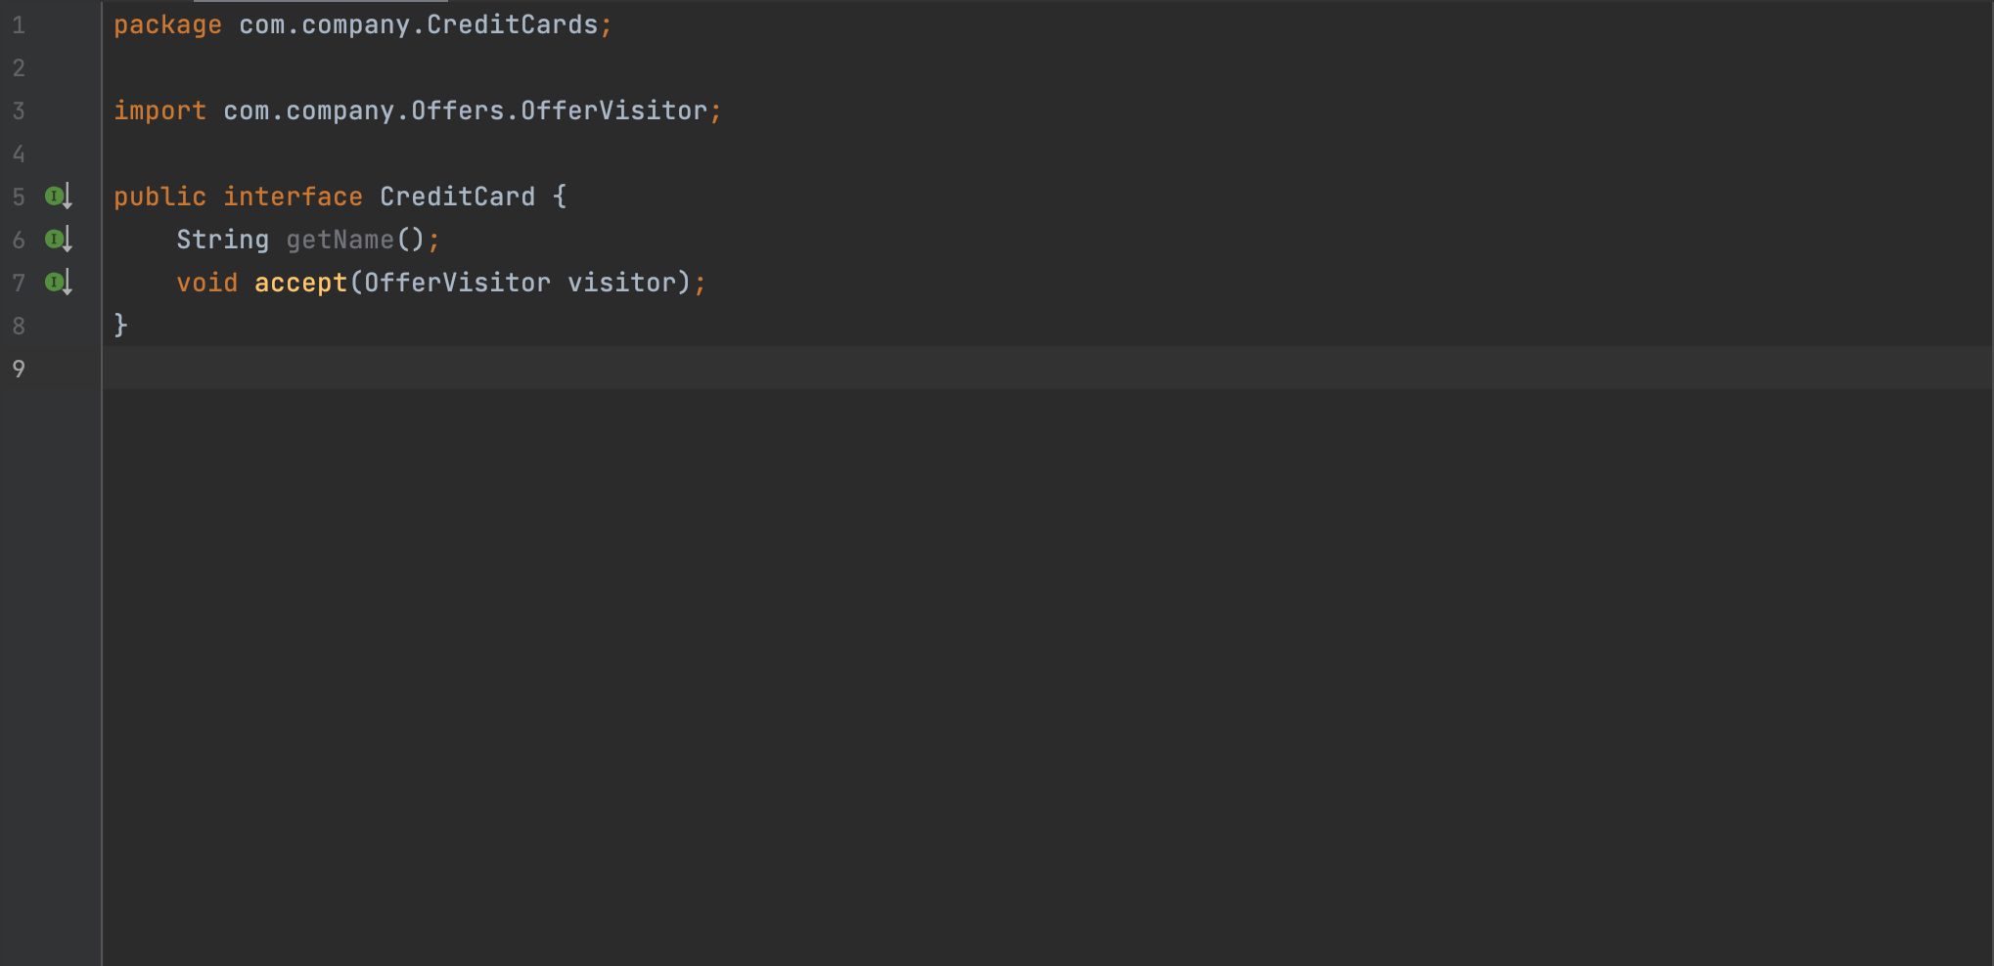
The CreditCard Interface
Notes:
Here we have the CreditCard interface. As mentioned before, the only change we need to make is adding the accept method which takes in an Offervisitor object. The idea behind the accept method is that the credit card classes “accept” visitors and let the visitors call the right visit method based on the type of credit card and the type of visitor.

Slide 14
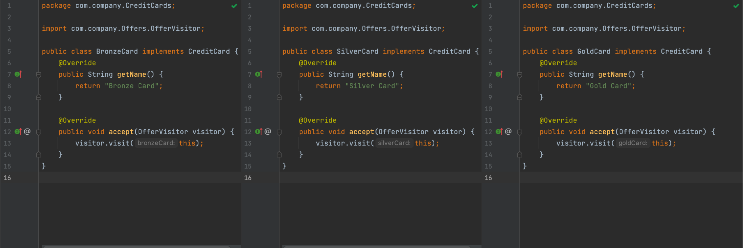
The BronzeCard, SilverCard, and GoldCard classes
Notes:
When implemented, the accept method is going to call the visit method by passing a reference to the current object. So each card class passes their own reference to the visitor which handles the appropriate call.

Slide 15
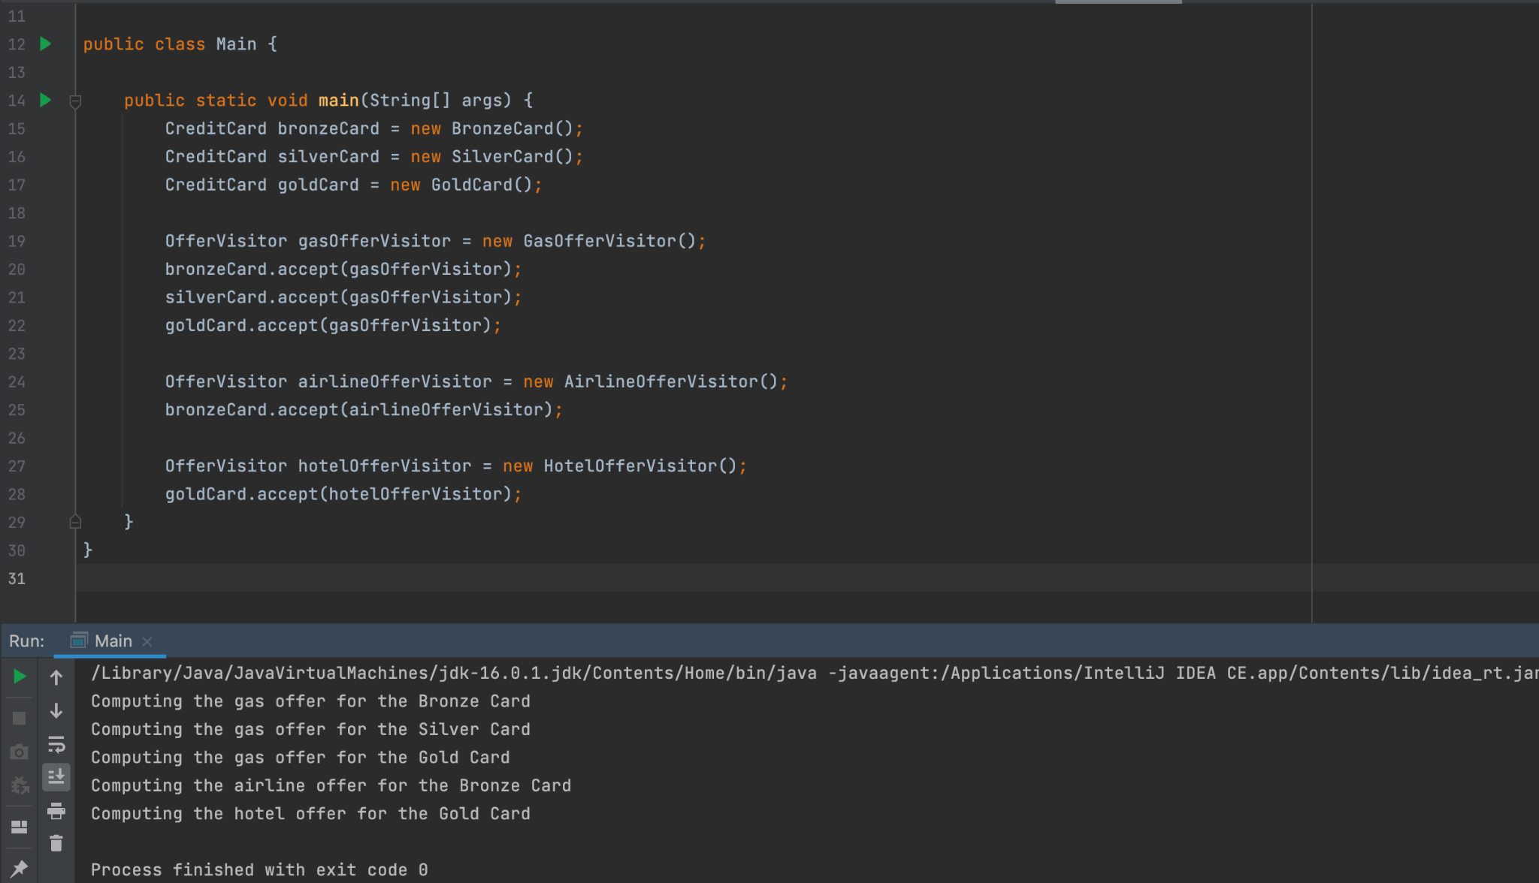
Running the example
Notes:
In order to test it, we create a few credit cards and one of each type of the offervisitor implementations. All we have to do now is just call the accept method on a credit card instance and pass one of the Gas/Hotel/ Airlone offervisitor as a parameter. As we can see, this outputs different offers, based on which credit card and visitor offer implementations we used.

Slide 16
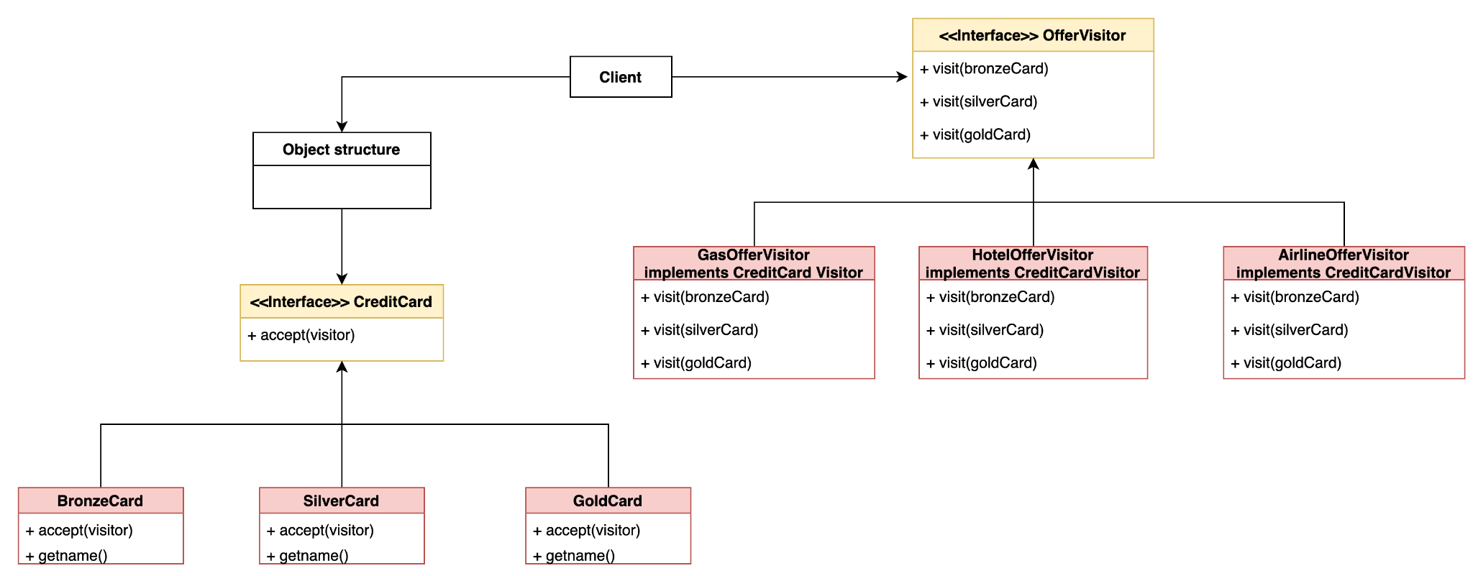
Credit card solution diagram
Notes:
Here we highlight the relationships between the different classes within our credit card solution. We can see the offer visitor interface which defines the visit methods based on each type of credit card, and the concrete visitors being implemented in the form of the Gas/Airline and Hotel Offer visitors. They all compute various offers for all credit card types.
As well as that, the credit card interface defines the required accept method which is implemented in all credit card classes.

Slide 17
PROS
CONS
Easy to add new operations to objects without modifying them.
Related behaviour is focused in a single concrete visitor.
It implements double dispatching in languages that don’t support it natively.
Your Visitor can modify your Elements since an instance of the Element is sent to the Visitor.
Code can become less readable.
It requires a new Visitor class for every action.
Notes:
Now that we’ve seen the visitor design pattern in action, let’s glance over some of its pros and cons
Pros:
Easy to add new operations to objects without modifying them.
Related behaviour is focused in a single concrete visitor. For example, all operations that handled gas offers on credit cards were found in the GasOfferVisitor class.
As well as that, It implements double dispatching in languages that don’t support it natively. - Java, as many other OOP languages support only single dispatch.
Cons:
The Visitor can modify your Elements since an instance of the Element is sent to the Visitor. This is not recommended as it leads to side effects. This can be fixed by making the element objects immutable.
Moreover the code of the Element objects is spread out in all the Visitor objects. Therefore, the Element's logic lives in many classes. It makes the code harder to read if you want to look at the code for a specific element object.
It requires a new visitor class for every action. As we’ve seen in the demo, for each action that we needed to perform we required a new class.

Slide 18
Questions?

Slide 19
Thank you!

