Slide 1
DevsDNA
Introducción a los Bots

Slide 2
Alternativas
Microsoft Bot Framework (https://dev.botframework.com/)
IBM’s Watson Conversation (https://www.ibm.com/watson/developercloud/conversation.html)
Google’s api.ai (https://api.ai/)
Smooch (https://smooch.io/)
Init.ai (https://www.init.ai/)
Facebook’s wit.ai (https://wit.ai/)

Slide 3
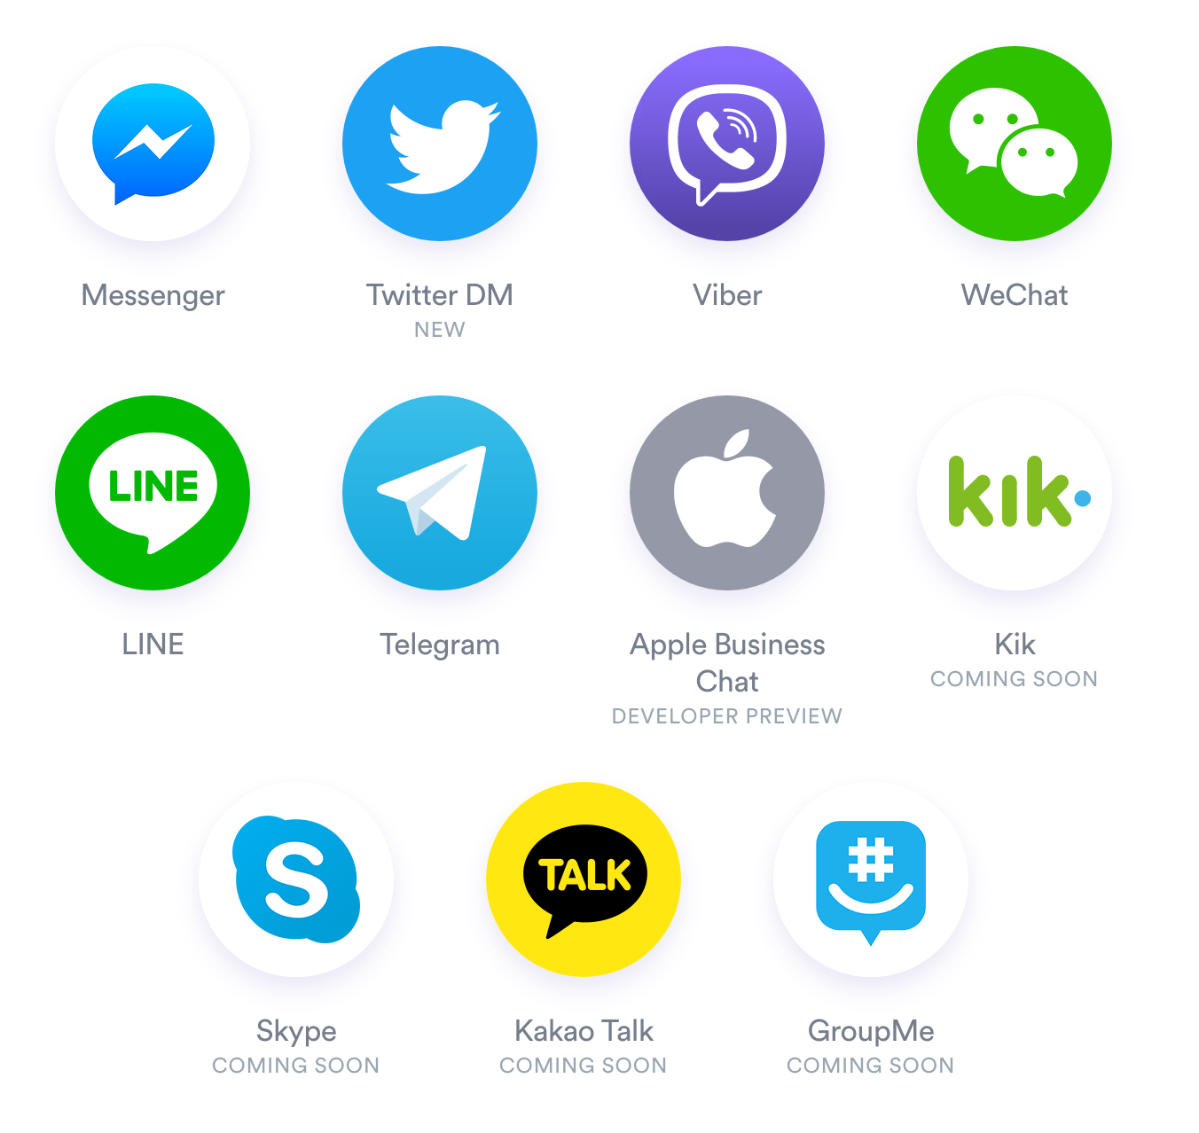
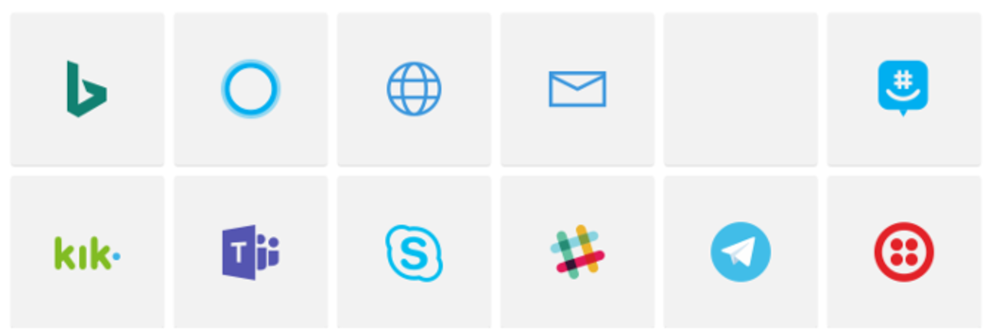
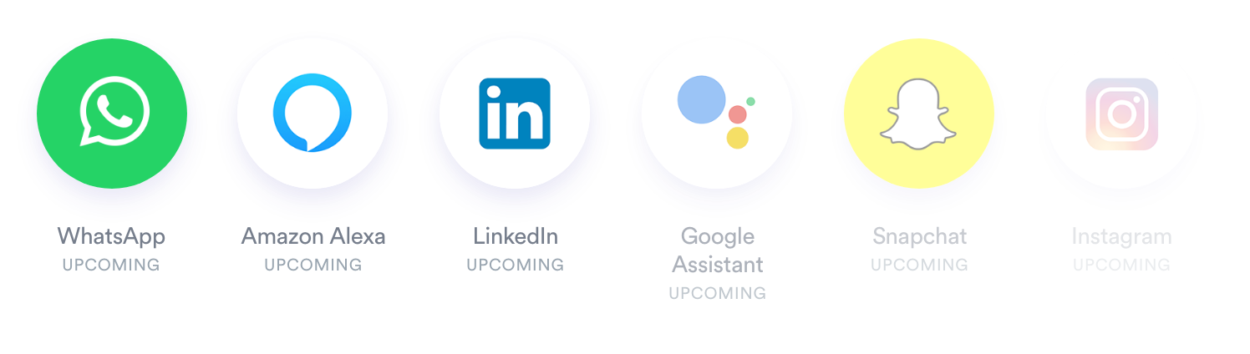
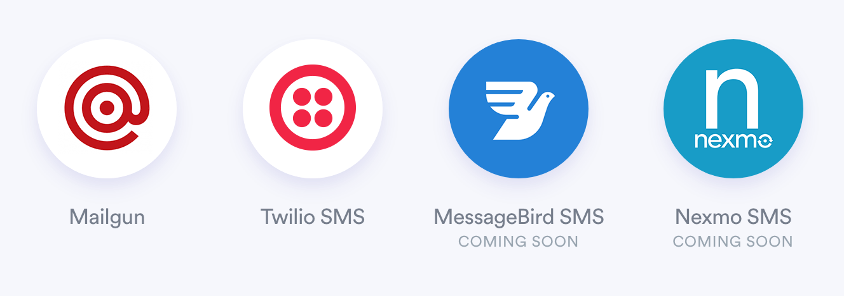
Build once, run everywhere
Also to your own app, using Bot Framework Direct Line API: https://docs.botframework.com/en-us/restapi/directline3/

Slide 4
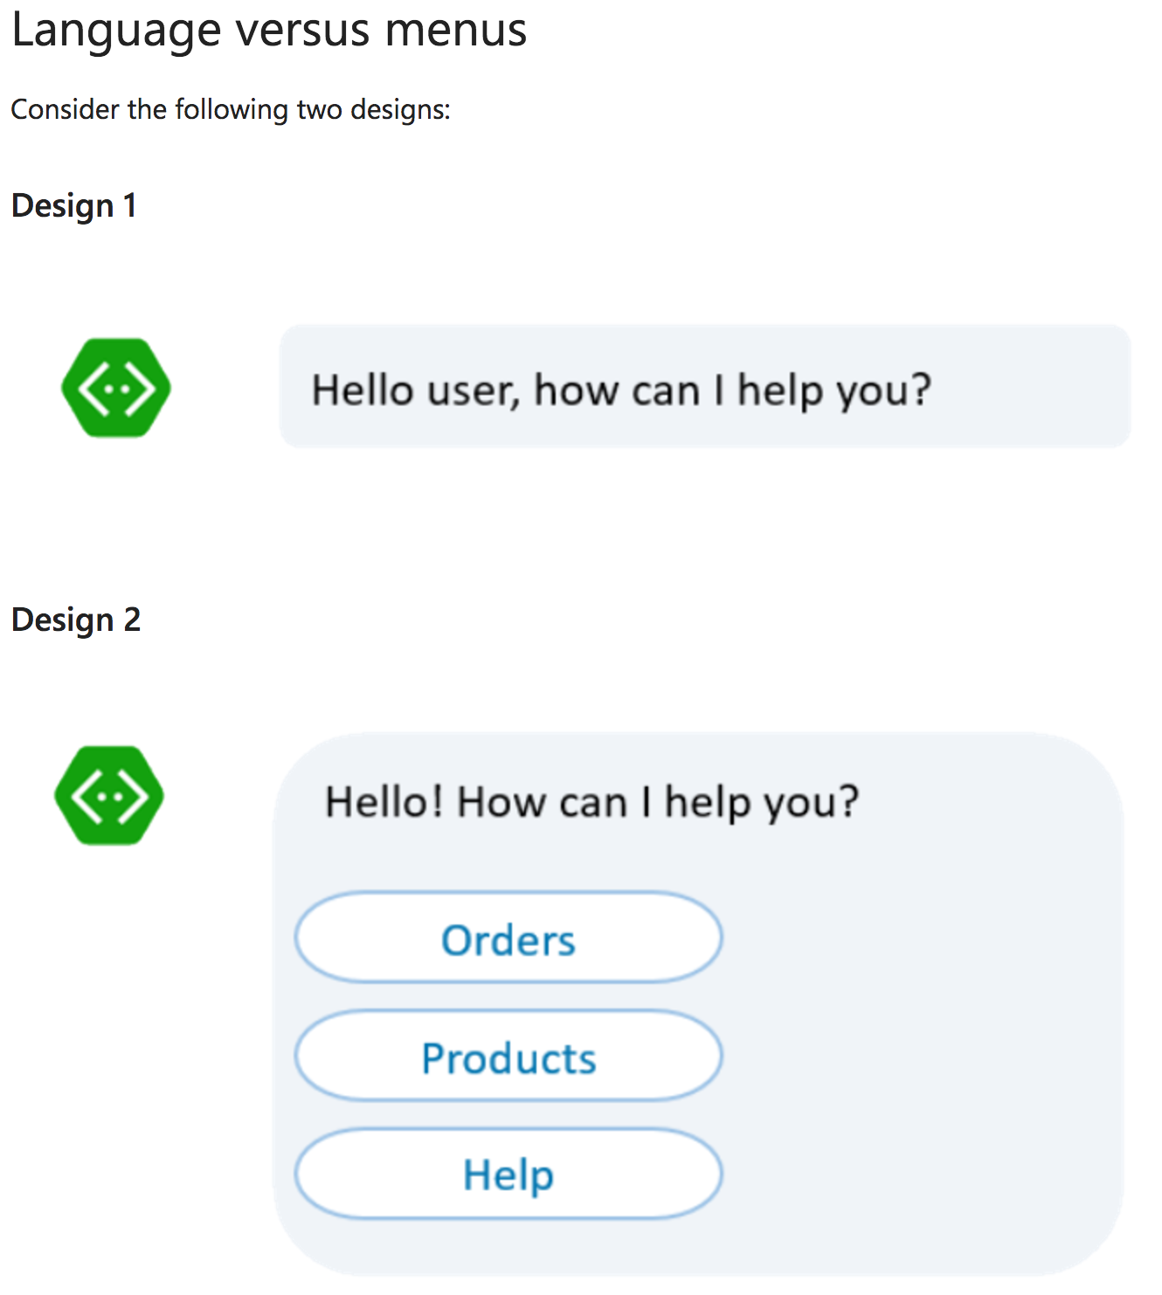

Slide 5
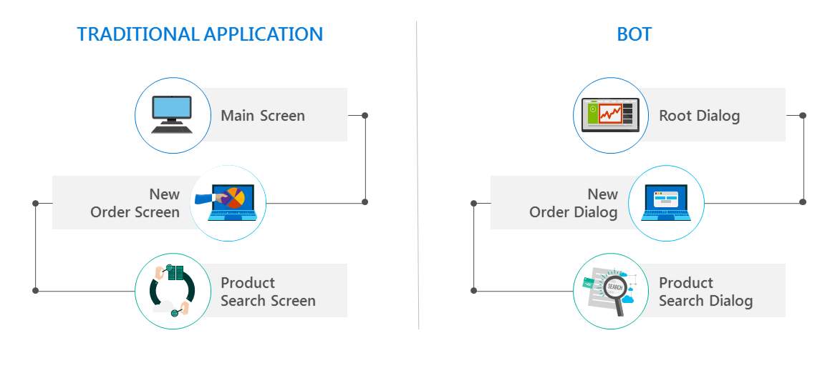
Reference: https://docs.microsoft.com/en-us/bot-framework/bot-design-conversation-flow

Slide 6
Bots typically use some combination of
Rich user controls: buttons, images, carousels, menus, …
Text and natural language: LUIS, etc.
Speech:
Reference: https://docs.microsoft.com/en-us/bot-framework/bot-design-user-experience

Slide 7
Patterns
Task automation (example: password-reset)
Knowledge base: Search, FAQ’s, …
Bot to web browser, and back again
Transition conversations from bot to human
Embed a bot in an app (using Direct Line API). Sample: https://github.com/Microsoft/BotBuilder-Samples/tree/master/CSharp/capability-BotInApps
Embed a bot in a website
Reference: https://docs.microsoft.com/en-us/bot-framework/bot-design-pattern-task-automation

Slide 8
Requisites
Locally hosted bot:
To develop & run it: Visual Studio 2017 (VSForMac not supported)
To test it: Bot Framework Emulator (Mac/Windows)
Remotely hosted bot:
To develop & upload it: Visual Studio 2017 (VSForMac not supported)
To test it: Bot Framework Emulator (Mac/Windows)
Azure Bot Service hosted bot:
To test it: Bot Framework Emulator (Mac/Windows)
Reference: https://docs.microsoft.com/en-us/bot-framework/azure/azure-bot-service-overview
Reference: https://docs.microsoft.com/en-us/bot-framework/debug-bots-emulator

Slide 9
Interesting links
BotBuilder Samples repo: https://github.com/Microsoft/BotBuilder-Samples

Slide 10
Next steps
Add intelligence with Cognitive Services https://docs.microsoft.com/en-us/bot-framework/cognitive-services-bot-intelligence-overview
Connect with LUIS (Language Understanding Intelligent Service): https://www.luis.ai/

