Slide 1
Segmenting characters from license plate using image processing techniques
IIVP Project Group 1
Prepared By:
Abhishek Agrawal (IIT2013128)
Anurag Das (IIT2013198)
Priyank Upadhya (IIT2013194)
Shaiwal Sachdev (IIT2013196)
Utkarsh Kumar (IRM2013002)

Slide 2
Aim
Segmentation of characters from the license plate using the image processing techniques.

Slide 3
Motivation
IDENTIFICATION OF STOLEN CARS
SMUGGLING OF CARS
INVALID LICENSE PLATES
USAGE OF CARS IN ILLELGAL ACTIVITIES
APPLICATION IN TRAFFIC SYSTEM (HIGHWAY ELECTRONIC TROLL COLLECTION,BORDER AND CUSTOM CHECKPOINTS)

Slide 4
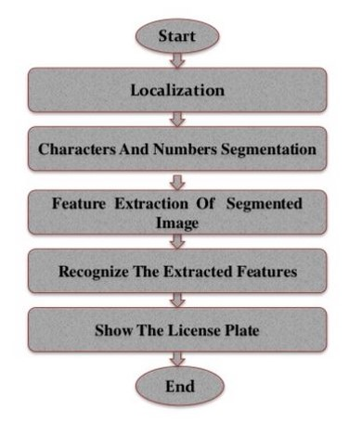
A General LPR System

Slide 5
Difficulties
Low resolution characters
Blurry image
Number plate not with in the legal specification
Poor maintenance of the vehicle plate

Slide 6
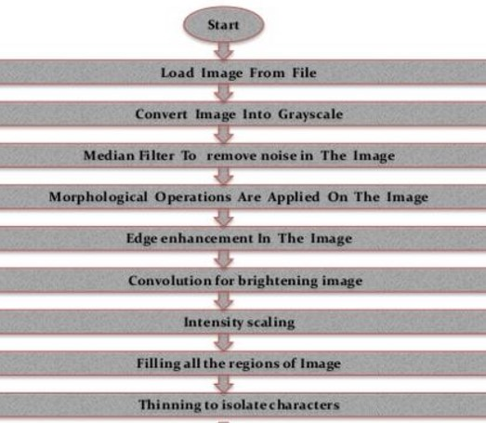
Flow chart for the procedure to achieve the aim of the project

Slide 7
Preprocessing
Preprocessing is very important for the better performance from the character extraction from the image.
Preprocessing consists of following:-
Resizing
RGB to Gray
Noise Removal

Slide 8
Morphological Operations
Morphological image processing is a collection of non linear operations related to the shape or morphology of features in an image.
Rely only one the relative ordering of the pixel value , not on their numerical values.
Best suited for processing binary images and grayscale images.
It probe an image with a small shape or template called a structuring element.
Structuring element is a small binary image or a matrix having values 0 and 1 only and matrix dimension specifies the size of the structuring element.

Slide 9
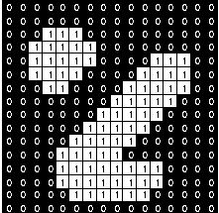
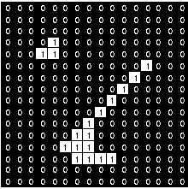

Fundamental Morphological operations
Erosion
The erosion of a binary image f with structuring element s produces a image g with ones in all location (x,y) of a structuring element’s origin at which that structuring element s fits the input image i.e.
$g\left(x,y\right)= \left\{\begin{aligned}1, if s fits f \\ 0, otherwise\end{aligned}\right\}$
Example of erosion
Image 2 is eroded with a 3x3 structuring element.
1 1 1 1 1 1 1 1 1
Image 1
Image 2

Slide 10
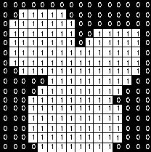

Fundamental Morphological operations
Dilation
The dilation of a binary image f with structuring element s produces a image g with ones in all location (x,y) of a structuring element’s origin at which that structuring element s hits the input image i.e.
$g\left(x,y\right)= \left\{\begin{aligned}1, if s hits f \\ 0, otherwise\end{aligned}\right\}$
Example of dilation
Image 2 is dilated with a 3x3 structuring element.
1 1 1 1 1 1 1 1 1
Image 1
Image 2

Slide 11

Structuring element used in the project
The disk of radius 1 is used as the structuring element for the implementation of this project. The matrix for the disk of radius one is show below.
The strel function in matlab is used to create the structuring element.
se = strel(‘disk’, 1);
0 1 0 1 1 1 0 1 0

Slide 12
Detection Of License Plate Region
There are different methods for the extraction of the license plate region based on different kind of image processing techniques.
Binary Image Processing
Gray level Processing
Color Processing

Slide 13
Binary Image Processing
Binary image has two possible values for each pixel (0 or 1) representing black and white colors.
Principle: The change of brightness in the LP region is more remarkable and more frequent than elsewhere.

Slide 14

TOP HAT Transform And Edge Detection
Extracts small elements and details from given images (i.e able to locate small objects of significantly different brightness).
White top hat transform - Difference between the input image and its opening (dilation of erosion)
Black Top hat transform – Difference between the closing (erosion of dilation) of an image and the image
Edge detection operations are performed on the resultant gray scale image arrived due to top hat transformation ( Eg: Sobel).
In our case we use Vertical Gradient.
To detect the license plate area in the image, the set of connected pixels need to be found out. For this purpose, morphological closing operation is performed on the edge retained image. Closing operation on binary image is performed by applying morphological dilation on the image followed by morphological erosion.

Slide 15



Top Hat Algorithm In this Project
Acquire Vertical Gradient from the gray image
Top hat transform of the vertical gradient (here A is the vertical gradient calculated in the previous step)
Get Horizontal candidate for the License Plate region

Slide 16
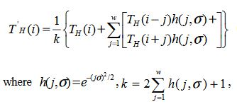

Top Hat Algorithm In this Project
Smooth the horizontal projection of the image
Find the average values of the smoothed horizontal projection
Find the threshold (T = threshold, aver = average, t = 3.5
Find the candidate mask in the rows for the License Plate
Amalgamate the image to get the License Plate

Slide 17
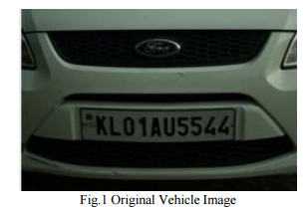
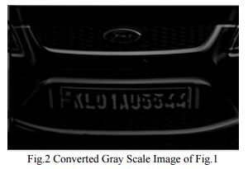
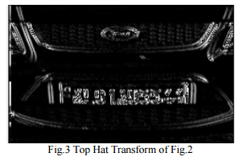

Slide 18
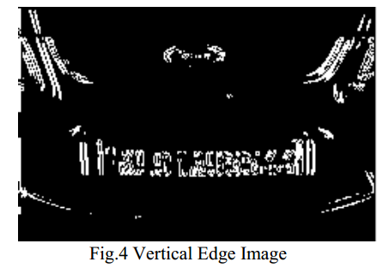
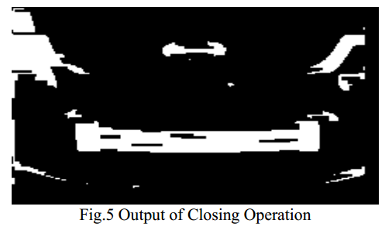
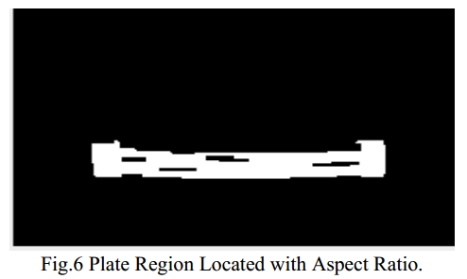

Slide 19
Gray Level Processing
Global Image Processing: The algorithm selects the area that presents the maximum local contrast that (possibly) corresponds to the rectangle that contains the LP . The approach used for the plate location was to horizontally scan the image, looking for repeating contrast changes on a scale of 15 pixels or more.
Partial Image Analysis: where the vehicle image is scanned with N -row distance, counting the existent edges. If the number of the edges is greater than a threshold value, the presence of a plate can be assumed. If the plate is not found in the first scanning process, then the algorithm is repeated, reducing the threshold for counting edges. The method features very fast execution times as it only scans some rows of the image.

Slide 20
Gray Level Processing
Statistical Measurements: blocks with a high edge magnitude or high edge variance are identified as possible LP regions. However, as not all blocks detected are LP regions, those who satisfy geometrical criteria like area and AR are favored.
Region Segmentation: An adaptive image segmentation technique sliding concentric windows (SCW) is considered for LP location . The method uses image statistics such as the standard deviation and the mean value as a “heuristic” for possible plate location. In two concentric windows A and B of different sizes (X 1 × Y 1 and X 2 × Y 2 , respectively), which scan the image from left to right and from top to bottom, the mean value or the standard deviation is calculated. If the ratio of the statistical measurements in the two windows exceeds a threshold set by the user, then the central pixel of the concentric windows is considered to belong to an LP.

Slide 21
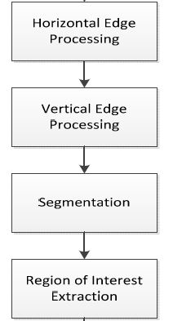
Gray Level Processing (Histogram Processing)

Slide 22
Gray Level processing
Histogram Processing
To find a horizontal histogram, the algorithm traverses through each column of an image. In each column, the algorithm starts with the second pixel from the top. The difference between second and first pixel is calculated. If the difference exceeds certain threshold, it is added to total sum of differences. Then, algorithm will move downwards to calculate the difference between the third and second pixels.
So on, it moves until the end of a column and calculate the total sum of differences between neighboring pixels. At the end, an array containing the column-wise sum is created. The same process is carried out to find the vertical histogram. In this case, rows are processed instead of columns.

Slide 23
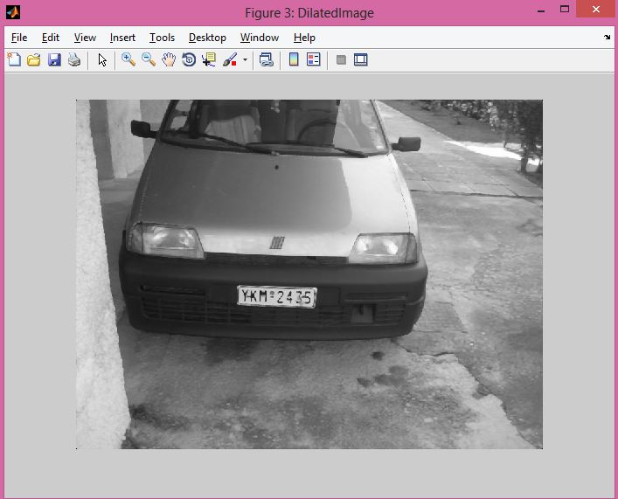

Slide 24
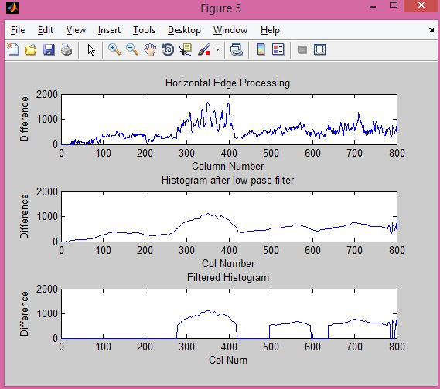
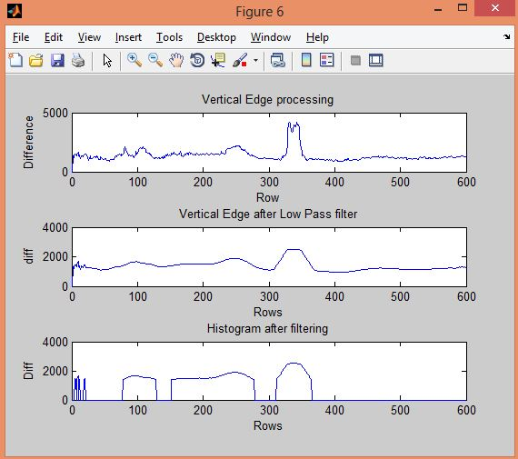

Slide 25
Histogram Processing
One can see that the histogram values changes drastically between consecutive columns and rows. Therefore, to prevent loss of important information in upcoming steps, it is advisable to smooth out such drastic changes in values of histogram. For the same, the histogram is passed through a low-pass digital filter. While performing this step, each histogram value is averaged out considering the values on it right-hand side and left-hand side. This step is performed on both the horizontal histogram as well as the vertical histogram.
Then the unwanted regions with low histogram values and the region having high histogram values has a higher probability of containing the LP.
Out of the all found regions the one with the highest histogram values is considered.

Slide 26
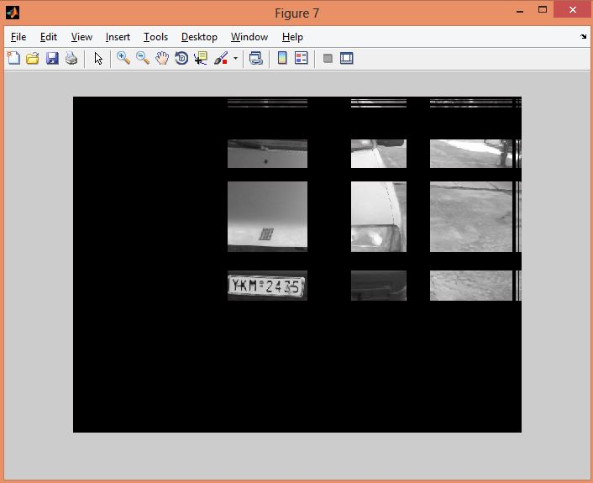

Slide 27
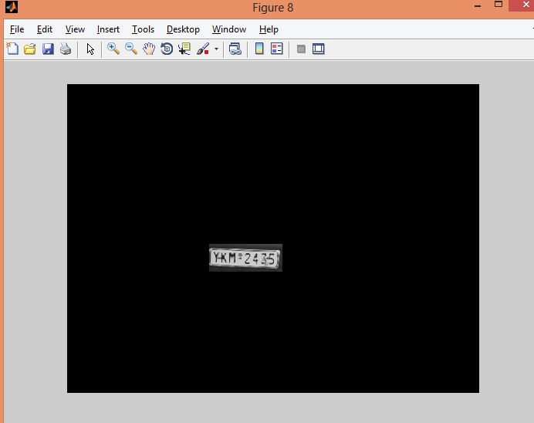

Slide 28
Color Processing
Make use of expected plate appearance (plate background and text color)
Currently available techniques are not highly accurate
Accuracy is low because color is not stable when the light conditions are changed

Slide 29
Color Processing
Color Model Transformation
Color combination of a plate and character is unique
The particular combination results only in one region of the input image

Slide 30
Color Processing
Fuzzy Set Theory
Fuzzy logics has been applied
Some membership function for the fuzzy set has been given for e.g. “bright,” “dark,” “bright and dark sequence,” “texture,” and “yellowness” to get the horizontal and vertical plate positions
Some rules based on the human perception has been also defined for LP
Bright rectangle area within which there are some dark areas
Located approximately in the middle or lower middle part of the image
The approximate dimension of the plate is 530 × 120 mm
The input image is partitioned into sub images
Each partitioning elements is matched with the above intuitive rules to find the best fit
The algorithm begins with the an edge detector sensitive to only three kinds of edges, black–white, red–white, and green–white

Slide 31
Color Processing
Fuzzy Set Theory
Method creates an initial edge image E in which all other color tones beside white, black, red, and green are eliminated (Since research is based in Korean plates)
RGB model of the input color image is transformed into the HSI model and respective HIS mapping is generated
This is the idea to generate the fuzzy set
Each of the four fuzzy maps, i.e., H , S, I, and E, serves as a universal set of the complete fuzzy set
Fuzzy maps are integrated into a single map M
Using this M the required area of the image is eliminated

Slide 32
Classifiers
Sub regions of image is scanned as expected LP area.
Statistical analysis is done on these regions
Classifier uses a conditional density function to classify
Unable to detect plates of different size
Highly dependent on the distance of object from the camera
Decision Tree or SVM can be used to classify the LP region
Using the ANN
Takes the pixel value and neighborhood as input
Trained to detect some particular color values depending on the LP
Long Execution time
Accuracy 90%

Slide 33
Character Segmentation in Binary Image Processing
There are various methods of Character Segmentation in Binary image processing :
CCA (Connected Component Analysis)
Mathematical Morphology.
Contours
Bounding Box

Slide 34
Connected Component Analysis (CCA)
CCA is intensely involved in character segmentation.
Connected component analysis (CCA) is a vital technique in binary image processing that scans an already binarized image and labels its pixels into components based on pixel connectivity (either 4-connected or, usually,8-connected). Once all groups of pixels have been determined, each group is examined and character are segmented out.

Slide 35
Mathematical Morphology
Morphological operations include two types of operations:
Dilation : The dilation operation usually uses a structuring element for probing and expanding the shapes contained in the input image.
Erosion : The erosion operation also uses a structuring element for probing and thinning(or masking) the shapes contained in the input image.

Slide 36
Contours
Contour tracking and modelling is also incorporated for character segmentation
First, coarse location of each character is found by an ordinary fast marching technique combined with a gradient- and curvature-dependent speed function
The method proceeds with the segmentation of exact boundaries through the calculation of a special fast marching methodology, which depends on gradient, curvature, and shape similarity information.
Shape similarity statistics were again embedded into a fast marching method to stop the evolving front when the front resembles one of the trained shapes.

Slide 37
Bounding Box Method
Bounding box method is based on finding a rectangle of smallest area which encloses a given set of points.
It first classifies pixels into foreground and background.
The foreground layer should be as large as possible.
The similarity between background and foreground layer should be as less as possible.

Slide 38




Algorithm for bounding box -
We aim to minimize the following –
Where E _{large} is sum of foreground pixels
And E similar is based on the contrast and large neighborhood similarity.

Slide 39
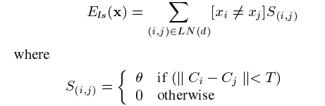
N represents all adjacent pixel pairs, C _{i} is the color vector of pixels i.
Long Range Neighborhood
Long range neighborhood similarity is given by –
To each distant pixel pair having similar colors but belonging to different we add a weight Ø as a penalty, therefore minimizing this function should keep the similarity as small as possible.

Slide 40
Bounding box continued …..
The bounding box is pre implemented in matlab and can be used by calling the function regionprops(I, ‘BoundingBox’) where I is the image on which the boundingbox method is to be applied as a property.
If one more property ‘Image’ is added to the above function then function will return the segmented binary images.

Slide 41
Results

Slide 42
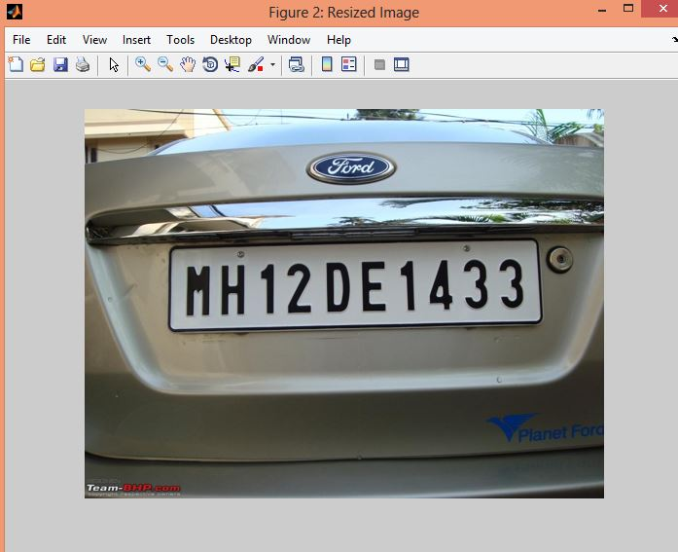
Resized Original Image

Slide 43
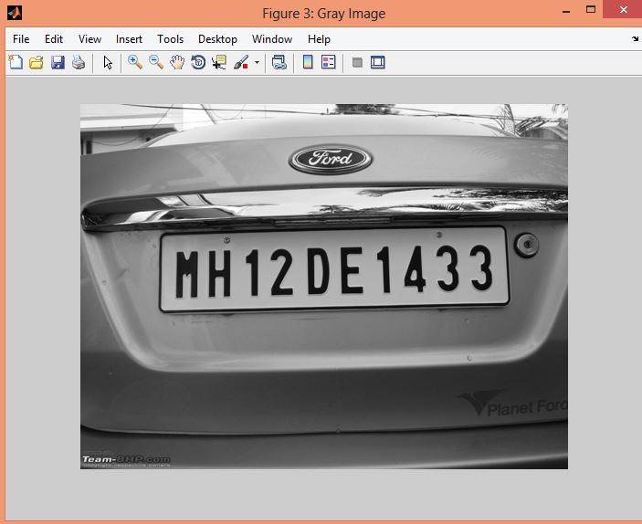
Gray Scale Image

Slide 44
Image Segmentation Using the Morphological Gradient Edge Detector and Bounding Box

Slide 45
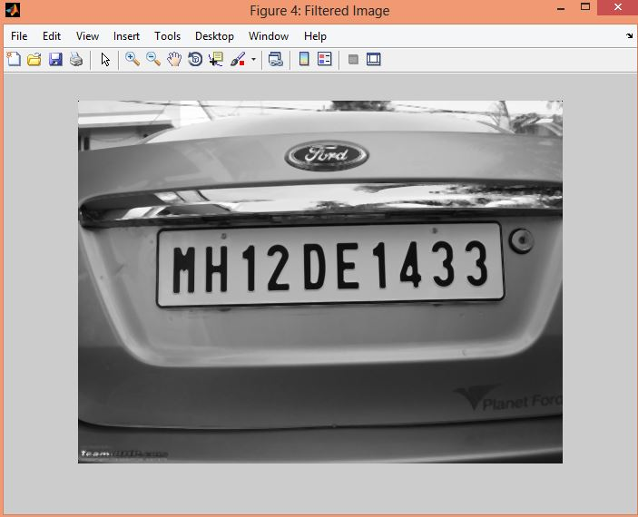
Filtered Image
The image is filtered using the median filter, other filters can also be used to enhance the image properties.
I = medfilt2(I,[3,3]);

Slide 46
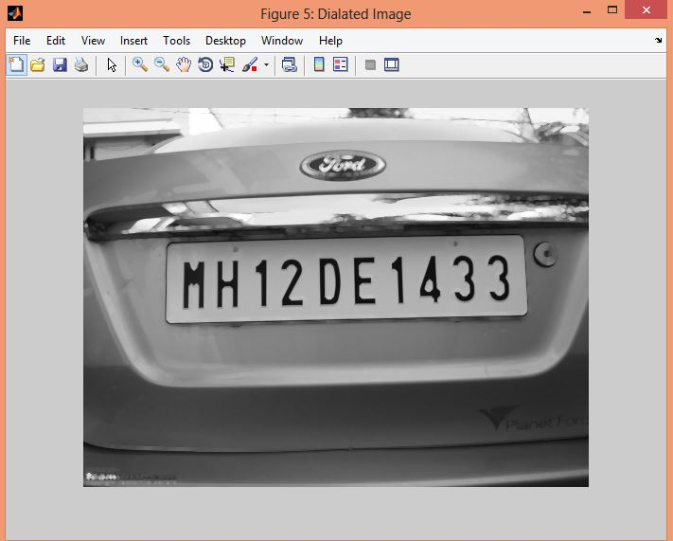
Image Erosion

Slide 47
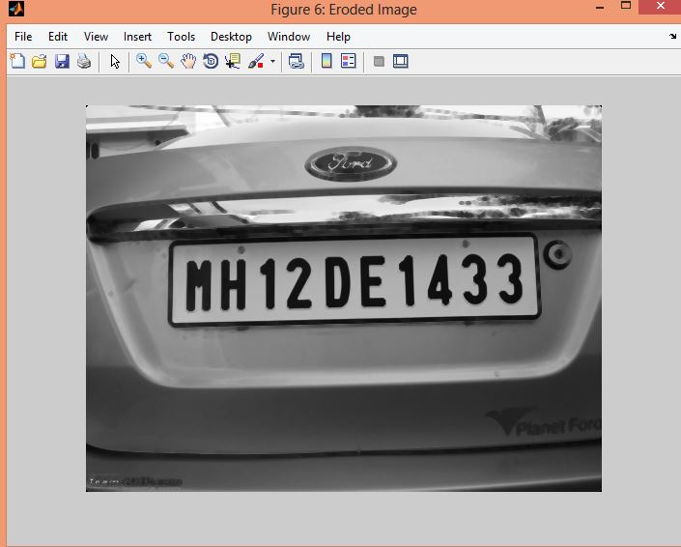
Image Dilation

Slide 48

Edge Enhancement
Morphological Gradient is used to enhance the edges in the image.
Morphological Gradient is defined as
After morphological gradient is applied the image convolved with a 2x2 matrix to brighten the edges.

Slide 49
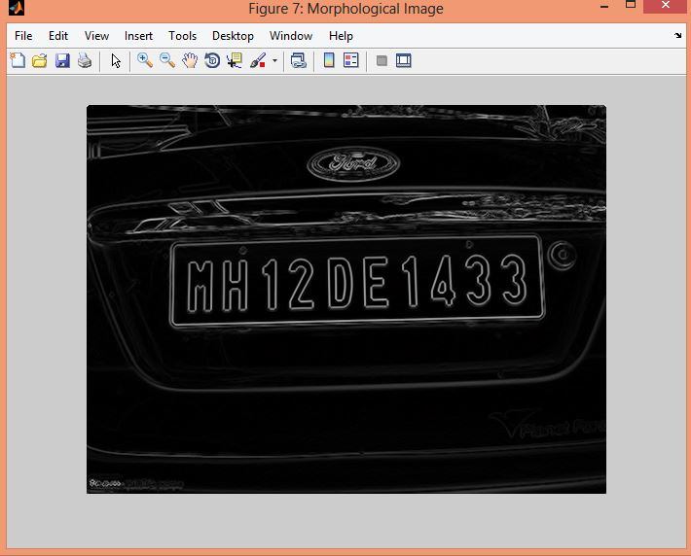
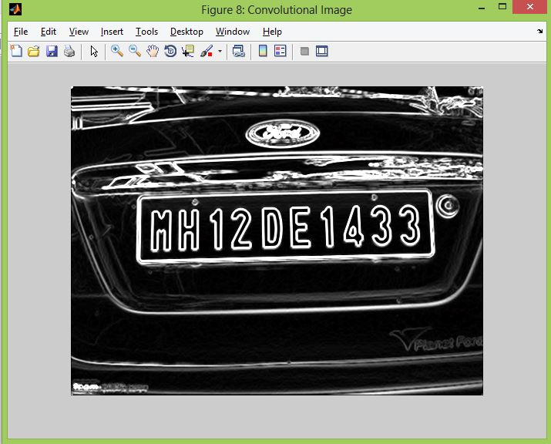
Morphological Gradient & Convolution

Slide 50
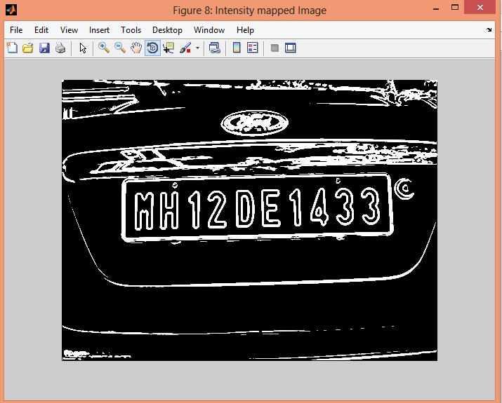
Intensity Scaling
The intensity of the obtained image is scaled between 0 to 1 to obtain the logical image
or binary image.

Slide 51
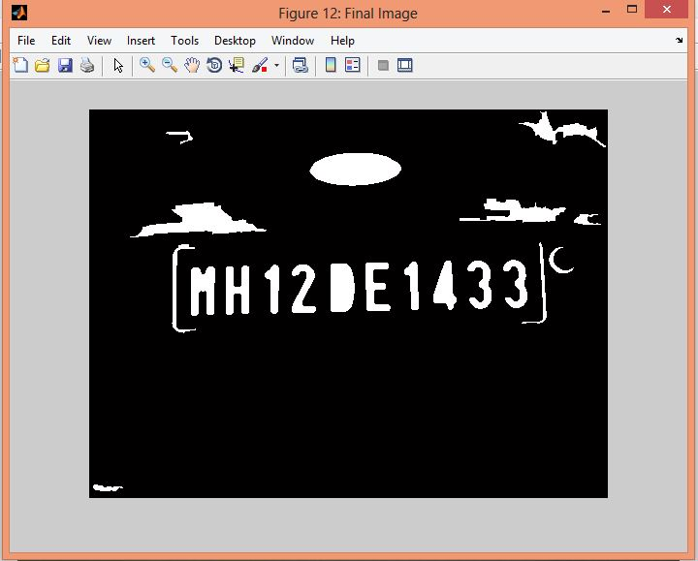
Morphological and Bounding Box Technique for the Character Segmentation
The resulted image is thinned infinite number of times until there is no change in the image to ensure the character isolation.
Finding the connected component area of more than 100 pixels

Slide 52
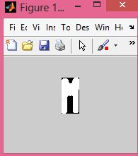
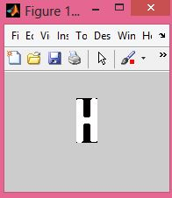
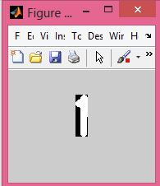
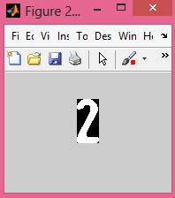
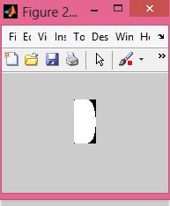
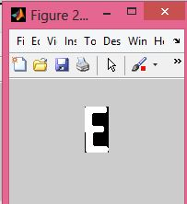
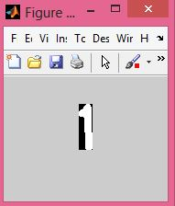
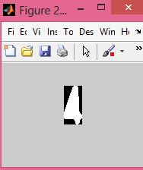
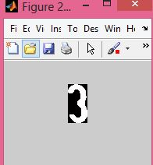
Segmented Images

Slide 53
LP Detection and Character Segmentation using the Sobel Edge Detector

Slide 54
Sobel Operator
Sobel Vertical Edge Detector Mask
Sobel Horizontal Edge Detector Mask
-1 | 0 | 1
-2 | 0 | 2
-1 | 0 | 1
-1 | -2 | 1
0 | 0 | 0
1 | 2 | 1

Slide 55
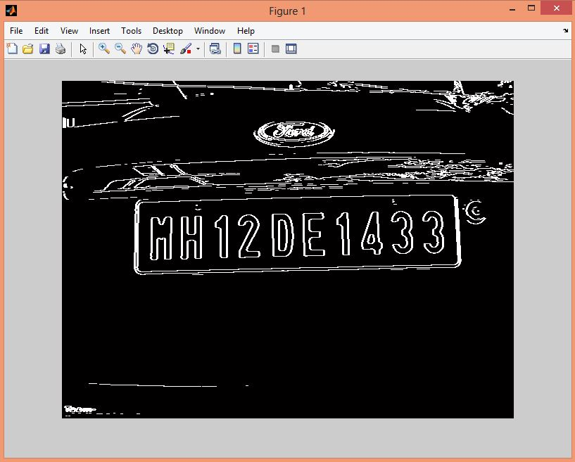
After the application of the Sobel Operator

Slide 56
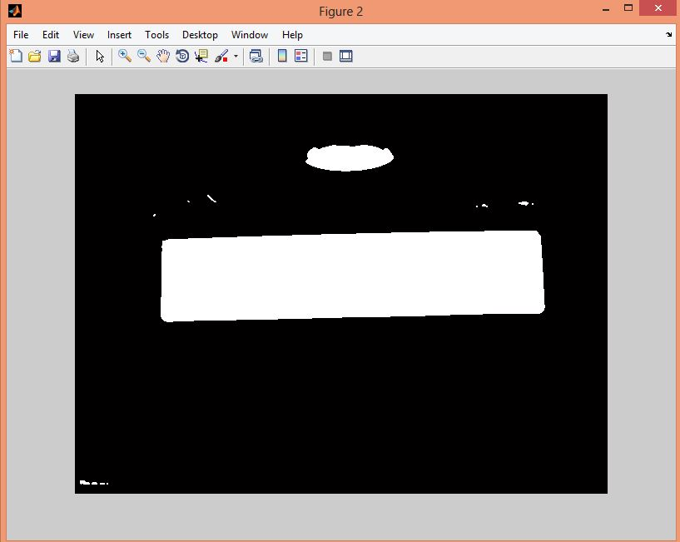
License Plate Region Detected

Slide 57
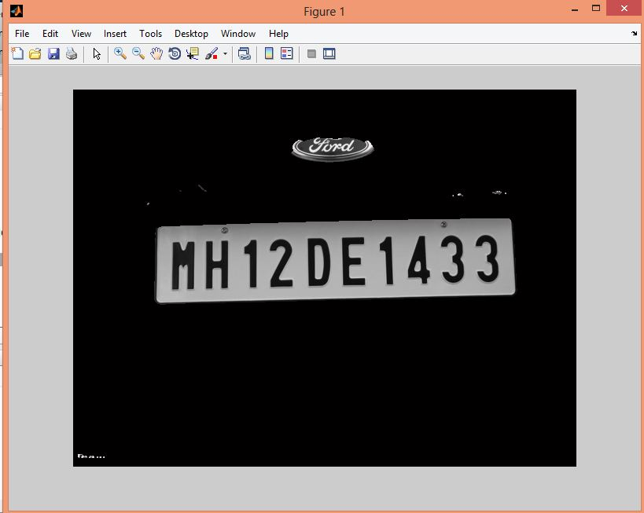
Original License Plate Detected

Slide 58
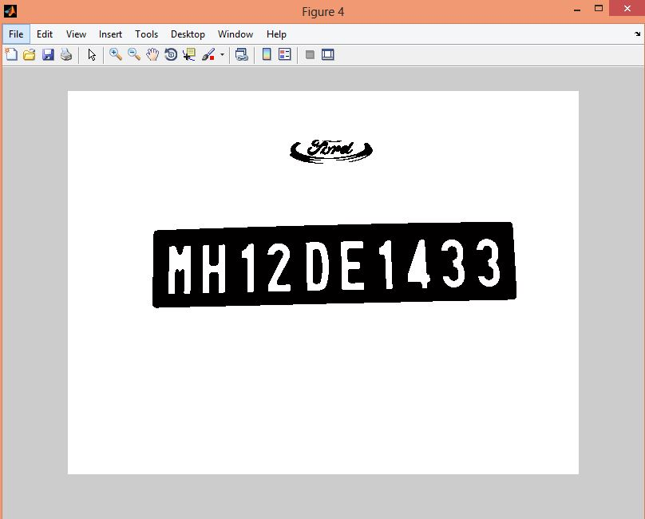
Binary Image

Slide 59
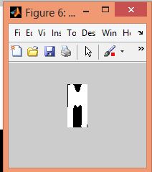
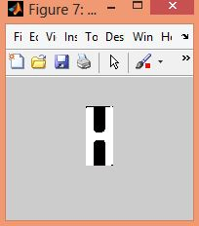
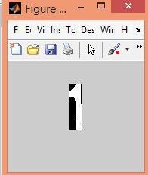
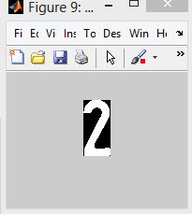
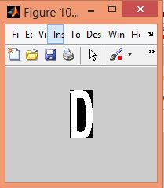
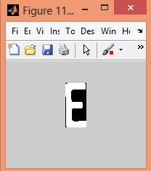

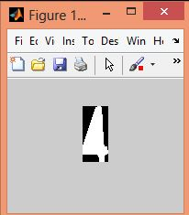

Segmented Characters

Slide 60
LP Detection and Segmentation using Top Hat Algorithm

Slide 61

Vertical Gradient

Slide 62


Horizontal Projection & Smoothed Horizontal Projection

Slide 63

Expected Region of LP

Slide 64

LP Detected

Slide 65









Segmented Characters

Slide 66
Scope
The project can be extended to recognize the individual segmented images that we have obtained.

Slide 67
References
License plate recognition From still images and Video sequences:A Survey (Christos-Nikolas E. Anagnostopoulos, Ioannis E. Anagnostopoulos, Ioannis D. Psoroulas, Vassili Loumos
Recognition of vehicle plate number in Matlab (Ragini Bhat , Bijender Mehandia)
Vehicle License Plate Character Segmentation- A Study (V.Karthikeyan, R.Sindhu, K.Anusha, D.S.Vijith)

Slide 68
Thank You!

