Slide 1
The Hydrus airlines
Fasten your seat belts for a journey you have never been before..!
Advance programming
G - 1 23-11-2020
Java

Slide 2

About
Airlines Management System
The project “Airline Management System” comprises of a large number of flights which belong to a particular airline. The system we have implemented manages different objects viz.
Airline
Customers/Traveller
Ticket
It is a window ticket generator system.
You can search, book and cancel tickets easily.

Slide 3
All the classes are present in package `airline.reservation.system`
Package Used
javax.swing
java.sql.ResultSet
java.awt
java.awt.event
java.awt.image
JFrame Class Objects
JMenuBar
JMenu
JLabel
JMenuItem
JTextField

Slide 4
ER - Diagram

Slide 5
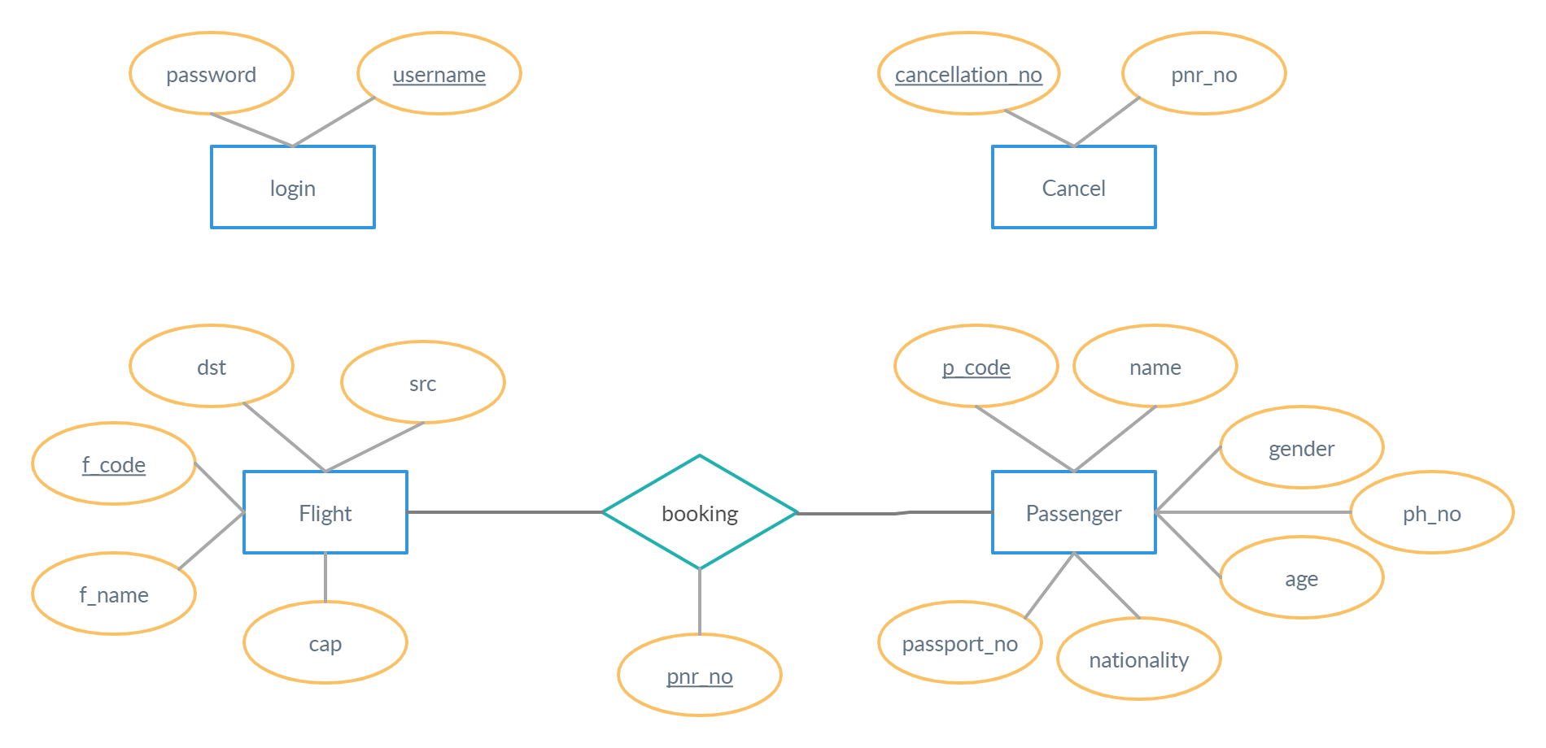

Slide 6
Classes & Relations

Slide 7
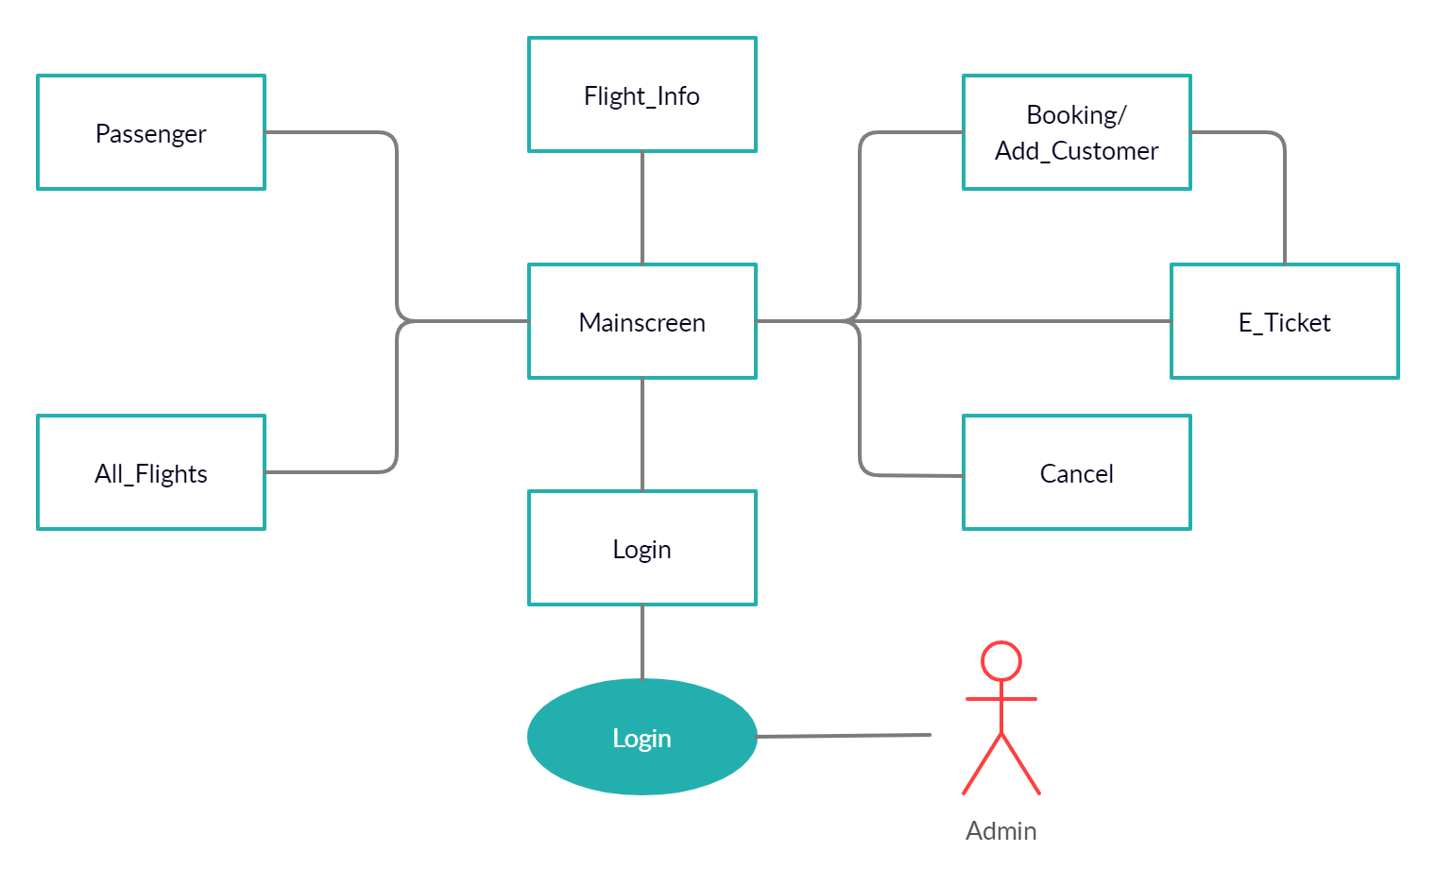

Slide 8
Code snippets

Slide 9
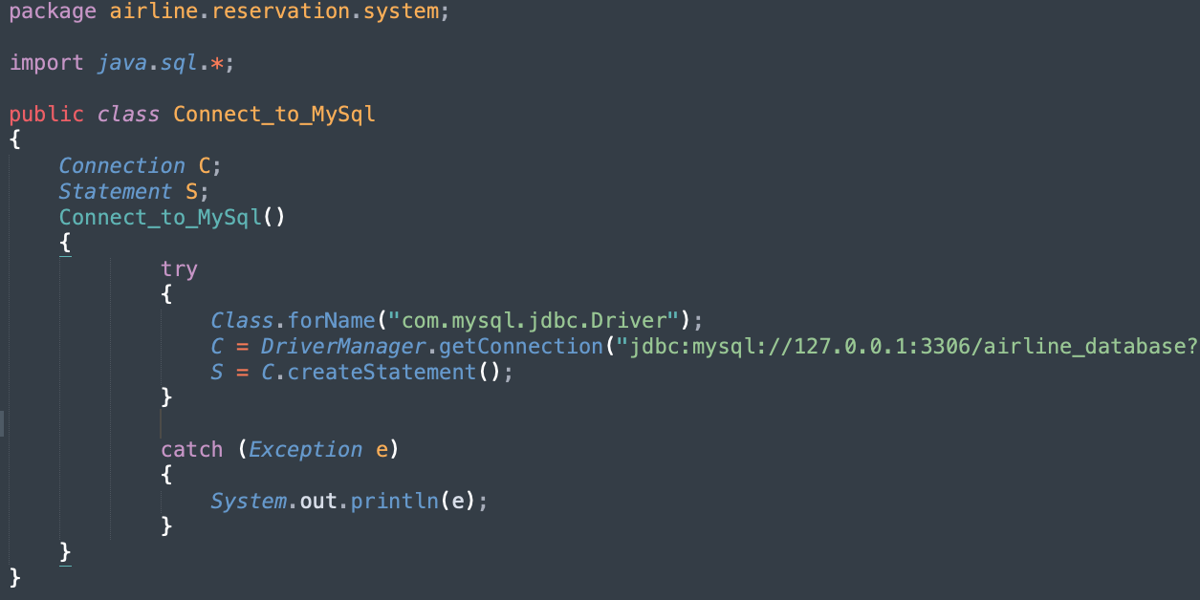

Slide 10
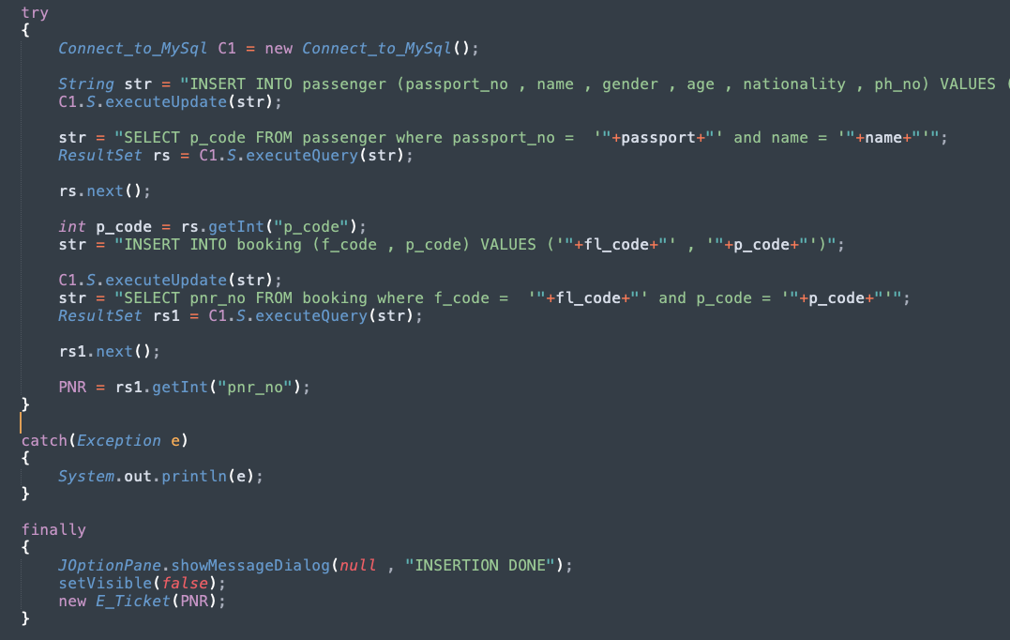

Slide 11
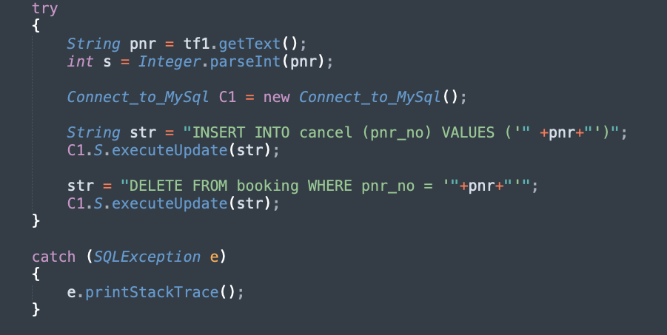

Slide 12
Database snippets

Slide 13
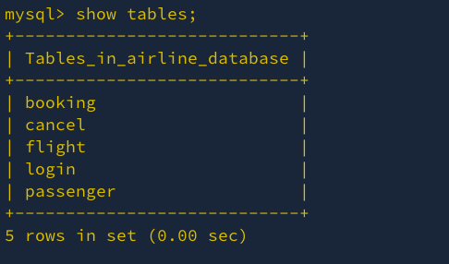
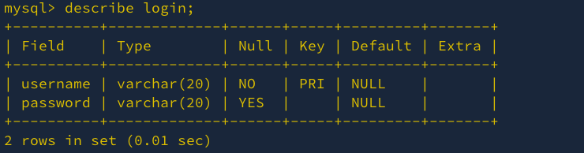

Slide 14
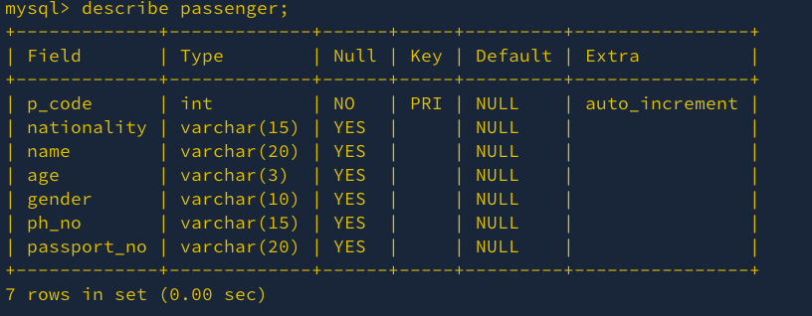
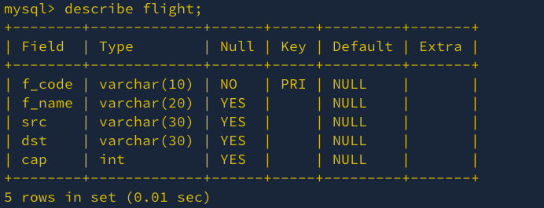

Slide 15
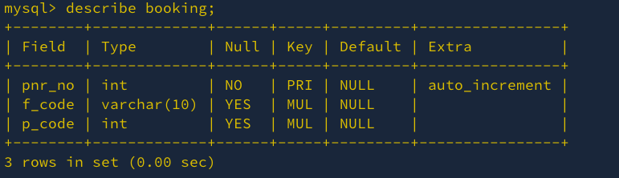
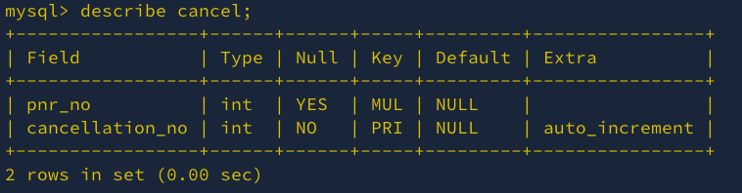

Slide 16
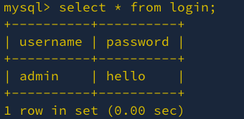
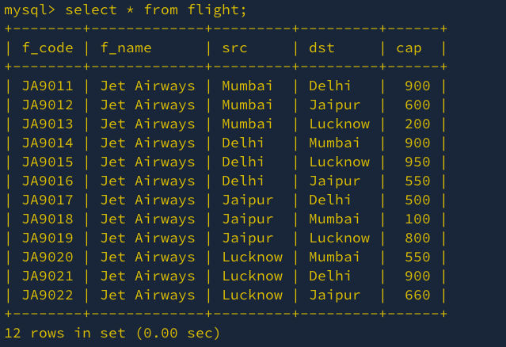

Slide 17
Working snippets

Slide 18

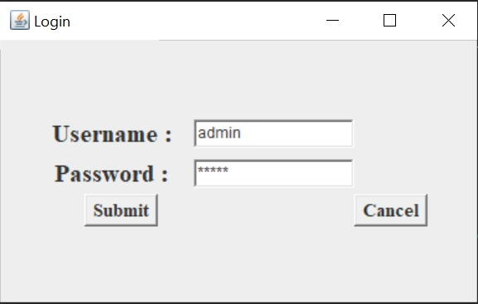
Login
This page authenticates the user using the details entered by him/her and also checks with database.

Slide 19

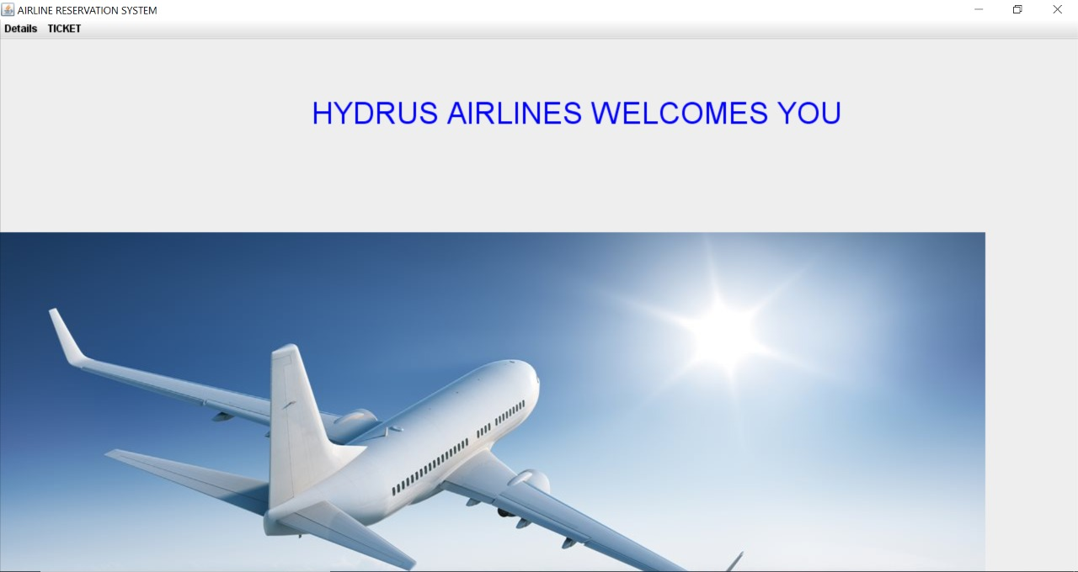
Main screen

Slide 20

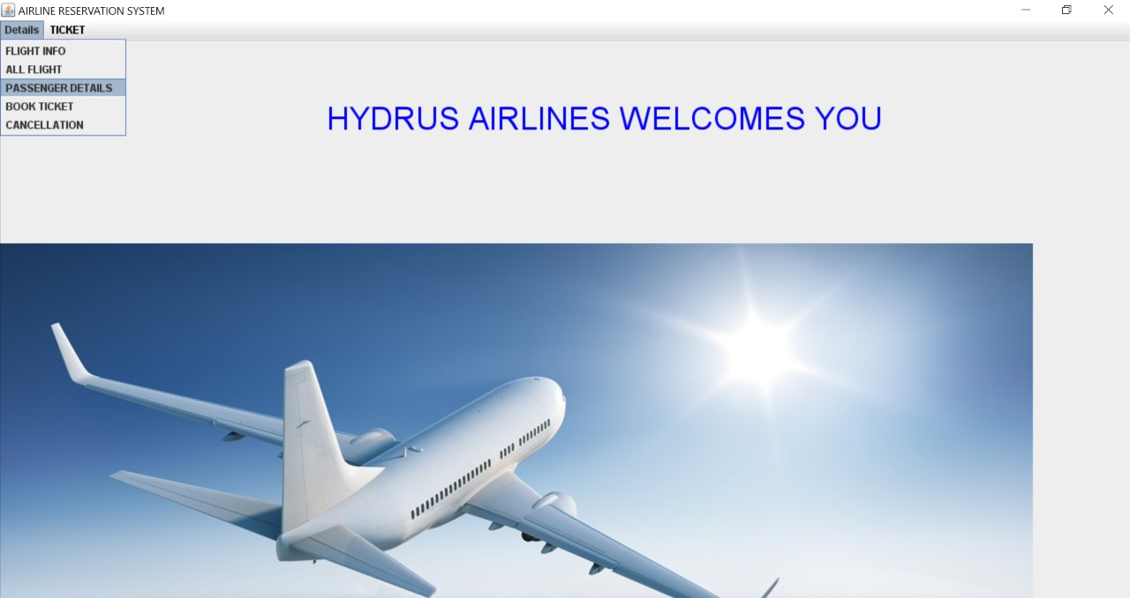
Main screen

Slide 21
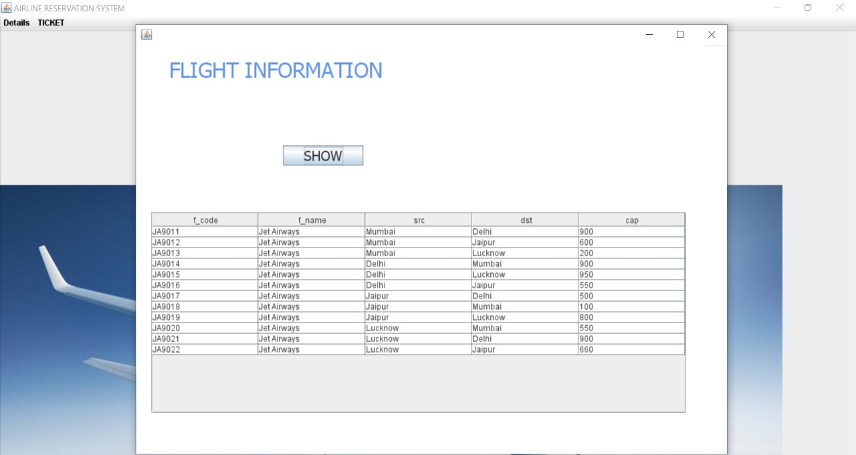
All Flights

Slide 22

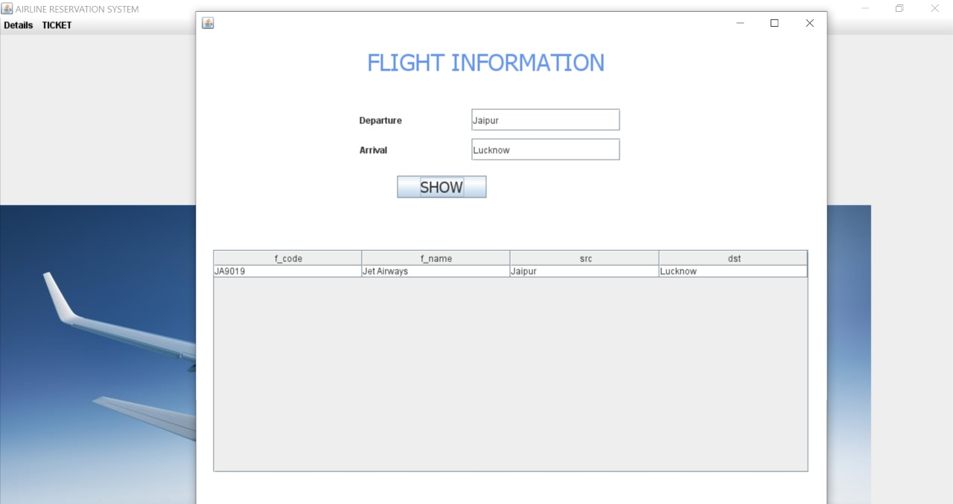
Between cities

Slide 23
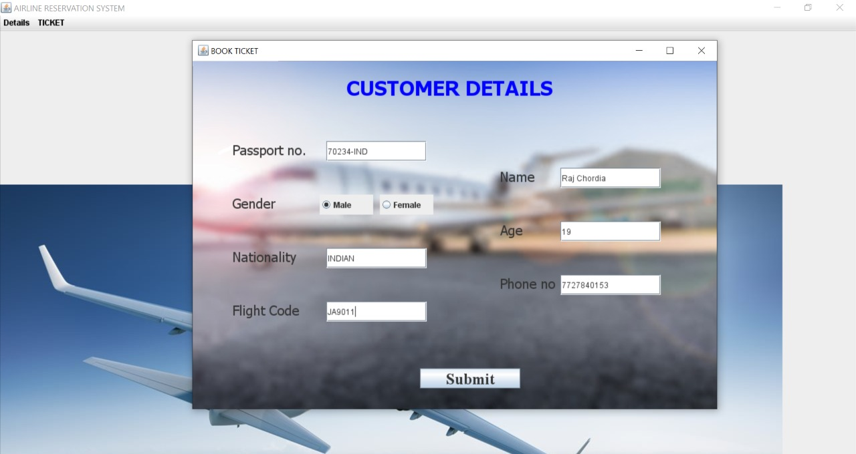
Book ticket

Slide 24
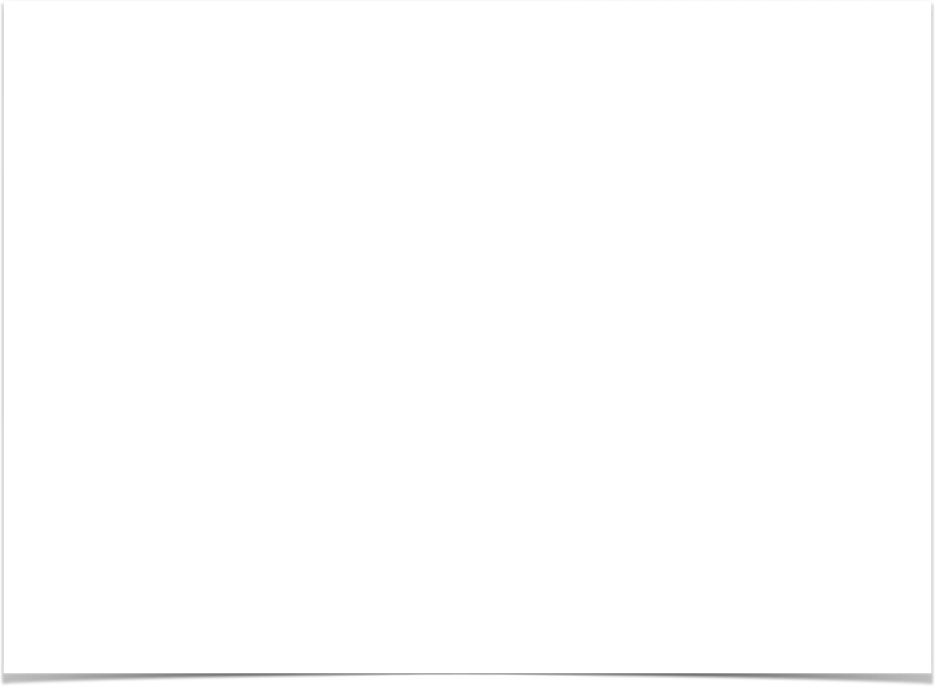
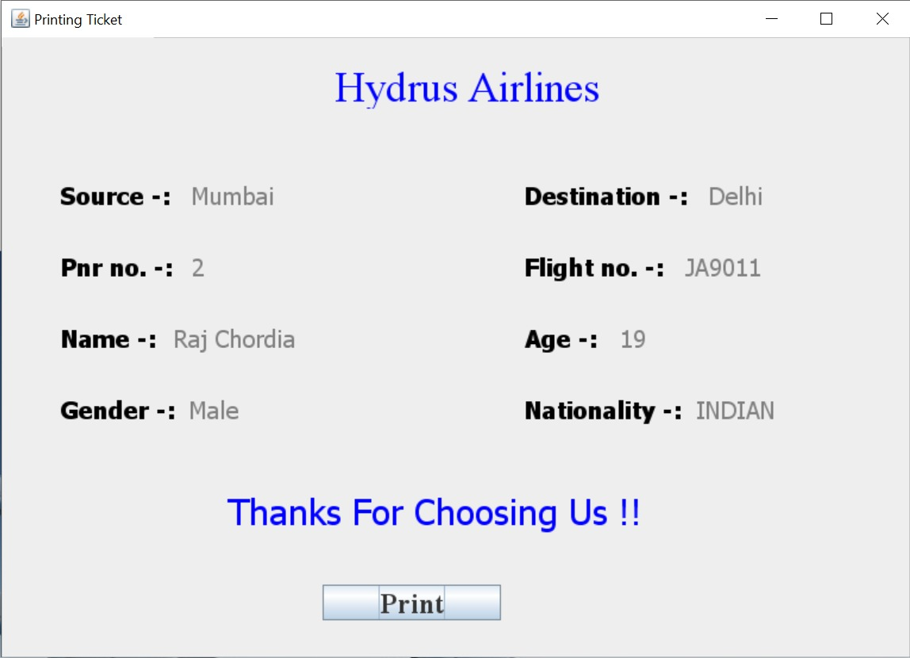

Slide 25

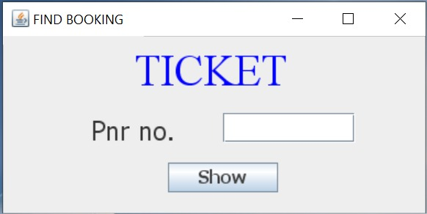
Journey details
Lost your ticket : ( no worries bring the Passenger Name Record Number (PNR No.) and we will give you the ticket : )
PNR No. is a unique identifier for your journey with us.

Slide 26

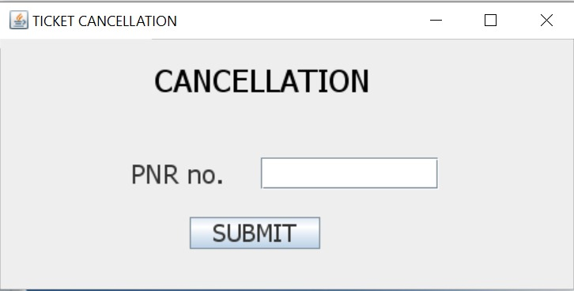
Cancel ticket
Changed your mind no worries you can cancel your ticket anytime you want.
Come to us with the Passenger Name Record Number (PNR No.) which is a unique identifier for your journey with us.

Slide 27
It is important to finalise the database design well in advance. Though we managed to discuss the design, we ended up making changes in the way of adding or deleting fields and figuring out referential integrity issues which consumed quite a lot of time.
Communication between people is a key aspect of creation of any project. It becomes more important when they all are working to achieve a common goal.
It is very essential to choose correct group members as this may cause harm during the process of project creation.
Code must be typed patiently as a single comma can crash the complete Frame. Even try catch can’t handle these types of errors.
Lessons Learned

Slide 28
Group members
19UCS230 Divyansh Goyal
19UCS246 Gaurav Singh Chauhan
19UCS257 Priyansh Bordia
19UCS205 Nishant Dixit

Slide 29
Thank you…!

Slide 30

(-: The END :-)
GitHub

