Slide 1

NIT Karnataka, Surathkal
INTERPRETABLE AND UNCERTAINTY-AWARE
FOOD PRICE FORECASTING
for Indian Markets using Temporal Fusion Transformers
Submitted by
Devulapalli Tharun
Roll No
252CS009
Deck Focus
Programme
CSE - M.Tech
- Problem and dataset
- Feature pipeline
- TFT-XGB fusion
- CQR calibration
- Results and dashboard
Institute
National Institute of Technology Karnataka, Surathkal
Email
devulapallitharun.252cs009@nitk.edu.in
Guided by
Dr. Shashidhar G Koolagudi
Mentor
L. Preethi
Best model: TFT-XGBFusion-CQR
Devulapalli Tharun | 252CS009 | Food Price Forecasting
01

Slide 2
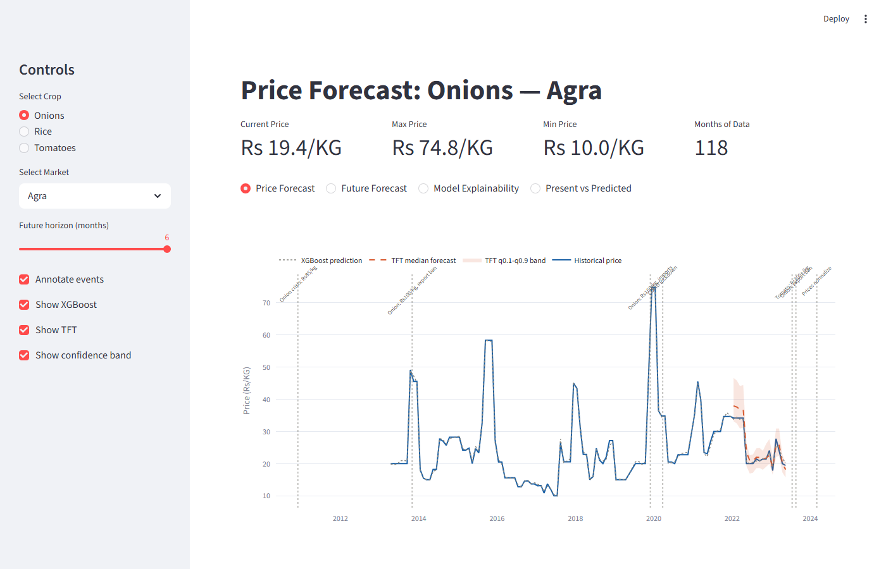
The Problem Worth Solving
MOTIVATION
Why does Indian food price forecasting need a better approach?
- Indian food prices are highly volatile — onion prices surged 5× in 2019 due to monsoon failure and export bans.
- Price shocks affect food security for hundreds of millions and disrupt farmer income, procurement, and policy decisions.
- Point-only forecasts do not quantify risk — stakeholders need a price range and a reason, not just a number.
- Existing models lack calibrated uncertainty bands and interpretable, statistically stable feature attribution.
₹130
1.4B
Peak onion
price 2019 (Rs/KG)
People food-
dependent
10+
3
Years of data
Staple commodities
What was missing:
Calibrated price bands
+ Interpretable attribution
+ Practical decision interface
→ This project delivers all three.
Devulapalli Tharun | 252CS009 | Food Price Forecasting
02

Slide 3
Problem Statement
PROBLEM
What are we forecasting, for whom, and how will we know it worked?
Scope | Detail
Commodities | Onions, Tomatoes, Rice
Markets | 53 WFP-reported markets across India
Training period | 2010 to Dec 2021 (TFT); XGBoost up to 2019
Forecast outputs | q10, q50, q90 per market-commodity series
Input:
WFP prices: 3 commodities × 53 markets (2010–2022)
NASA weather: temperature, rainfall, humidity (monthly)
Task:
Forecast q10, q50, q90 for 1–6 months ahead per series
No look-ahead leakage
Constraints:
Calibrated bands · Stable feature attribution
Evaluation:
2023+ test, n=792 · MAE · MAPE · Coverage
Price history
+ weather data
XGBoost + TFT
quantile model
q10/q50/q90
forecast bands
Calibrated bands
+ attribution
Design principle: the forecast output must be usable by non-ML stakeholders —
a price range with an explanation, not just a number.
Devulapalli Tharun | 252CS009 | Food Price Forecasting
03

Slide 4
Project Question and Design Answer
OVERVIEW
Can we forecast Indian food prices with accuracy, uncertainty, and explanation?
- Point forecast alone is risky during onion and tomato shock periods.
- The project predicts q10, q50, and q90 prices for 1-6 months ahead.
- TFT gives dynamic feature weights and attention; CQR makes bands empirically reliable.
- The final dashboard exposes history, future bands, explanations, and test validation.
11.4%
84.0%
Test MAPE
Band coverage
792
123
Test rows
Series
System answer: WFP prices + NASA weather -> 26 engineered features -> XGBoost point signal -> TFT quantile forecast -> per-commodity CQR -> Streamlit decision dashboard
Devulapalli Tharun | 252CS009 | Food Price Forecasting
04

Slide 5
Dataset and Modeling Scope
DATA
145,124
16,939
53
3
2023+
Raw WFP rows
Final rows
Markets
Commodities
Test period
Source | Role | Selected content
WFP food prices | Target history | Monthly retail prices, 1994-2026
WFP markets | Spatial join | 53 city coordinates
NASA POWER | Weather covariates | Rainfall, temperature, humidity
Processed panel | Model input | Market x commodity monthly series
Commodity | Rows | Series | Volatility meaning
Onions | 5,003 | 38 | Seasonal crisis-prone
Tomatoes | 5,245 | 45 | Fast spike-prone
Rice | 6,691 | 40 | Stable staple baseline
- Train: up to Dec 2021 for the final TFT family.
- Validation: 2022, used for early stopping and CQR offsets.
- Test: 2023 onward, held out for final evaluation.
Group key = market + commodity Target = log1p(price Rs/KG) Horizon H = 6 months Encoder window = 24 months
Devulapalli Tharun | 252CS009 | Food Price Forecasting
05

Slide 6
End-to-End System Flow
PIPELINE
Raw data WFP + NASA
Cleaning and filtering
Feature panel 26 columns
Main artifacts
- models/xgb_clean_2019.pkl
- models/tft_best_xgbfused.ckpt
- models/conformal_offsets_step5.json
- data/processed/tft_predictions_calibrated_step5.csv
- app.py dashboard selects best available family
XGBoost point baseline
TFT quantiles q10 / q50 / q90
xgb_log_pred
Per-commodity CQR calibration
Final family = step5 Name = TFT-XGBFusion-CQR Active when fused checkpoint and fused dataset exist.
Streamlit dashboard forecast + explain
Devulapalli Tharun | 252CS009 | Food Price Forecasting
06

Slide 7
Feature Engineering
PREPROCESSING
Group | Examples | Why it matters
Static | commodity, market, state | Series identity and regional context
Calendar | month, season, sin/cos | Known future seasonal structure
Price memory | lag_1m, lag_12m, rolling_3m/6m | Momentum and annual baseline
Weather | rainfall, temperature, humidity | Supply-side stress signal
Shock flags | rain_deficit, heat_stress | Nonlinear crisis regimes
Fusion | xgb_log_pred | Strong point prior for TFT
log_price = log(1 + price) month_sin = sin(2*pi*month/12) month_cos = cos(2*pi*month/12) roll_3(s,t) = mean(p[s,t], p[s,t-1], p[s,t-2]) yoy_change = (p[s,t] - p[s,t-12]) / p[s,t-12] rain_deficit = 1 if rainfall < 25th percentile
- Features are shared by XGBoost and TFT to keep the comparison controlled.
- Log-price reduces spike dominance while preserving multiplicative changes.
- Binary weather shocks give the VSN readable, domain-aligned gates.
- The fused XGBoost feature is created using a leakage-controlled pre-2020 model.
Simple idea: convert raw price history into a supervised panel where every row knows its season, market, weather state, and price memory.
Devulapalli Tharun | 252CS009 | Food Price Forecasting
07

Slide 8
Model Stack: Point + Distribution + Calibration
METHOD
XGBoost 500 trees max_depth=6 eta=0.05
Temporal Fusion Transformer q10 q50 q90
CQR per commodity log-space offset
Dashboard forecast band explanation
Layer | Output | Limitation solved
XGBoost | single log-price | Strong tabular accuracy
TFT | three quantiles per horizon | Uncertainty + interpretability
CQR | adjusted q10/q90 | Empirical coverage
Streamlit | interactive evidence | Usability and audit
Prediction object per future month: lower = q10_calibrated median = q50 upper = q90_calibrated Risk label uses relative band width: (upper - lower) / median
Key design choice: XGBoost is not just averaged with TFT. Its prediction becomes a known covariate, so TFT can learn when to trust or override it.
Devulapalli Tharun | 252CS009 | Food Price Forecasting
08

Slide 9
TFT Architecture in This Project
METHOD
Static IDs commodity market state
LSTM encoder 24 months
VSN gates Softmax weights
Static enrichment
Interpretable attention
Known future month, season xgb_log_pred
LSTM decoder 6 months
Configuration: hidden_size=32 attention_heads=2 lstm_layers=1 hidden_continuous=16 dropout=0.2 quantiles=[0.1,0.5,0.9]
Quantile heads q10 q50 q90
Observed past price, weather lags, shocks
- VSN answers: which input variable matters now?
- Attention answers: which past month influenced this horizon?
- Quantile heads answer: what is the likely range, not only the center?
Devulapalli Tharun | 252CS009 | Food Price Forecasting
09

Slide 10
XGBoost Fusion Without Leakage
NOVELTY
The strongest point model is injected into TFT as xgb_log_pred.
Model family | Training cutoff | What changed
TFT-Base | 2020 | Plain TFT, weaker coverage
TFT-Retrain21 | 2021 | Fairer recent training window
TFT-XGBFusion | 2021 | Adds xgb_log_pred known feature
TFT-XGBFusion-CQR | 2021 + 2022 cal | Final calibrated band
1. Train auxiliary XGBoost only up to 2019-12. 2. Generate xgb_log_pred for all rows after that. 3. Add xgb_log_pred as a known real covariate. 4. Train TFT up to 2021-12, validate on 2022. 5. Test on 2023+ with CQR-calibrated bands.
XGB prediction strong local prior
TFT VSN learns gate weight
Quantile output keeps uncertainty
CQR band reliability
Why pre-2020 XGB? It prevents calibration/test leakage: the signal used inside TFT has not already seen the answer for 2022-2023.
Devulapalli Tharun | 252CS009 | Food Price Forecasting
10

Slide 11
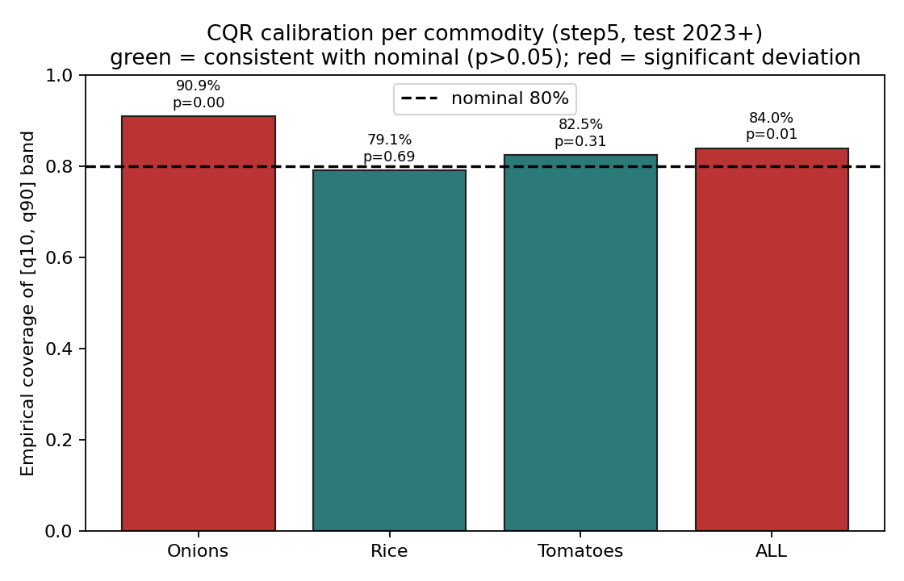
Quantile Loss and CQR Calibration
MATH
Pinball loss for quantile q: QL(y, yhat, q) = q * max(y - yhat, 0) + (1-q) * max(yhat - y, 0) TFT total loss: L = sum over q in {0.1,0.5,0.9}, horizon H=6
CQR score on validation: s_i = max(q10_i - y_i, y_i - q90_i) Offset c = quantile_{1-alpha}(s_i) q10_cal = q10 - c q90_cal = q90 + c Applied separately for onions, tomatoes, rice.
Commodity | CQR offset in log space | Test coverage
Onions | -0.0277 | 90.9%
Rice | 0.0978 | 79.1%
Tomatoes | 0.0432 | 82.5%
All | per-commodity | 84.0%
Plain meaning: CQR widens the predicted band only as much as the 2022 validation errors say is needed.
Devulapalli Tharun | 252CS009 | Food Price Forecasting
11

Slide 12
Evaluation Protocol
EVALUATION
Metric | Formula / definition | Interpretation
MAE | mean |y - q50| | Average Rs/KG error
MAPE | mean |(y - q50)/y| x 100 | Scale-free percent error
Coverage | mean 1[q10 <= y <= q90] | Band reliability
Band width | mean(q90 - q10) | Usefulness of uncertainty
Test set discipline: Train final TFT : through 2021-12 Calibration window : 2022 Held-out test : 2023+ Matched test rows : n = 792 Statistical checks: paired t-test, Wilcoxon, Cohen's d, binomial coverage test, VSN bootstrap.
792
1000
80%
1-6 mo
24 mo
Ablation rows
Bootstrap resamples
Coverage target
Horizon
Encoder
- XGBoost is reported honestly as the better point-only baseline.
- TFT-XGBFusion-CQR is evaluated as the best combined system: point + band + explanation.
- Coverage is empirical test coverage, not a theoretical claim copied from quantile labels.
Devulapalli Tharun | 252CS009 | Food Price Forecasting
12

Slide 13
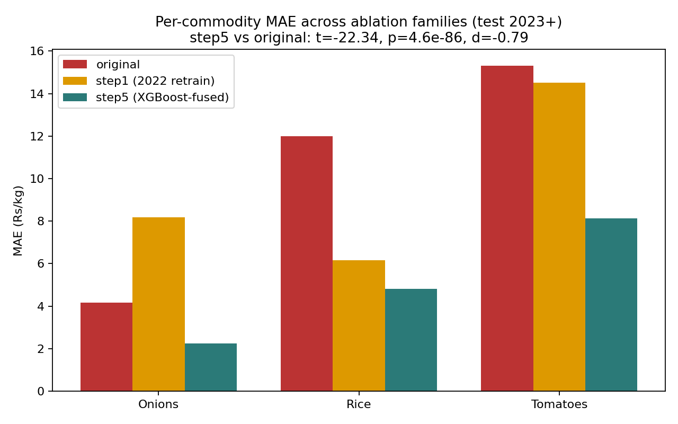
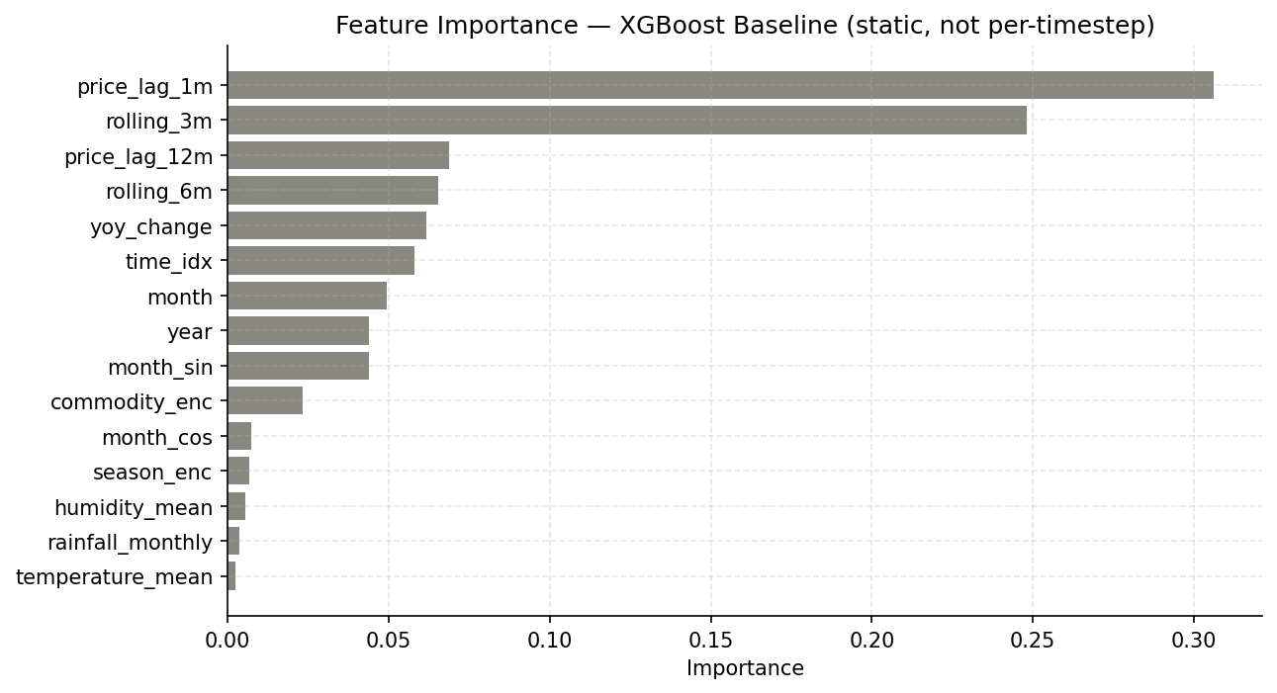
Main Results on 2023+ Test Set
RESULTS
Model | MAE | MAPE | Coverage | Band width
XGBoost point baseline | 1.95 | 3.5% | -- | --
TFT-Base | 10.53 | 29.1% | 64.9% | 23.62
TFT-EnsCQR | 10.85 | 28.3% | 88.5% | 32.44
TFT-Retrain21-CQR | 9.91 | 29.2% | 87.6% | 34.78
TFT-XGBFusion-CQR | 5.27 | 11.4% | 84.0% | 11.99
5.27
11.4%
Final MAE
Final MAPE
84.0%
11.99
Coverage
Band width
Result story: XGBoost wins raw point error; the final TFT stack wins the complete forecasting objective with calibrated uncertainty and inspectable explanations.
Devulapalli Tharun | 252CS009 | Food Price Forecasting
13

Slide 14
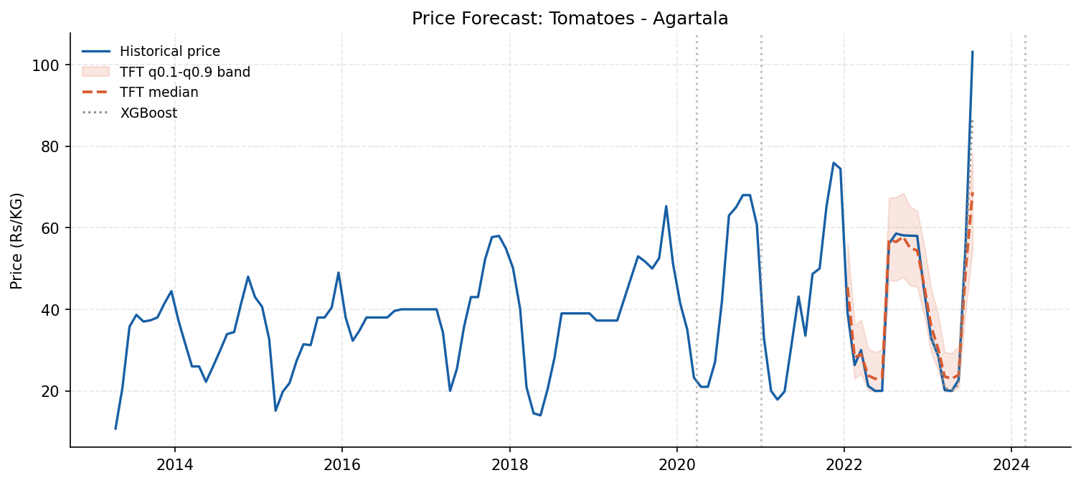
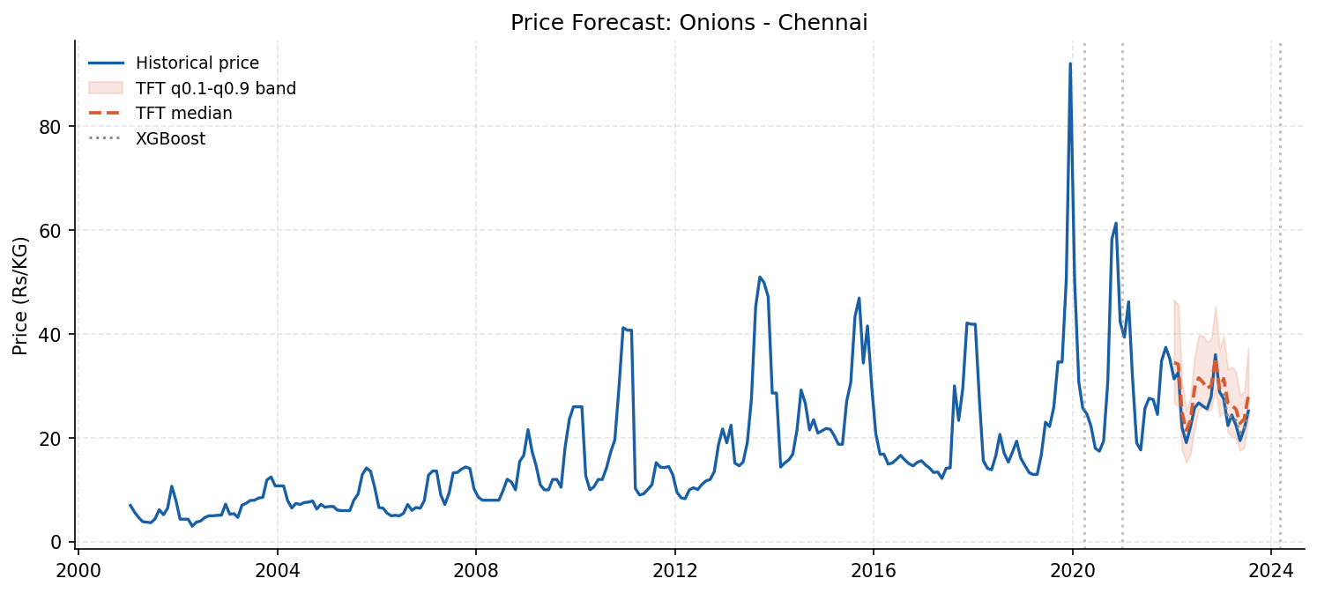
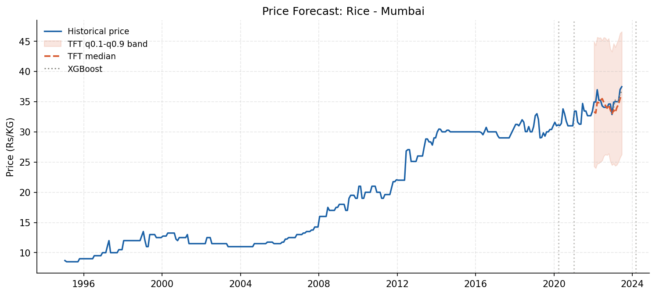
Commodity-Level Behavior
RESULTS
Commodity | MAE | MAPE | Coverage | Interpretation
Onions | 2.25 | 9.1% | 91% | Best calibrated; seasonal memory helps
Tomatoes | 8.13 | 13.0% | 82% | Hardest due to sudden supply shocks
Rice | 4.81 | 11.7% | 79% | Stable series, narrower uncertainty need
- Tomatoes show the widest practical risk because monthly data cannot capture short one-week crop failures.
- Onions benefit from annual lag and rolling features around known crisis seasons.
- Rice checks whether the same architecture can avoid exaggerating stable commodity risk.
Devulapalli Tharun | 252CS009 | Food Price Forecasting
14

Slide 15
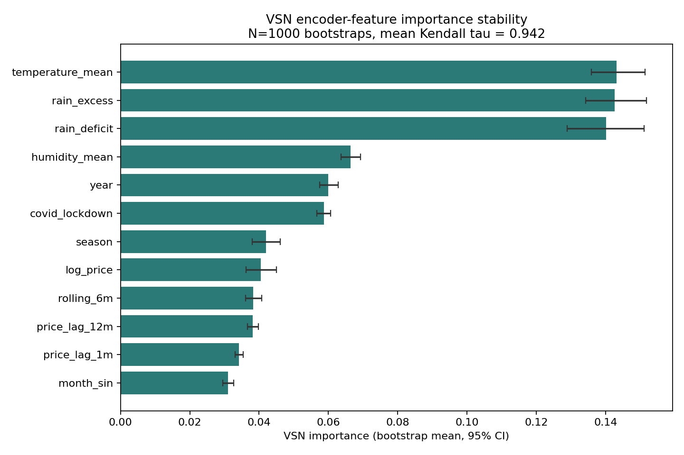
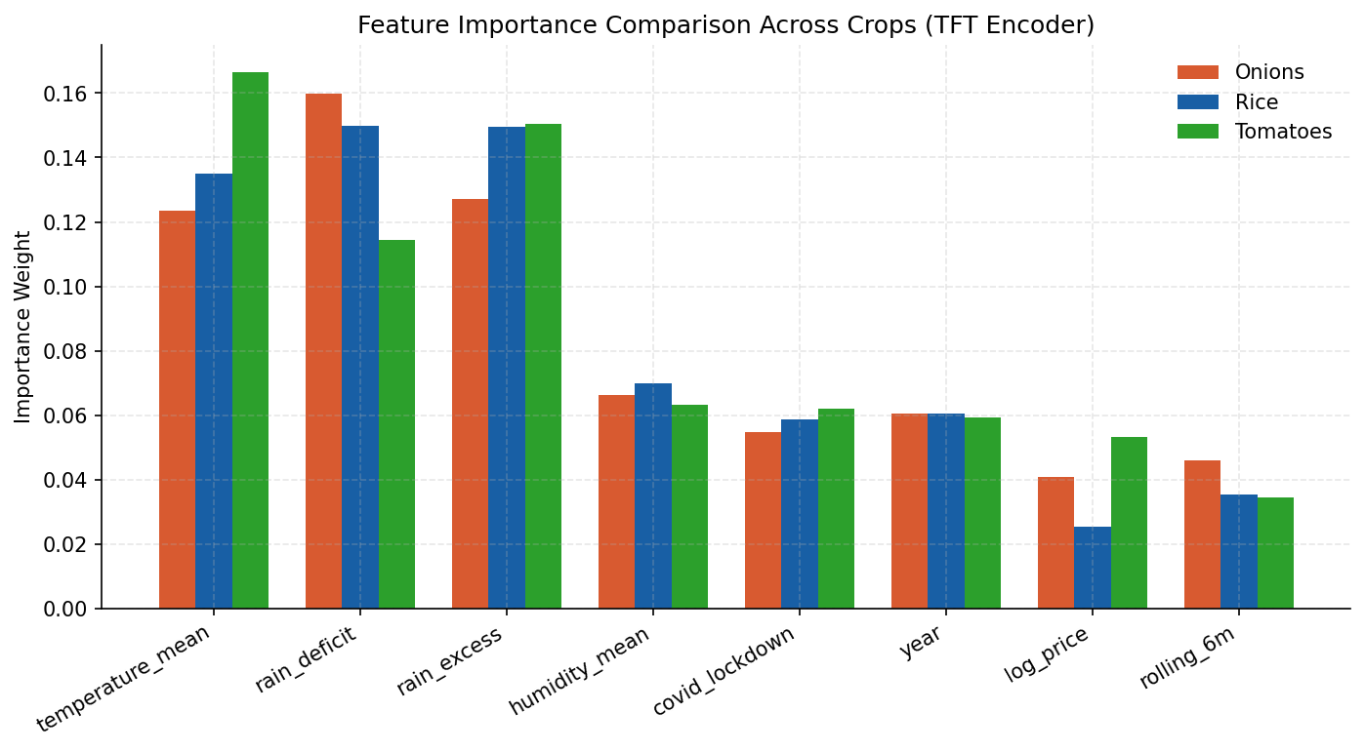
Explainability: Stable Feature Rankings
EXPLAINABILITY
0.942
0.895
0.990
Top encoder feature | Mean VSN weight
temperature_mean | 0.143
rain_excess | 0.143
rain_deficit | 0.140
humidity_mean | 0.066
year | 0.060
Kendall tau
95% CI low
95% CI high
The explanation is not just visual: ranking stability is tested with 1000 bootstrap resamples across series.
Devulapalli Tharun | 252CS009 | Food Price Forecasting
15

Slide 16
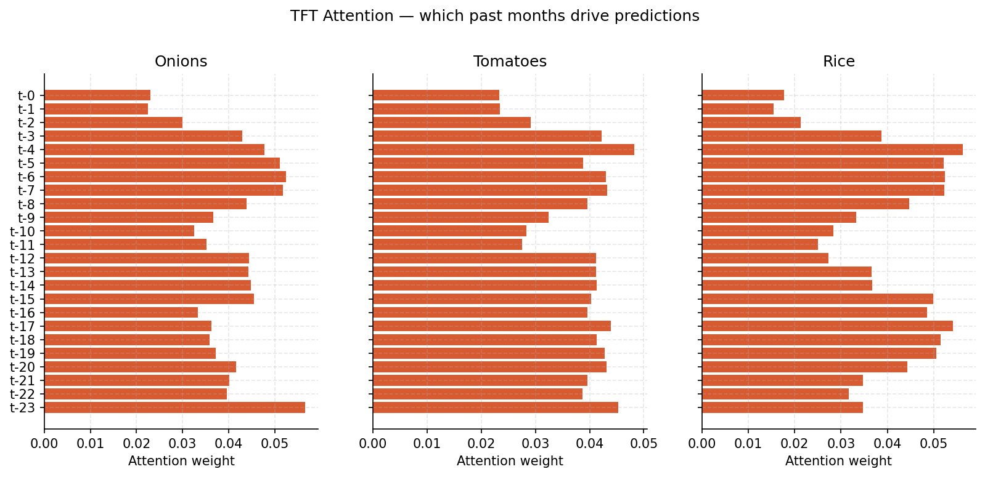
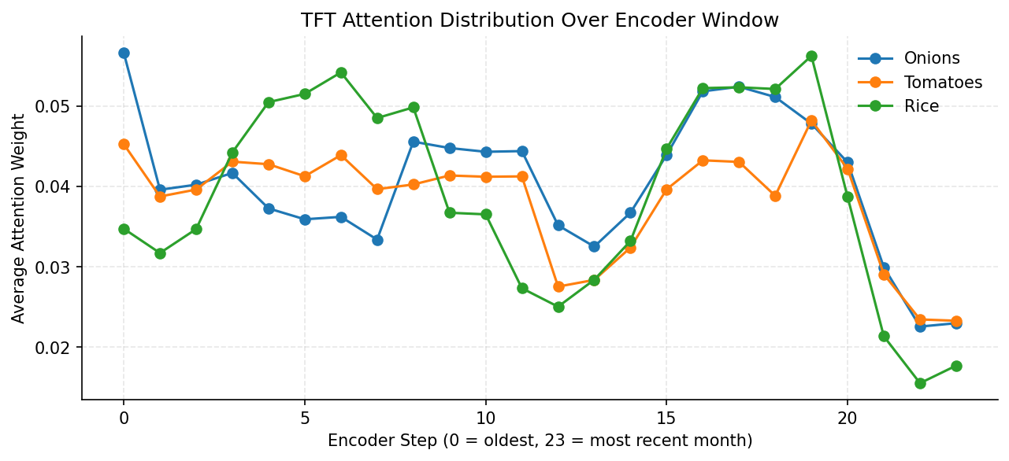
Attention and Forecast Evidence
EXPLAINABILITY
Interpretation rule: High attention at t-1 -> recent momentum High attention at t-12 -> annual seasonality Spread attention -> uncertain regime VSN explains variables; attention explains time.
- Dynamic VSN weights can change per market, commodity, and month.
- Attention weights expose which encoder months affect each decoder horizon.
- Together they let the dashboard answer why a forecast moved, not just what number changed.
Devulapalli Tharun | 252CS009 | Food Price Forecasting
16

Slide 17
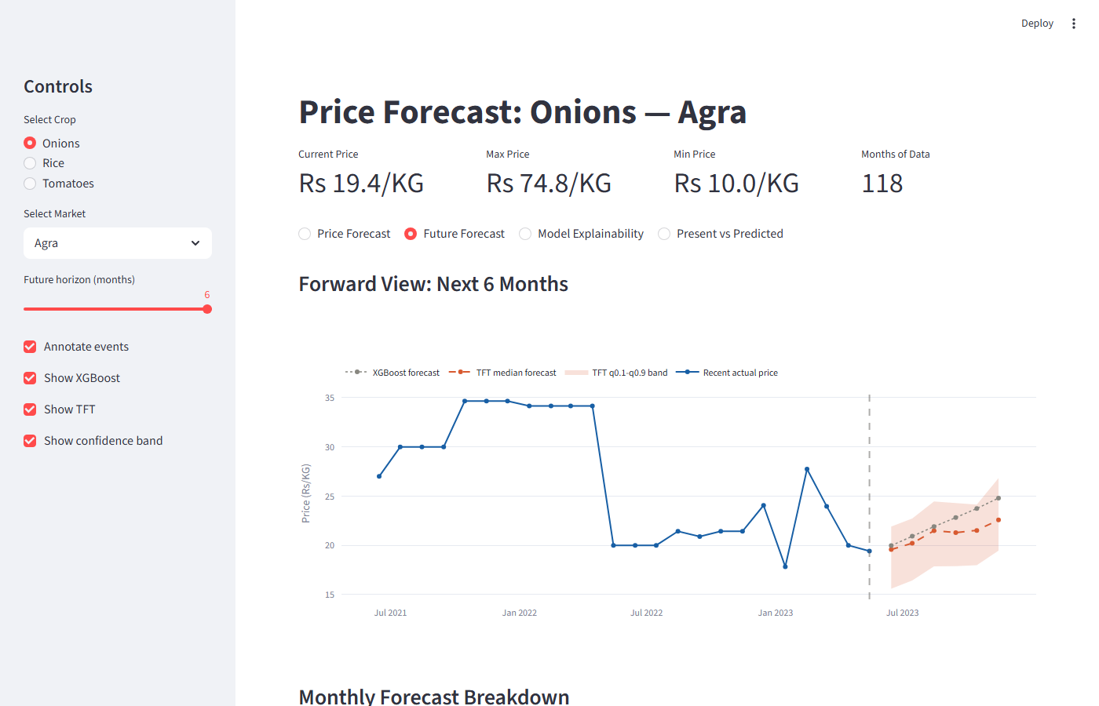
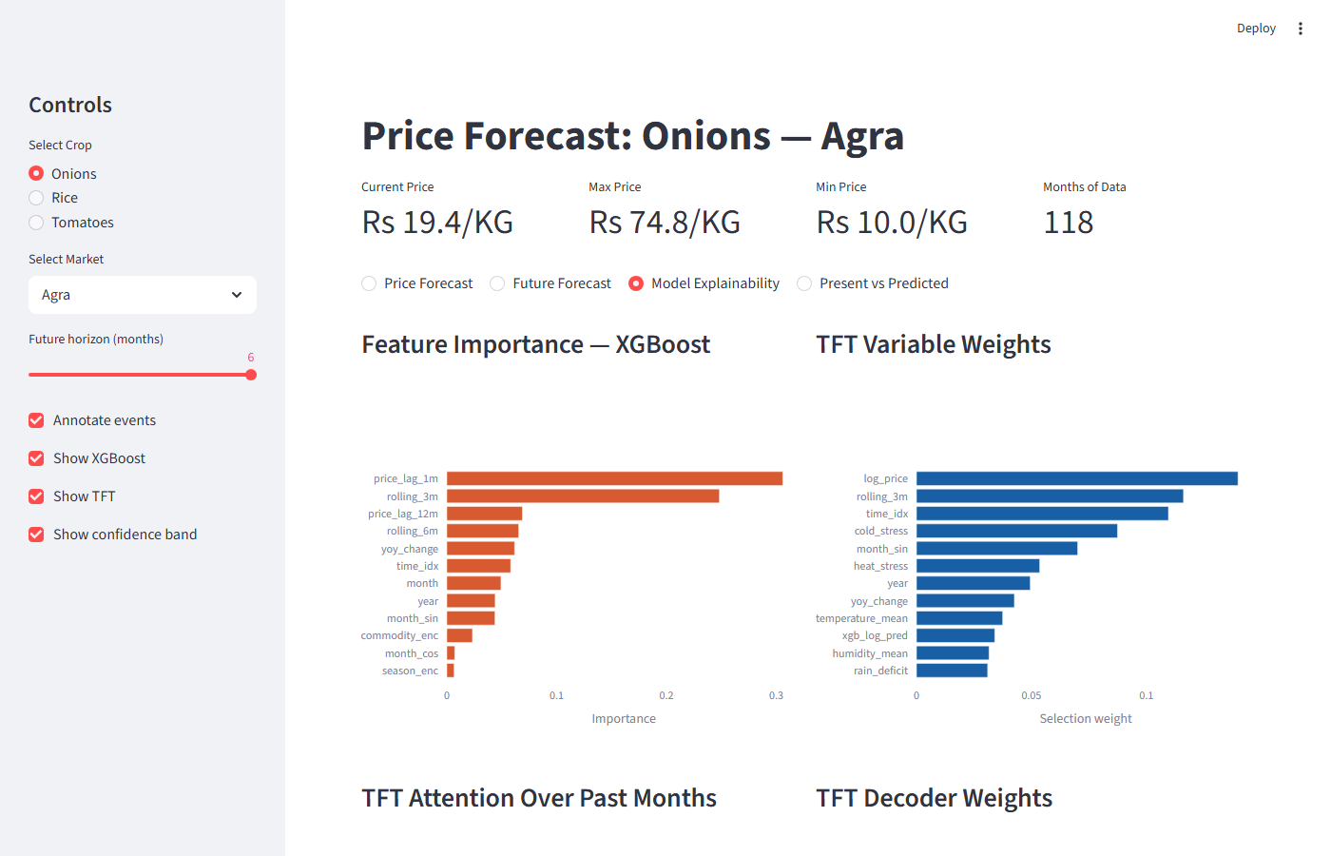
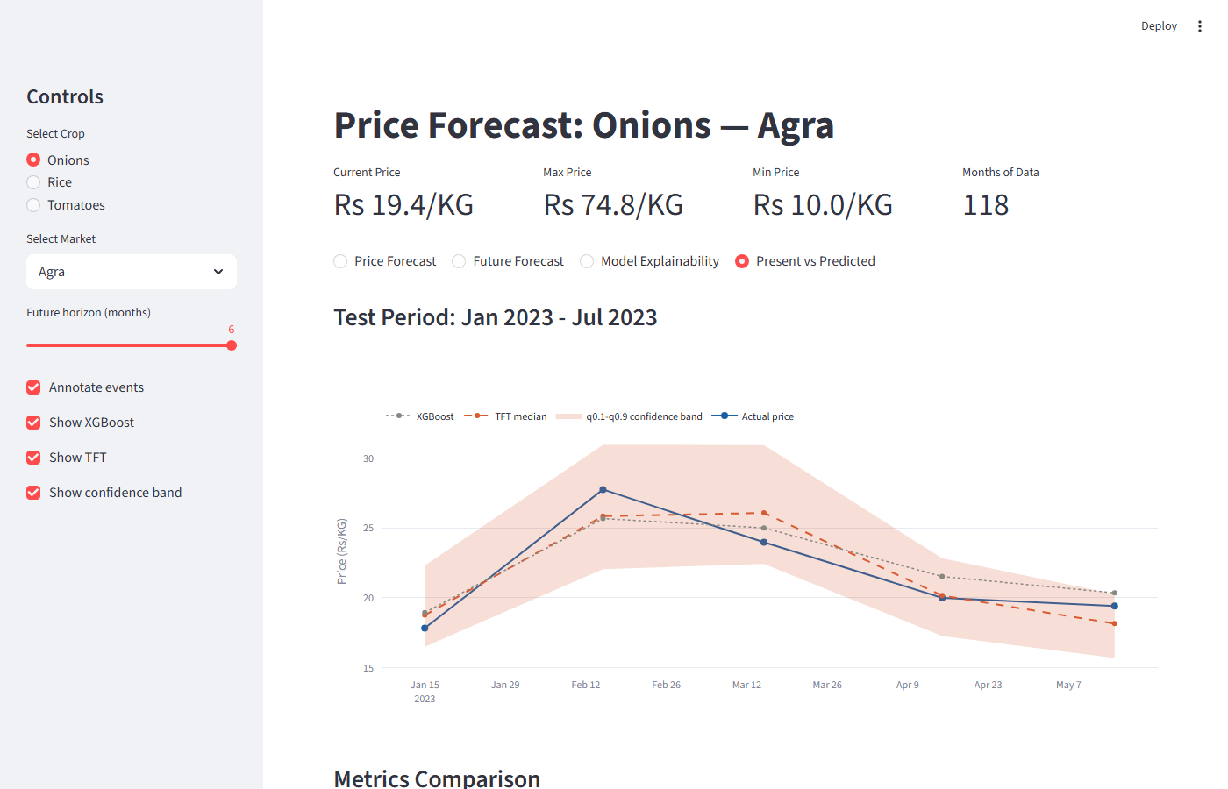
Dashboard: Four Operational Views
IMPLEMENTATION
Views: historical forecast, future forecast, model explainability, and present-vs-predicted test validation.
Devulapalli Tharun | 252CS009 | Food Price Forecasting
17

Slide 18
Limitations and Future Work
CLOSING
Current limitation | Effect | Future improvement
Monthly data | Weekly spikes are smoothed | Daily/weekly AGMARKNET expansion
Monthly weather means | Short heat shocks invisible | Higher frequency weather features
Three commodities | Limited generality test | Extend to pulses, oils, vegetables
Static calibration | Regime shifts may drift | Rolling conformal recalibration
Prototype dashboard | Manual artifact refresh | Scheduled data/model update job
Devulapalli Tharun | 252CS009 | Food Price Forecasting
18

Slide 19
Conclusion
CLOSING
Contribution | What it delivers
Leakage-controlled XGB→TFT fusion | XGB trained up to 2019; its log-prediction is a TFT known covariate
Quantile forecasting (q10/q50/q90) | 6-month price bands per market-commodity series, 53 markets
Per-commodity CQR calibration | Conformal offsets from 2022 validation; 84.0% empirical test coverage
Statistical explainability | Bootstrap VSN stability: Kendall τ = 0.942, 95% CI [0.895, 0.990]
Streamlit decision dashboard | Forecast bands, VSN attribution, and test validation on one screen
TFT-XGBFusion-CQR on 2023+ test set:
5.27 Rs/KG MAE · 11.4% MAPE · 84.0% empirical coverage
The system turns volatile food-price prediction into a decision-support workflow:
expected price, calibrated band, and model evidence — on one screen.
Thank you
Guided by: Dr. Shashidhar G Koolagudi, NIT Karnataka, Surathkal
Devulapalli Tharun | 252CS009 | Food Price Forecasting
19

Slide 20
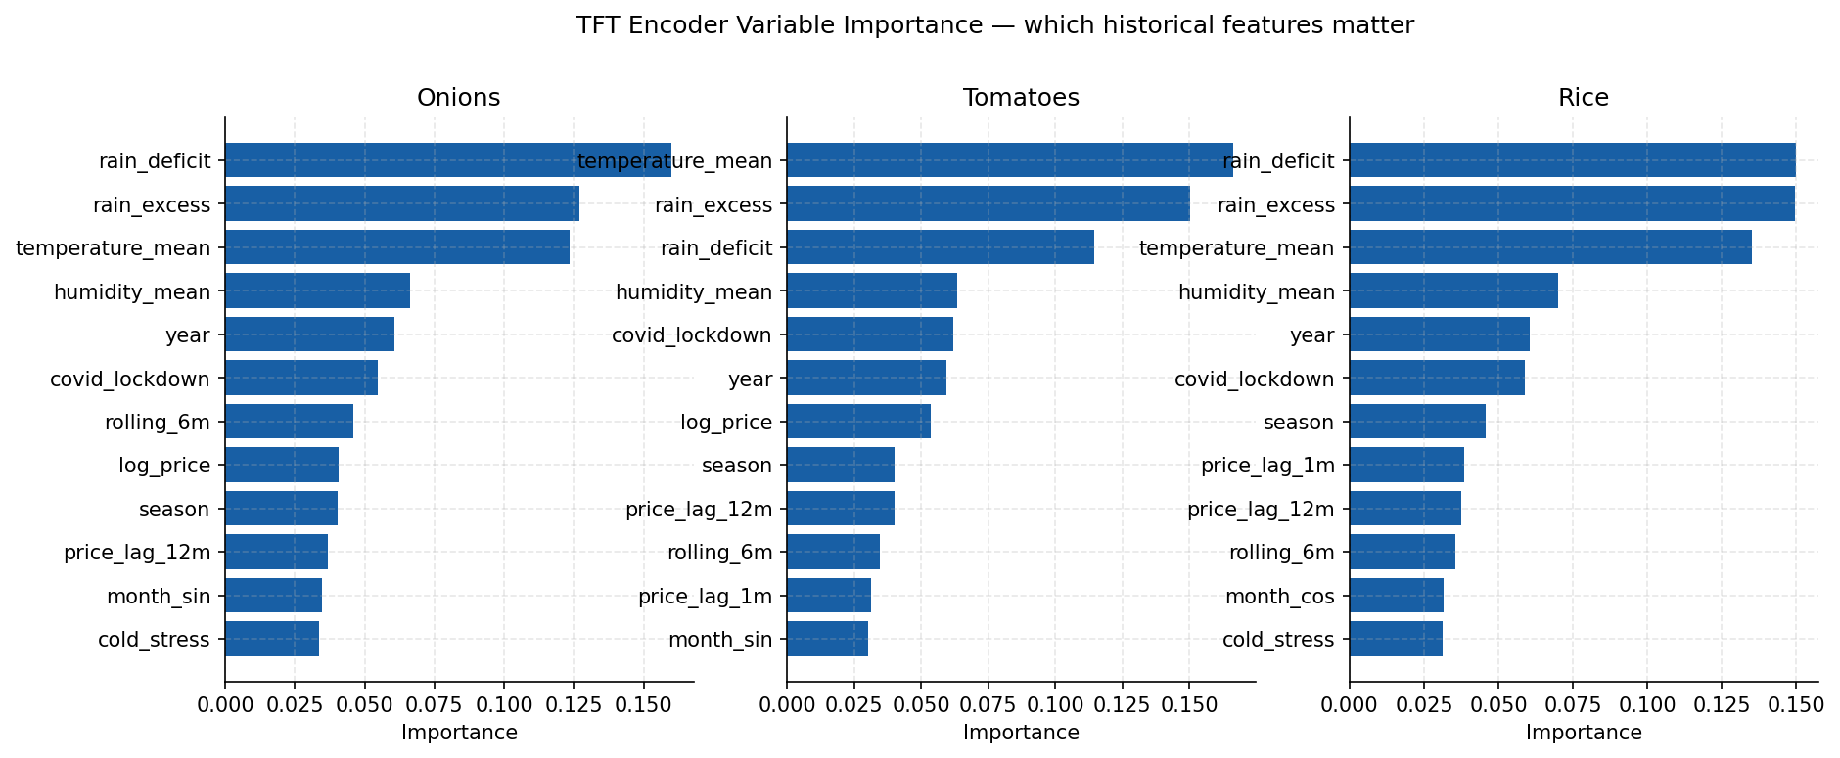
Key References
CLOSING
- Lim et al. (2021): Temporal Fusion Transformers for interpretable multi-horizon time series forecasting.
- Romano et al. (2019): Conformalized Quantile Regression for distribution-free prediction intervals.
- World Food Programme India food price dataset, HDX.
- NASA POWER monthly point API for rainfall, temperature, and humidity covariates.
- Project report and IEEE-style paper in Report&Paper/ are the source documents for this deck.
Core claim: TFT-XGBFusion-CQR = point signal + quantile model + conformal reliability + built-in explanation. This is why the final system is not only a model comparison; it is a complete forecasting workflow.
Devulapalli Tharun | 252CS009 | Food Price Forecasting
20

