Slide 1

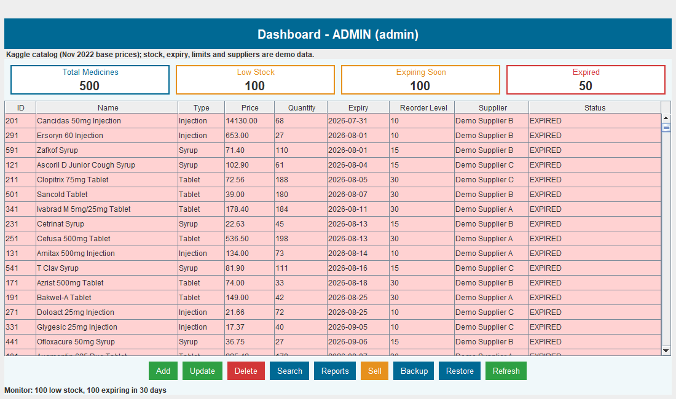
PBL PROJECT II YEAR
Intelligent Medical Inventory Tracking System
Project ID – Group 24 / CCSE0355
Problem Statement – Intelligent Medical Inventory Tracking System
PS Category – Software
Team Members – Devvrat Tripathi, Manas Srivastava, Pranjal Sharma, Hardik Kumar, Mritunjay Gupta
Roll Nos – 0251CSAI231, 0251CSAI144, 0251CSAI141, 0251CSAI195, 0251CSAI132
Guide Name – Ms Shweta Singh & Ms Barkha Bhardwaj
Live Swing dashboard · 500 medicines
CCSE0355 · Semester III · Group 24 · SDG 3

Slide 2
GROUP 24
Intelligent Medical Inventory Tracking System
Proposed Solution
How the system works
A JDK-only desktop application that turns manual medicine registers into a live, alert-driven inventory.
Track
Quantity, expiry and reorder level in one CSV catalog.
1
One catalog, every medicine
500 CSV-backed records hold quantity, price, expiry, reorder level and supplier details in one place.
Alert
2
Live stock control
Low stock and near-expiry flags refresh every five seconds.
Dashboard cards, low-stock and expiry alerts, plus sales that stop when stock is expired or too low.
3
More than one screen
Act
The Swing GUI, console mode and TCP counter client all reuse the same Java business rules.
Block unsafe sales, reorder stock and export ready reports.
Same rules, three interfaces: GUI · console · TCP counter
A daemon monitor checks stock every 5 seconds; unsafe sales are rejected before the CSV is written.
2

Slide 3
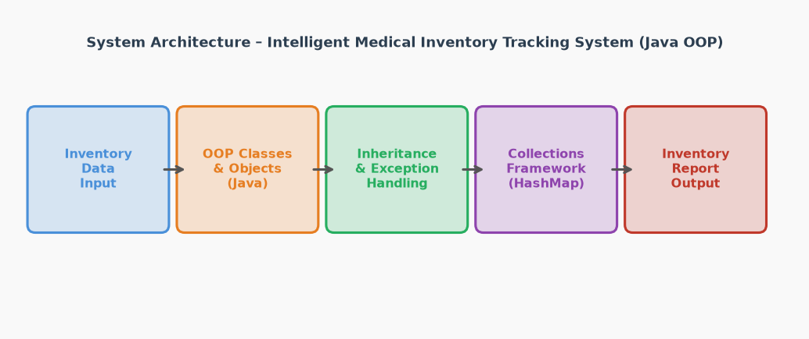
GROUP 24
TECHNICAL APPROACH
Core Java stack
Layered system architecture
Every unit of CCSE0355 is used in the running application.
Java 8+ / standard JDK only
Swing desktop GUI
OOP, inheritance and interfaces
Generics and collections
CSV storage and strict validation
Threads, streams and TCP sockets
No frameworks · no database server · no external libraries
The GUI, console and TCP counter share one inventory core, so business rules are written only once.
Model
Business rules
CSV + lock
GUI / console / TCP
3

Slide 4
GROUP 24
Implementation
Dashboard: live stock view
Key modules
Medicine model
Inventory
Abstract Medicine base with Tablet, Syrup and Injection subclasses.
Search, add, update, delete and refresh the 500-record catalog.
Expiry monitor
CSV storage
Daemon thread recalculates low-stock and expiry states every 5 seconds.
Strict load, atomic save and a lock file for shared access.
TCP sales server
Reports
SELL <id> <qty> keeps counter sales in sync with the main inventory.
Stock, expiry, reorder, sales and activity reports.
Summary cards, colour-coded stock table, expiry alerts and one-click stock actions.
Three interfaces · one inventory core
4

Slide 5
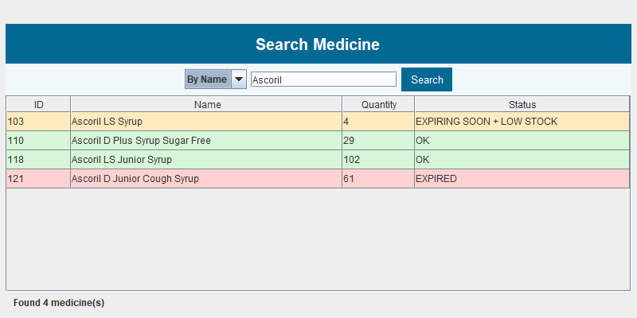
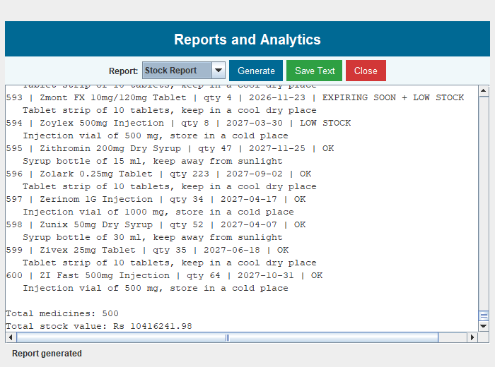
GROUP 24
Results
500
17 / 17
5 sec
3
medicine records loaded
test cases passing
expiry monitor refresh
GUI, console and TCP
Search by name or ID
Reports and analytics
Verified behaviour
Expired sale blocked
Over-stock sale rejected
CSV refreshed after each sale
Backup and restore pass
Catalog test: 500 total · 100 low · 100 expiring · 50 expired.
5

Slide 6
GROUP 24
FEASIBILITY AND VIABILITY
The project is viable as an offline, JDK-only capstone and needs no new hardware.
Technical
Economic
Operational
Java 8+ and standard JDK only
Runs on existing college PCs
CSV avoids database setup and cost
No licence or server cost
One-time development effort
Reuses the existing desktops
Simple login and dashboard
GUI, console and TCP modes
Backup and restore included
Risks already addressed
Risk GUI and server overwrite stock → lock file + reload before every save
Risk Network sale freezes the GUI → sale runs on a background thread
Risk Failed save corrupts the CSV → temporary file + atomic rename
6

Slide 7
GROUP 24
IMPACT AND BENEFITS
Who benefits from it
Pharmacy staff
Hospital administrators
Patients
Social
Economic
Environmental
Expired medicines blocked at sale
Low-stock and expiry alerts
Safer availability for patients
Zero software licence cost
Less wastage from expiry
Faster reporting and reordering
Less expired-stock disposal
Less paper register use
Offline system, no server power draw
SDG 3 · Good Health and Well-being
Timely stock and expiry control supports safer medicine availability.
7

Slide 8
GROUP 24
Limitation
Five limits are visible in the current build; each has a workaround or a clear next step.
Current limitation
Workaround / next step
1 CSV file, not a database server
Lock file protects local GUI + server saves
2 Desktop-only Swing interface
Console mode keeps the core usable
3 Basic username and password login
Role-based access and hashing planned
4 Demo catalog uses public medicine data
Pharmacy-specific import before deployment
5 TCP server handles one request per connection
Thread pool planned for many counters
Scope: an offline academic capstone, not a production hospital ERP
8

Slide 9
GROUP 24
GITHUB LINK
Source bundle in this submission
BUILD & RUN
MedicalInventory/
├─ src/ 44 Java files
├─ data/medicines.csv 500 records
├─ run.bat build + launch
├─ Team24_..._Report.docx editable report
└─ Team24_..._Report.pdf submission copy
1 Compile and launch
run.bat
2 Start the sales-counter server
java -cp out network.InventoryServer
3 Open console mode
java -cp out gui.Main -console
Repository status
No public GitHub remote is configured in this project bundle.
The complete buildable project travels with the submission.
All source and data are available for review.
9

Slide 10
THANK YOU
Questions & Discussion
Intelligent Medical Inventory Tracking System
Group 24 · CCSE0355 · Semester III
Devvrat Tripathi · Manas Srivastava · Pranjal Sharma · Hardik Kumar · Mritunjay Gupta
0251CSAI231 · 0251CSAI144 · 0251CSAI141 · 0251CSAI195 · 0251CSAI132
Guided by Ms Shweta Singh & Ms Barkha Bhardwaj
SDG 3 · Good Health and Well-being
Five course units. One working Java system.
10

