Slide 1
Problem Statement
AI Revenue Recovery
Find revenue that’s slipping away and win it back
Businesses lose revenue from failed payments, subscription failures, abandoned checkouts, and overdue invoices. Identifying these cases is only the first step.the system must determine what action to take, when to escalate, and when to stop, while safely recovering revenue.
The Problem in the Razorpay Ecosystem Based on the Problem statement
Razorpay processes a large variety of payment flows, including one-time payments, subscriptions, checkouts, and invoices. When these payments fail or remain incomplete, merchants face a revenue-recovery challenge
Scenario
A customer attempts a ₹15,000 payment through Razorpay, but the payment fails.
How can merchants recover more revenue from failed or incomplete Razorpay payment flows without blindly retrying, manually reviewing every case, or risking duplicate charges?

Slide 2

Solution
RecoveraX
From Revenue at Risk → Verified Revenue Recovery.RecoveraX uses an agentic workflow to determine the safest and most effective recovery action for every payment case
An agentic revenue-recovery system that diagnoses the failure, scores recovery potential, recommends the right action, applies deterministic safety rules, and verifies the money actually recovered.
AI recommends → Policy controls → Execute → Verify → Recover
Three Core Capabilities
Intelligent Decision Diagnose failures, score recovery potential, recommend action.
Safe Automation Deterministic policies → AUTO / HUMAN / BLOCK
Verified Recovery Execute → Verify → Measure actual revenue recovered.

Slide 3
1. Detect Identify a failed or incomplete revenue event.
2. Load Context Collect customer, transaction, payment state, history, and retry information.
3. AI Diagnose LLM identifies the likely failure pattern.
4. Recovery Score Deterministic scoring calculates recovery probability.
5. Recommend Action AI recommends Retry / Remind / Escalate / Stop.
6. Policy Guardrails Deterministic rules decide: Human/auto/block
7. Fresh Re-check Verify the latest payment state before taking action.
8. Execute Perform the approved recovery action.
9. Verify Outcome Confirm whether the payment/revenue was actually recovered.
10. Re-evaluate If unsuccessful, reassess the latest context.
11. Retry / Stop Retry only when permitted; otherwise stop permanently.

Slide 4
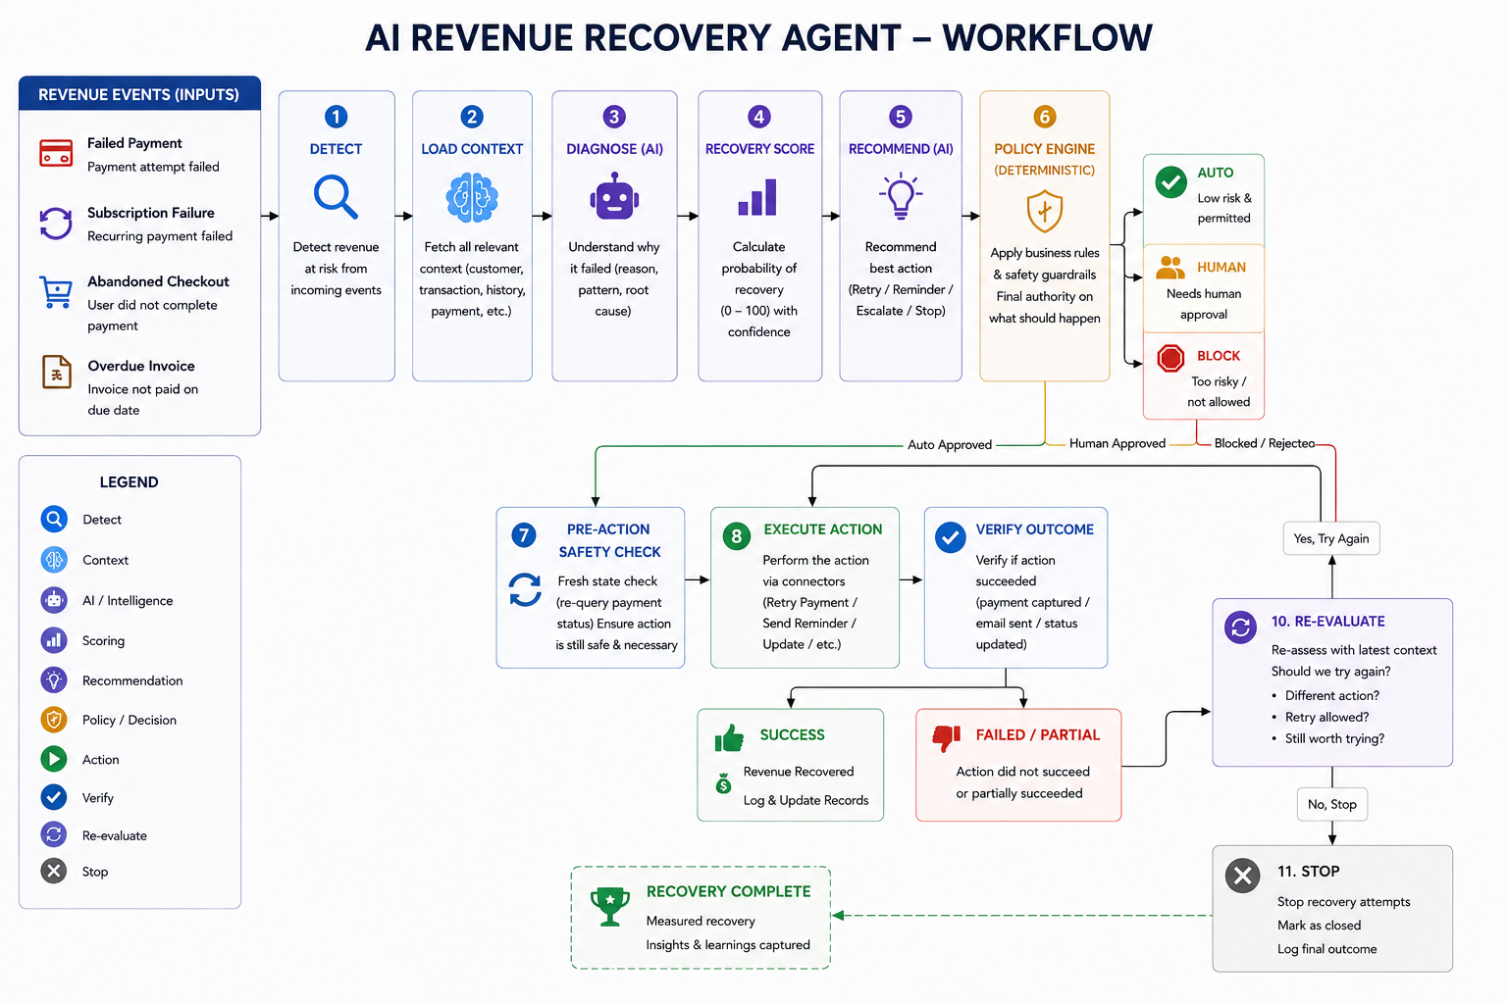
Workflow of Agent

Slide 5
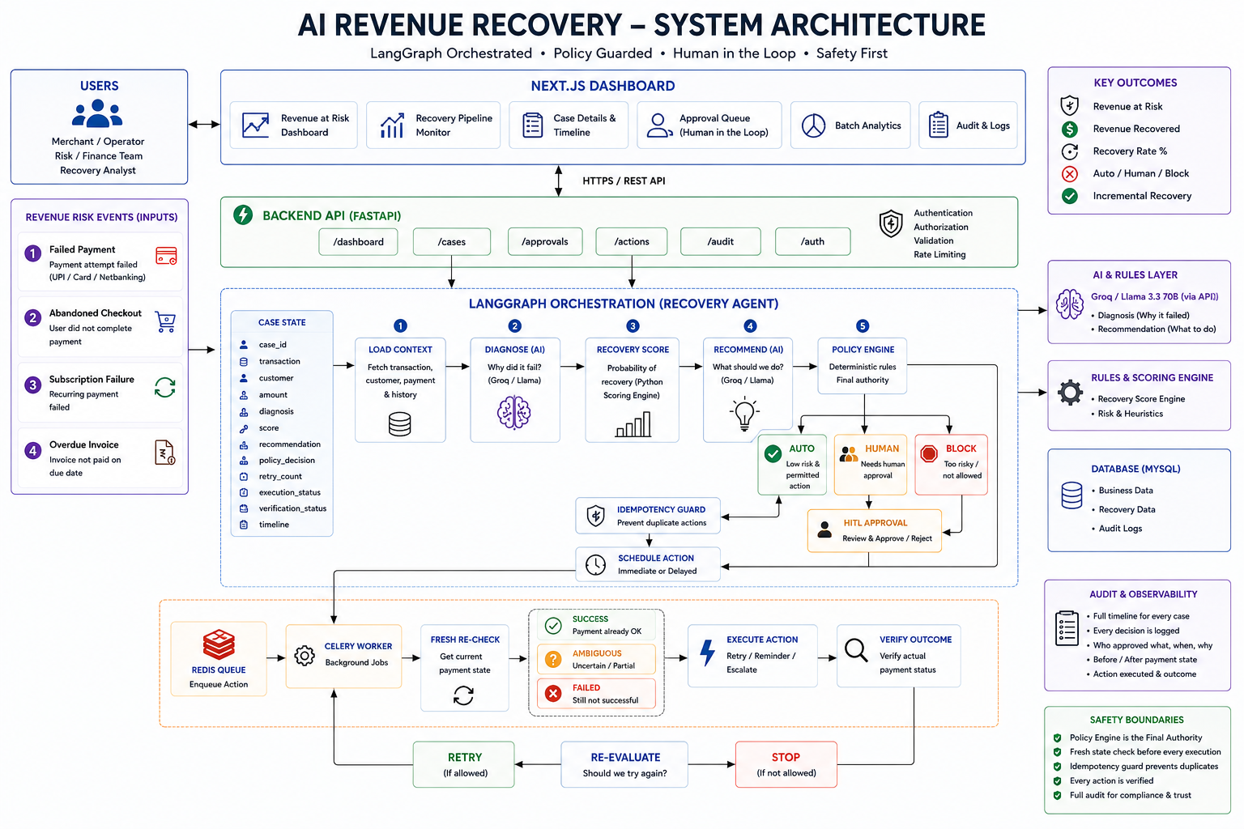
System architecture

Slide 6
Recovery scenarios
Scenario | AI Diagnosis | Recovery Action | Policy Decision | Outcome
₹2K Temporary Failure | TEMPORARY_FAILURE | RETRY | AUTO | ₹2K recovered
₹15K Low Confidence | TEMPORARY_FAILURE | ESCALATE | HUMAN | Approval → Recovery
Ambiguous Payment | POSSIBLE_DEBIT | STOP | BLOCK | ₹0 risked
.
Safe → Automate | Uncertain → Escalate | Unsafe → Stop

Slide 7
Safety, Governance & Auditability
AI | Policy Engine | Human Control
Diagnoses failures | Amount limits | Approves uncertain cases
Scores recovery | Retry limits | Rejects recovery
Recommends actions | Debit protection | Controls high-risk actions
Stopping Rules
Ambiguous payment → BLOCK
Possible customer debit → BLOCK
Fraud signal → BLOCK
Retry limit reached → STOP
High-value / low-confidence → HUMAN
Only verified success → RECOVERED
Complete Audit Trail
Diagnosis → Score → Policy → Approval
→ Execution → Verification → Outcome

