Slide 1
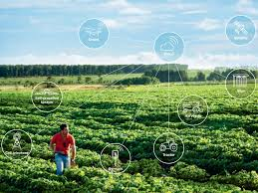
Agriculture Crop Production In India By Using Machine Learning
Presented By:
G.Valli ( 16221A0534)
K.Srinu (16221A0546)
K.Sai Vamsi (16221A0548)
Binod.P (16221A0516)
Under the Guidance of
Mrs. B. Ganga bhavani
Associate Professor

Slide 2
ABSTARCT
This project mainly focused on the techniques and measures taken to improve farming by incalculating the technical knowledge and developments in order to make the agricultural sector more reliable and easy for the farmers by predicting the suitable crop by using Machine Learning techniques.

Slide 3
CONTENTS:
Abstract
Introduction
What is machine learning
Machine learning algorithm
Supervised learning
Linear regression
Decision Tree
Support vector machine
Random forest

Slide 4
Introduction
Agriculture is the backbone of every economy. In a country like India .which ever increasing demand of food due to rising population.
By using supervisor learning in machine learning we can predict the agriculture crop production .
Now a days, modern people don’t have awareness about the cultivation of crops in a right time and right place.
To over come this problem we use machine learning techniques for crop prediction in right place and right time.

Slide 5

What is machine learning?
Machine learning is concerned with computer programs that automatically improve their perfomance through experience.

Slide 6
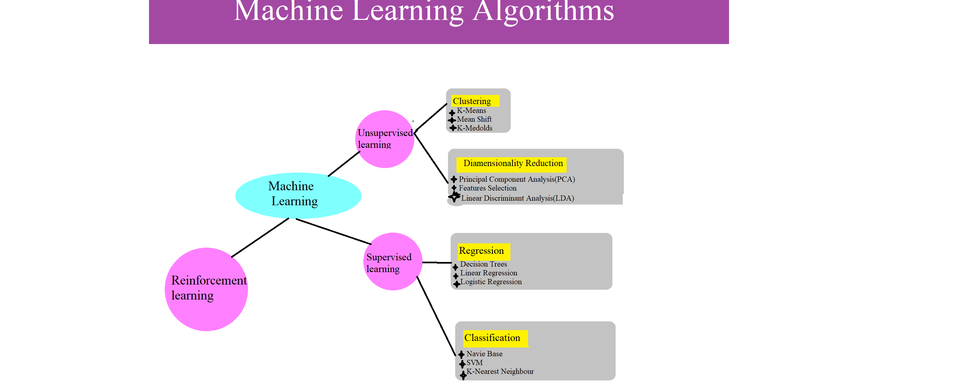

Slide 7
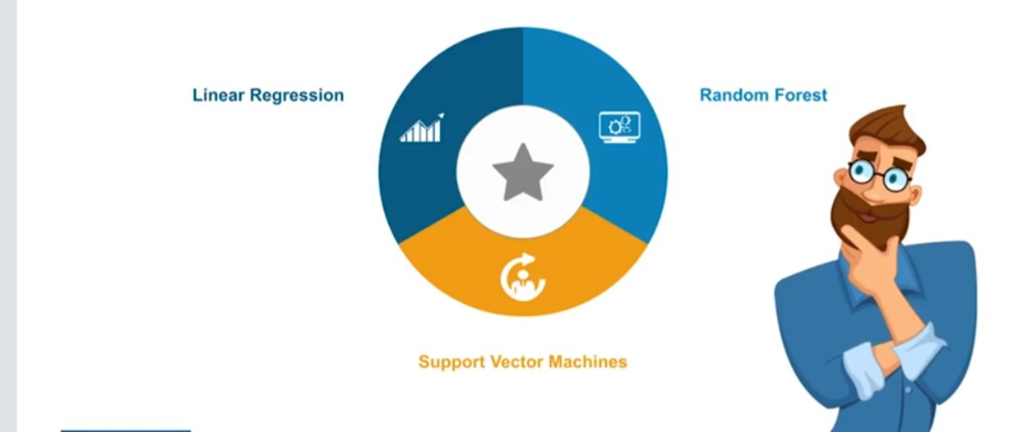
Supervised learning
Supervised learning is when the model is getting trained on a labelled (input and output)dataset.
Supervised Learning Algorithms:

Slide 8
Linear Regression
Linear Regression is a machine learning algorithm based on supervised learning. It performs a regression task. Regreesion models a target prediction value based on independent variables. It mostly used for finding out the relationship between variables and forecasting.

Slide 9
Algorithm Steps:
Step: 1
Calculate mean for dependent(x)and independent(y) variable values
Step: 2
Calculate ‘m’(Gradient line) values by using x and y means
Step: 3
By using above two steps values ‘c’ value can be find out.
Step: 4
Finally.R^2 value can be calculated.

Slide 10
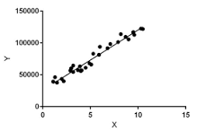
Linear Regression
Linear regression performs the task to predict a dependent variable value (y) based on a given independent variable (x).

Slide 11
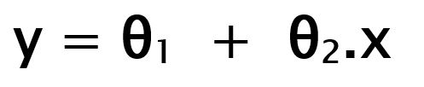
Hypothesis function for linear Regression
x: input training data (univariate – one input variable(parameter)) y: labels to data (supervised learning)
When training the model – it fits the best line to predict the value of y for a given value of x. The model gets the best regression fit line by finding the best θ1 and θ2 values. θ1: intercept θ2: coefficient of x
Once we find the best θ1 and θ2 values, we get the best fit line. So when we are finally using our model for prediction, it will predict the value of y for the input value of x

Slide 12

Cost function (j):
By achieving the best-fit regression line, the model aims to predict y value such that the error difference between predicted value and true value is minimum. So, it is very important to update the θ₁ and θ₂ values, to reach the best value that minimize the error between predicted y value (pred) and true y value (y)

Slide 13

Gradient Descent
Cost function(J) of Linear Regression is the Root Mean Squared Error (RMSE) between predicted y value (pred) and true y value (y).
Gradient Descent: To update θ₁ and θ₂ values in order to reduce Cost function (minimizing RMSE value) and achieving the best fit line the model uses Gradient Descent. The idea is to start with random θ₁ and θ₂ values and then iteratively updating the values, reaching minimum cost.

Slide 14
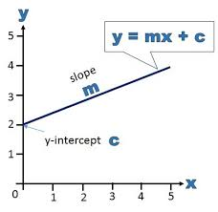
Linear Regression Formula
y = mx + c
Where,
m=gradient of
the line
c=constant value

Slide 15
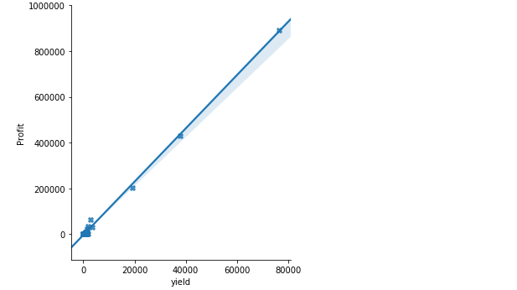

Slide 16
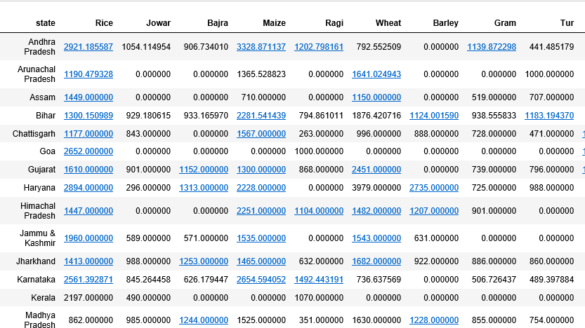
Dataset Of a Crop Production:

Slide 17
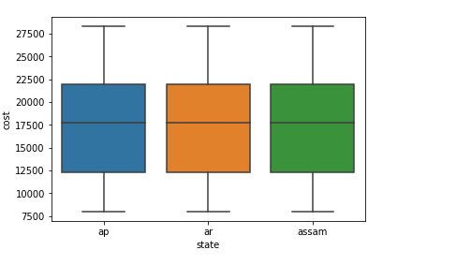
Data representation of boxplot graph:

Slide 18
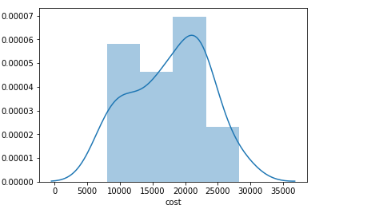
Cost representation of displot graph:

Slide 19
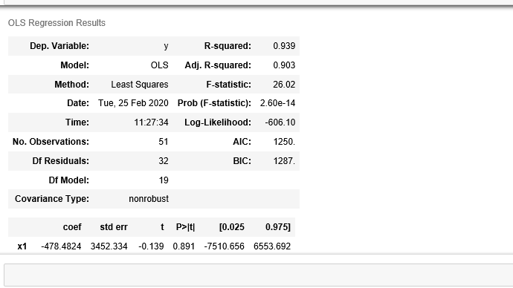
Linear Regression Prediction Value Result:

Slide 20
Decision Tree
Decision Trees are a type of Supervised Machine Learning (that is you explain what the input is and what the corresponding output is in the training data) where the data is continuously split according to a certain parameter. The tree can be explained by two entities, namely decision nodes and leaves.
1.The leaves are the decisions or the final outcomes.
2.The decision nodes are where the data is split.

Slide 21
Classification trees (yes / no types ):
What we’ve seen above is an example of classification tree, where the outcome was a variable like ‘fit’ or ‘unfit’. Here the decision variable is Categorical.
Regression Trees (continuous types ):
Here the decision or the outcome variable is Continuous, e.g. a number like 123.

Slide 22
Algorithm Steps :
1.Create root node for the tree
2.If all examples are positive, return leaf node ‘positive’
3.Else if all examples are negative, return leaf node ‘negative’
4.Calculate the entropy of current state H(S)
5.For each attribute, calculate the entropy with respect to the attribute ‘x’ denoted by H(S, x)
6.Select the attribute which has maximum value of IG(S, x)
7.Remove the attribute that offers highest IG from the set of attributes
8.Repeat until we run out of all attributes, or the decision tree has all leaf nodes.

Slide 23
Support Vector Machine :
Support vector machine also as support vector networks are supervised machine learning models with associated learning algorithms analize data used for classification and regression analysis.
The objective of the support vector machine algorithm is to find a hyperplane in an N-dimensional space(N — the number of features) that distinctly classifies the data points.

Slide 24
Hyperline support vectors :
Hyperplanes are decision boundaries that help classify the data points. Data points falling on either side of the hyperplane can be attributed to different classes. Also, the dimension of the hyperplane depends upon the number of features. If the number of input features is 2, then the hyperplane is just a line. If the number of input features is 3, then the hyperplane becomes a two-dimensional plane. It becomes difficult to imagine when the number of features exceeds 3.

Slide 25
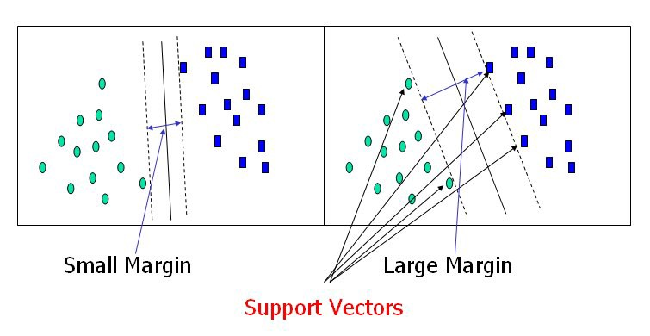
Hyperline support vectors :

Slide 26
Large margin intution :
In logistic regression, we take the output of the linear function and squash the value within the range of [0,1] using the sigmoid function. If the squashed value is greater than a threshold value(0.5) we assign it a label 1, else we assign it a label 0. In SVM, we take the output of the linear function and if that output is greater than 1, we identify it with one class and if the output is -1, we identify is with another class. Since the threshold values are changed to 1 and -1 in SVM, we obtain this reinforcement range of values([-1,1]) which acts as margin.

Slide 27
Support Vector Machine Algorithm Steps :
Step 1:
Loading the data.
Step 2:
Exploring the data.
Step 3:
Spitting the data.
Step 4:
Generating the data.
Step 5:
model the evaluation.

Slide 28
Cost function and Gradient descent :
In the SVM algorithm, we are looking to maximize the margin between the data points and the hyperplane. The loss function that helps maximize the margin is hinge loss.

Slide 29
Advantages :
1.Accuracy.
2.Works very well with limited datasets.
3.Kernel SVM contains a non-linear transformation function to convert the complicated non-linearly separable data into linearly separable data.
Disadvantages :
1.Does not work well with larger datasets.
2.Sometimes, training time with SVMs can be high.

Slide 30
RANDOM FOREST ALGORITHM
Random forest is a supervised learning algorithm which is used for both classification as well as regression. As we know that a forest is made up of trees and more trees means more robust forest. Similarly, random forest algorithm creates decision trees on data samples and then gets the prediction from each of them and finally selects the best solution by means of voting. It is an ensemble method which is better than a single decision tree because it reduces the over-fitting by averaging the result.

Slide 31
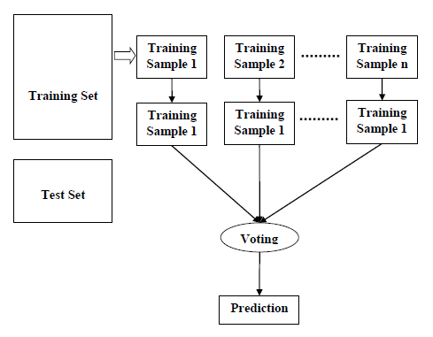
THE FLOW CHART WILL ILLUSTRATE ITS WORKING:

Slide 32
RANDOM FOREST ALGORITHM STEPS
We can understand the working of Random Forest algorithm with the help of following steps
Step 1 − First, start with the selection of random samples from a given dataset.
Step 2 − Next, this algorithm will construct a decision tree for every sample. Then it will get the prediction result from every decision tree.
Step 3 − In this step, voting will be performed for every predicted result.
Step 4 − At last, select the most voted prediction result as the final prediction result.

Slide 33
PROS AND CONS OF RANDOM FOREST
PROS
Random forests are very flexible and possess very high accuracy.
It overcomes the problem of over fitting by averaging or combining the results of different decision trees.
Random forests work well for a large range of data items than a single decision tree does.
CONS
Complexity is the main disadvantage of Random forest algorithms.
More computational resources are required to implement Random Forest algorithm.
It is less intuitive in case when we have a large collection of decision trees.

Slide 34
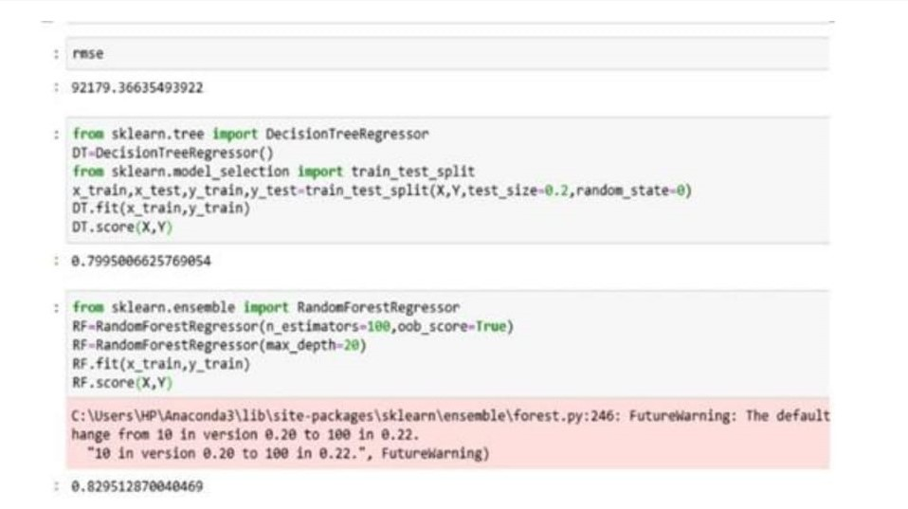
Here we applied 15 states on decision tree and random forest algorithm to predict score

Slide 35
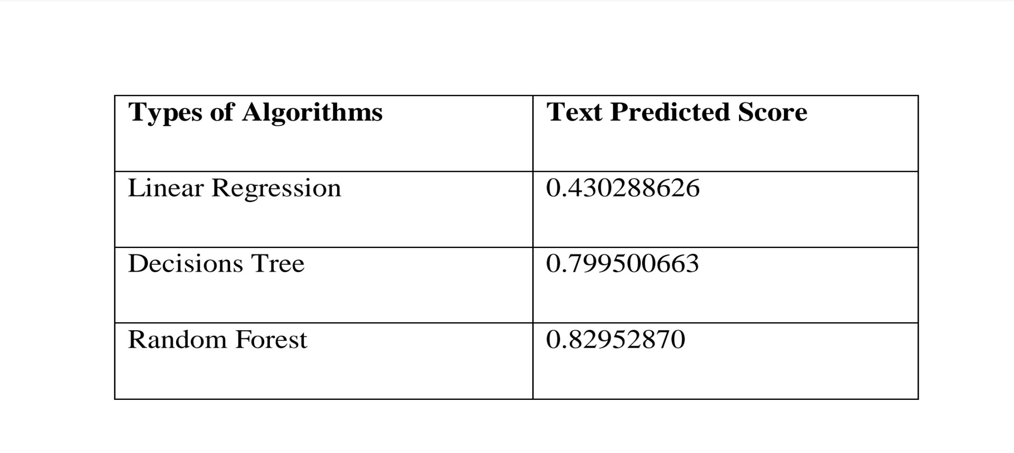
In the above table algorithm we have seen random forest is highest.

Slide 36
THANK YOU

