Slide 1
Music Similarity and Event Annotation using Lyrics
Team
Devyani Raghuwanshi
Huzefa Raja

Slide 2
Motivation
No explicit definition of what make two musical entities lyrically similar.
Subjectiveness of music annotation.
Biased human perception of music and its similarity.
How to annotate abstract categories like pop, rock, etc.
Notes:
1) There is no explicit definition of what makes two musical entities similar
2) Human perception of music similarity depends on several factors – not all of them strongly related to musical properties. Hence, when trying to model music similarity algorithmically, the cultural context should not be neglected

Slide 3
Existing System
Context Based Similarity [MIR- Schedl, Knees] and Music Recommendation usually works on :-
Rules created from the metadata (genre, year, artist)
Rules created from the audio information
User Listening history
Notes:
There has been a variety of work is done in music genre categorization and / or emotion /
mood extraction on the basis of audio. Annotation, based on lyrics in particular, is not as
common. The subjectiveness of the task makes it challenging. In this project, we are trying
to look at the lyrics objectively and extract information.

Slide 4
Proposed System
The objectives of the system are
Content Based similarity detection
Annotate songs using “tags” extracted from lyrics
Use the “annotation vectors” to find similarity between songs
Techniques Used
Topic Modeling
Bootstrapping Algorithm
Multi-Label Classification
Notes:
Bootstrapping provides an alternative to painstaking manual annotation. The techniques reviewed herein are all trained on unannotated lyrics.
The topic model algorithm used in this project is LDA. Problem with LDA is to find out optimal number of topics that causes proper division of songs.

Slide 5
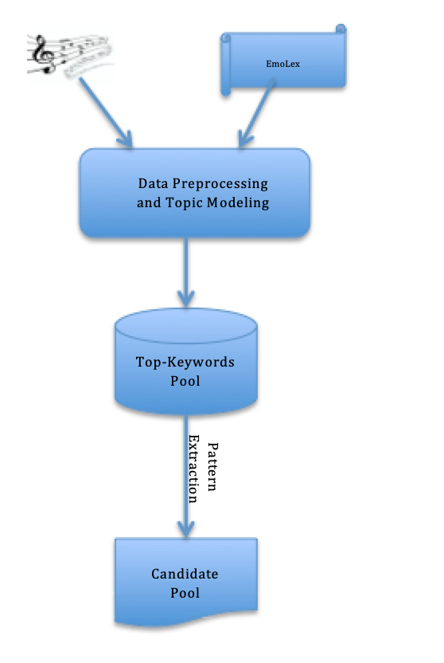
Proposed System Architecture

Slide 6
Dataset
The project uses following datasets:
Lyrics (Source: Kaggle, 57650 songs)
EmoLex (Not publicly available, 7000 words, word level emotions association)
These two datasets are used to tag the songs with emotions based on the words present in the songs
The website “genius.com” is also used to gain additional context for the songs when creating extraction patterns

Slide 7
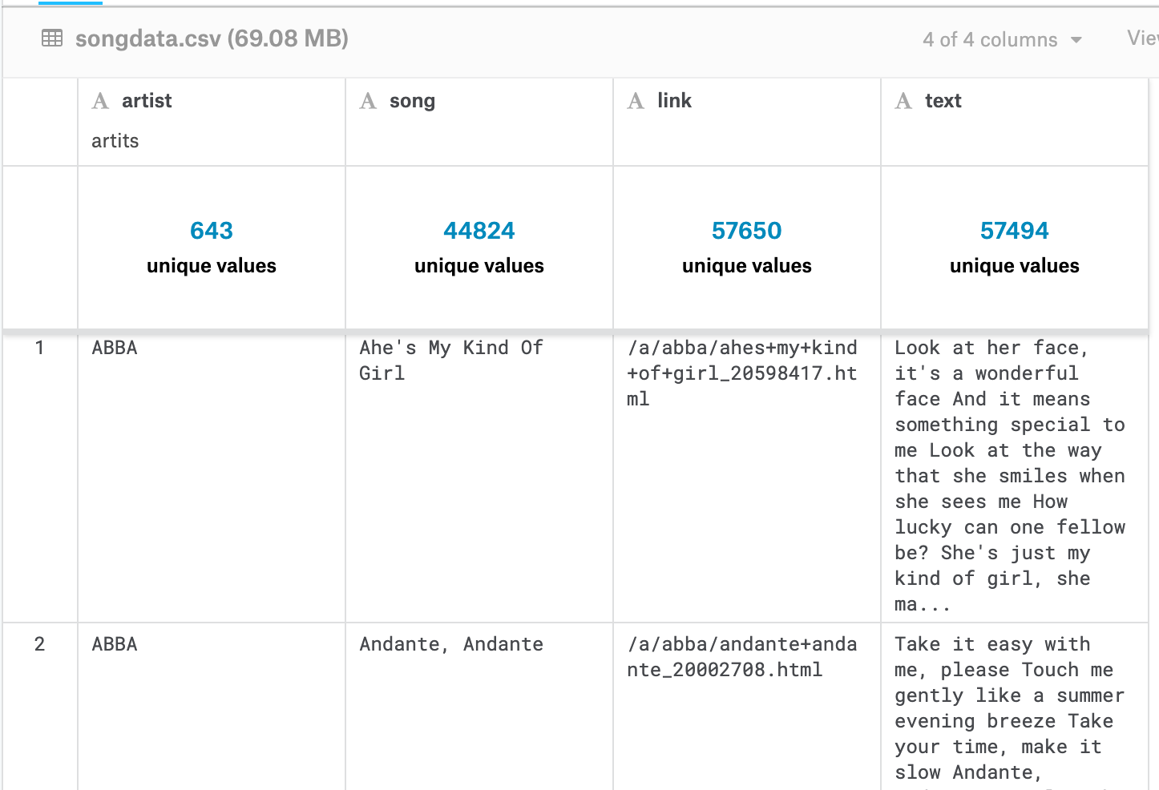
Dataset
Fig.1 Kaggle Dataset

Slide 8
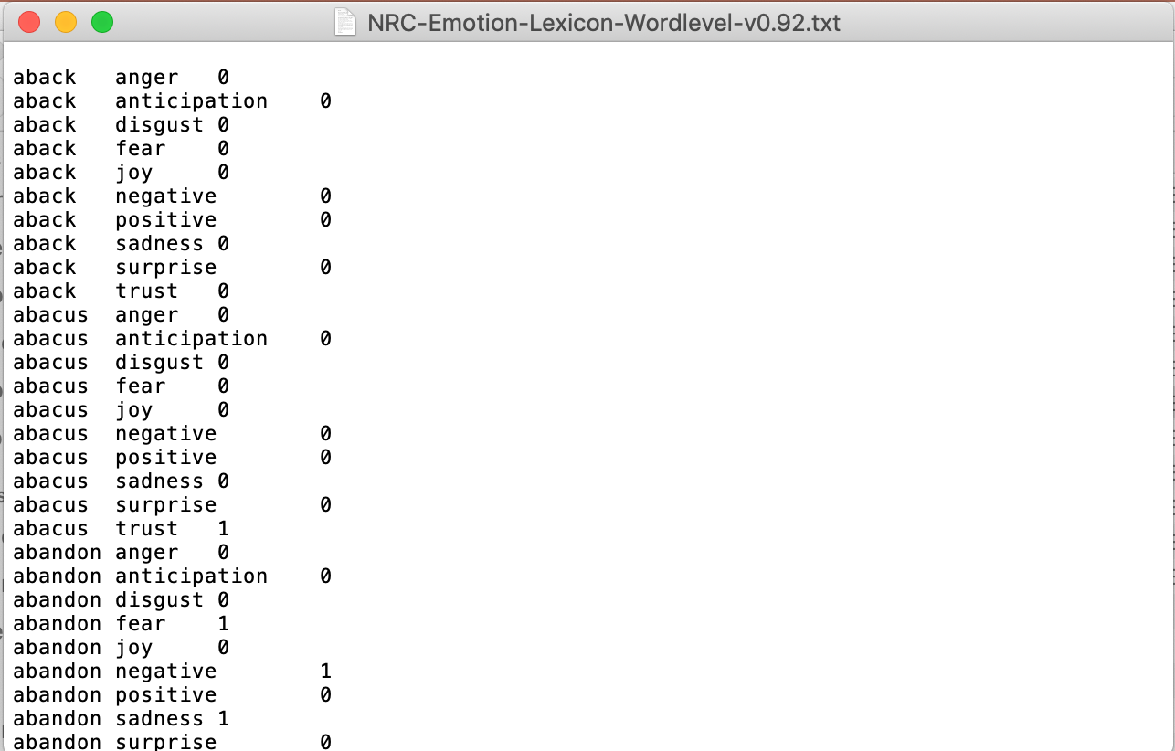
Dataset
Fig.2 EmoLex

Slide 9
Data Preprocessing
Because of the noisy input, data pre-processing was an iterative process.
The basic cleaning of the text involved
removing stopwords
removing proper nouns
expanding contractions to merge different spellings
If the top words identified as keywords later in the approach were lacking context or emotions, they were added to the list of stopwords and cleaning was repeated.

Slide 10
Approach - Topic Modelling
Topic Modelling is used to divide songs into clusters based on the lyrics.
The songs are then “assigned” the top topics prevalent in them. This is done using a custom metric.
The top terms in these assigned topics are then used to annotate “emotions” and “sentiments” to the songs using the EmoLex Dataset

Slide 11
Approach - Bootstrapping
The idea of bootstrapping is used to create “event” or “tag” extraction patterns for the lyrics.
The lyrics are optionally augmented with more contextual information using existing annotations / descriptions of song lyrics by various users on genius.com
The top keywords from topics assigned to songs are then used as seed values for bootstrapping.

Slide 12
Approach - Multilabel Classification
A Neural Network (implemented using Keras) is used to learn the annotated emotion vectors and then predict them for new songs.
Depending on whether the “tags” are fixed and limited, the model can be extended to annotate the tag vectors as well.

Slide 13
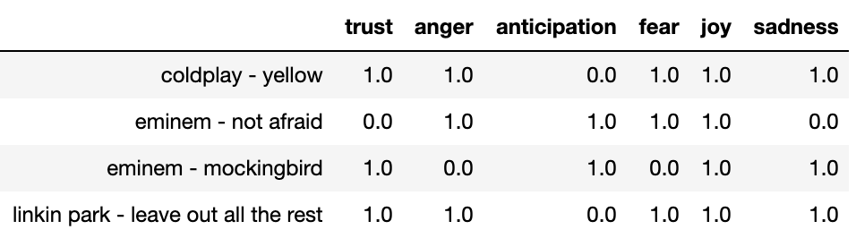
Results - Multilabel Classification
The results for the multi-label classification of emotions gives us results like:

Slide 14
Results - Bootstrapping
Raw Text: I wrote a song for you
Pattern: ['PRON', 'VERB', 'DET', 'NOUN', 'ADP', 'PRON']
Seed: ‘song’
Output: I drew a line for you

Slide 15
System Evaluation
For the multilabel classifier, we use F1 score as a metric and get an accuracy of: 83% on the test dataset.
For the bootstrapping approach, the idea was to use manual tagging to correlate with the tags that came out of the system. More information about this is in the future work slide.

Slide 16
Conclusion
Limiting the number of tags became a problem as the tags increased with the number of songs and the seed values.
The pattern extraction does seem to work but the output is difficult to evaluate.

Slide 17
Future Work
The top words from the topic model that are used as seeds for the bootstrapping approach could be collectively labeled. As in, a label for a topic.
The words that come out of the bootstrapping extraction patterns can then be assigned such labels and the Keras model can be extended to predict them.

Slide 18
References
Riloff, E., & Jones, R. (2018). A Retrospective on Mutual Bootstrapping. AI Magazine, 39(1).
Schedl, M., & Knees, P. (2009, December). Context-based music similarity estimation. In Welcome to the 3rd International Workshop on Learning Semantics of Audio Signals (p. 59).
Olsson, F. (2009). A literature survey of active machine learning in the context of natural language processing.

