Slide 1
TCP congestion control
Devyani tushar REMULKAR [2203110]
RUPESH HEMANT BHUSARE [2203106]
MARYADA HARSHINI [2203118]
MUDADLA SAI PRASANNA [2203120]

Slide 2

What is Congestion?
Congestion is when a place or thing is
too crowded or full.
In network system:
Congestion occurs when network resources are overloaded.
Leading to delays, packet loss, and reduced throughput.

Slide 3
THE PROBLEM
Problem is
How do we overcome this?
Through:
TCP Congestion Control Algorithm

Slide 4
To overcome this:
The approach taken by TCP is, to have each sender limit the rate at which it sends traffic into its connection.
If a TCP sender perceives that there is little congestion on the path, then the TCP sender increases its send rate; if the sender perceives that there is congestion along the path, then the sender reduces its send rate

Slide 5
Dynamically Adjusting Sending Rate
Changing network conditions in real-time.
This ensures efficient utilization of available bandwidth while preventing
network congestion.
Each side of a TCP connection consists: receive buffer, send buffer, and
several variables (like LastByteRead, cwnd, rwnd, etc.).

Slide 6

Dynamically Adjusting Sending Rate
Congestion window(cwnd):
It refers to the amount of data that a sender can transmit to a receiver without receiving an acknowledgment (ACK) from the receiver.
Receiver window(rwnd):
It’s a variable that indicates the amount of data that the receiver can
accept at the current time
Unacknowledged data $≤$ min(cwnd, rwnd)
It ensures that the sender doesn't send more data than either the cwnd or the rwnd can handle.

Slide 7
Key Mechanisms for congestion control
Congestion Window Management: By adjusting cwnd based on perceived congestion, TCP regulates the sending rate to prevent overloading the network.
Detection of Congestion: TCP detects congestion through loss events, such as timeouts or receipt of multiple duplicate ACKs. These events signal network congestion, prompting TCP to adjust its transmission behavior accordingly.
Self-Clocking and Bandwidth Probing: TCP dynamically adjusts its transmission rate based on implicit signals from the network. It increases the rate until a loss event occurs, then backs off, effectively probing for the maximum sustainable rate without causing congestion collapse.

Slide 8
TCP Congestion Control Algorithm

Slide 9
celebrated TCP congestion-control algorithm. First described in [Jacobson 1988] and standardized in [RFC 5681].
The algorithm has three major components:
(1) slow start
(2) congestion avoidance
(3) fast recovery

Slide 10
Slow Start
Linear additive increase takes too long to ramp up a new TCP connection from cold start.
Beginning with TCP Tahoe, the slow start mechanism was added to provide an initial exponential increase in the size of cwnd.
Remember mechanism by: slow start prevents a slow start. Moreover, slow start is slower than sending a full advertised window’s worth of packets all at once.

Slide 11
Slow Start
cwnd initialized to a small value of 1 MSS
cwnd = cwnd+1 MSS for each of the acknowledged segments

Slide 12
Figure: Slow Start
Source
Destination
Slow Start
Add one packet
per ACK

Slide 13
Question:
When should this exponential growth end?

Slide 14
Various Cases for SLOW START
Loss Event
ssthresh value
3 Duplicate ACKS
If there is a loss event (i.e., congestion) indicated by a timeout
ssthresh= cwnd/2
cwnd = 1 MSS
(shorthand for “slow start threshold”) when congestion was detected and begins the slow start process anew
When cwnd=ssthresh , slow start ends and TCP transitions into congestion avoidance mode.
TCP performs a fast retransmit and enters the fast recovery state (we will see later)

Slide 15
Congestion Avoidance
increases the value of cwnd by just a single MSS every RTT
Which implies cwnd = cwnd+ MSS/ cwnd bytes whenever a new acknowledgment arrives.

Slide 16
When should congestion avoidance’s linear increase (of 1 MSS per RTT) end?
Question:

Slide 17
When a timeout occurs - As in the case of slow start: The value of cwnd is set to 1 MSS, and the value of ssthresh is updated to half the value of cwnd when the loss event occurred.
A loss event also can be triggered by a triple duplicate ACK event. TCP halves the value of cwnd (adding in 3 MSS for good measure to account for the triple duplicate ACKs received) and records the value of ssthresh to be half the value of cwnd when the triple duplicate ACKs were received. The fast-recovery state is then entered.
3 dup ACKs indicates network capable of delivering some segments
timeout before 3 dup ACKs is “more alarming”
Philosophy:

Slide 18
One Final Phase: Fast Recovery
The problem : congestion avoidance too slow in recovering from an isolated loss

Slide 19
Example
Consider a TCP connection with:
CWND=10 packets
Last ACK was for packet # 101
i.e., receiver expecting next packet to have seq. no. 101
10 packets [101, 102, 103,…, 110] are in flight
Packet 101 is dropped
What ACKs do they generate?
And how does the sender respond?

Slide 20
Timeline
ACK 101 (due to 102) cwnd=10 dupACK#1 (no xmit)
ACK 101 (due to 103) cwnd=10 dupACK#2 (no xmit)
ACK 101 (due to 104) cwnd=10 dupACK#3 (no xmit)
RETRANSMIT 101 ssthresh=5 cwnd= 5
ACK 101 (due to 105) cwnd=5 (no xmit)
ACK 101 (due to 106) cwnd=5 (no xmit)
ACK 101 (due to 107) cwnd=5 (no xmit)
ACK 101 (due to 108) cwnd=5 (no xmit)
ACK 101 (due to 109) cwnd=5 (no xmit)
ACK 101 (due to 110) cwnd=5 (no xmit)
ACK 111 (due to 101) ⬅ only now can we transmit new packets
Plus no packets in flight so no ACKs for another RTT

Slide 21
Solution: Fast Recovery
Idea: Grant the sender temporary “credit” for each dupACK so as to keep packets in flight
If dupACKcount = 3
ssthresh = cwnd/2
cwnd = ssthresh + 3
While in fast recovery
cwnd = cwnd + 1 for each additional duplicate ACK
Exit fast recovery new ACK
Set cwnd = ssthresh

Slide 22
Example
Consider a TCP connection with:
CWND=10 packets
Last ACK was for packet # 101
i.e., receiver expecting next packet to have seq. no. 101
10 packets [101, 102, 103,…, 110] are in flight
Packet 101 is dropped

Slide 23
Timeline
ACK 101 (due to 102) cwnd=10 dup#1
ACK 101 (due to 103) cwnd=10 dup#2
ACK 101 (due to 104) cwnd=10 dup#3
REXMIT 101 ssthresh=5 cwnd= 8 (5+3)
ACK 101 (due to 105) cwnd= 9 (no xmit)
ACK 101 (due to 106) cwnd=10 (no xmit)
ACK 101 (due to 107) cwnd=11 (xmit 111)
ACK 101 (due to 108) cwnd=12 (xmit 112)
ACK 101 (due to 109) cwnd=13 (xmit 113)
ACK 101 (due to 110) cwnd=14 (xmit 114)
ACK 111 (due to 101) cwnd = 5 (xmit 115) ⬅ exiting fast recovery
Packets 111-114 already in flight (and now sending 115)
ACK 112 (due to 111) cwnd = 5 + 1/5 ← back in congestion avoidance

Slide 24
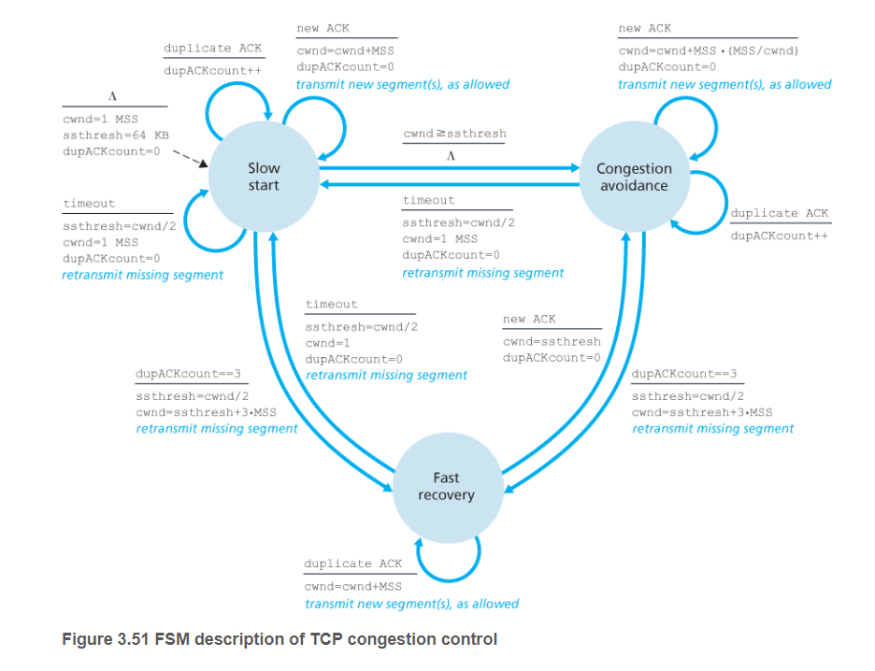

Slide 25
TCP Flavors and TCP Fairness

Slide 26
TCP FLAVORS
TCP-Tahoe – SS + AI + FastRetransmit
ssthresh = cwnd/2 in FastRetransmit state
cwnd =1 on both triple dupACK and timeout
TCP-Reno – SS + AI + FastRetransmit + FastRecovery
cwnd =1 on timeout
cwnd = cwnd/2 on triple dupack
TCP-NewReno – Reno + PartialAck
TCP-Reno + improved fast recovery
TCP-SACK – Reno + Selective Ack
incorporates selective acknowledgements

Slide 27
TCP Tahoe vs. TCP Reno
Two similar versions of TCP
TCP Tahoe (SIGCOMM’88 paper)
TCP Reno (1990)
TCP Tahoe
Always repeat slow start after a loss
Assign slow-start threshold to half of congestion window
TCP Reno
Repeat slow start after timeout-based loss
Divide congestion window in half after triple dup ACK

Slide 28
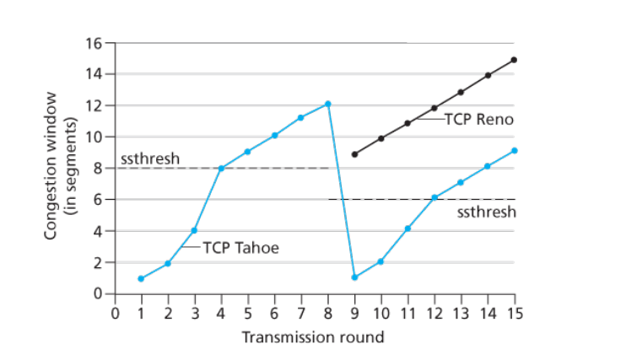
Conclusion:TCP Reno is better than TCP Tahoe as TCP Reno provides Fast Recovery

Slide 29
Two goals of congestion control:
Fairness
Efficiency
Fairness : Every sender needs to gets their fair share
Efficiency : Network resources are used well

Slide 30
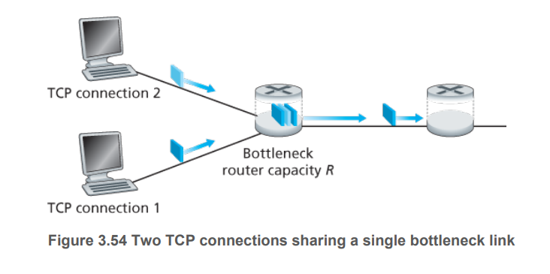
TCP fairness
Fairness goal : If K TCP sessions share same bottleneck link of bandwidth R, each connection should have average transmission rate of R/K.
Achieving this goal, each connection gets an equal share of the link bandwidth

Slide 31
Question:
Is TCP’s AIMD algorithm fair?

Slide 32
Full Bandwidth utilization line
R
Why?
As throughput increases, additive​
increase typically results in a slope ​of 1 ​
Multiplicative decrease decrease​
throughput proportionally​
equal bandwidth share
loss: decrease window by factor of 2
congestion avoidance: additive increase
Connection 2 throughput
loss: decrease window by factor of 2
congestion avoidance: additive increase
Connection 1 throughput
R

Slide 33
TCP THROUGHPUT

Slide 34
What’s the average throughput of TCP as a function of window size and RTT?
Question:

Slide 35

Calculation on a simple model
Ignore slow start
Let W be the window size (cwnd) (measured in bytes) when loss occur
Loss is detected by duplicate ACKs
Window: $\frac{W}{2},\frac{W}{2}+1,\frac{W}{2}+2…W,$ $\frac{W}{2}$…
Increase the window size by 1 MSS for each RTT until a loss event occurs at W
After W/2 RTTs, loss event occurs then drop the window to half and repeat

Slide 36

Calculation on a simple model
When window is W, throughput is W/RTT
Just after the loss , window drops to W/2 ,throughput to W/2RTT
Assuming that RTT and W are approximately constant over the duration of the connection, the TCP transmission rate ranges from W/(2 · RTT) to W/RTT
Average throughput: 0.75W(MSS/RTT)
Avg of $\frac{3}{4}$W packets per RTTs and there are $\frac{W}{2}$ RTTs between two packet drops
i.e, One packet is dropped out of ($\frac{W}{2}$)*($\frac{3W}{4}$) = ($\frac{3}{8}$)W² packets

Slide 37

TCP Throughput/loss Relationship
Packet drop rate, p = $\frac{8}{3}$W⁻²
W = ($\frac{8}{3}$p)⁻²
Throughput = $\frac{3W}{4}$(MSS/RTT) = ($\frac{3}{4}$)*($\frac{8}{3}$p)⁻² (MSS/RTT)
= ($\frac{3}{4}$p)⁻²(MSS/RTT)
Throughput= $\frac{1.22}{\text{p}\text{2}}$(MSS/RTT)
Flows get throughput inversely proportional to RTT and packet loss

Slide 38
A Simple Model for TCP Throughput
cwnd
Loss
½ W_{max} RTTs between drops
A
Avg. ¾ W_{max} packets per RTTs
1
time
RTT

Slide 39
A Simple Model for TCP Throughput
cwnd
Loss
½ W_{max} RTTs between drops
A
Avg. ¾ W_{max} packets per RTTs
time
A=(3/8)W²

Slide 40
OtheR alternatives

Slide 41
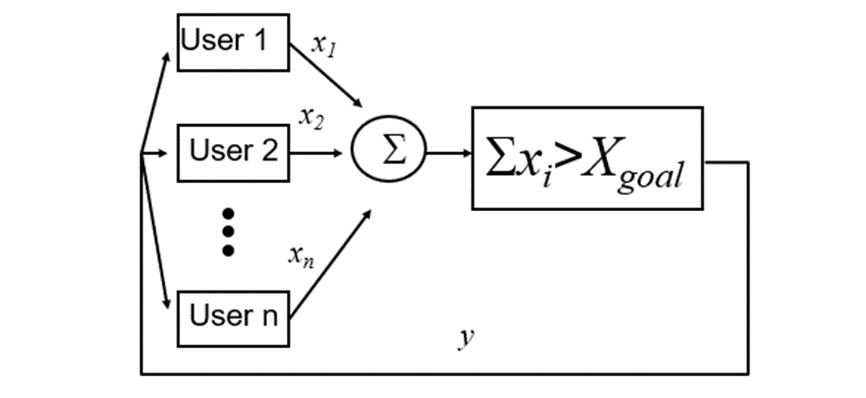

Control System Model
${ x}_{1}=x_{2}…=x_{n}$ (Fairness)
$X_{goal}$ = 1 (Efficient)
$Σ_{x_{\dot{i}}}$> $X_{goal}$ (Congestion)

Slide 42
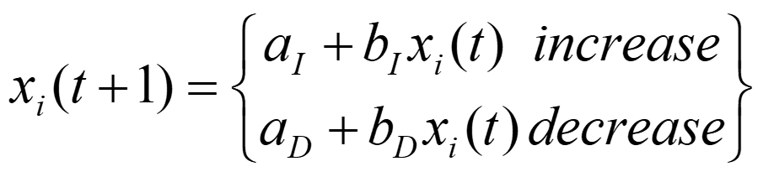
Four alternatives
Simplest control strategy by Chiu and Jain(1988)
MIAD: Multiplicative increase, Additive decrease
a_{I}=0, b_{I}>1, a_{D}<0, b_{D}=1
AIAD: Additive increase, Additive decrease
a_{I}>0, b_{I}=1, a_{D}<0, b_{D}=1
MIMD: Multiplicative increase and Multiplicative decrease
a_{I}=0, b_{I}>1, a_{D}=0, 0< b_{D}<1
AIMD: Additive increase, Multiplicative decrease
a_{I}>0, b_{I}=1, a_{D}=0, 0<b_{D}<1

Slide 43


Multiplicative Increase, Additive Decrease(MIAD)
fairness
line
($b_{I}\left(X_{1}+a_{D}\right)$, $b_{I}\left(X_{2}+a_{D}\right)$)
$$\left(X_{1}=X_{2}\right)$$
a_{I}=0, b_{I}>1, a_{D}<0, b_{D}=1
quickly reach high bandwidth
utilization.
Increasing the sending rate
multiplicatively
(x₁,x₂)
User 2: x₂
(x₁+a_{D},x₂+a_{D})
congested →
← inefficient
efficiency
line
User 1: x₁

Slide 44

Additive Increase, Additive Decrease(AIAD)
fairness
line
a_{I}>0, b_{I}=1, a_{D}<0, b_{D}=1
Efficiency is somewhat lower
compared to MIAD.
Increase in sending rate is
additive.
Slower convergence to high
bandwidth utilization.
(x₁-a_{D}+a_{I}),x₂-a_{D}+a_{I}))
$$\left(X_{1}=X_{2}\right)$$
(x₁,x₂)
User 2: x₂
(x₁-a_{D},x₂-a_{D})
congested →
← inefficient
User 1: x₁

Slide 45

Multiplicative Increase, Multiplicative Decrease(MIMD)
fairness
line
a_{I}=0, b_{I}>1, a_{D}=0, 0<b_{D}<1
Efficiency is well-maintained.
Aggressively increasing sending
rates and proportionally reducing
them upon congestion
(x₁,x₂)
$$\left(X_{1}=X_{2}\right)$$
(b_{I}b_{D}x₁,b_{I}b_{D}x₂)
User 2: x₂
(b_{d}x₁,b_{d}x₂)
congested →
← inefficient
User 1: x₁

Slide 46

Additive Increase, Multiplicative Decrease(AIMD)
fairness
line
(x₁,x₂)
a_{I}>0, b_{I}=1, a_{D}=0, 0<b_{D}<1
Efficiency may be compromised
due to additive increase.
Well suited where fairness is
primary concern.
$$\left(X_{1}=X_{2}\right)$$
(b_{D}x₁+a_{I}, b_{D}x₂+a_{I})
(b_{D}x₁,
b_{D}x₂)
User 2: x₂
congested →
← inefficient
efficiency
line
User 1: x₁

Slide 47
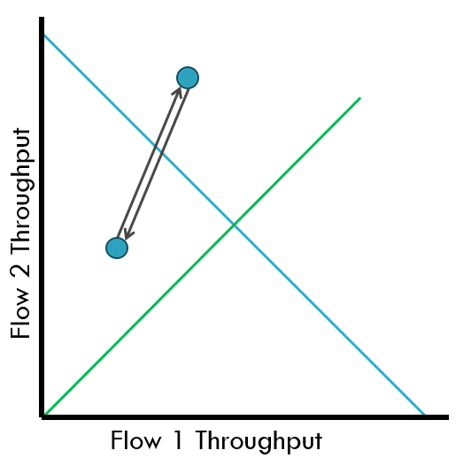
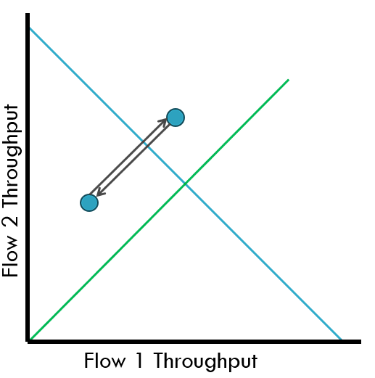
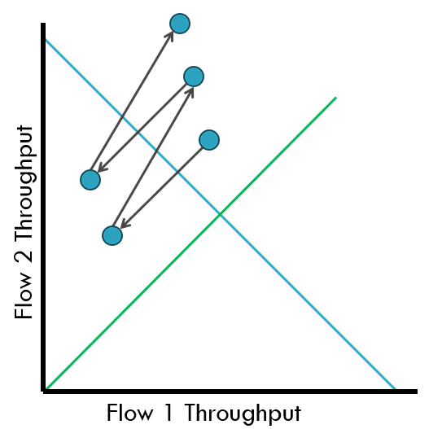
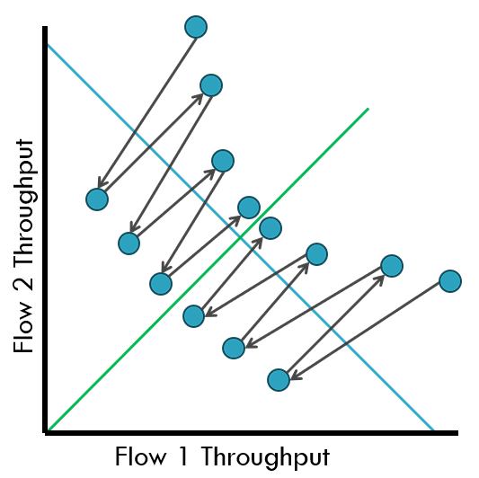
MIMD
AIAD
Stable!
But doesn’t converges to Fairness
MIAD
Unstable!
Goes away from Fairness
AIMD
Converges to stable and fair cycle
Symmetric to fairness
Images Taken from the slides of CS390: lec8-9

Slide 48
A Critical Analysis of TCP CC

Slide 49
Failings of TCP Congestion Control
Leads to the Queuing of packets(large delays)
Does not scale to high-speed
Produces irregular saw-tooth behaviour
Takes a long time to reach steady state
Depends on RTT(unfair)
Depends on losses(non congestive losses)

Slide 50
DEMO

Slide 51
Four alternatives
Simplest control strategy by Chiu and Jain(1988)
MIAD: Multiplicative increase, Additive decrease
a_{I}=0, b_{I}>1, a_{D}<0, b_{D}=1
AIAD: Additive increase, Additive decrease
a_{I}>0, b_{I}=1, a_{D}<0, b_{D}=1
MIMD: Multiplicative increase and Multiplicative decrease
a_{I}=0, b_{I}>1, a_{D}=0, 0< b_{D}<1
AIMD: Additive increase, Multiplicative decrease
a_{I}>0, b_{I}=1, a_{D}=0, 0<b_{D}<1

Slide 52
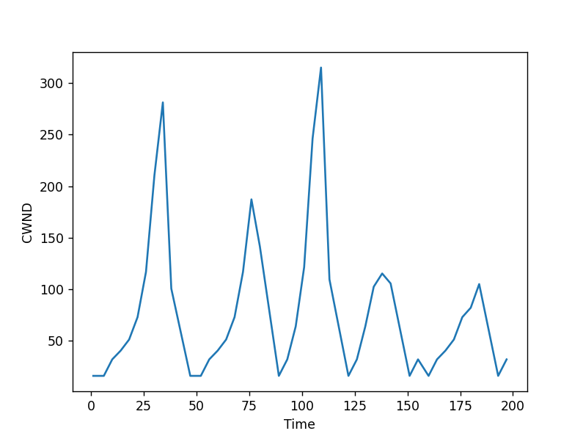
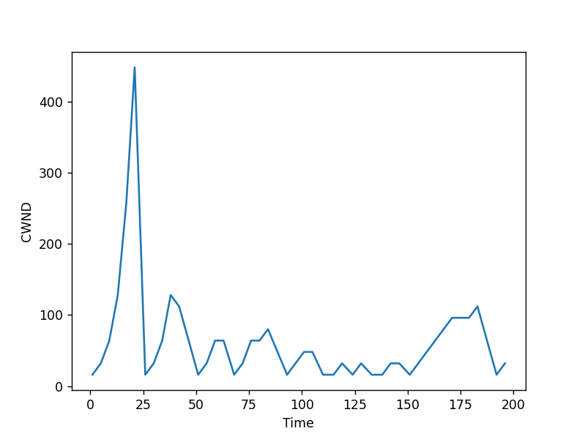
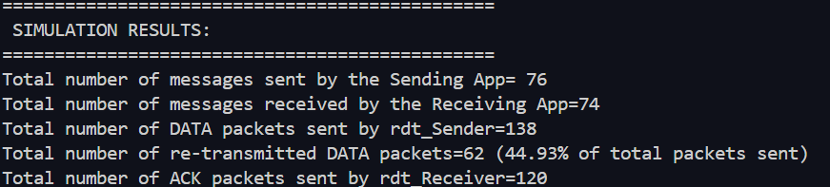
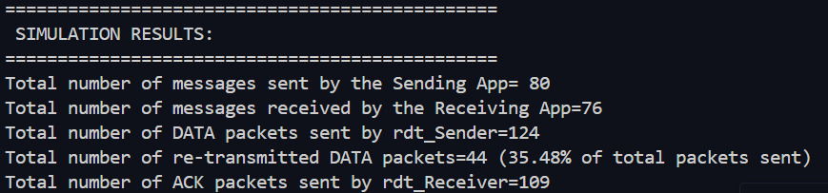
SIMULATION RESULTS
MIAD
AIAD
a_{I}=0, b_{I}=1.125, a_{D}=-3, b_{D}=1
a_{I}=1, b_{I}=1, a_{D}=-3, b_{D}=1

Slide 53
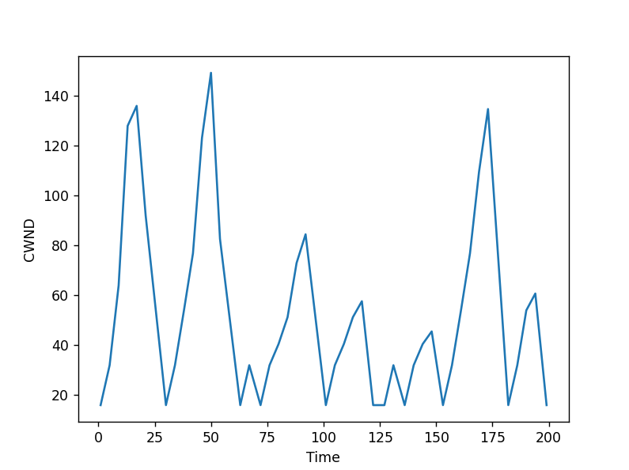
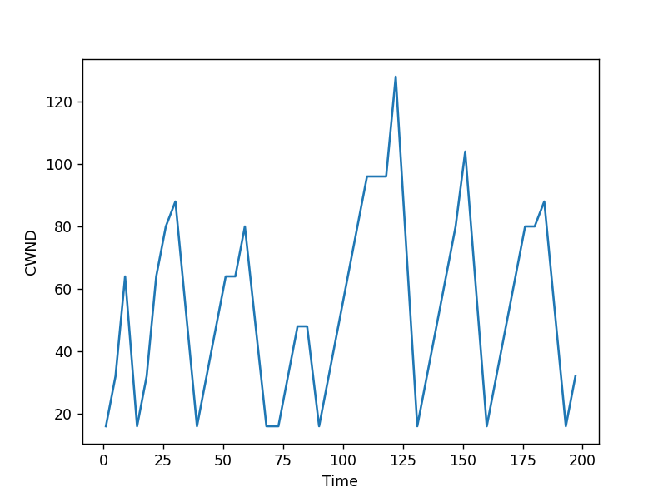
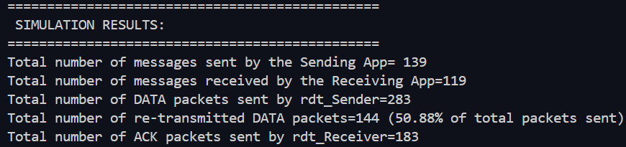
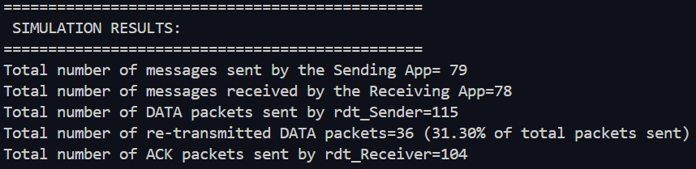
SIMULATION RESULTS
MIMD
AIMD
a_{I}=0, b_{I}=1.125, a_{D}=0, b_{D}=0.8
a_{I}=1, b_{I}=1, a_{D}=0, b_{D}=0.8

Slide 54

Quiz

Slide 55
REFERENCES
https://www.ucg.ac.me/skladiste/blog_44233/objava_64433/fajlovi/Computer%20Networking%20_%20A%20Top%20Down%20Approach,%207th,%20converted.pdf
https://slideplayer.com/slide/6466058/#google_vignette
https://miet.ac.in/assets/uploads/cs/TCP.pdf
https://www.researchgate.net/publication/2937689
https://slideplayer.com/amp/8694372/
https://www.slideserve.com/lovey/congestion-control-and-active-queue-management
https://www.slideserve.com/pbenning/tcp-fairness-powerpoint-ppt-presentation

Slide 56
THANK YOU

Slide 57


