Slide 1
Enterprise-Grade Secure Network Architecture with Active Threat Defense
Presented By:
1. Binoy Dev
ID: 0222310005101088
2. Nure Muskan
ID: 0222410005101113

Slide 2
Real‑Life Scenario — Everyday Dependence on Networks
t.
Financial Systems
Healthcare
Remote Work & Education
Low latency and integrity are essential for transactions and fraud detection.
Remote diagnostics and EHR access demand availability and confidentiality.
Real‑time collaboration requires predictable throughput and QoS.

Slide 3

Why Speed and Reliability Matter
The network is the backbone of modern life — supporting economic activity, safety, and innovation. Performance shortfalls lead to transaction failures, delayed care, and degraded user experience.
Banking
Millisecond latencies for transaction validation and anti‑fraud analytics.
Healthcare
Secure channels and guaranteed delivery for telehealth and device telemetry.
Remote Work
Consistent throughput and low jitter for real‑time collaboration tools.
E‑commerce
High availability during traffic spikes to avoid revenue loss and cart abandonment.

Slide 4

Threat Landscape — Realistic Attack Vectors
ISP‑scale networks face a broad spectrum of threats: distributed automated botnets, volumetric floods, targeted credential attacks, rogue local access points, and lateral movement after compromise.
IoT Botnet DDoS
Targets edge devices and core routers
Internal Lateral Movement
Network Attack Surface
SMTP Flood
Overwhelms mail servers
Spreads between compromised hosts
Brute Force Logins
Rogue WiFi Attacker
Attempts credentials on internal hosts
Compromises local access points
Understanding these vectors informs placement of controls at edge, distribution, and core layers.

Slide 5
Problems with Existing Solutions
High Cost
Complexity
Proprietary appliances create CAPEX/OPEX pressure at ISP scale.
Siloed tools and inconsistent policies across domains.
Vendor Lock‑in
Single Point Failure
Limited interoperability and upgrade friction.
Monolithic designs risk broad outages under failure or attack.
Poor Scalability
Solutions that don’t scale horizontally fail under real traffic growth.

Slide 6
Proposed Solution — Principles at a Glance
We propose a modular, ISP‑grade architecture that is scalable, resilient, and observable. Key building blocks: a 3‑tier topology, redundant control planes, secure NAT boundaries, and a SOC‑driven detection loop.
3‑Tier Architecture
HSRP & Redundancy
OSPF Routing
Access • Distribution • Core separation for predictable scaling.
Active/standby mechanisms and multi‑path failover for zero downtime.
Fast convergence and load sharing across ISP fabric.
NAT + Firewalling
SOC Monitoring
Stateful edge controls with dynamic ACLs and address hygiene.
Centralized telemetry, anomaly detection, and automated response.

Slide 7
Methodology — Operational Controls
These core practices are enforced via automated policy pipelines and continuous validation tests.
Defense in Depth
Segmentation
Layered controls at edge, distribution, and host levels to reduce blast radius.
Micro‑segmentation and VLAN/VRF separation to isolate workloads and tenants.
Redundancy
Logging & Telemetry
HSRP, ECMP, and redundant links to eliminate single points of failure.
High‑fidelity flow records, packet captures, and SIEM ingestion for forensic and ML analytics.

Slide 8
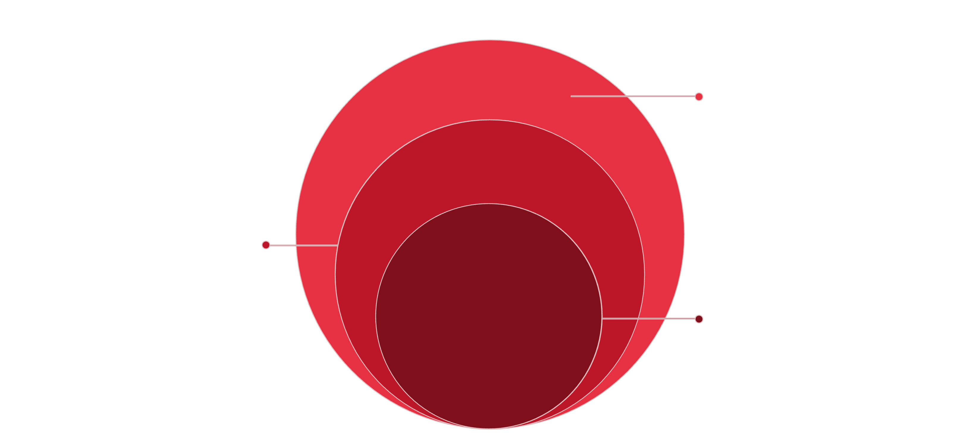
Architecture Overview — Topology
Access & Server Farm
CPE, access switches, firewalls, load balancers
Distribution Layer
Aggregation routers, DDoS scrubbing appliances
Core Layer
High‑capacity routers, peering, SOC taps
Labels: Access, Distribution, Core, Server Farm. Include scrubbing points, peering exchanges, and SOC telemetry taps. Designed for horizontal scaling and predictable traffic engineering.

Slide 9
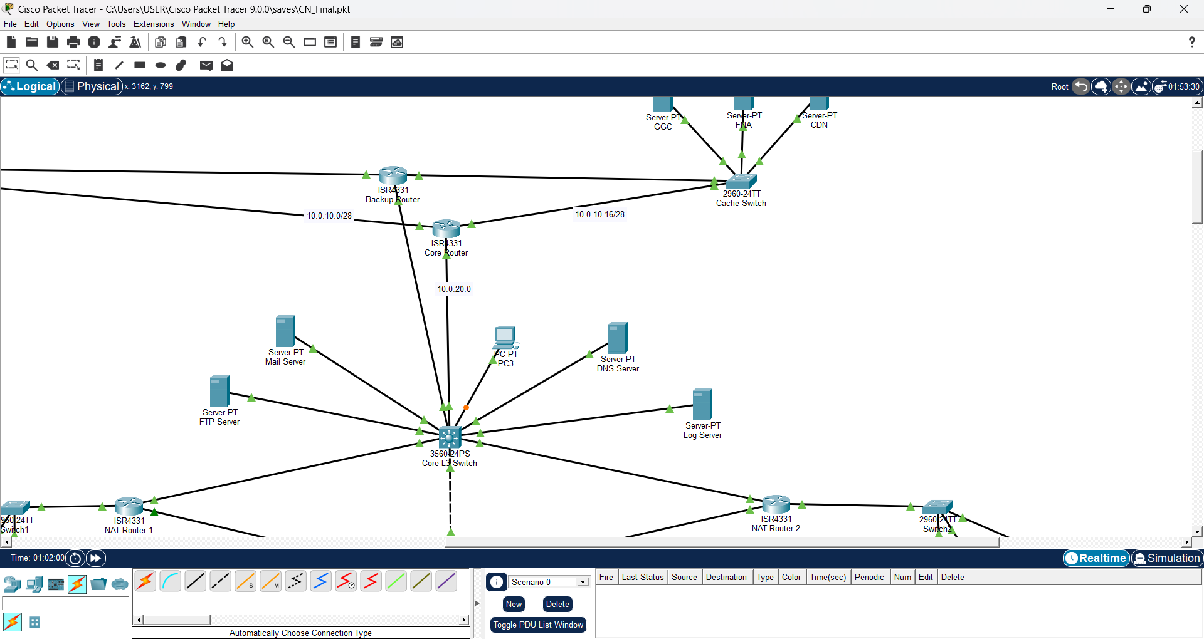

High Availability — HSRP Failover
Primary Forwards
Standby Ready
Heartbeat Lost
Failover: VIP Moves
Outcome: Zero downtime routing for critical prefixes through rapid failover. Combine HSRP with ECMP and BFD for sub‑second convergence under link or device failure.

Slide 10
Operational Summary & Next Steps
Validate
Run synthetic transactions, failure injection, and routing convergence tests.
Deploy
Roll out in phased stages: pilot, regional expansion, full fabric cutover.
Observe
Continuously monitor telemetry, tune ML detectors, and refine playbooks.
Iterate
Periodic red team exercises and capacity planning to stay ahead of threats.

Slide 11
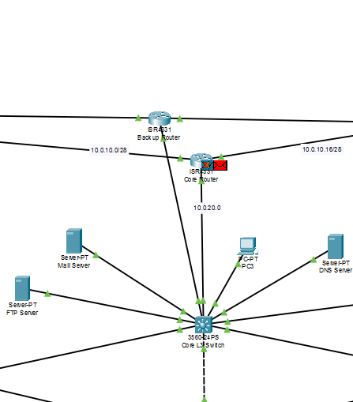
Security Design: Layered Perimeter
ACL Protection
Rule-based filtering at edge and internal routers to enforce least-privilege access and block unauthorized flows.
NAT
Network address translation to hide internal IPs and reduce external attack surface.
Zone Isolation
Network segmentation (DMZ, production, management) with dedicated controls and micro-segmentation where needed.

Slide 12
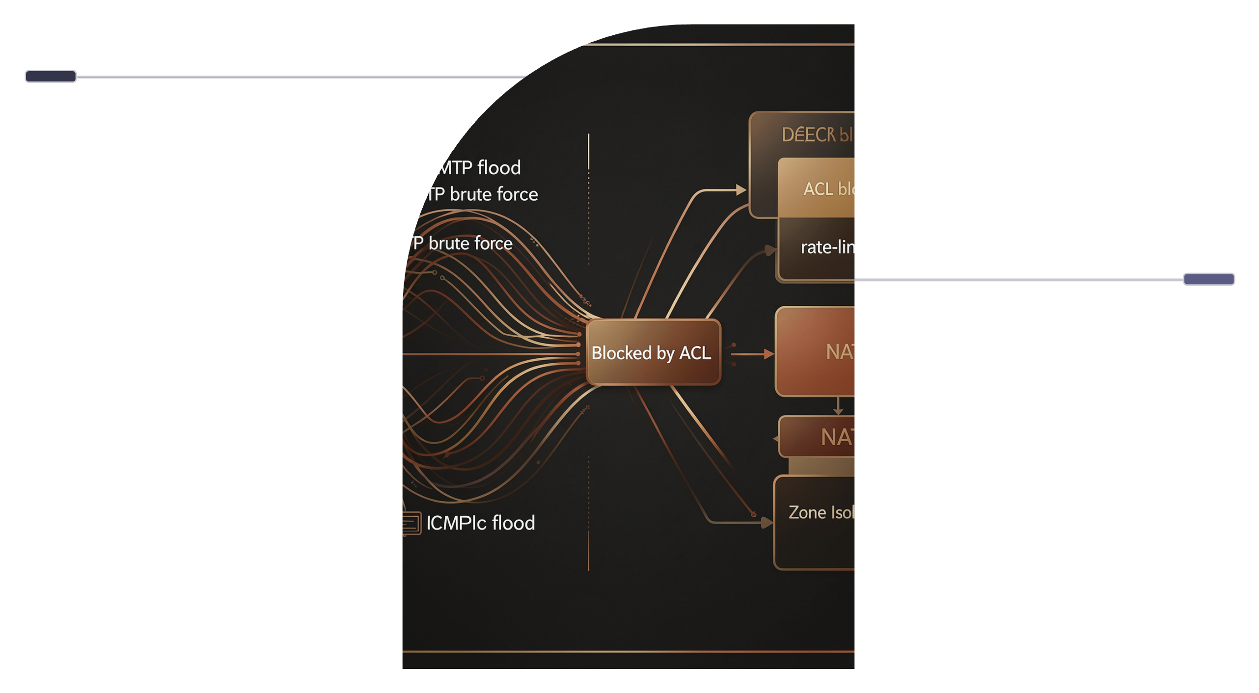
Attack Simulation — Attack vs Defense
Attacks
SMTP flood, FTP brute force, ICMP flood targeting services.
Defenses
ACL blocking, rate-limit, NAT, zone isolation protect infrastructure.
Visual simulation of common volumetric and credential attacks and how layered controls—especially ACLs—intercept them.

Slide 13



SOC Monitoring: Real‑time Visibility
Centralized monitoring that turns telemetry into prioritized action: logs ingested, alerts triaged, metrics visualized.
Logs
Alerts
Normalized, retained, and searchable across hosts and network devices for forensic timelines.
Severity-driven alerts with playbooks for rapid containment and escalation.
Graphs
SOC Design Considerations
Trend dashboards for traffic, anomalies, and SLA metrics to guide operational decisions.
Centralized SIEM with tiered retention
Automated alert enrichment and playbooks
Dedicated analyst queues and threat hunting cadence

Slide 14
Why This Solution Is Best
Cost-effective
Scalable
Optimized use of open standards and vendor-neutral tooling lowers total cost of ownership.
Modular controls and automation scale with traffic and cloud workloads without redesign.
Secure
Vendor‑neutral
Defense-in-depth, segmentation, and proactive monitoring reduce mean time to detect and respond.
Standards-based integrations avoid lock-in and simplify multi-vendor orchestration.

Slide 15
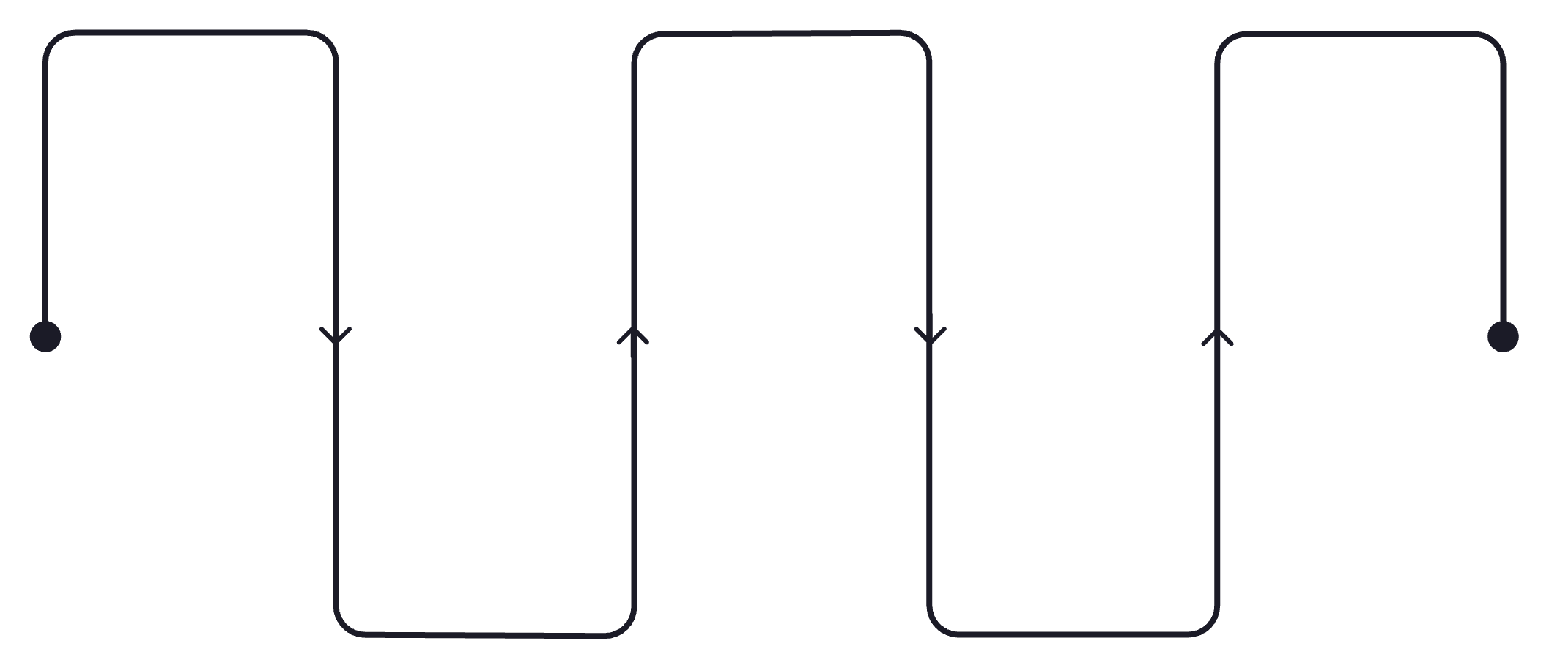
Future Improvements Roadmap
Near-term Automation
Cloud Integration
Zero Trust
Least-privilege enforcement
Automate routine detection
Native telemetry and ops
SDN Adoption
AI Security
Programmatic network control
Behavioral analytics and ML
Planned evolution to improve detection, reduce human toil, and enable secure cloud-native operations.
AI Security
Behavioral analytics and ML-assisted triage to reduce false positives.
Cloud Integration
Native telemetry collection, policy-as-code, and workload-aware controls.
SDN & Automation
Programmatic micro-segmentation and automated remediation playbooks.
Zero Trust
Continuous authentication, least-privilege access, and device posture checks.

Slide 16

Socio‑Economic Impact: Human‑Centric Security
Education
Healthcare
Secure digital classrooms and protected student data enable scalable learning initiatives.
Protected EHRs and resilient networks ensure continuity of care and patient privacy.
Business Growth
Smart Cities
Trusted infrastructure lowers risk, unlocking digital transformation and new markets.
Secure IoT and transport systems improve safety and economic opportunity for citizens.

Slide 17
Conclusion
Our architecture delivers a reliable, secure, and scalable foundation—designed for modern threats and future growth.
Reliable
Redundancy and monitoring ensure continuous protection.
Secure
Layered controls and segmentation minimize risk.
Scalable
Modular components grow with your environment.
Future-ready
Roadmap includes AI, SDN, automation, and Zero Trust adoption.

