Slide 1






MULTIMODAL INTELLIGENCE FOR DENTAL ASSESSMENT
OF SDM (MIDAS)#15
PERAWIS BURANASING · PATHOMPONG PRASITPHOL · PHANA MAHACHAIRACHUN
ADVISORS: DR. QUN JIN · DR. SIRIWAN SUEBNUKARN · DR. KANOKSAK WATTANACHOTE
Notes:
Hello everyone. Today we will talk about Intellectual Property in the AI Era.
*****https://shorturl.at/Sfvqi

Slide 2
THIS UPDATE
ANSWERS TWO QUESTIONS
  MFCC count: Do 50 or 60 coefficients help more than smaller choices?
  Review time: What can text-only ranking find under the same listening budget?
  Next test: Can controlled audio scores improve that review-time curve?
2
Notes:
“AI today can use text, images, voices, and even human identity to create new content.
This creates many ethical questions — such as:
Who owns the content?
Did the person give consent?
Is the AI system fair and transparent?
We will explore these issues through real cases.

Slide 3
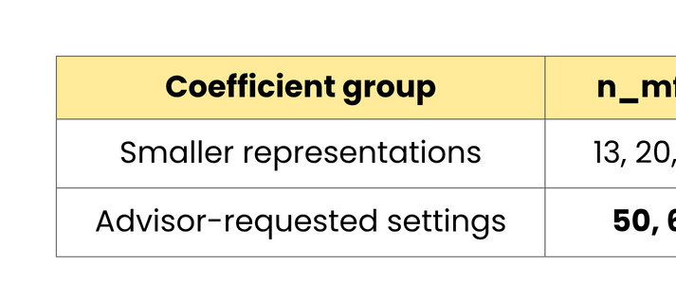
WE TESTED THE REQUESTED
50 AND 60 MFCC COEFFICIENTS
  Advisor request: compare 50 and 60 MFCC coefficients per frame.
  Reference points: 13, 20, and 40 coefficients span smaller representations.
  Five counts × two audio windows: the first 6 seconds and the full turn.
  Task: detect patient Cue/Concern turns under the VR-CoDES framework [1].
[1] C. Zimmermann et al., "Coding patient emotional cues and concerns in medical consultations: The Verona coding definitions of emotional sequences (VR-CoDES)," Patient Educ Couns, 2011.
3
Notes:
“AI today can use text, images, voices, and even human identity to create new content.
This creates many ethical questions — such as:
Who owns the content?
Did the person give consent?
Is the AI system fair and transparent?
We will explore these issues through real cases.

Slide 4
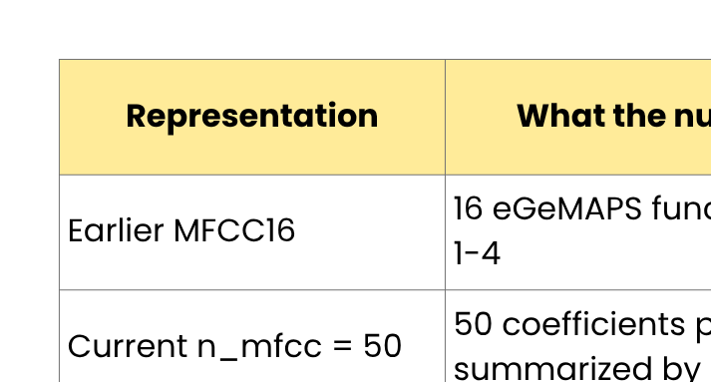
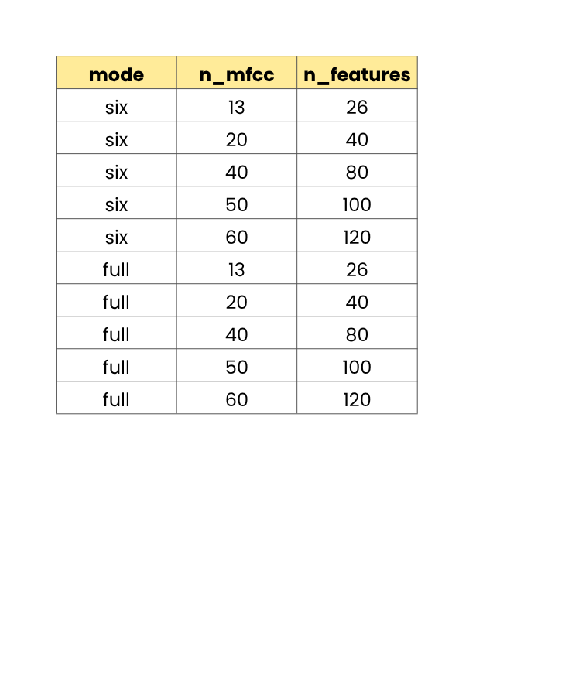
EACH COUNT USED
THE SAME FEATURE PIPELINE
  Audio → MFCC frames → mean + standard deviation → logistic probe → 1:1 fusion.
  Fixed setup: 16 kHz; 25 ms windows; 10 ms hops; 128 mel bands.
  Per-turn feature size: 2 × n_mfcc.
  ⚠️ Averaging frames removes their temporal order.
4
Notes:
“AI today can use text, images, voices, and even human identity to create new content.
This creates many ethical questions — such as:
Who owns the content?
Did the person give consent?
Is the AI system fair and transparent?
We will explore these issues through real cases.

Slide 5
THE COMPARISON
HOLDS OUT WHOLE CASES
  Evaluation set: 723 patient turns from 20 cases; 132 Cue/Concern turns.
  Outer test: leave one entire case out at a time.
  Metric: PR-AUC for imbalanced labels [2]; earlier text-only out-of-fold score = 0.3710.
  Uncertainty: 2,000 paired case bootstrap samples; 12 prespecified contrasts with BH FDR [3].
  Decision rule: a positive difference needs a 95% interval above zero and adjusted q < 0.05.
[2] T. Saito and M. Rehmsmeier, "The precision-recall plot is more informative than the ROC plot when evaluating binary classifiers on imbalanced datasets," PLOS ONE, 2015.
[3] Y. Benjamini and Y. Hochberg, "Controlling the false discovery rate: A practical and powerful approach to multiple testing," J R Stat Soc B, 1995.
5
Notes:
“AI today can use text, images, voices, and even human identity to create new content.
This creates many ethical questions — such as:
Who owns the content?
Did the person give consent?
Is the AI system fair and transparent?
We will explore these issues through real cases.

Slide 6
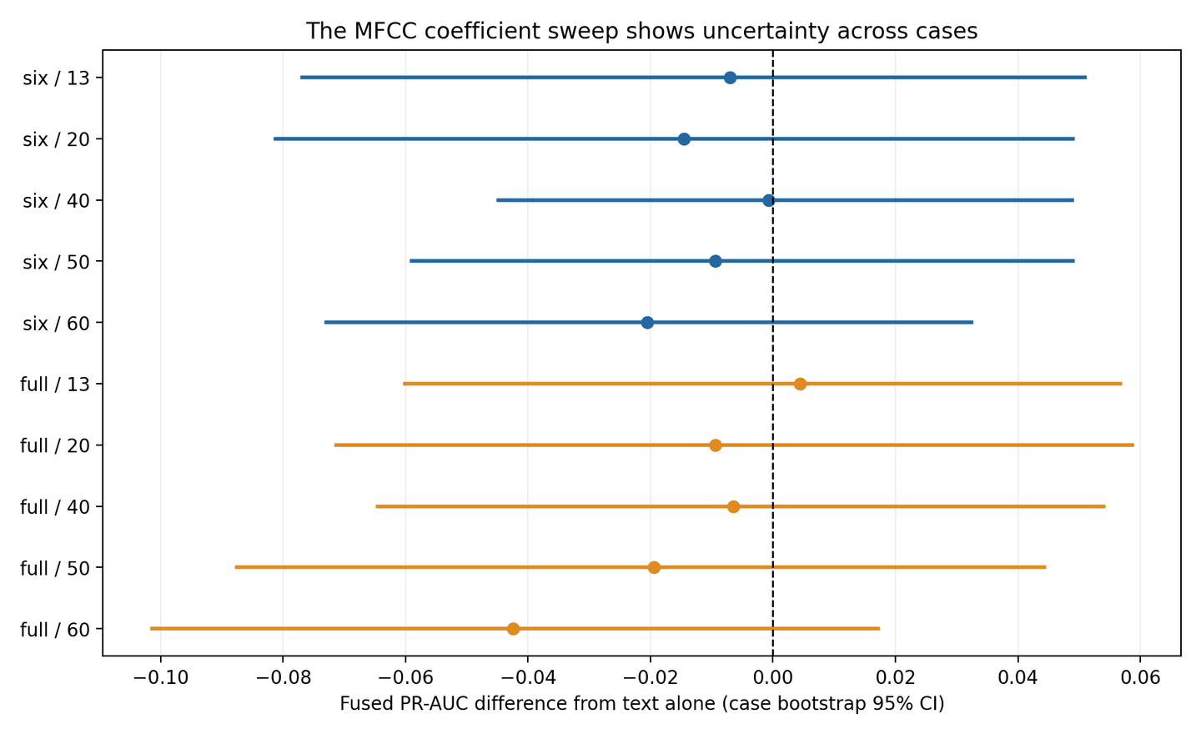
NO MFCC COUNT SHOWS A CONFIRMED FUSION GAIN
  All ten 95% case intervals cross zero; none meet the CI and FDR rule.
  Full-turn 13: Δ = +0.0044, q = 0.9535.
  No coefficient count has a confirmed fusion gain.
6
Notes:
“AI today can use text, images, voices, and even human identity to create new content.
This creates many ethical questions — such as:
Who owns the content?
Did the person give consent?
Is the AI system fair and transparent?
We will explore these issues through real cases.

Slide 7
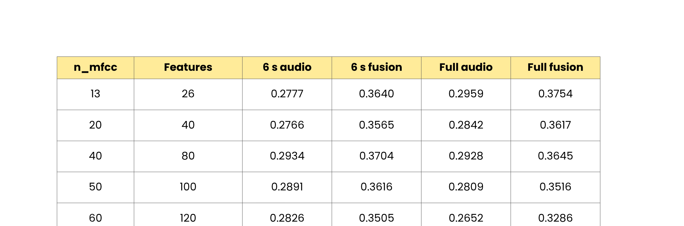
THE FULL SWEEP SHARES ONE TEXT REFERENCE
  Reference text PR-AUC: 0.3710 for all ten conditions.
  All values below are out-of-fold PR-AUC; uncertainty is shown on Slide 6.
7
Notes:
“AI today can use text, images, voices, and even human identity to create new content.
This creates many ethical questions — such as:
Who owns the content?
Did the person give consent?
Is the AI system fair and transparent?
We will explore these issues through real cases.

Slide 8
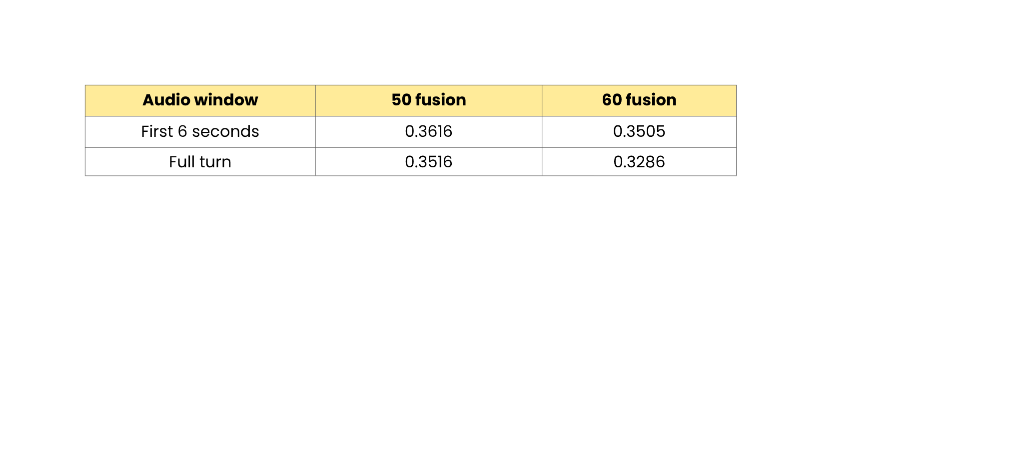
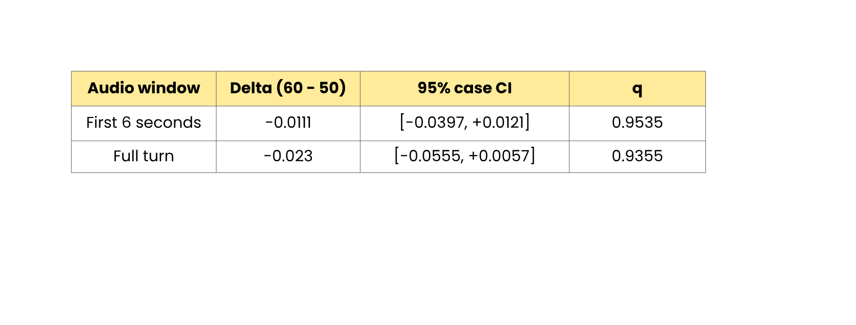
THE DATA DO NOT RESOLVE
50 VERSUS 60
  The requested comparison uses the same fusion rule in both windows.
  ⚠️ 50 uses fewer features, but neither count is a confirmed winner.
8
Notes:
“AI today can use text, images, voices, and even human identity to create new content.
This creates many ethical questions — such as:
Who owns the content?
Did the person give consent?
Is the AI system fair and transparent?
We will explore these issues through real cases.

Slide 9
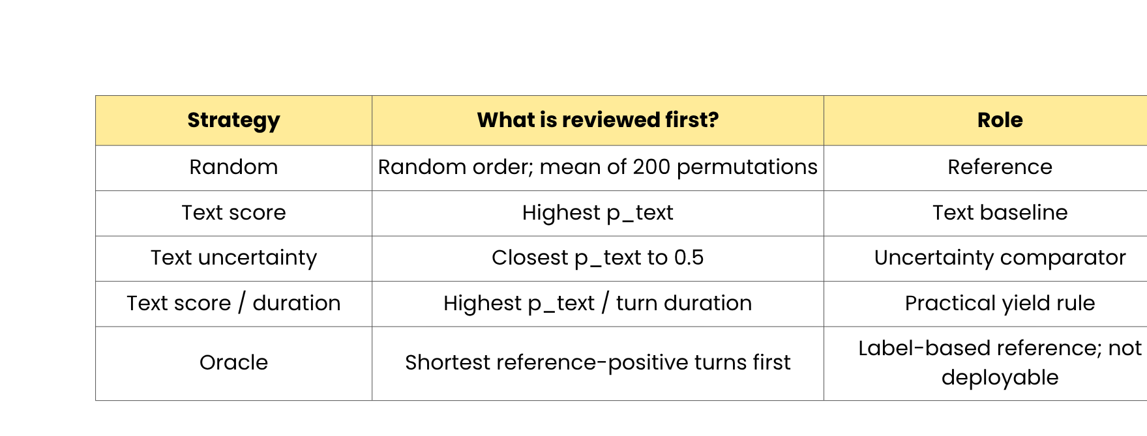
WE BUILT
A TEXT-ONLY REVIEW-TIME BENCHMARK
  Input audit: 723 turns, 20 cases, complete ASR, and valid intervals.
  Total patient speech: 4,149.15 seconds.
  Review rule: rank whole turns; stop before the next whole turn would exceed the per-case cap.
9
Notes:
“AI today can use text, images, voices, and even human identity to create new content.
This creates many ethical questions — such as:
Who owns the content?
Did the person give consent?
Is the AI system fair and transparent?
We will explore these issues through real cases.

Slide 10
TEXT MODEL SELECTION
STAYS INSIDE TRAINING CASES
  Outer loop: predict each held-out case once.
  Inner loop: compare word and character TF-IDF on training cases only.
  Character TF-IDF was selected in all 20 outer folds.
  New text out-of-fold PR-AUC: 0.4417.
  ⚠️ 0.4417 and the earlier 0.3710 come from different text models; their difference has no paired case interval yet.
10
Notes:
“AI today can use text, images, voices, and even human identity to create new content.
This creates many ethical questions — such as:
Who owns the content?
Did the person give consent?
Is the AI system fair and transparent?
We will explore these issues through real cases.

Slide 11
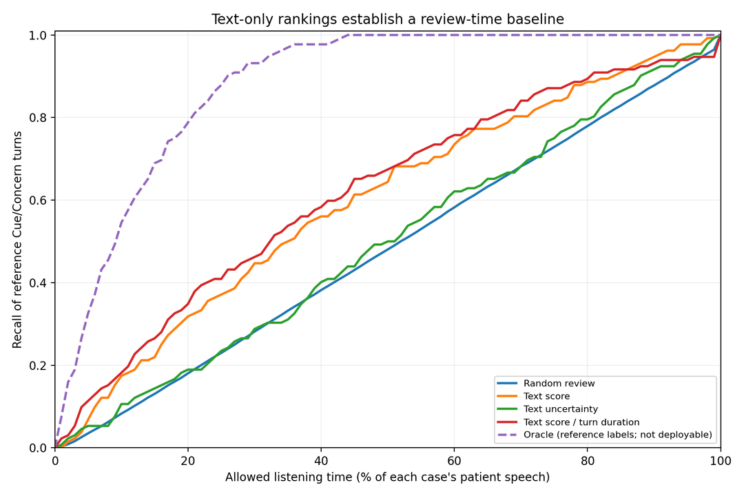
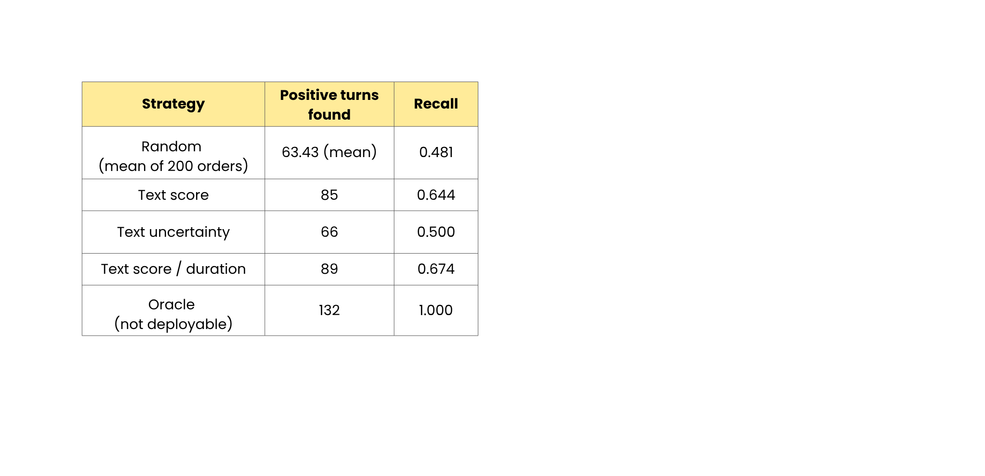
TEXT RANKINGS SET
A REVIEW-TIME REFERENCE
  Illustrative 50% per-case listening cap: random recall 0.481; text score 0.644.
  Score per duration: recall 0.674; label-based oracle 1.000 at that cap.
  These are descriptive curves without case-level confidence intervals.
  ⚠️ The 50% cap was selected for explaining the plot after the run, not as a primary decision threshold.
11
Notes:
“AI today can use text, images, voices, and even human identity to create new content.
This creates many ethical questions — such as:
Who owns the content?
Did the person give consent?
Is the AI system fair and transparent?
We will explore these issues through real cases.

Slide 12
THESE RESULTS DO NOT YET
TEST AUDIO-ASSISTED REVIEW
  MFCC sweep: a CPU linear probe, not the planned chunked wav2vec2 A1 study.
  A2 curve: text-only retrospective simulation, not a clinician listening study.
  Missing: audio-aware ranking, case-level curve uncertainty, clinician context, and a timeline interface.
  We cannot yet claim that audio saves review time or finds otherwise missed Cues.
12
Notes:
“AI today can use text, images, voices, and even human identity to create new content.
This creates many ethical questions — such as:
Who owns the content?
Did the person give consent?
Is the AI system fair and transparent?
We will explore these issues through real cases.

Slide 13
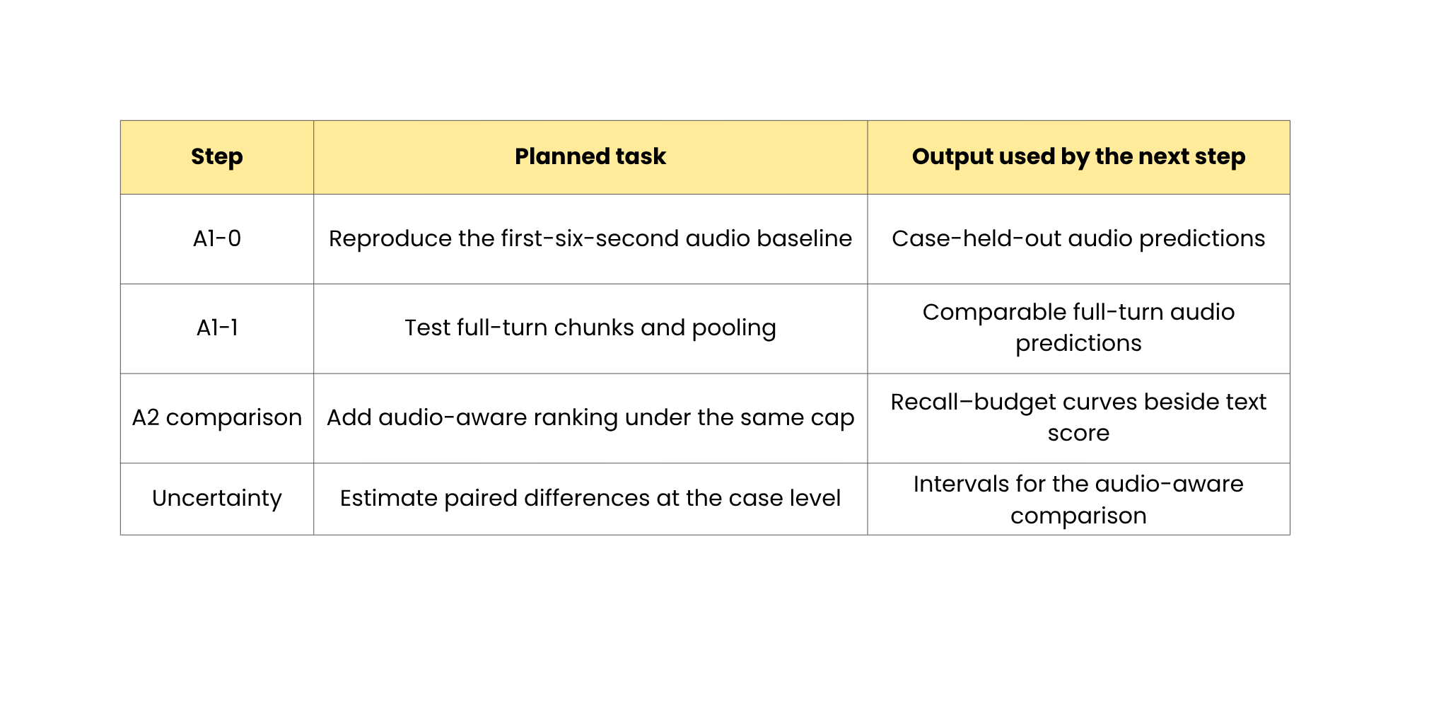
CONTROLLED AUDIO SCORES
WILL FEED A2
  Next work connects controlled audio inputs to the existing review-time benchmark.
13
Notes:
“AI today can use text, images, voices, and even human identity to create new content.
This creates many ethical questions — such as:
Who owns the content?
Did the person give consent?
Is the AI system fair and transparent?
We will explore these issues through real cases.

Slide 14
REFERENCES
[1] C. Zimmermann et al., "Coding patient emotional cues and concerns in medical consultations: The Verona coding definitions of emotional sequences (VR-CoDES)," Patient Education and Counseling, vol. 82, no. 2, pp. 141–148, 2011. doi: 10.1016/j.pec.2010.03.017. Official source.
[2] T. Saito and M. Rehmsmeier, "The precision-recall plot is more informative than the ROC plot when evaluating binary classifiers on imbalanced datasets," PLOS ONE, vol. 10, no. 3, e0118432, 2015. doi: 10.1371/journal.pone.0118432. Official source.
[3] Y. Benjamini and Y. Hochberg, "Controlling the false discovery rate: A practical and powerful approach to multiple testing," Journal of the Royal Statistical Society: Series B (Methodological), vol. 57, no. 1, pp. 289–300, 1995. doi: 10.1111/j.2517-6161.1995.tb02031.x. Official source.
14
Notes:
“AI today can use text, images, voices, and even human identity to create new content.
This creates many ethical questions — such as:
Who owns the content?
Did the person give consent?
Is the AI system fair and transparent?
We will explore these issues through real cases.

Slide 15
THANK YOU

