Slide 1




TRAVEL STYLE SEGMENTATION
& DRIFT MONITORING
ITCS355 - Machine Learning Operations
Perawis Buranasing (6688012) | Supitsara Tanasarnsukstid (6688121) | Atichat Kangsamut (6688193)
Notes:
15 seconds. Introduce our team and the travel profile service. We focus on the working MLOps system.

Slide 2
ONE PROFILE,
A SIMPLE TRAVEL SEGMENT
A travel platform can use rating profiles to group similar interests.
INPUT
MODEL
OUTPUT
24 category ratings [1]
Each value: 0-5
K-Means, k=5
Shared preprocessing
Segment + distance
Uncertainty + version
Segment names are provisional. This is a preference tool, not a personality test.
Source: docs/MODEL_CARD.md; reports/bundle-manifest.json; UCI [1]
2
Notes:
45 seconds.
A travel platform can group users by their rating profiles. We take 24 category ratings and return a segment, distance, uncertainty flag, and model version. Names are provisional; we have not tested recommendation quality with users.
Source: docs/MODEL_CARD.md; reports/bundle-manifest.json; UCI [1]

Slide 3
FROM VERSIONED DATA
TO A MONITORED API
DATA
TRAIN
REGISTER
SHIP
SERVE
Git + DVC
Azure Blob
Azure ML
MLflow
Model version
Bundle hash
Actions
ACR image
FastAPI
Container Apps
Tests gate deployment.
Failure checks feed back into tests.
OBSERVE
Azure Monitor + Log Analytics
Dashboard, semantic alert, model version
Azure region: centralindia | Provider code: cloudlayer/
Source: README.md; docs/reference/course/project/project-brief.md [2]
3
Notes:
40 seconds.
Follow the arrows from versioned data to the live endpoint. Azure ML trains and registers the model. Actions checks the code and deploys an immutable ACR image. Monitor records requests and checks the semantic canary. Cloud-specific code stays in cloudlayer.
Source: README.md; docs/reference/course/project/project-brief.md [2]

Slide 4
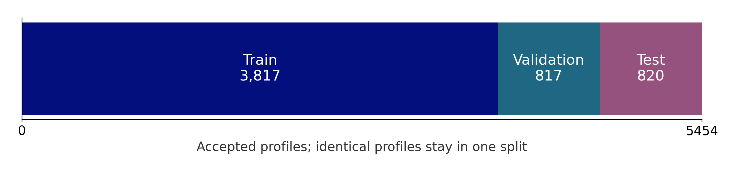
ONE VERSIONED DATASET,
ONE REPEATABLE PIPELINE
5,456
5,454
2
Raw rows
Accepted rows
Quarantined rows
CC BY 4.0 [1] | Raw SHA-256 + DVC pointer | Seed 42
Train-only imputation/scaling. Identical profiles stay in one split.
Source: reports/data-audit.json; prepared-data.json; selection.json; UCI [1]
4
Notes:
25 seconds.
UCI Travel Review Ratings is licensed CC BY 4.0. We quarantined two malformed rows, removed user IDs from features, and kept duplicates in one split. We kept zeros as supplied and fit preprocessing only on training data. The fresh DVC pull passed.
Source: reports/data-audit.json; prepared-data.json; selection.json; UCI [1]

Slide 5
THE SAME BUNDLE
REACHES THE API
MANAGED TRAINING
SERVING BUNDLE
Azure ML job: Completed
Fresh-fit equivalence: passed
Registry: travel-style, version 1
Preprocessing + feature order
Centers + mapping + thresholds
Hash and golden checks at startup
Model version: abfd88e893ca
Bundle SHA-256: 71f3ba41b4b964f5...
CI image digest: f124df59007a...
Immutable images use one canonical bundle.
Source: reports/finish-training-registry.json; bundle-manifest.json; ci-deploy-result.json
5
Notes:
25 seconds.
The managed training job completed and the registered model is travel-style version 1. Azure checks a fresh fit against the selected model before exporting the canonical bundle. Startup checks the bundle hash and golden predictions. K-Means test silhouette is 0.1445; model quality is not the main capstone focus.
Source: reports/finish-training-registry.json; bundle-manifest.json; ci-deploy-result.json

Slide 6
LIVE DEMO:
VALID AND UNEXPECTED INPUT
Request | Expected / verified
Valid 24-field profile | 200 + segment
Missing fields / invalid rating | 422, clear validation error
Batch of 100 profiles | 200; golden check passed
Semantic canary | 200; predictions match
SAVED REAL HTTP RESPONSE
{
"segment": "Segment 1",
"cluster_id": 0,
"distance": 4.1435,
"uncertain": false,
"model_version": "abfd88e893ca"
}
Exactly 24 named, finite ratings in [0,5]. A valid uncertain profile returns a null segment.
Source: output/presentation/evidence/api-demo.json; service/schemas.py
6
Notes:
90 seconds.
Live demo: open Notebook 22 and run the small smoke check in PRESENTATION.md. Show one valid prediction, an incomplete profile returning 422, and a batch of 100. A valid uncertain profile returns 200 with a null segment. The example shown here is a saved real HTTP response, not a live screenshot.
Source: output/presentation/evidence/api-demo.json; service/schemas.py

Slide 7
FAILED TESTS
BLOCK DEPLOYMENT
NORMAL RUN
DELIBERATE FAILURE
Tests: success
Deploy: success
Real HTTP smoke: passed
Tests: failure
Deploy: skipped
Failed code was not shipped
Open GitHub Actions run 38173375457
Open GitHub Actions run 38173380800
Same tested source commit: 9fea51a | OIDC login + limited roles | Immutable image
Source: reports/ci-runs.json; reports/ci-deploy-result.json; .github/workflows/ci.yml
7
Notes:
35 seconds.
Both saved runs use commit 9fea51a. In the normal run, tests and deployment passed. In the deliberate failure run, tests failed and deployment was skipped. Click the run links to show the actual jobs. These runs do not verify later local code changes.
Source: reports/ci-runs.json; reports/ci-deploy-result.json; .github/workflows/ci.yml

Slide 8
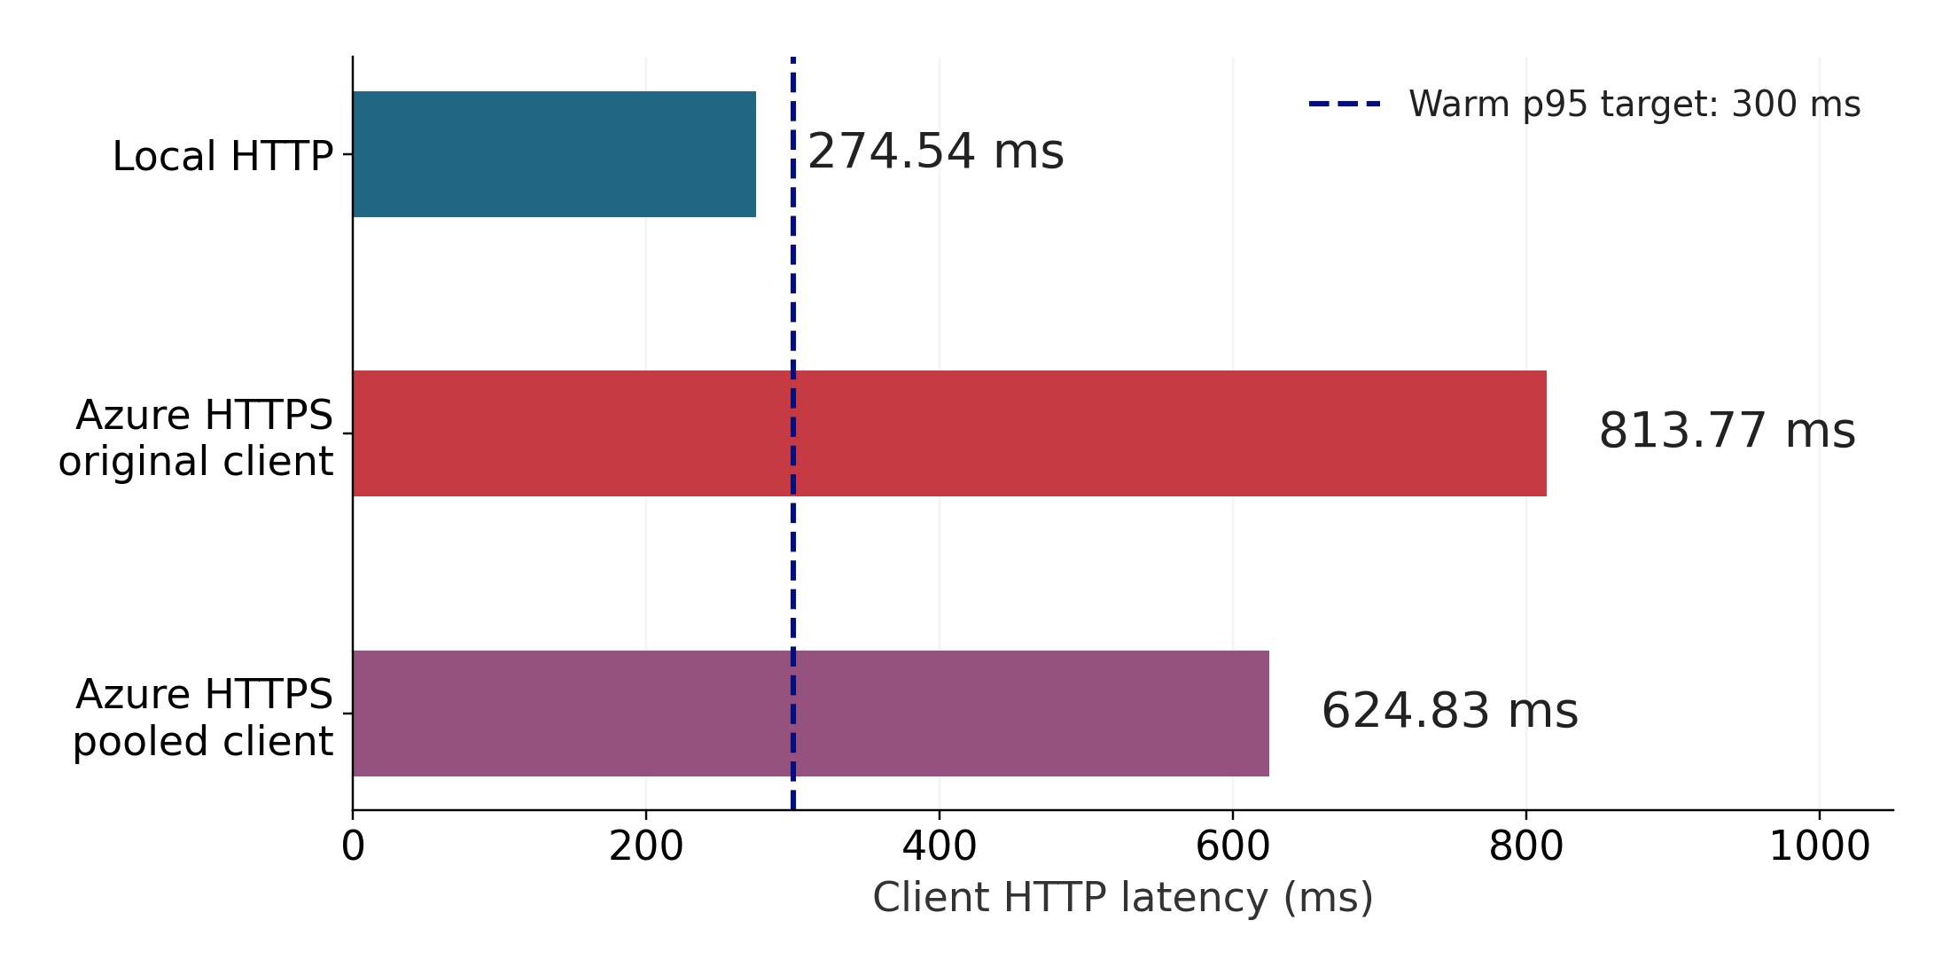
THE API WORKS;
CLOUD LATENCY MISSES OUR TARGET
WARM TEST
200 requests
Concurrency: 10
Errors: 0 in all runs
COLD REQUEST
3.82 seconds
After verified zero replicas
One WSL HTTPS sample
Source: reports/serving-recheck/local-load.json; azure-load.json; pooled-load.json; finish-cold.json
8
Notes:
25 seconds.
Warm tests used 200 requests, concurrency 10, batch size 1, and excluded warm-up requests. All had zero errors. The pooled-client test used parallel warm-up and connection reuse, so it is a separate measurement, not proof of a server speedup. Azure timing includes the WSL network path. Cold start is one readiness request after verified zero replicas, not a percentile.
Source: reports/serving-recheck/local-load.json; azure-load.json; pooled-load.json; finish-cold.json

Slide 9
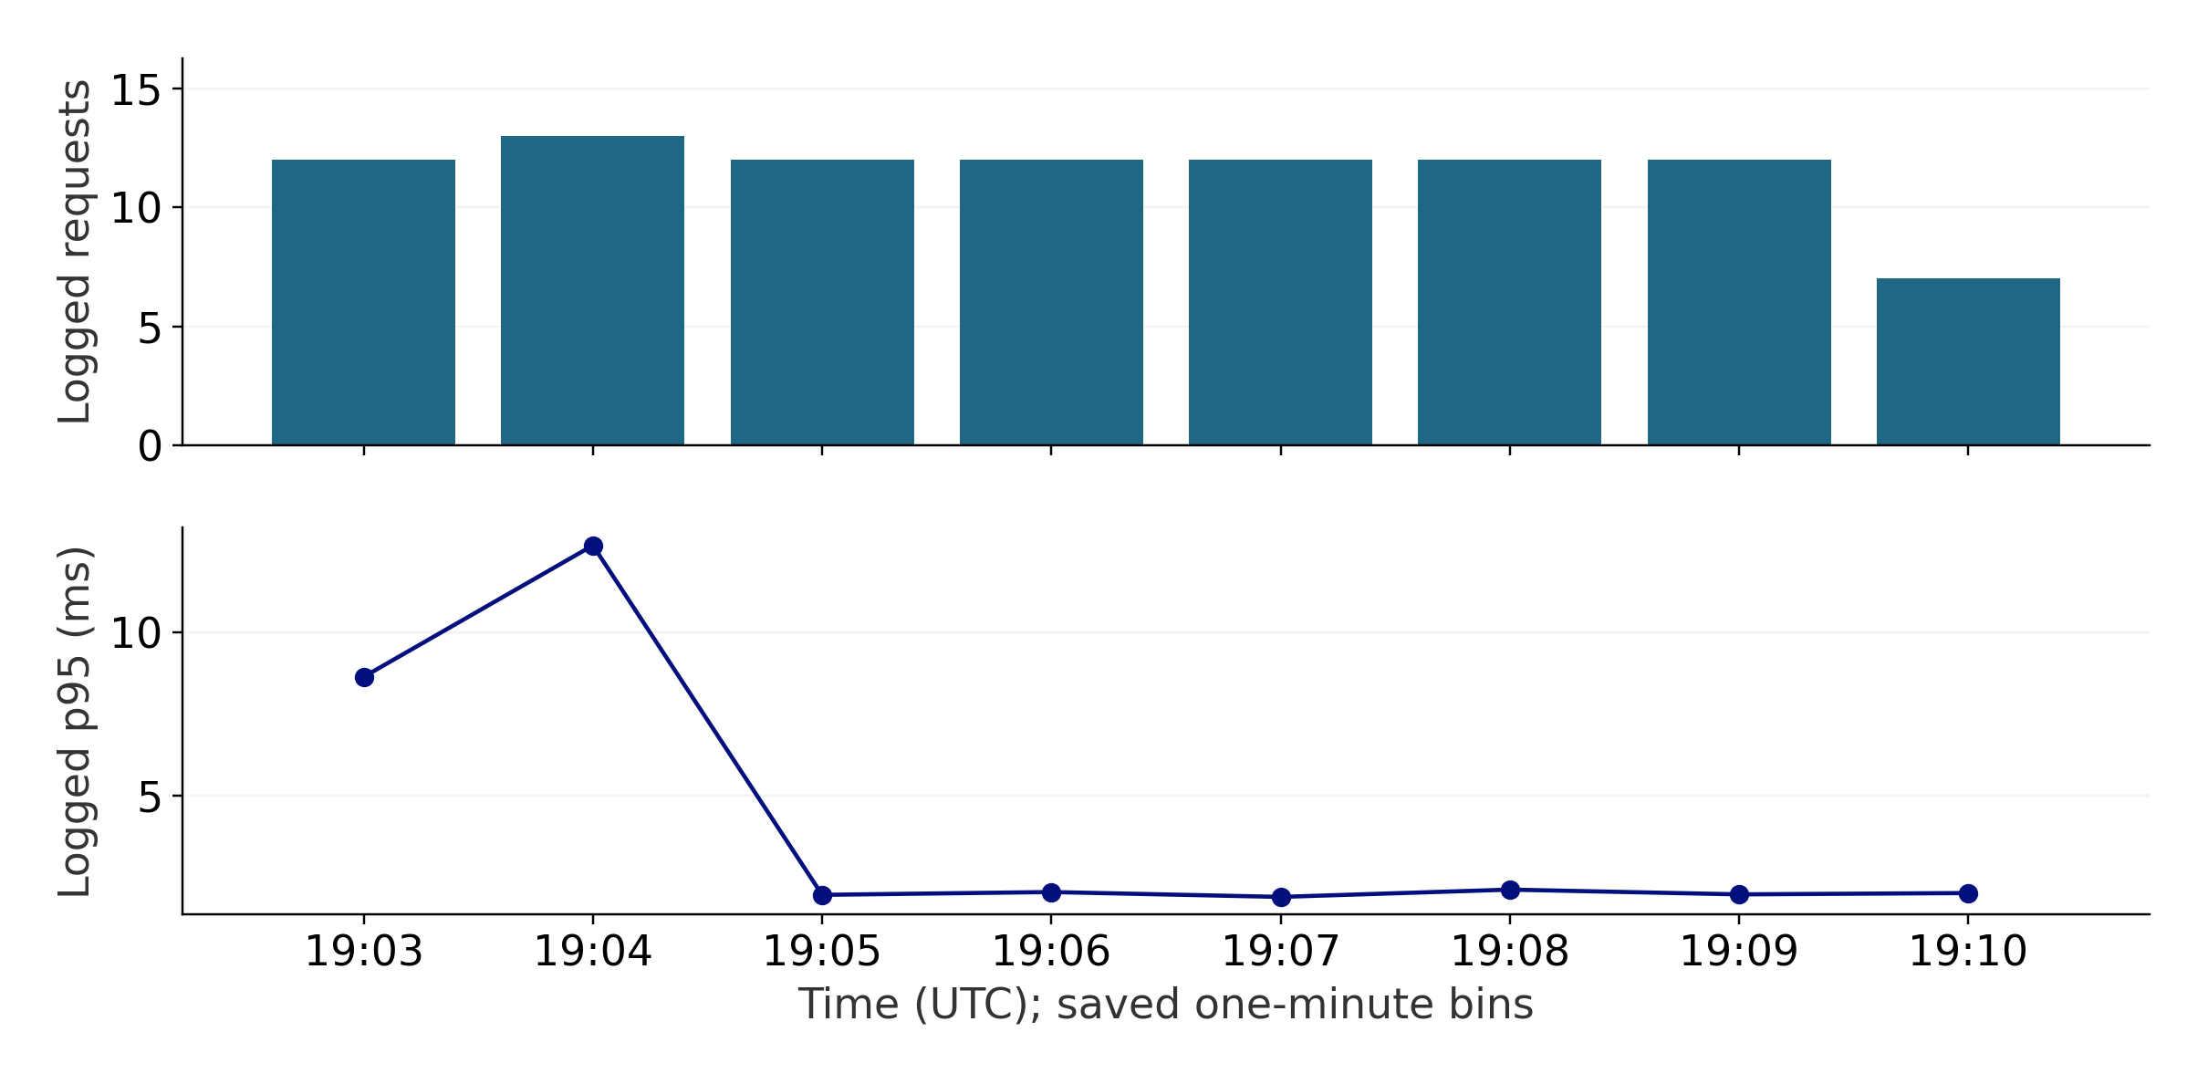
MONITOR REQUESTS
AND CHECK PREDICTION MEANING
DASHBOARD
MLOP Travel Style
Requests, errors, latency
Model version in logs
ACTUAL ALERT
Semantic failure detected
Alert fired, then resolved
Email is not configured
Saved Log Analytics results; application timing, not client HTTPS latency.
Source: reports/azure-telemetry.json; finish-monitor.json; finish-alert.json
9
Notes:
25 seconds.
This chart uses actual saved Log Analytics bins, not an Azure Portal screenshot. The dashboard is MLOP Travel Style. Logs contain derived counts, status, latency, and model version rather than full profiles. Logged p95 is application timing and must not be compared directly with client HTTPS p95. An actual semantic alert fired and later resolved; email notification is not configured.
Source: reports/azure-telemetry.json; finish-monitor.json; finish-alert.json

Slide 10
A WRONG SEGMENT MAPPING
TRIGGERED DETECTION AND RECOVERY
Controlled fault in the separate staging app: wrong cluster-to-segment mapping.
INJECT
DETECT
ALERT
RECOVER
16:54:22 UTC
Wrong mapping
16:54:52 UTC
Canary: 503
16:56:39 UTC
Actual alert fired
17:02:08 UTC
Canary: 200
Detection to confirmed recovery: 7 min 16.4 sec, including the failed first recovery attempt.
Fix: restore config, restart staging, confirm the canary twice, and keep a regression test.
Saved failure evidence. Arrows show event order, not equal time gaps.
Source: reports/finish-failure.json; finish-alert.json; tests/test_api.py
10
Notes:
45 seconds.
This is saved failure evidence from a separate staging app. We changed the segment mapping; the canary returned 503. The first recovery attempt failed, so the total detection-to-confirmed-recovery time was about seven minutes sixteen seconds. We restored configuration, stopped and started staging, and checked the semantic canary twice. The actual alert is separate evidence. The failure was added to regression checks.
Source: reports/finish-failure.json; finish-alert.json; tests/test_api.py

Slide 11
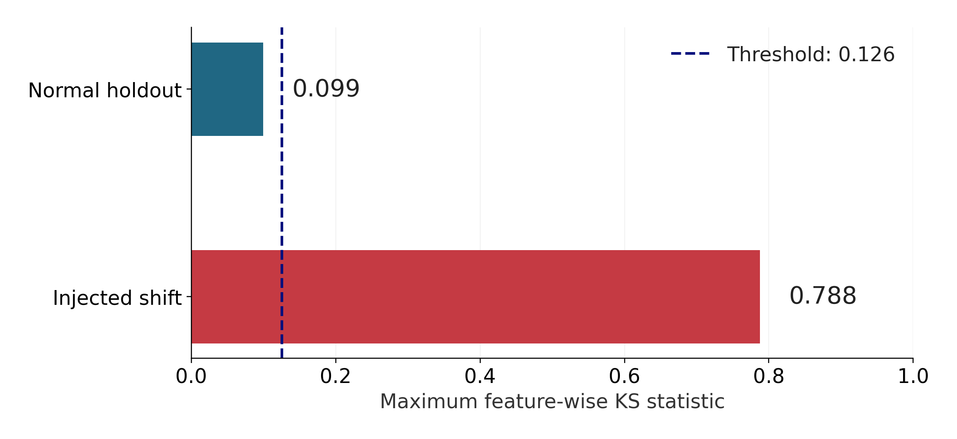
A CONTROLLED SHIFT
IS DETECTED OFFLINE
CONTROLLED TEST
Reference: 1,908 rows
Recent sample: 200 rows
100 calibration rounds
Shift: +1.5 in four ratings,
clipped to [0,5].
Offline input drift only.
No concept-drift claim.
Source: reports/input-drift.json; monitoring/drift.py
11
Notes:
20 seconds.
We used a maximum feature-wise KS statistic. The reference has 1,908 rows and the recent sample has 200. One hundred calibration rounds set the threshold. Adding 1.5 to the first four features, clipped to 0-5, caused the alert condition. This is an offline controlled test, not observed temporal drift or evidence of concept drift.
Source: reports/input-drift.json; monitoring/drift.py

Slide 12
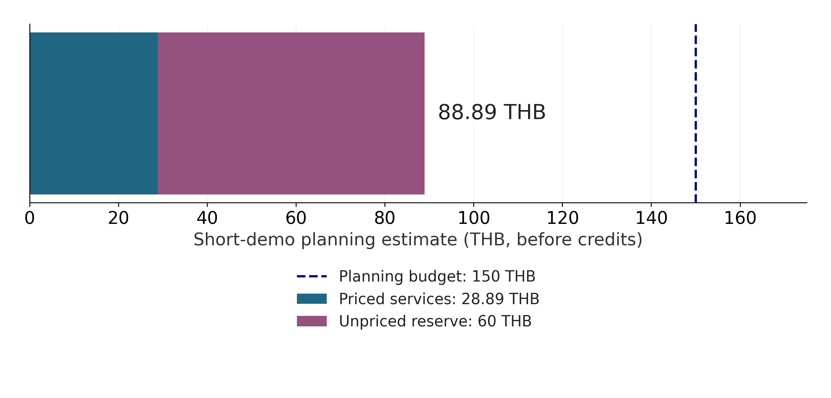
COST PER 1,000 PREDICTIONS:
THE ESTIMATE AND ITS LIMITS
PLANNED COST
8.89 THB / 1,000
Assume 10,000 predictions
One prediction per request
REPORTED COST
0.00143104 USD / 1,000
841 observed profiles
Provisional; not a final bill
Assumptions: 40 THB/USD; training 1 h; app active 2 h; ACR 2 days. No credits applied.
Source: reports/azure-cost-plan.json; cost-per-1000.json; docs/COST_REPORT.md
12
Notes:
30 seconds.
The short-demo plan totals 88.89 THB, including a 60 THB reserve. At 10,000 planned predictions, that is 8.89 THB per 1,000 before credits. The reported Azure cost is 0.00120350 USD for 841 observed valid profiles in the same query window. Billing and logs may lag. This is provisional, not the final invoice or proof of the budget cap.
Source: reports/azure-cost-plan.json; cost-per-1000.json; docs/COST_REPORT.md

Slide 13
WHAT ANOTHER WEEK
WOULD IMPROVE
Priority | Next action
Cloud warm latency | Measure network vs. application time; retest p95
Cost reconciliation | Recheck full cost and usage when billing updates
Live feature drift | Add rolling windows when current data is available
User quality | Review segment labels and test useful recommendations
Current limits: provisional labels, unknown zero meaning, and no user-quality study.
Save evidence before cleanup. Remove cloud resources after the final demo.
Source: reports/finish-delivery.json; docs/DELIVERY_STATUS.md; docs/FINAL_STEPS.md
13
Notes:
45 seconds.
Our first priorities are the unmet latency target and complete cost reconciliation. Separate network time from application time before changing replicas or spending more. Recheck billing and usage after cleanup when the data has settled. Add live feature windows only when current data is available. Review segment labels and improve the dashboard. Save evidence and remove resources after the demo.
Source: reports/finish-delivery.json; docs/DELIVERY_STATUS.md; docs/FINAL_STEPS.md

Slide 14
REFERENCES
[1] S. Renjith, "Travel Review Ratings," UCI Machine Learning Repository, 2018.
DOI: 10.24432/C5C31Q. License: CC BY 4.0.
[2] ITCS355, "Capstone Project Brief," course/project/project-brief.md.
Presentation: 8 minutes + 5 minutes of questions.
[3] MLOP-PJ team, "Project reports and CI runs."
Data, registry, API, load, alert, recovery, drift, and cost evidence.
Dataset: https://doi.org/10.24432/C5C31Q
Repository: https://github.com/DewPerawis/MLOP-PJ (access required)
Source: UCI dataset page; course brief; project reports and CI runs
14
Notes:
5 seconds.
The dataset citation and course brief support the scope. Our measurements and operational claims come from the listed project reports. GitHub evidence requires repository access.
Source: UCI dataset page; course brief; project reports and CI runs

Slide 15
THANK YOU
Notes:
10 seconds. Thank the audience. Open the API and evidence reports for the five-minute Q&A.

