Slide 1
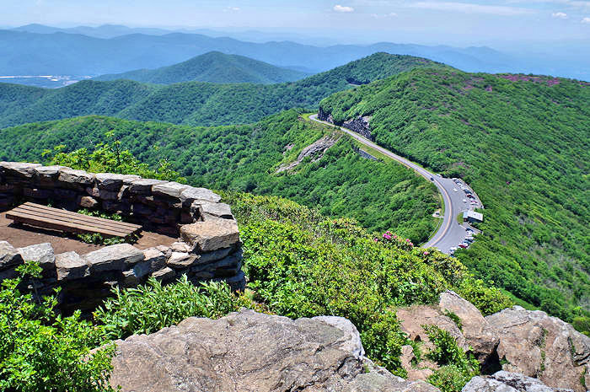
ASHEVILLE, NORTH CAROLINA
Notes:
Asheville is a city in western North Carolina’s Blue Ridge Mountains. It’s known for a vibrant arts scene and historic architecture, scenic views, and access to outdoor actviites like hiking, white water rafting, kayakiing etc.
Asheville, with a less than 1% vacancy rate in rental housing, has been declared to be in a "housing crisis". It has just been named the 6th most unsustainable housing market in the nation.
The question about short-term rentals, which facilitates and incentivizes the conversion of residential housing to tourist accomodation, is very real in Asheville, a city that is both a great place to live and work, and a tourist destination.

Slide 2
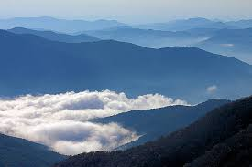
Determinations:
What percentage of Airbnb hosts might be operating illegally?
What criteria should be considered to make a determination of legality?
Who they are?
Where are they?
What neighborhoods are they operating in?

Slide 3
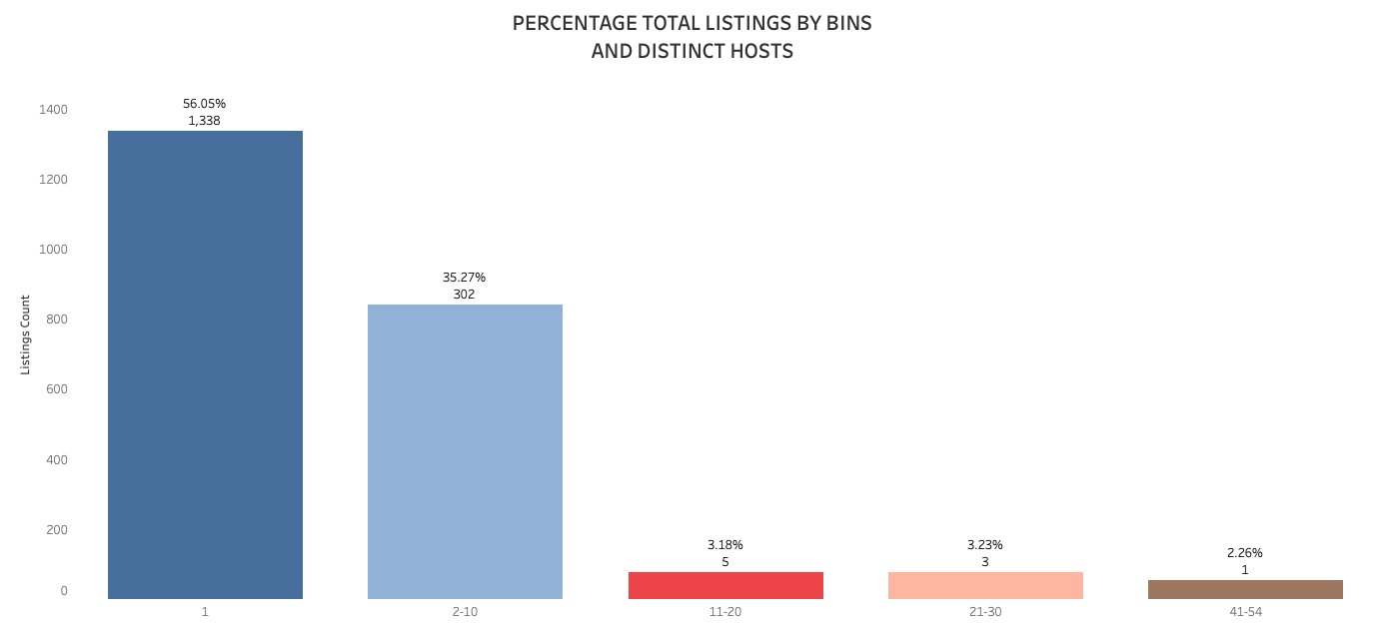
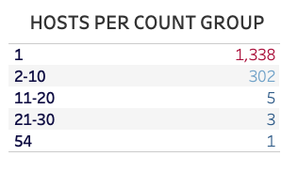
Data provided shows Asheville with 2,387 unique Airbnb listings represented by 1,649 distinct host. Host with multiple listings make up almost 44% of the total number of listings.

Slide 4
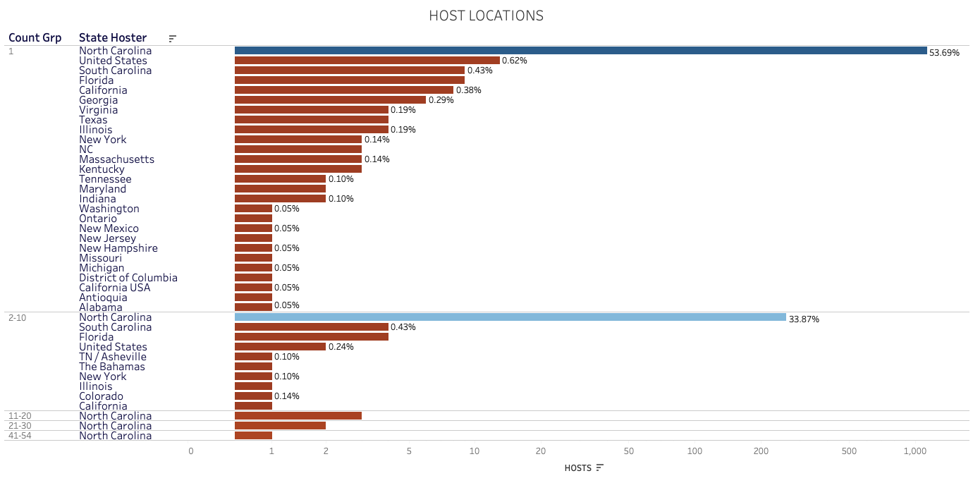
77% of Airbnb Host list their location as Asheville, but consideration should be paid to the roughly 25% who don’t live locally since many are hosts with multiple listings.

Slide 5
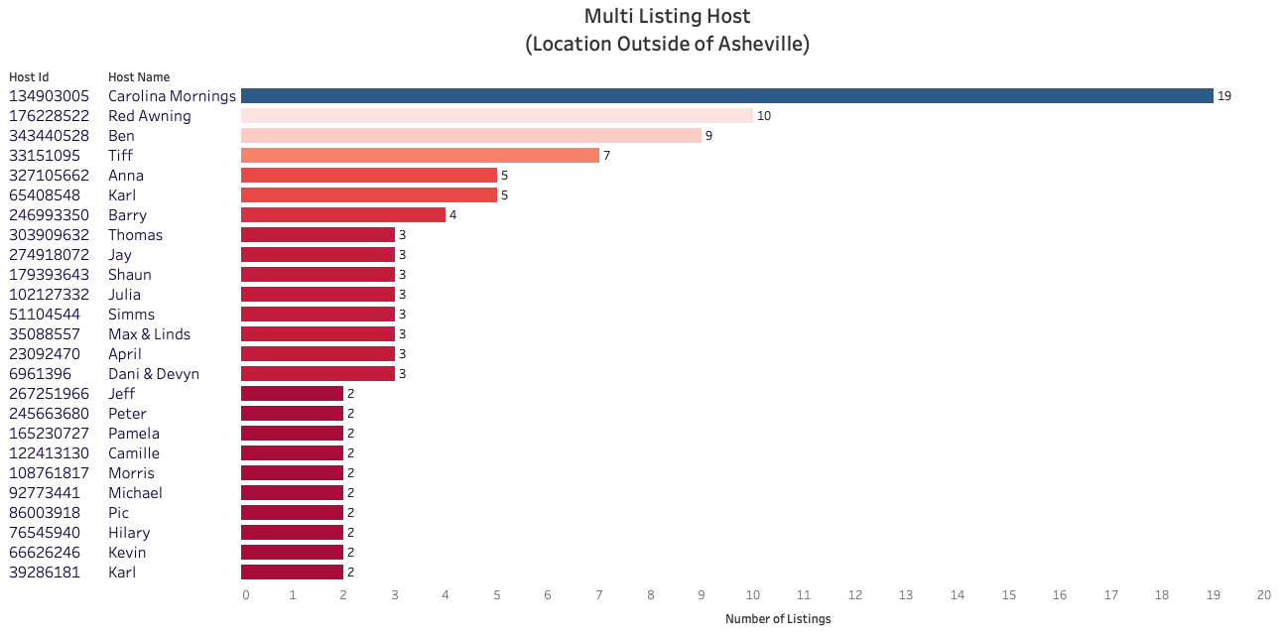
CRITERIA:
HOST WITH MULTIPLE LISTINGS
HIGH AVAILABILITY
SHORT TERM STAY
JURISDICTION
RENTAL IS AN ENTIRE HOUSE OR APARTMENT
HOST IS NOT LOCAL
Only 16% of the host with multiple listings indicate their location as outside of Asheville. Their Airbnb listings represent about 10% of the pool.

Slide 6
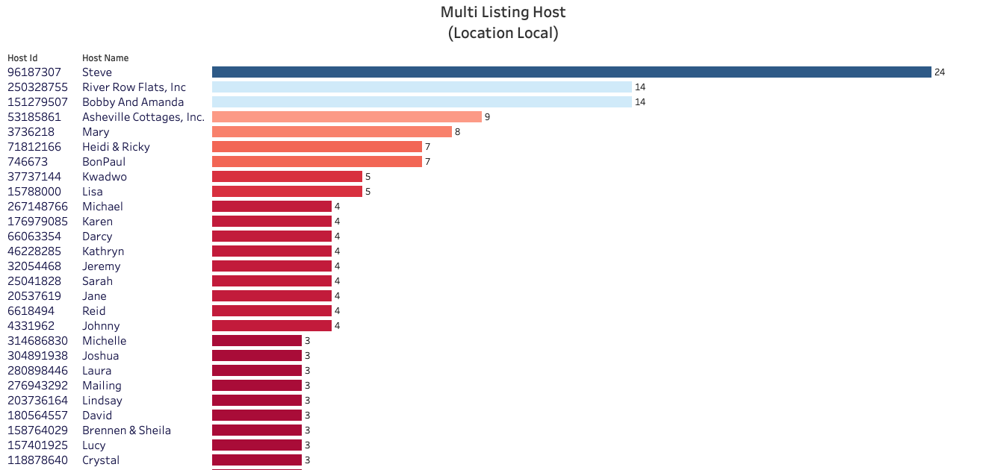
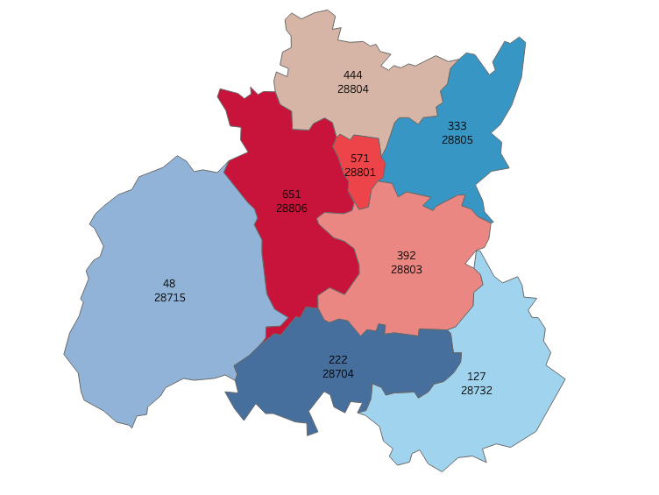
Most host with multiple listings live locally with almost 87% having between 2 and 3 listings. The above chart is truncated due to size and represents only a portion of 134 local host who meet our criteria.

Slide 7
Recommendations:
Stricter enforcement of current regulations
Additional Resources and Staff
More stringent oversight of the approval process
Implementation and enforcement of fines with increasing penalties for repeat offenders
Particular emphasis on hosts with multiple listings who do not reside in the jurisdiction.
Dawn E. Walker
Galvanize Cohort II
Capstone II

Slide 9
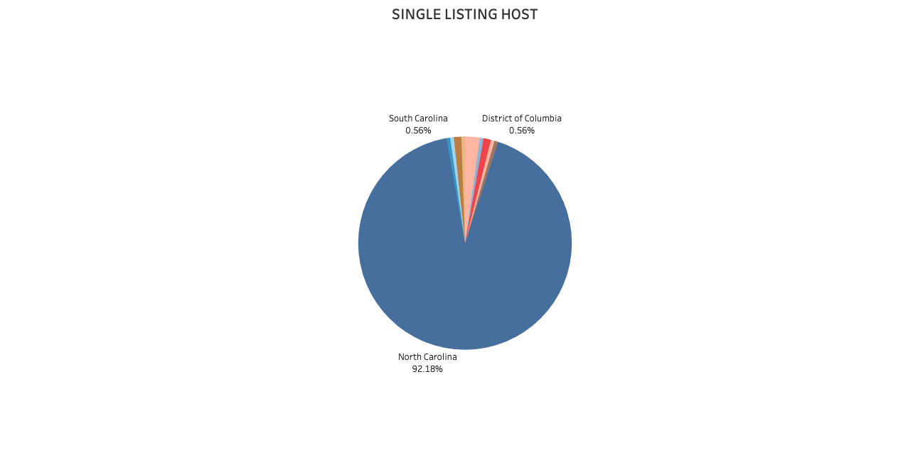
Although only a small portion are out of state hosts, these hosts do not appear to follow applicable laws for operating an Airbnb.
The above represents Airbnb hosts with a single listing who also appear to be operating illegally, but this group only represent about 13% of our single listings.

