Slide 1
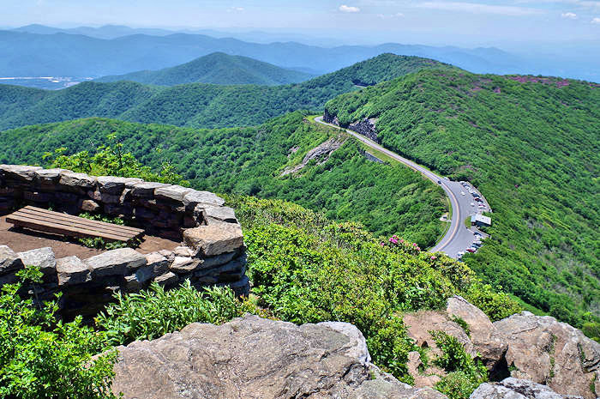
ASHEVILLE, NORTH CAROLINA
Notes:
Asheville is a city in western North Carolina’s Blue Ridge Mountains. It’s known for a vibrant arts scene and historic architecture, scenic views, and access to outdoor actviites like hiking, white water rafting, kayakiing etc.
Asheville, with a less than 1% vacancy rate in rental housing, has been declared to be in a "housing crisis". It has just been named the 6th most unsustainable housing market in the nation.
The question about short-term rentals, which facilitates and incentivizes the conversion of residential housing to tourist accomodation, is very real in Asheville, a city that is both a great place to live and work, and a tourist destination.

Slide 2
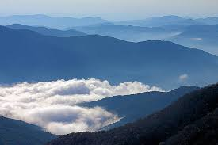
Determinations:
What percentage of Airbnb hosts might be operating illegally?
What criteria should be considered to make a determination of legality?
Who they are?
Where are they?
What neighborhoods are they operating in?

Slide 3
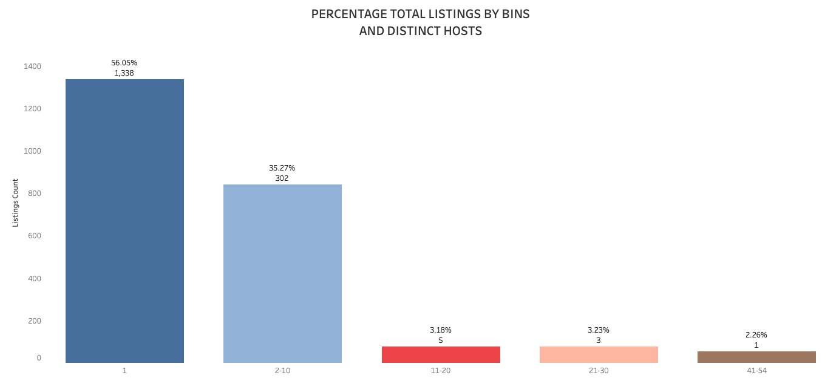
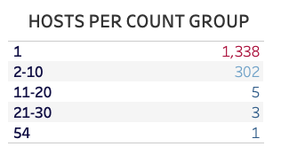
Data provided shows Asheville with 2,387 unique Airbnb listings represented by 1,649 distinct host. Host with multiple listings make up almost 44% of the total number of listings.

Slide 4
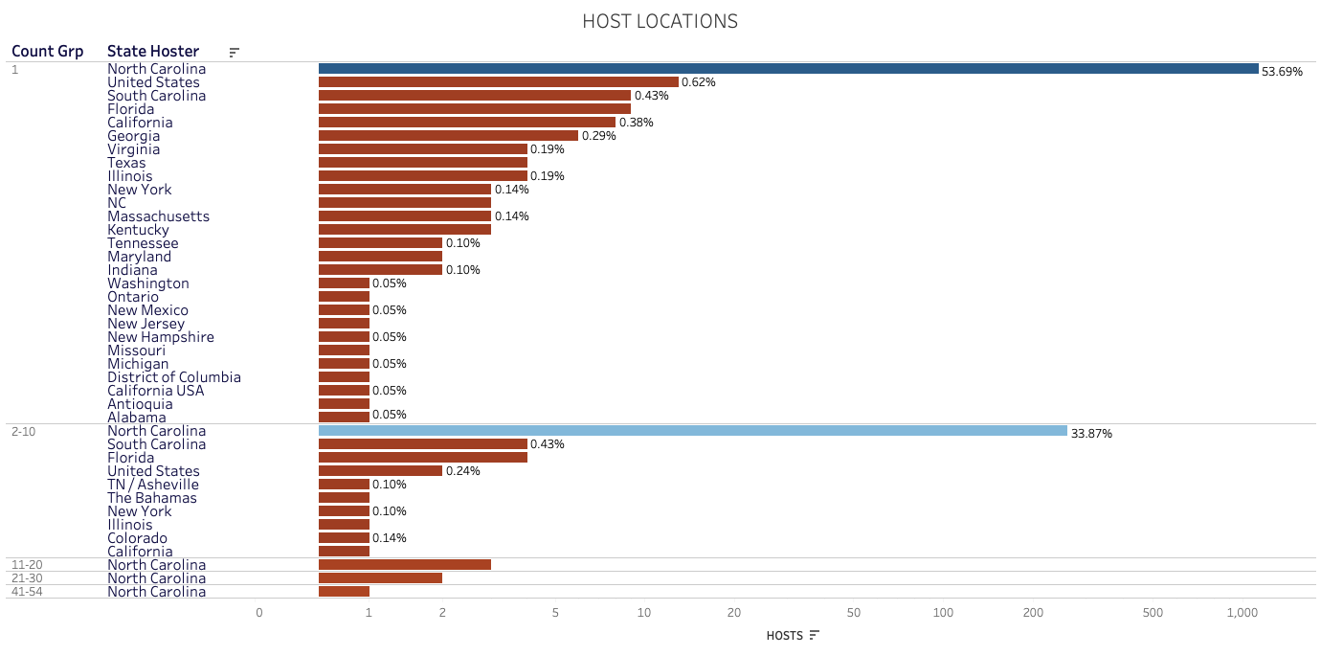
77% of Airbnb Host (with more than 1 listing) indicate their location as Asheville, but consideration should also be paid to the roughly 25% who don’t live locally since many are hosts with multiple listings.

Slide 5
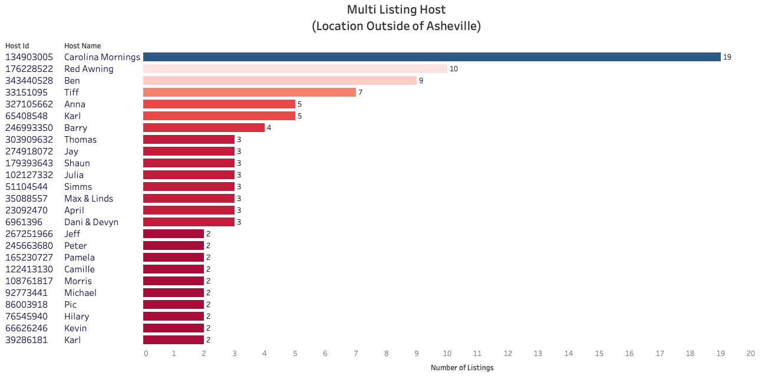
CRITERIA:
HOST WITH MULTIPLE LISTINGS
HIGH AVAILABILITY
SHORT TERM STAY
JURISDICTION
RENTAL IS AN ENTIRE HOUSE OR APARTMENT
HOST IS NOT LOCAL
Only 16% of the host with multiple listings indicate their location as outside of Asheville. Their Airbnb listings represent about 10% of the pool.

Slide 6
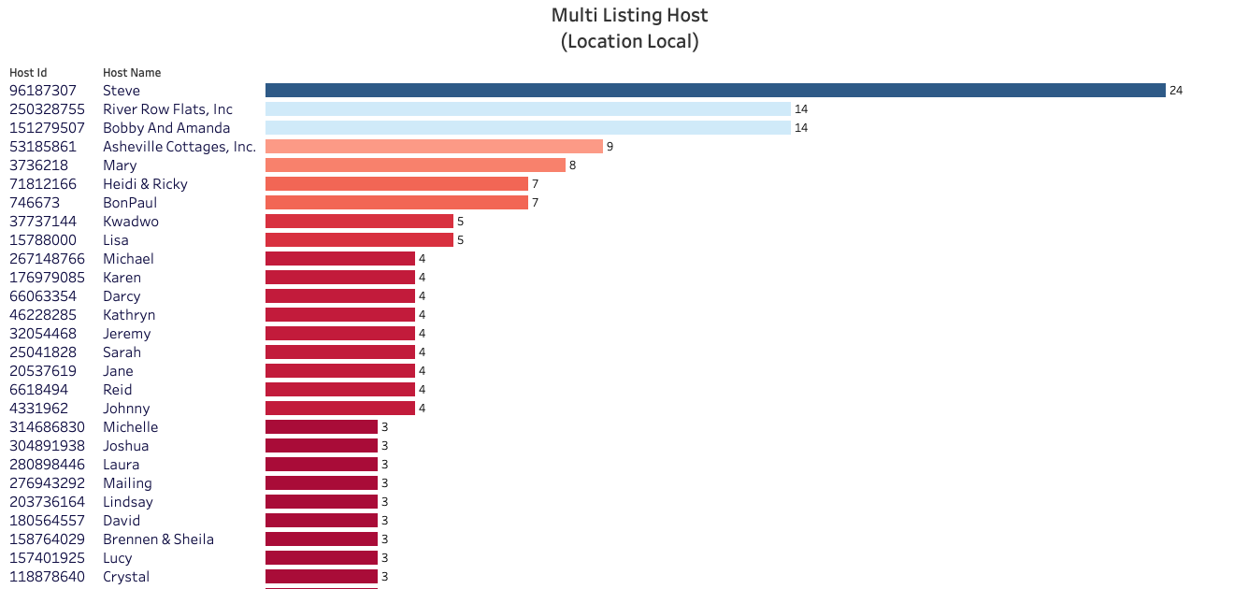
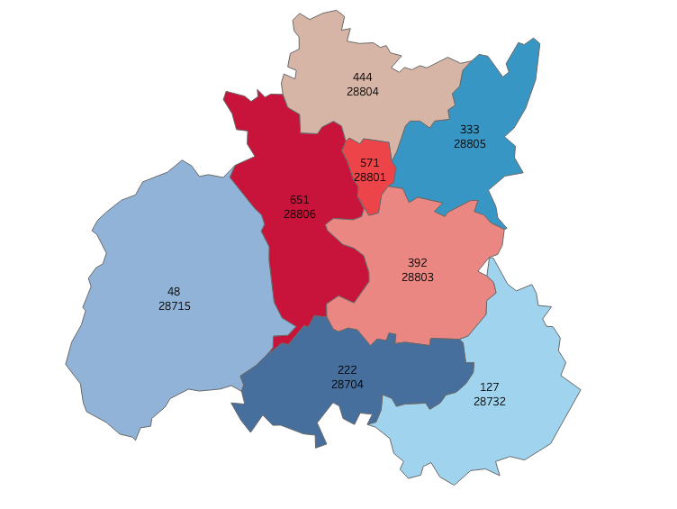
Most host with multiple listings live locally with almost 87% having between 2 and 3 listings. The above chart is truncated due to size and represents only a portion of 134 local host who meet the criteria.

Slide 7
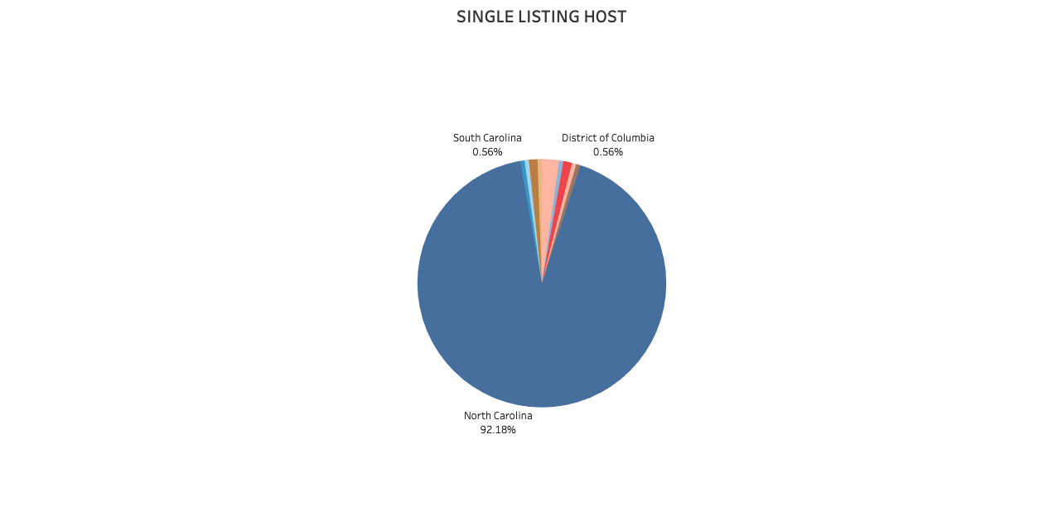
Although only a small portion are out of state hosts, these hosts do not appear to follow applicable laws for operating an Airbnb.
The above represents non-local, single listing hosts who also appear to be operating illegally. This group represents about 13% of our single listings.

